Slide 1
Research Background
Yuan Sui
2022.3.18

Slide 2
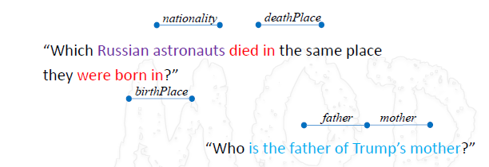
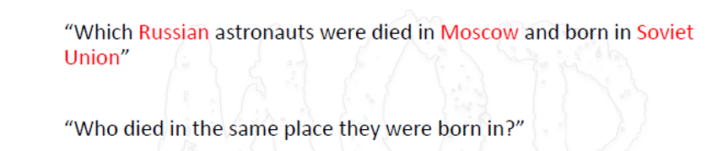
Learning Causal Representations for Knowledge Graph-based Question Answering.
Embedding based and data-driven model.
Focus on two of the challenges of KGQA: Spurious entity relations & Missing link.
  E.g., predicate expression variety, entity name ambiguity (partial names & share the same entity name)
Challenges of Complex Questions:

Slide 3
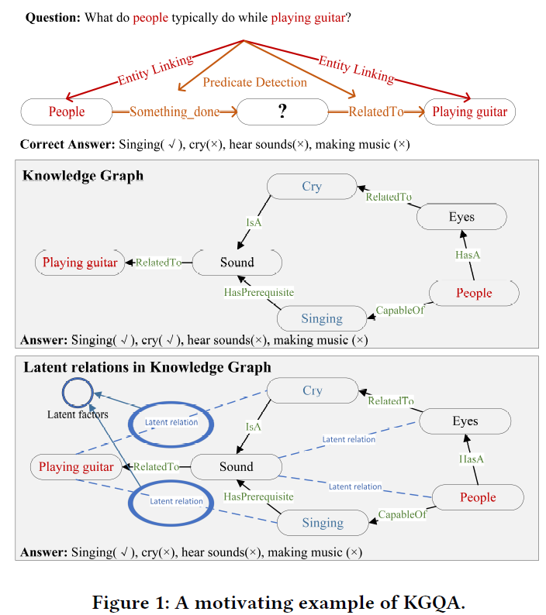
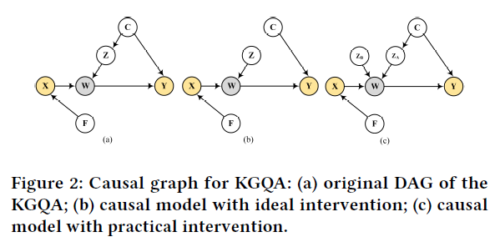


Step1: Entity linking & Predicate detection, obtain the candidate answers.
Step2: Generate latent relations (TransE based) and filter out the non-causal links (Causal Interference).
Step3: Clustering the latent relations as some latent factors, then use the latent factors to interfere the ranking section
Step4: Re-ranking the candidate answers according to the disentangled latent factors.

Slide 4
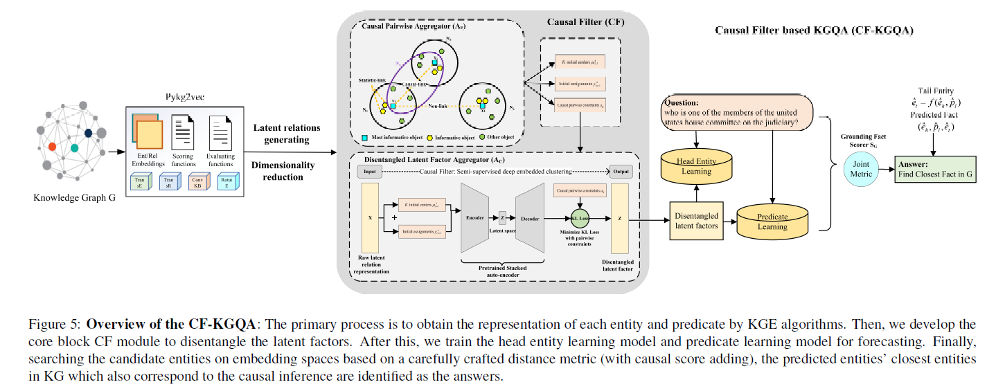

Slide 5
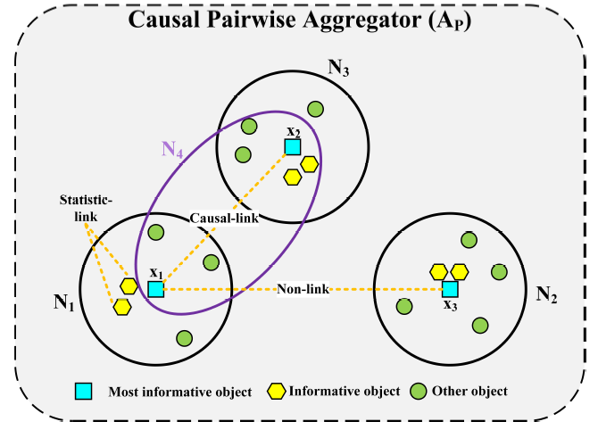
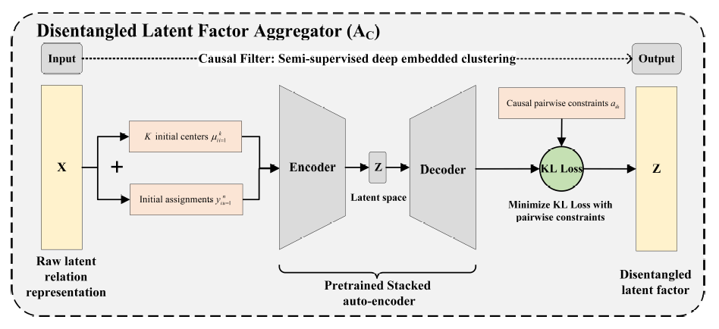
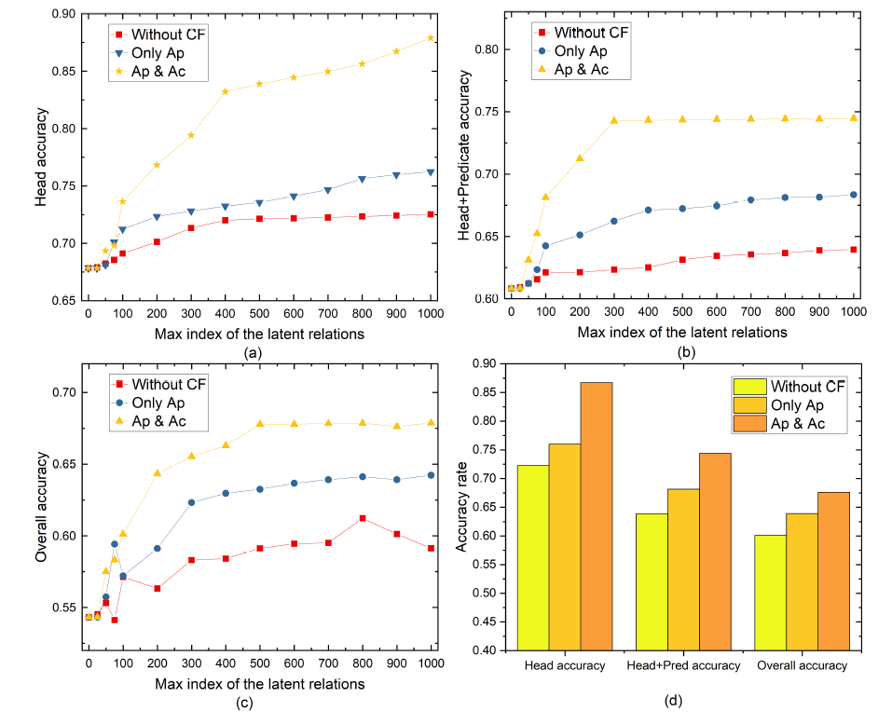
“Ap + Ac”:
Ap –
  filters out most spurious entity relations inconsistent to their dense groups’ neighborhood
  generates the causal constraint pairwise.
Ac –
  utilize the causal constraint pairwise to learn the representation of the latent relation via an encoder-decoder framework
  disconnects the latent factor and causal confounder beneath the knowledge embedding space.

Slide 6
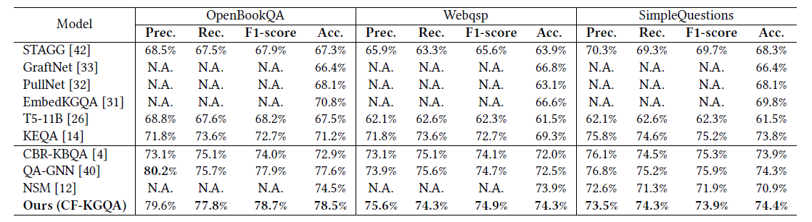
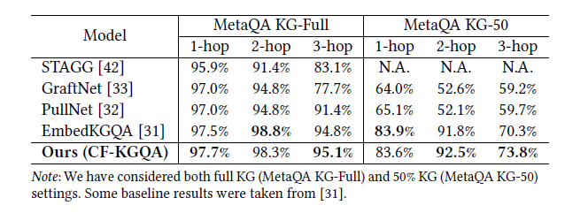
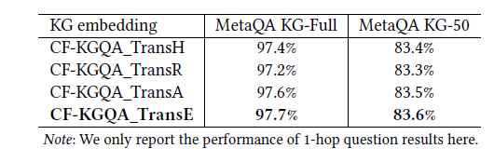
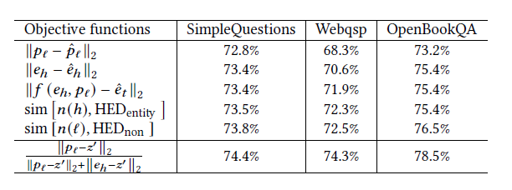
Performance:

