Slide 1

Team SRN:
PES2UG25CS609
PES2UG25CS620
PES2UG25CS642
COMPUTER NETWORKS · SYSTEM DESIGN
Remote System Health
Monitoring
A lightweight path from local readings to protected alerts
Small agents send local health updates, the server checks and tracks them, and SDN keeps critical alerts moving when the network is busy.

Slide 2

HOW IT WORKS
Each node sends a small update—no permanent connection needed
Every node sends a small UDP update on a timer, so the monitor does not need a separate TCP connection for each client.
01
02
03
Collect local data
Keep each report small
Prioritize alerts
psutil gathers CPU and memory use, process counts, top processes, and network I/O.
Strict JSON includes the node ID, sequence, timestamp, interval, priority, and metrics.
DSCP 46 marks threshold violations, allowing OpenFlow to route them to Queue 2.
PACKET RULES · COMMON/PROTOCOL.PY
WHAT THE SERVER SAVES · SERVER_REPORTS.CSV
payload=json.dumps(report,separators=(",",":")).encode()
if len(payload)>1400: raise ProtocolError("payload exceeds MTU guard")
validate(report)
node_id,seq,delay_ms,priority
h_partial,1,0.24,NORMAL
h_partial,10,0.26,NORMAL
THE SERVER STORES EVIDENCE FOR EVERY PACKET, NOT JUST A LIVE DASHBOARD.
VALIDATION AND THE ≤1400-BYTE GUARD KEEP EACH DATAGRAM COMPACT AND PREVENT FRAGMENTATION.

Slide 3

AGENT DESIGN · LOCAL SAMPLING
How small agents turn local readings into useful telemetry
DSCP / TOS MARKING
# DSCP 46 (EF); 46 << 2 = 184
sock.setsockopt(socket.IPPROTO_IP,
socket.IP_TOS, 0xB8)
Normal reports use DSCP 0; threshold violations use EF marking.
A steady timer prevents drift, and repeatable simulation modes make alerts and failures easy to test.
What each report includes
node_id · seq · sent_ts · interval · priority · validated metrics
What happens when collection fails
HEARTBEAT still goes out, so the node stays alive even when a metric read fails.
Message size
HEALTH: 378-byte payload / 420-byte wire size / 3.36 kbps at 1 s.
STATS_COLLECTOR.PY · MODES
if pattern == "spike":
cpu, processes = 95.0, 550
elif pattern == "normal":
cpu, processes = safe_values()
In spike mode, CPU reaches at least 95% and processes reach 550 on configured ticks. Normal mode stays below warning thresholds.

Slide 4
SERVER DECISION LOOP · RECEIVE, CHECK, ALERT
The server turns each packet into a decision
A non-blocking UDP socket and select handle telemetry without creating a thread for every client.
SELECT LOOP + DELAY
OUTPUT · CSV EVIDENCE
Recorded decisions
server_reports.csv: h_partial,1,0.24 ms,NORMAL
server_reports.csv: h_partial,10,0.26 ms,NORMAL
server_alerts.csv: node_silence,3.0,CRITICAL,0.0 ms
server_alerts.csv: packet_loss_percent,20.0,CRITICAL,0.26 ms
select.select([sock], [], [], 0.5)
sock.recvfrom(2048)
decode_and_validate(data)
Delay: (time.time() - report["sent_ts"]) * 1000
ALERT THRESHOLDS
CPU: warn at 70%, critical at 90%; memory: warn at 75%, critical at 90%; processes: warn at 300, critical at 500; packet loss: warn at 5%, critical at 20%.
If the clock jumps, the delay is clamped to 0.0 ms and a warning is recorded.
REPORTS AND ALERTS STAY APPEND-ONLY, GIVING THE DASHBOARD AND EXPERIMENTS A RELIABLE RECORD.

Slide 5

QUALITY OF SERVICE · KEEPING CRITICAL PACKETS MOVING
QoS keeps critical monitoring packets moving
The agent marks a critical report, and OpenFlow sends it to a protected queue across the 10 Mbps bottleneck.
OPENFLOW 1.3 · MATCH → ACTION
HTB RESERVATION · TOPOLOGY.PY
DSCP 46
Reserved queue capacity
Queue | Traffic | Minimum
Queue 2 | critical | 5 Mbps
Queue 1 | normal | 3 Mbps
Queue 0 | best-effort | 1 Mbps
At the socket, the agent uses EF marking (DSCP 46 / TOS 0xB8). OpenFlow 1.3 matches IPv4 (eth_type=0x0800), UDP (ip_proto=17), port 5005, and DSCP 46.
Priority 100 sends this traffic to Queue 2 with OFPActionSetQueue(2), then outputs to OFPP_NORMAL. Priority 50 maps DSCP 0 to Queue 1; priority 10 sends bulk traffic to Queue 0.
THESE MINIMUMS KEEP A CRITICAL LANE OPEN WHEN BACKGROUND TRAFFIC FILLS THE LINK.

Slide 6

FAILURE DETECTION · WHEN A NODE STOPS REPORTING
When a quiet node becomes a visible failure
Sequence gaps reveal packet loss. Three missed intervals help separate a real failure from normal packet disorder.
SEQUENCE GAPS AND SILENCE
MEASURED FAILURE RESULTS
When reports stop, the last-seen time keeps advancing. Duplicates and out-of-order packets are tracked separately, while a reset to 0 or 1 triggers restart handling.
Failure | TTD
agent_crash | 1.07 ± 0.04 s
link_failure | 3.30 ± 0.00 s
partial_loss | 3.31 ± 0.02 s
recovery on resume | < 0.05 s
gap = seq - last_seq - 1
loss_rate = lost / (received + lost)
if now - last_seen >
3.0 * interval:
emit("NODE_DOWN")
ACROSS FIVE TRIALS, CRASHES WERE DETECTED IN 1.07 S; LINK AND PARTIAL-LOSS CASES TOOK ABOUT 3.30 S.

Slide 7
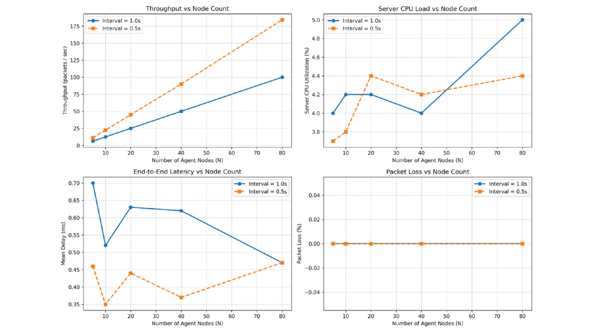
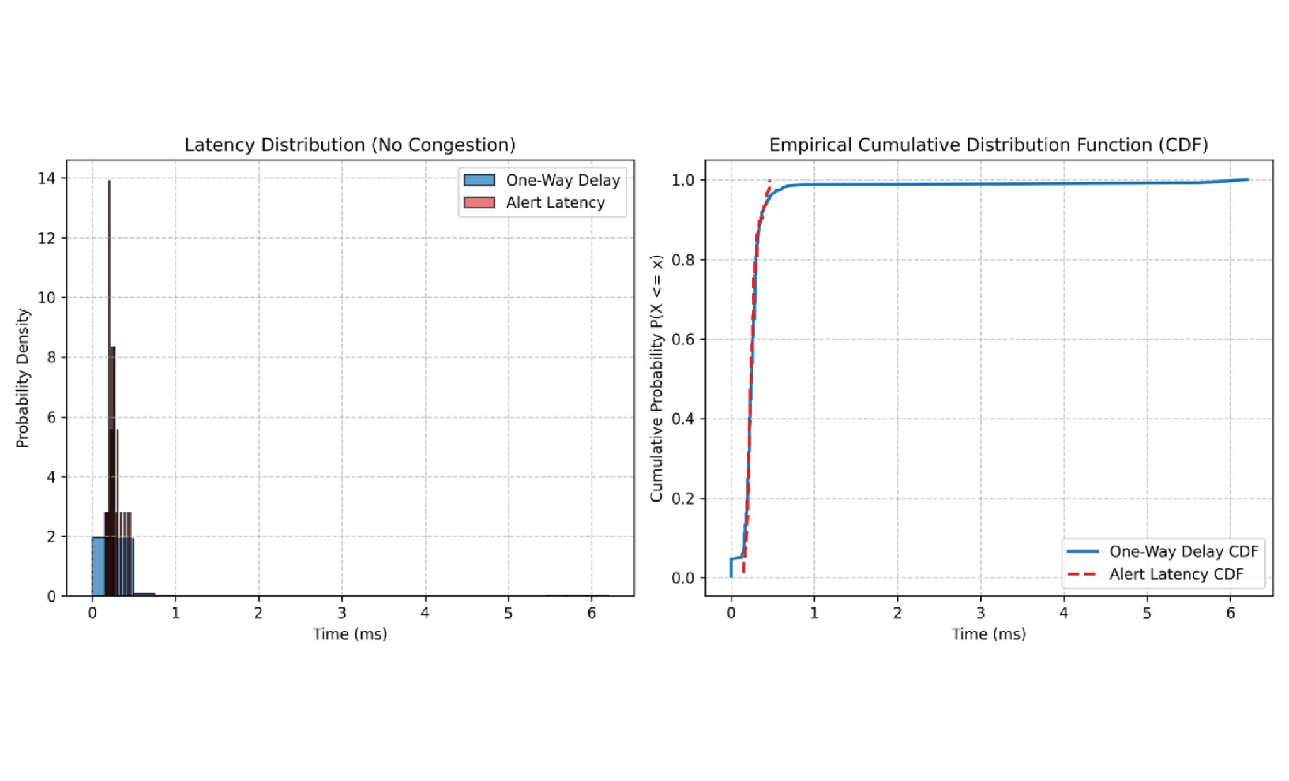
RESULTS · WHAT THE DATA TELLS US
The results: fast alerts that scale
These charts come from the supplied CSV files, so every number is tied to the recorded experiment.
CONGESTION_COMPARISON.PNG · CRITICAL LOSS: 56.67% WITHOUT PRIORITY, 0.00% WITH PRIORITY; P95 DELAY: 30.75 MS VS 1.48 MS
LATENCY_DISTRIBUTION.PNG · ALERT LATENCY STAYS CONCENTRATED BELOW 1 MS IN THE SUPPLIED SUMMARY
Baseline performance
Priority routing on
Scale
Alert latency: 0.257 ms mean; 0.430 ms at p95
Critical loss: 0.00%; critical p95 delay: 1.48 ms
5–80 nodes; mean delay stays below 0.7 ms; CPU stays at or below 5.0%

Slide 8

WHAT WE BUILT · WHAT WE LEARNED
What we built — and what we learned
Lightweight UDP reports become reliable through validation, sequence tracking, and silence checks. SDN QoS keeps the most important monitoring packets moving first.
Start on your machine
Run the tests
python3 server/monitor_server.py --port 5005
python3 agent/health_agent.py --id=h1 \
--server 127.0.0.1 --port 5005 --interval 1.0 --mode real
pytest tests/ -v --cov=common --cov=server \
--cov=agent
60 passed · 87% coverage
python3 experiments/run_congestion_test.py --runs 3
What the results show
Critical-packet loss: 56.67% with Priority OFF vs 0.00% with Priority ON. Scale: up to 80 nodes, 184.2 packets/s, with server CPU at or below 5.0%.
RUN THE LOCAL SERVER AND AGENT, VERIFY THE 60-TEST SUITE, THEN COMPARE PRIORITY OFF AND ON IN THE DOCUMENTED CONGESTION EXPERIMENT.

