Slide 1

Team SRN:
PES2UG25CS609
PES2UG25CS620
PES2UG25CS642
COMPUTER NETWORKS · SYSTEM DESIGN
Remote System Health
Monitoring
A lightweight path from local readings to protected alerts (Deliverables 1 & 2)
Small agents send local health updates, the server monitors them, and SDN dynamically throttles congestion and prioritizes critical alerts.

Slide 2

HOW IT WORKS
Each node sends a small update—no permanent connection needed
Every node sends a small UDP update on a timer, so the monitor does not need a separate TCP connection for each client.
01
02
03
Collect local data
Keep each report small
Prioritize alerts
psutil gathers CPU and memory use, process counts, top processes, and network I/O.
Strict JSON includes the node ID, sequence, timestamp, interval, priority, and metrics.
DSCP 46 marks threshold violations, allowing OpenFlow to route them to Queue 2.
PACKET RULES · COMMON/PROTOCOL.PY
WHAT THE SERVER SAVES · SERVER_REPORTS.CSV
payload=json.dumps(report,separators=(",",":")).encode()
if len(payload)>1400: raise ProtocolError("payload exceeds MTU guard")
validate(report)
node_id,seq,delay_ms,priority
h_partial,1,0.24,NORMAL
h_partial,10,0.26,NORMAL
THE SERVER STORES EVIDENCE FOR EVERY PACKET, NOT JUST A LIVE DASHBOARD.
VALIDATION AND THE ≤1400-BYTE GUARD KEEP EACH DATAGRAM COMPACT AND PREVENT FRAGMENTATION.

Slide 3

AGENT DESIGN · LOCAL SAMPLING
How small agents turn local readings into useful telemetry
DSCP / TOS MARKING
# DSCP 46 (EF); 46 << 2 = 184
sock.setsockopt(socket.IPPROTO_IP,
socket.IP_TOS, 0xB8)
Normal reports use DSCP 0; threshold violations use EF marking.
A steady timer prevents drift, and repeatable simulation modes make alerts and failures easy to test.
What each report includes
node_id · seq · sent_ts · interval · priority · validated metrics
What happens when collection fails
HEARTBEAT still goes out, so the node stays alive even when a metric read fails.
Message size
HEALTH: 378-byte payload / 420-byte wire size / 3.36 kbps at 1 s.
STATS_COLLECTOR.PY · MODES
if pattern == "spike":
cpu, processes = 95.0, 550
elif pattern == "normal":
cpu, processes = safe_values()
In spike mode, CPU reaches at least 95% and processes reach 550 on configured ticks. Normal mode stays below warning thresholds.

Slide 4
SERVER DECISION LOOP · RECEIVE, CHECK, ALERT
The server turns each packet into a decision
A non-blocking UDP socket and select handle telemetry without creating a thread for every client.
SELECT LOOP + DELAY
OUTPUT · CSV EVIDENCE
Recorded decisions
server_reports.csv: h_partial,1,0.24 ms,NORMAL
server_reports.csv: h_partial,10,0.26 ms,NORMAL
server_alerts.csv: node_silence,3.0,CRITICAL,0.0 ms
server_alerts.csv: packet_loss_percent,20.0,CRITICAL,0.26 ms
select.select([sock], [], [], 0.5)
sock.recvfrom(2048)
decode_and_validate(data)
Delay: (time.time() - report["sent_ts"]) * 1000
ALERT THRESHOLDS
CPU: warn at 70%, critical at 90%; memory: warn at 75%, critical at 90%; processes: warn at 300, critical at 500; packet loss: warn at 5%, critical at 20%.
If the clock jumps, the delay is clamped to 0.0 ms and a warning is recorded.
REPORTS AND ALERTS STAY APPEND-ONLY, GIVING THE DASHBOARD AND EXPERIMENTS A RELIABLE RECORD.

Slide 5

QUALITY OF SERVICE · PROACTIVE QUEUE ALLOCATION
Static OpenFlow rules reserve dedicated switch queues
The agent marks critical telemetry with DSCP 46, and OpenFlow directs datagrams into guaranteed hardware queues over the 10 Mbps bottleneck.
OPENFLOW 1.3 · MATCH → ACTION
HTB RESERVATION · TOPOLOGY.PY
DSCP 46
Reserved queue capacity
Queue | Traffic | Minimum
Queue 2 | critical | 5 Mbps
Queue 1 | normal | 3 Mbps
Queue 0 | best-effort | 1 Mbps
At the socket, the agent uses EF marking (DSCP 46 / TOS 0xB8). OpenFlow 1.3 matches IPv4 (eth_type=0x0800), UDP (ip_proto=17), port 5005, and DSCP 46.
Priority 100 sends this traffic to Queue 2 with OFPActionSetQueue(2), then outputs to OFPP_NORMAL. Priority 50 maps DSCP 0 to Queue 1; priority 10 sends bulk traffic to Queue 0.
THESE MINIMUMS KEEP A CRITICAL LANE OPEN WHEN BACKGROUND TRAFFIC FILLS THE LINK.

Slide 6
DYNAMIC SDN CONTROL · REAL-TIME ADAPTIVE MITIGATION (D2)
SDN controller dynamically mitigates congestion & isolates rogue hosts
Ryu controller polls port statistics every 2.0s and dynamically injects reactive OpenFlow rules to preserve critical queue headroom.
PORT LOAD TELEMETRY & ADAPTIVE THROTTLING
REACTIVE FLOW MODULATION · RYU_CONTROLLER.PY
OFPPortStats
Dynamic mitigation policies
Condition | Trigger / Threshold | Dynamic OpenFlow Rule
Bottleneck Congestion | TX rate >= 8.0 Mbps | Priority 80 -> Queue 0 (idle=15s)
Bandwidth Restored | TX rate < 4.0 Mbps | OFPFC_DELETE_STRICT (Priority 80)
Rogue Flooder / DoS | Malformed packet burst | Priority 200 -> DROP (actions=[])
Every 2.0s, the Ryu controller polls switch ports via OFPPortStatsRequest. When bottleneck TX load reaches >= 8.0 Mbps (80%), the controller dynamically issues an OFPFlowMod to demote bulk cross-traffic to Queue 0 with idle_timeout=15s.
When port rate drops below 4.0 Mbps, the controller issues OFPFC_DELETE_STRICT to decommission the throttle rule and restore fair sharing. If an untrusted host floods traffic, a Priority 200 DROP rule isolates it.
DYNAMIC OPENFLOW MODULATION OPERATES AT WIRE SPEED WITHOUT MANUAL OPERATOR INTERVENTION.

Slide 7

FAILURE DETECTION & ROBUSTNESS · STRESS SCENARIOS (D2)
When a quiet node becomes a visible failure
Sequence gaps detect packet loss, silence timeouts flag crashes in 3.0s, and the MTU guard safely drops 10,000 malformed packets.
SEQUENCE GAPS AND SILENCE
MEASURED FAILURE RESULTS
When reports stop, the last-seen time keeps advancing. Duplicates and out-of-order packets are tracked separately, while a reset to 0 or 1 triggers restart handling.
Failure | TTD
agent_crash | 1.07 ± 0.04 s
link_failure | 3.30 ± 0.00 s
partial_loss | 3.31 ± 0.02 s
recovery on resume | < 0.05 s
gap = seq - last_seq - 1
loss_rate = lost / (received + lost)
if now - last_seen >
3.0 * interval:
emit("NODE_DOWN")
ROBUSTNESS VERIFIED ACROSS THREE SCENARIOS: 12 MBPS CONGESTION, NODE SILENCE CUTS, AND MALFORMED BURSTS.

Slide 8
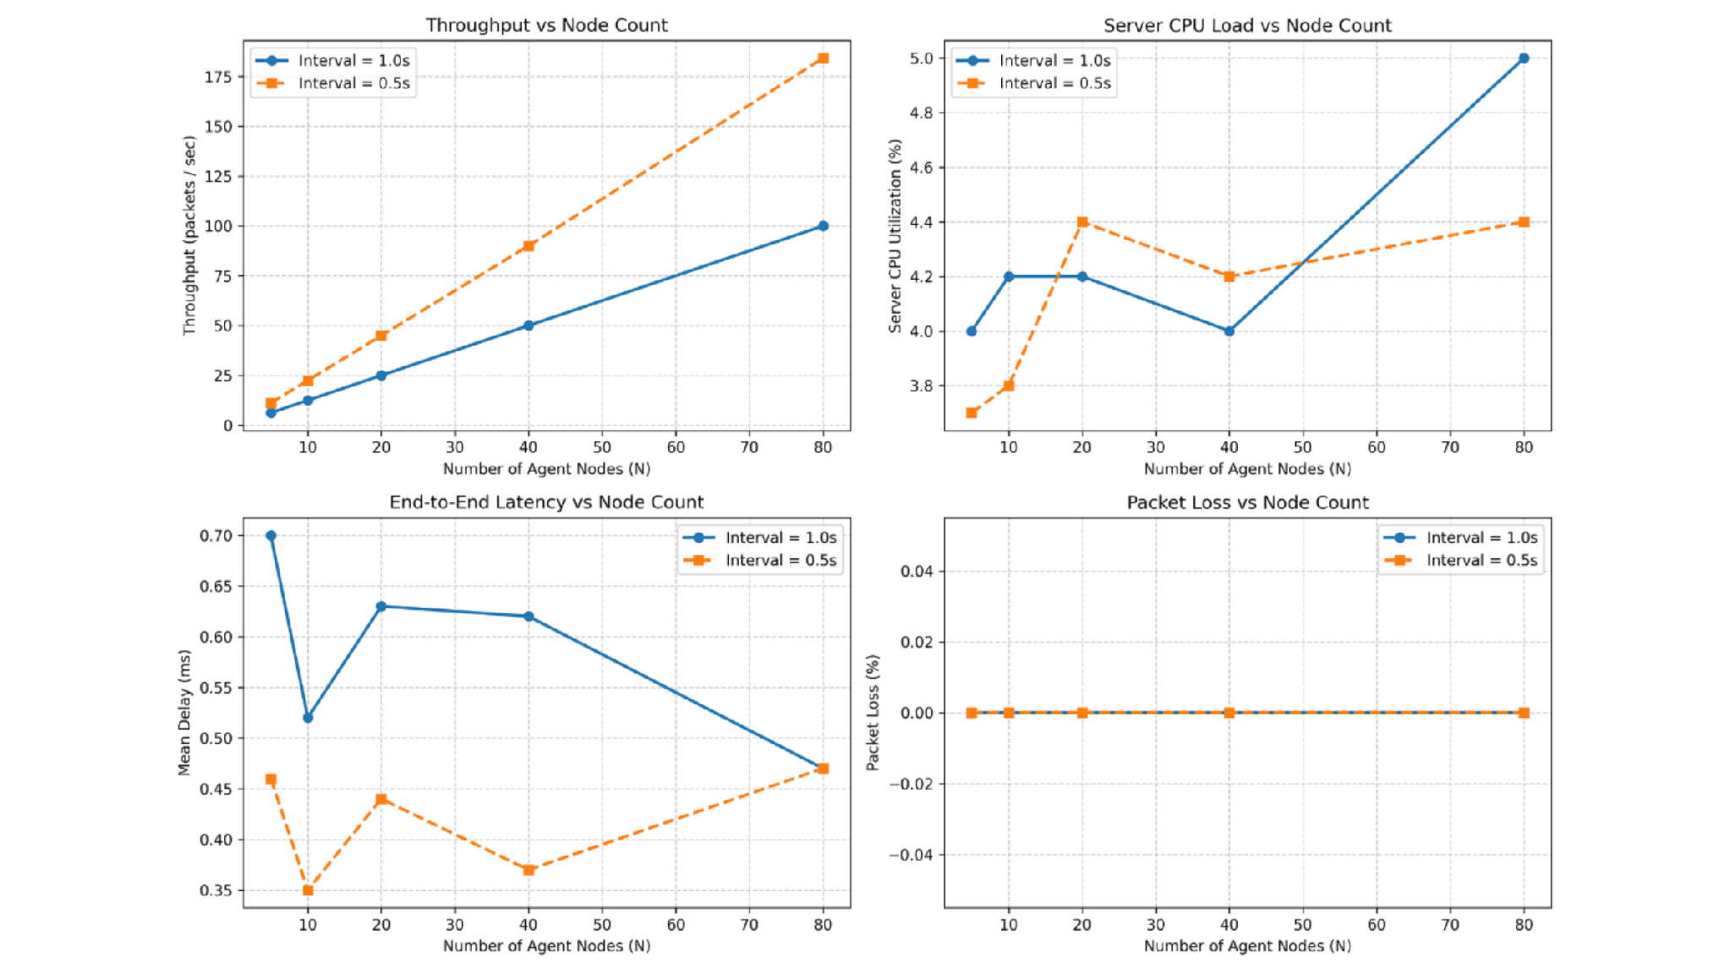
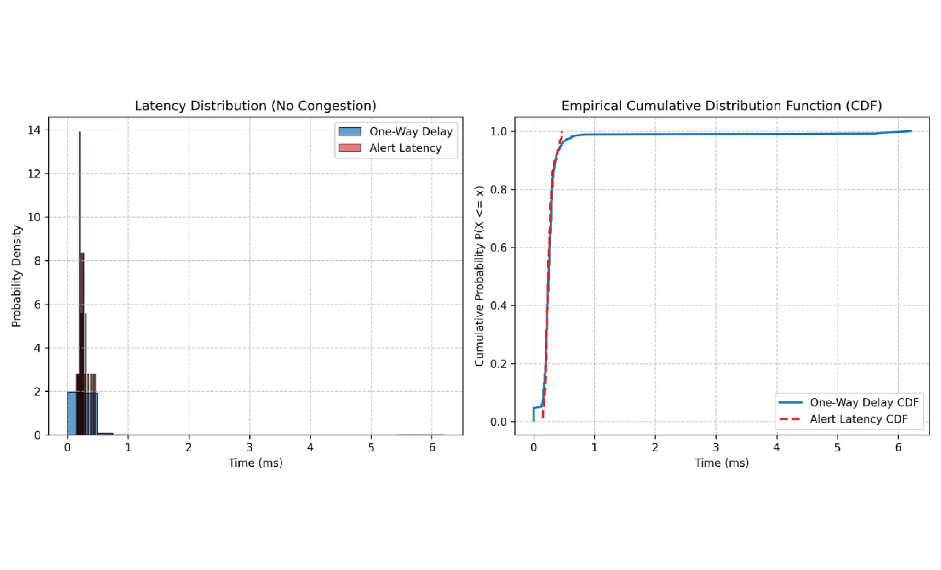
RESULTS · EMPIRICAL BENCHMARK EVALUATION
The results: fast alerts that scale
Empirical benchmarks compare the proposed SDN QoS architecture against a standard baseline FIFO queue under severe congestion.
CONGESTION_COMPARISON.PNG · CRITICAL LOSS: 56.67% WITHOUT PRIORITY, 0.00% WITH PRIORITY; P95 DELAY: 30.75 MS VS 1.48 MS
LATENCY_DISTRIBUTION.PNG · ALERT LATENCY STAYS CONCENTRATED BELOW 1 MS IN THE SUPPLIED SUMMARY
Baseline performance
Priority routing on
Scale
Alert latency: 0.257 ms mean; 0.430 ms at p95
Critical loss: 0.00%; critical p95 delay: 1.48 ms
5–80 nodes; mean delay stays below 0.7 ms; CPU stays at or below 5.0%

Slide 9

WHAT WE BUILT · DELIVERABLE 2 VERIFICATION
What we built — and what we learned
Lightweight UDP reports become reliable through validation and sequence tracking. Dynamic SDN QoS guarantees critical health alerts survive severe congestion.
Start on your machine
Run the tests
python3 server/monitor_server.py --port 5005
python3 agent/health_agent.py --id=h1 \
--server 127.0.0.1 --port 5005 --interval 1.0 --mode real
pytest tests/ -v --cov=common --cov=server --cov=agent --cov=sdn
65 passed · Full verification across core & SDN controller
python3 demo.py # Option 5: Deliverable 2 Showcase
What the results show
Critical-packet loss: 56.67% with Priority OFF vs 0.00% with Priority ON. Scale: up to 80 nodes, 184.2 packets/s, with server CPU at or below 5.0%. Dynamic SDN throttle activates at >= 8.0 Mbps.
DELIVERABLE 2 COMPLETE: DYNAMIC SDN FLOW MODULATION, ROBUSTNESS SCENARIOS, AND 65 PASSING TESTS WITH COMPREHENSIVE REPRODUCIBILITY.

