Slide 1
HDFS Optimizer
report.pdf
report-final.pdf
One stored copy
HDFS-Based Distributed File Replication, Deduplication and Storage Optimization System
report (1).pdf
Store it once. Replicate it safely. Prove every byte.
copy of report.pdf
backup.pdf
[Student name] · [Roll number] · [Department] · [University]
Guide: [Supervisor] · Session: [Academic session]
Notes:
Introduce the project in one sentence: an application layer over real, unmodified Apache Hadoop that stores identical content once, leaves HDFS replication alone, and proves every restored file is byte-identical. Replace the bracketed placeholders with your details before presenting.

Slide 2
HDFS protects blocks, but it cannot see duplicate files
Plain HDFS: three uploads of one book
With HDFS Optimizer
report.pdf
report.pdf
report-final.pdf
report-final.pdf
copy of report.pdf
copy of report.pdf
9 block copies stored
3 block copies, same fault tolerance
Each square is one replica of one block. Blue copies provide safety. Orange copies come only from duplicate uploads.
Notes:
HDFS copies each block for fault tolerance. That is deliberate. But when the same book is uploaded three times, HDFS treats those as three unrelated files, and replicates each one. This drawing shows what plain HDFS stores for three identical uploads at replication factor 3: nine block copies. Only three are needed for the same fault tolerance.

Slide 3
Every accidental copy is multiplied by the replication factor
240 MiB
40 MiB
3 ×
consumed by 9 books with 5 extra copies each, stored as plain uploads
for the same logical files, deduplicated, at the same replication factor
every stored byte is kept on three DataNodes, including accidental copies
Why this is hard to fix by hand
No visibility
Risky cleanup
Confusing numbers
HDFS has no view of identical content across files.
Deleting a "duplicate" by hand can remove what someone needs.
Logical size, stored size and disk use are three different things.
Measured with authentic files on the test cluster. Duplicates were created for the experiment.
Notes:
This is a measured example, not an estimate: nine authentic books with five extra copies each. Without deduplication the NameNode reports 240 MiB consumed; with whole-file deduplication, 40 MiB. The duplicates were created for the experiment, so this shows the mechanism and does not predict savings on a real system.

Slide 4
A layer above HDFS that stores each distinct content once
1
2
3
Whole-file deduplication
Chunk-level deduplication
Safe optimization
SHA-256 identity. Any number of names, one stored object.
Fixed-size chunks shared across different files.
Dry run first. Each file is verified before its old copy goes.
4
5
6
Reference-aware deletion
Replication management
Honest metrics
Recoverable deletes. Shared content stays while it is needed.
Real factor changes, confirmed with fsck and block locations.
Every headline value says: measured, derived or estimated.
Notes:
HDFS is not modified at all. The application decides what is written, and HDFS still replicates it. Walk through the six capabilities briefly. The point to stress: each headline number in the interface states whether it is measured, derived or estimated.

Slide 5
What the project set out to achieve
Reduce
Protect
Operate
Prove
Detect exact duplicates with SHA-256
Find identical chunks across files
Store unique data in content-addressed form
Reconstruct originals exactly
Verify with cryptographic checksums
Delete safely, and recover
Manage supported replication settings
Monitor NameNode and DataNode health
Show storage and savings clearly
Evaluate on authentic datasets
Compare storage visually
Document design and results
Keep the redundancy that protects data. Remove the redundancy that only costs space.
Notes:
All of these are implemented and tested. Future work, such as content-defined chunking, is kept separate and is on a later slide.

Slide 6
A deliberately ordinary, inspectable technology stack
Next.js 16
React 19
TypeScript
Tailwind + shadcn/ui
Recharts
Interface
Python 3.12
FastAPI
Pydantic
HTTPX
hashlib SHA-256
API and logic
SQLite (WAL)
SQLAlchemy 2
Alembic migrations
Metadata
Apache Hadoop 3.5.0
HDFS
WebHDFS REST
JMX and fsck
Storage
Docker Compose
Colima
Pytest
Playwright
Typst
Platform and tests
Notes:
Everything here is free and open source. WebHDFS means the Python backend needs no Java client. SQLite keeps setup simple, and its limits are discussed on a later slide. The Hadoop image is built from the official Apache tarball because the official images are amd64-only and this laptop is arm64.

Slide 7
Bytes reach HDFS first, and metadata commits afterwards
Services
SQLite metadata
Files, objects, chunks, manifests, jobs, audit
Ingest and content store
Browser
Next.js dashboard
REST API
FastAPI, /api/v1
Optimizer and lifecycle
Integrity and replication
HDFS through WebHDFS
1 NameNode, 3 DataNodes, factor 3
Monitor, analytics, audit
Write order: 1 stage in HDFS 2 check bytes 3 rename atomically 4 commit metadata
A crash can leave an unreferenced file, but never metadata pointing at missing bytes.
Notes:
HDFS and SQLite cannot share a transaction. So every write has a fixed order: stage in HDFS, check it, rename atomically, then commit metadata. A crash can leave an unreferenced file, which reconciliation finds. It can never leave metadata that points at missing bytes.

Slide 8
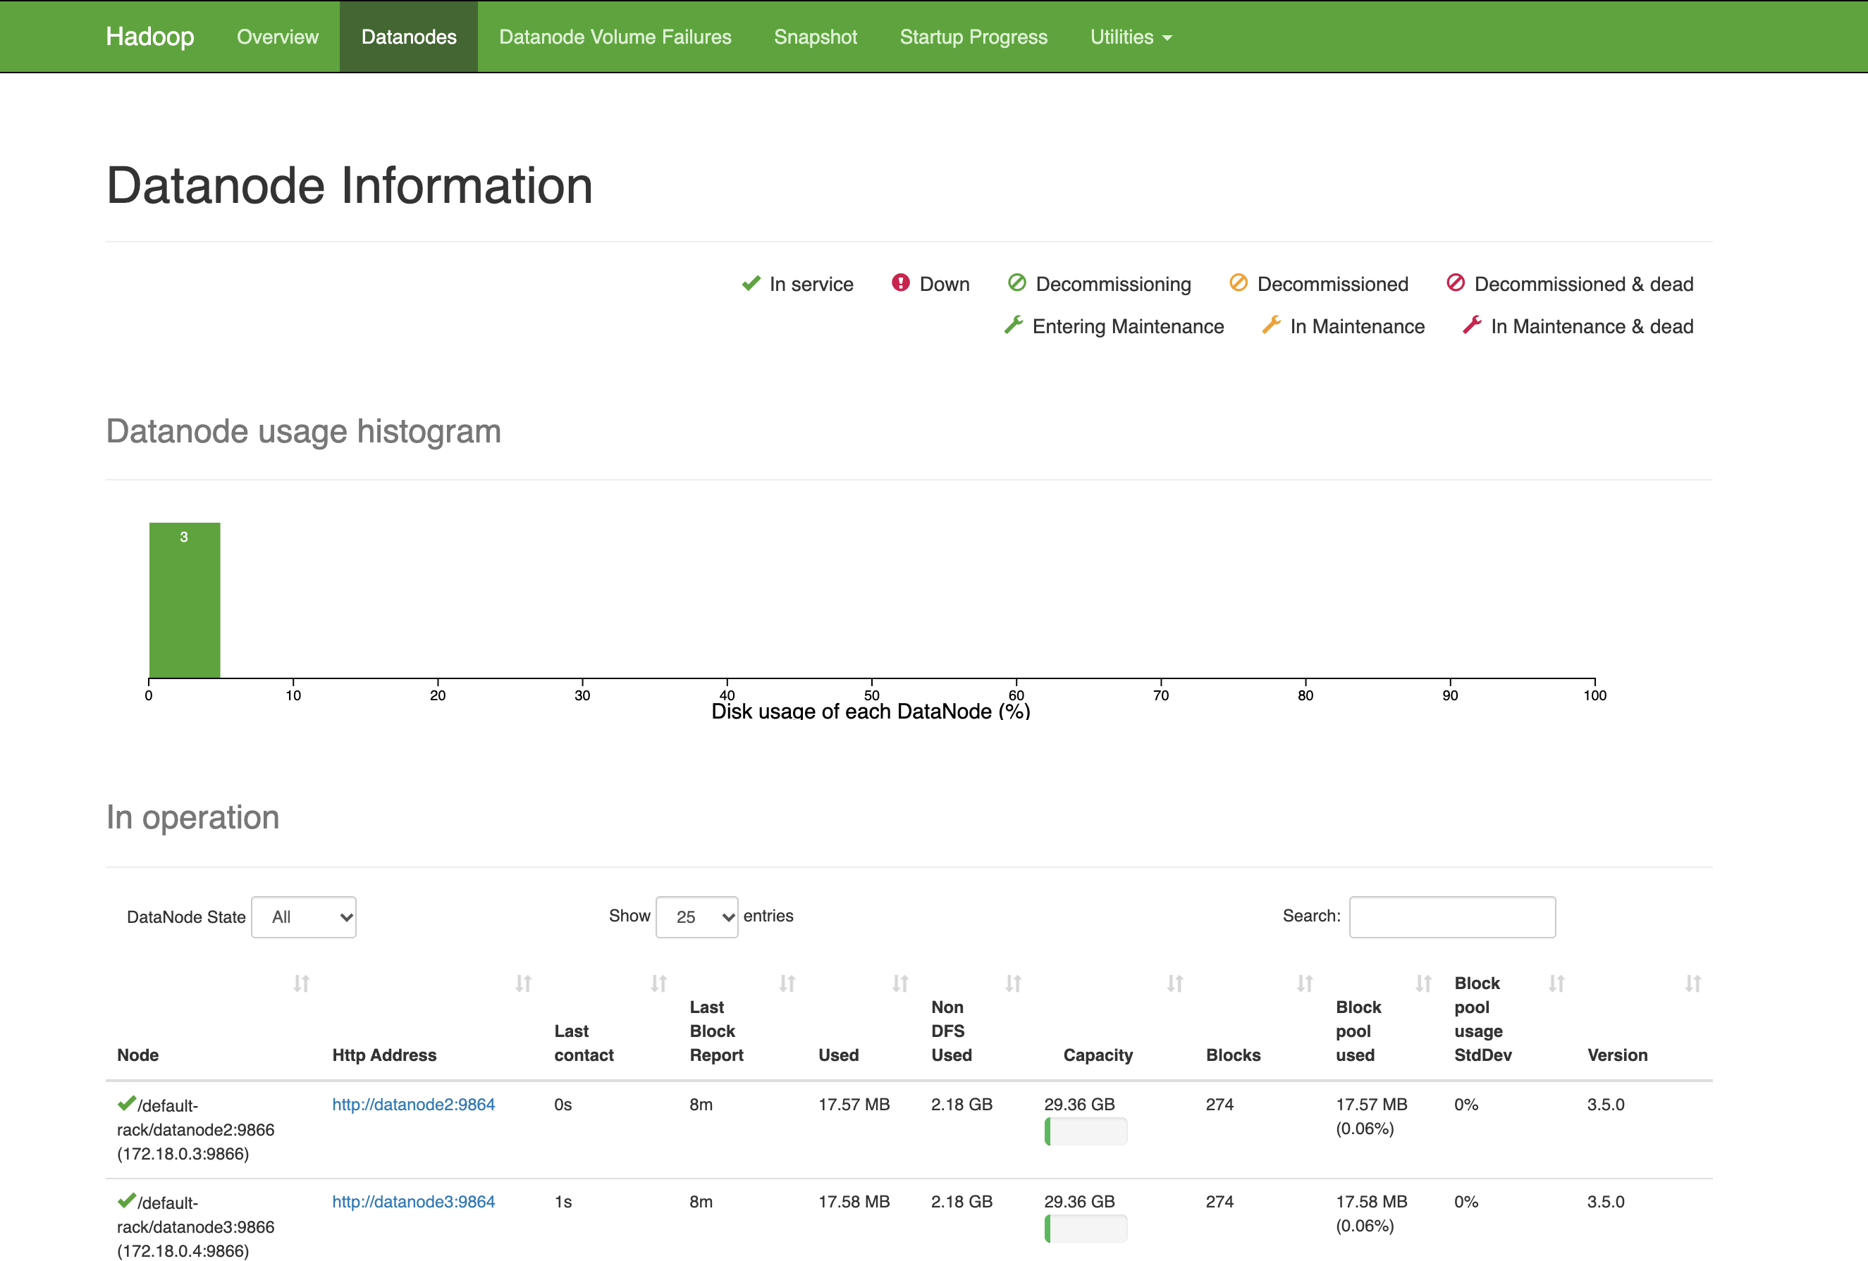
A real HDFS cluster: one NameNode and three DataNodes
Heartbeats every 3 s, and block reports
NameNode
Namespace and block map
DataNode 1
Blocks
DataNode 2
Blocks
DataNode 3
Blocks
Each block is stored on 3 DataNodes. Stopping a DataNode leaves files readable, which we tested for real.
Hadoop's own NameNode interface, showing this cluster
Limit: all nodes share one laptop and one disk.
Notes:
This is genuine Apache Hadoop 3.5.0, running in containers. The screenshot is Hadoop's own interface. It is honest to say this is all on one laptop: it shows the software's behaviour under failure, but the three DataNodes share one disk, so it gives no real hardware fault tolerance.

Slide 9
Whole-file deduplication: same hash, no new bytes
Hash already stored?
Add a reference
New logical file, 0 bytes written
Upload
Any file name
SHA-256
Streamed
Yes
No
Stage, check, rename
/objects/ab/cd/<sha256>
20 names
1 HDFS file
20 of 20
of one authentic file, in a single test
stored for all of them
names passed SHA-256 verification
Notes:
Identity depends only on content. Two different names with the same bytes are duplicates. The same name with different bytes is not: the second file becomes name (1). Lookup is by a unique index on the hash.

Slide 10
Chunks find overlap between different files
Original file
c1
c2
c3
c4
Byte-identical file
c1
c2
c3
c4
One chunk changed
c1
c2
c5
c4
Stored once each: c1, c2, c3, c4, c5. A manifest lists each file's chunks in order, and rebuilds it exactly.
Chunks are application-level HDFS files, not HDFS blocks.
One inserted byte shifts every boundary. Content-defined chunking would fix this; it is future work.
Notes:
Each file is split at fixed sizes, and each chunk hashed. A manifest lists the chunks in order. Reconstruction reads them in order, checks each hash, and compares the whole file hash at the end. Important: these are application-level chunks, each its own HDFS file. They are not HDFS blocks, which we cannot deduplicate from outside. The right side is a measured result showing the known weakness of fixed-size chunking.

Slide 11
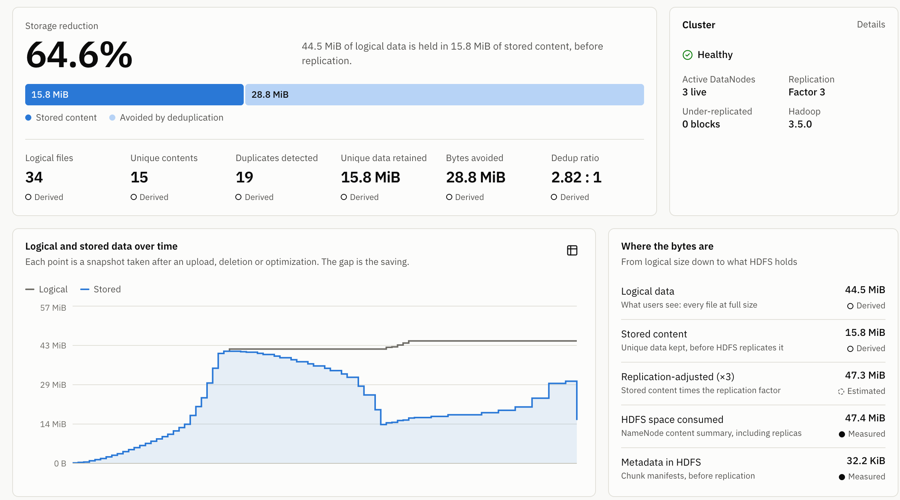
The dashboard says how every number is known
Derived
Exact, from the metadata database. Excludes replication.
Measured
Reported by HDFS at the time shown.
Estimated
A calculation or a prediction, and labelled as one.
N/A when undefined
An empty system never shows a fake zero.
Notes:
This is a real screenshot of the running system, cropped to the top of the page. Point out the storage reduction figure and bar, then the small labels: Derived values come from metadata, Measured values come from HDFS, and Estimated values are calculations. On an empty system, it shows N/A rather than a fake zero.

Slide 12
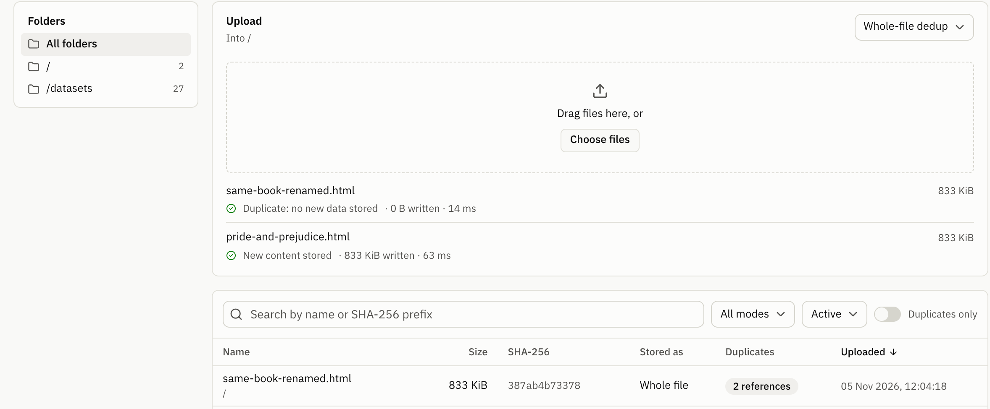
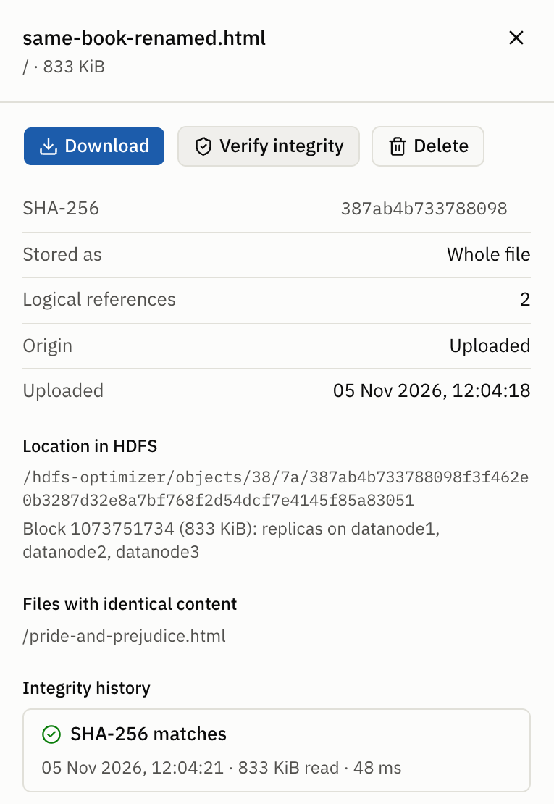
Upload, browse and inspect files, down to replica locations
A renamed copy is reported as a duplicate: no new data stored.
Replicas stay on three DataNodes, and the SHA-256 check passes.
Notes:
Left: uploading the same bytes under a new name is reported as a duplicate, and no new data is written. Right: the detail panel shows the hash, the HDFS path, the DataNodes holding replicas and a passed SHA-256 check. Progress bars show the bytes the browser has really sent.

Slide 13
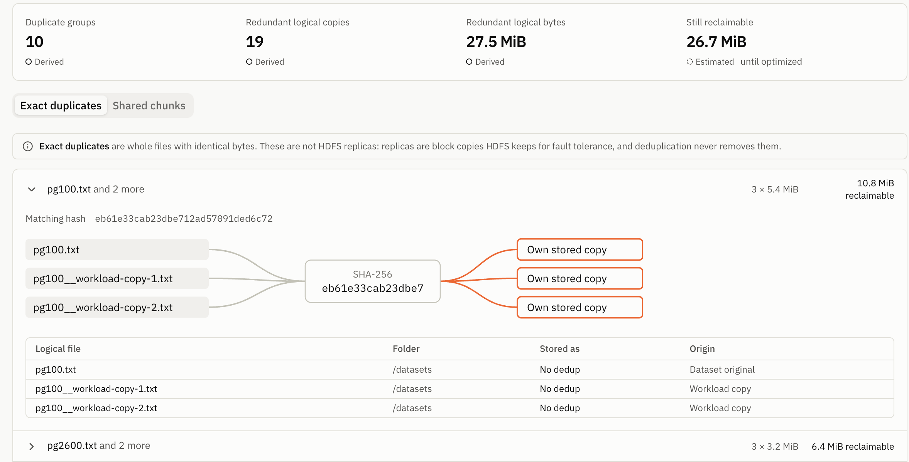
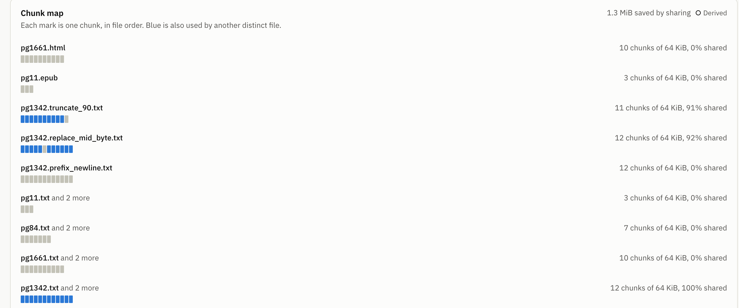
Duplicate detection shows how names map to stored bytes
Exact duplicates
Shared chunks
Same SHA-256, different names. In orange, each copy is still stored separately, so its space can be reclaimed.
Blue marks are shared with another file. Truncating or editing one byte shares almost everything. Inserting one byte at the start shares nothing.
Notes:
This group has one SHA-256 and several logical names. The diagram shows that each copy is still stored separately, in orange, so space can be reclaimed. After optimization the lines converge on one blue box. The tab on the right shows shared chunks: a truncated copy and a one-byte edit share almost everything, and a one-byte insertion at the start shares nothing.

Slide 14
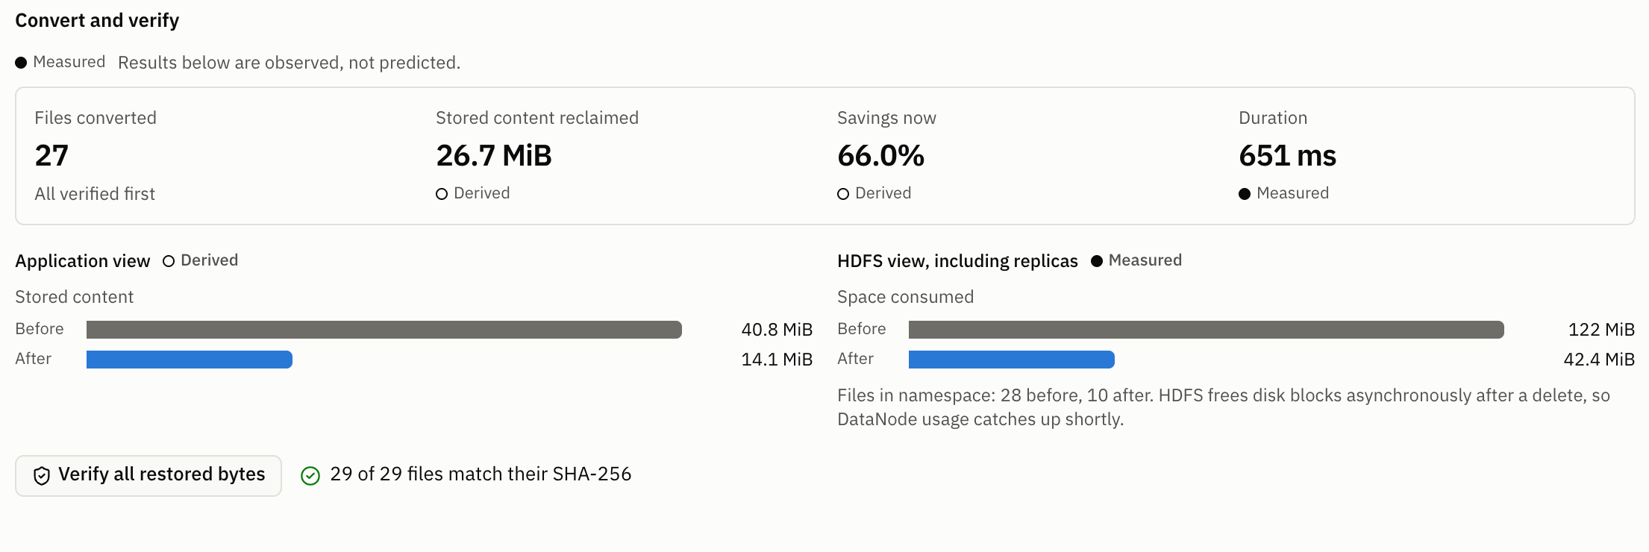
Optimization reclaimed the copies and kept every byte
27 of 27
27 to 9
files passed SHA-256 afterwards
HDFS files, whole-file mode
121 to 40 MiB
on DataNode disks, measured with du
Notes:
Both runs started from 27 files stored without deduplication: nine books with two exact copies each. Each is measured by the NameNode and includes replication. All 27 files then passed SHA-256 verification. Chunk mode uses slightly more space than whole-file, because of its manifests. The chart and figures are from the repeated benchmark. The screenshot is from the demonstration session, which also holds two uploaded files, so its totals differ slightly.

Slide 15
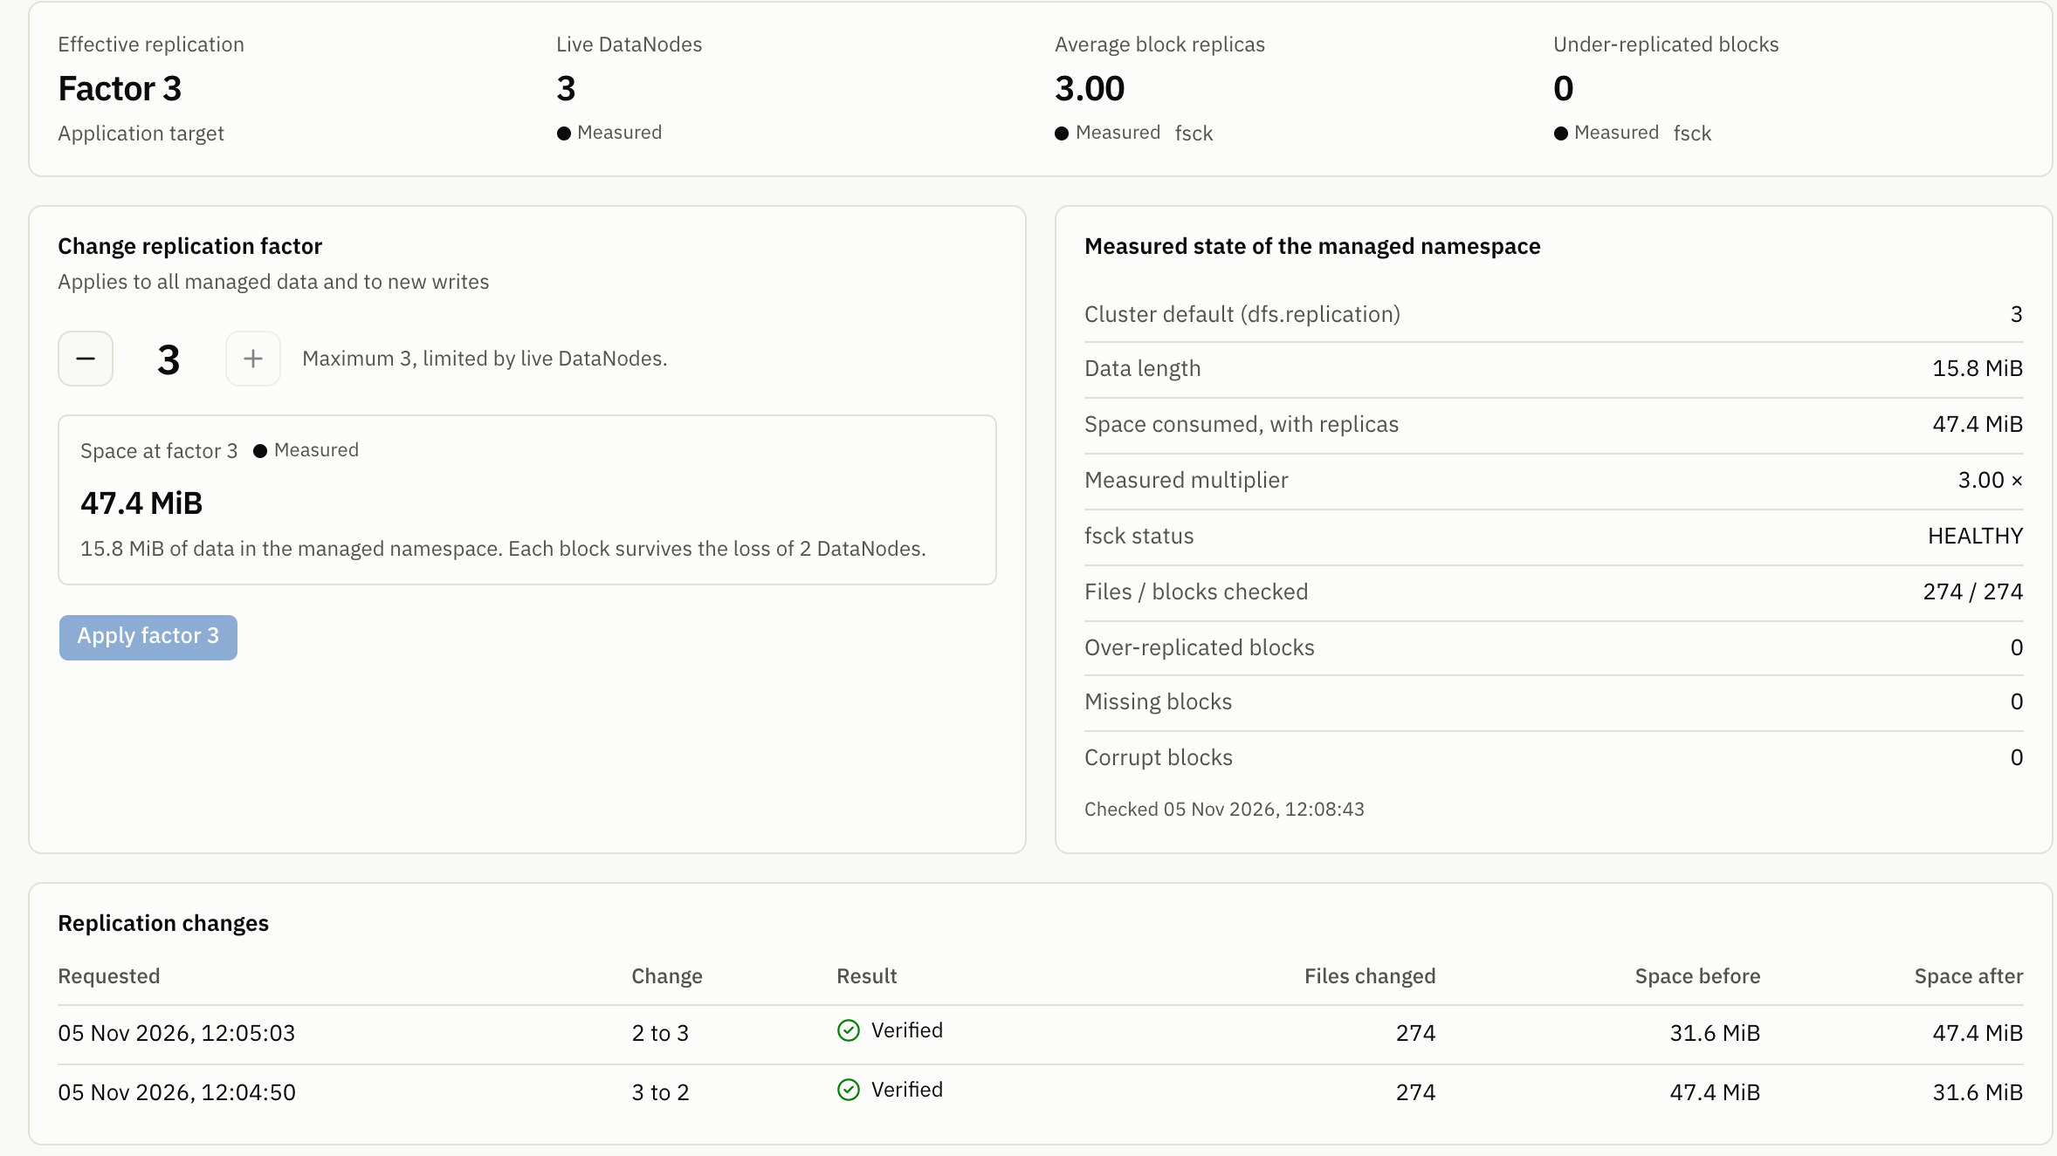
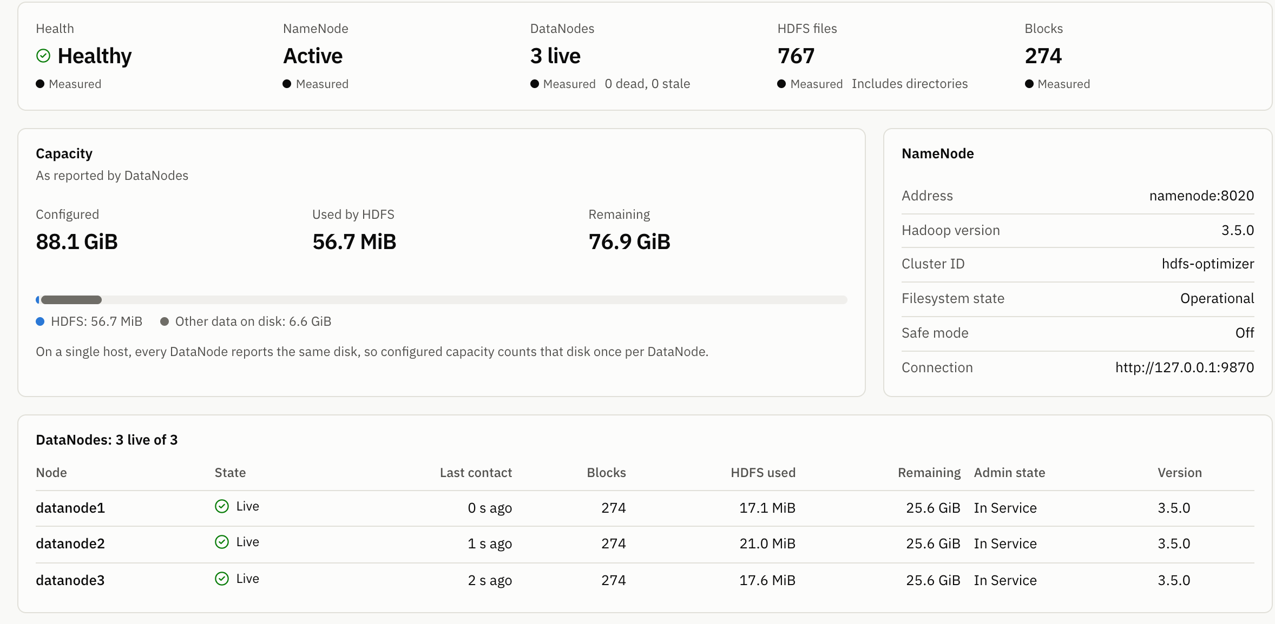
Replication and cluster health come from HDFS itself
Measured at factor 2: space multiplier 2.00, with 0 under-replicated blocks. Success is reported only when fsck and block locations agree. A factor above the live DataNodes is refused.
Notes:
A factor above the number of live DataNodes is refused, and lowering it needs confirmation. Success is reported only when fsck and the block locations agree. An interesting finding: fsck stops counting a replica as soon as it is marked excess, before it is deleted, so our first version reported success too early. A real test caught that.

Slide 16
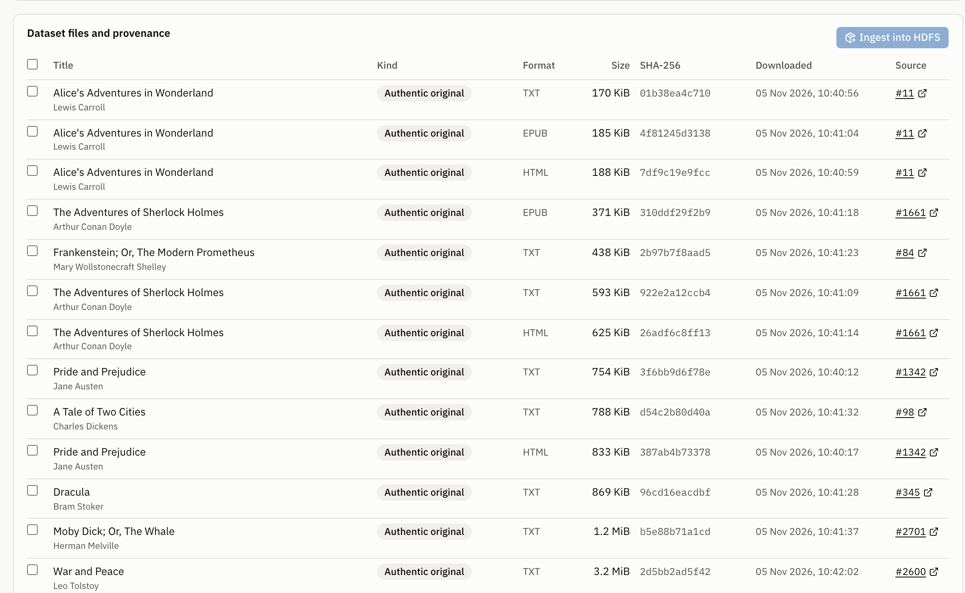
Authentic files, with provenance for every byte
15
39 MiB
original files from Project Gutenberg
of authentic data, as published
Kind | What it is | Used for
Original | Bytes as published, with URL, date and SHA-256 | Everything
Workload copy | Same bytes, another logical name, labelled | Duplicate tests
Transformed | One documented byte edit of one original | Overlap tests
Every file: source page, download URL, date, SHA-256 and kind.
No data was invented. Savings verify the mechanism on chosen workloads; they do not predict real-world savings.
Notes:
This project does not need a labelled machine-learning dataset, but it does need real files. The files are from Project Gutenberg, including the three suggested in the brief. Duplicates are clearly labelled test copies. Be ready to say what this cannot show: it is small, so it says nothing about production scale, and its duplicate rates are chosen, not observed.

Slide 17
Finer chunks find more overlap, at a steep cost
Logical savings can mislead: at 16 KiB, they read 8.9%, yet disk use measured with du is 14.6% higher than whole-file storage.
Timings: mean of three runs on one laptop. They show the trend, and do not predict a real cluster.
Notes:
These are measured results for the same workload at each chunk size: originals plus three edited variants. Savings rise as chunks shrink, but throughput falls and the number of NameNode objects grows, because each chunk is its own HDFS file. Chunks larger than the book find nothing, since the variants are smaller than one chunk. Timings describe this laptop, not a production cluster. Each timing is the mean of three runs.

Slide 18
We broke it on purpose, and no data was lost
DataNode stopped
Automated tests that passed
Files stayed readable. A request for factor 3 with two live nodes was refused (HTTP 422).
129
unit and API tests
NameNode stopped
17
on the real HDFS cluster
Upload failed with HTTP 503. No file recorded. The retry after restart succeeded (HTTP 201).
Backend killed mid-job
13
real-browser tests
Job marked interrupted. After resume, 27 of 27 files restored byte-identical.
Corrupt or missing chunks are reported individually, and a corrupt download aborts.
Notes:
These failures were real: containers were stopped, and a process was killed with SIGKILL during a job. With a DataNode down, files stayed readable, and the NameNode declared it dead after about 88 seconds. With the NameNode down, uploads failed cleanly with HTTP 503 and recorded nothing. After the kill, the job was marked interrupted; resuming it finished the remaining files, and 27 of 27 files restored byte-identical. The test counts come from the saved test output.

Slide 19
What we learned, what limits it, and what comes next
Engineering challenges
Current limits
Future work
No transaction spans HDFS and SQLite
fsck reported success before replicas were deleted
NameNode JMX values lag by about 10 s
DataNode deletes are asynchronous, so disk readings need care
Fixed-size chunks: a shift defeats them
Each chunk is an HDFS file, which costs NameNode memory
One process and SQLite limit scale
One laptop: no real hardware fault tolerance
Content-defined chunking (FastCDC)
Packing chunks into container files
Distributed index; Spark background jobs
Kerberos, HA and real multi-machine deployment
The largest measured cost, small chunk files, points directly at the next step: packing chunks into containers.
Notes:
Be open about limits; it counts for you. The biggest measured cost is that each chunk is an HDFS file, and packing would address that. Content-defined chunking fixes the shift weakness. Everything in the right column is future work, and none of it is implemented.

Slide 20
Duplicates gone.
Replicas intact.
Every byte verified.
120 MiB
NameNode space consumed before optimization
40 MiB
A working deduplication layer on real HDFS, evaluated with authentic data, including real failures.
after, same logical files, same replication
27 of 27
Thank you. Questions?
files passed SHA-256 afterwards
Notes:
Close with the takeaway: we separated deliberate redundancy from accidental redundancy, removed only the second, and proved the bytes are intact. These figures are from a controlled workload with labelled copies. Thank the audience and invite questions.

