Slide 1
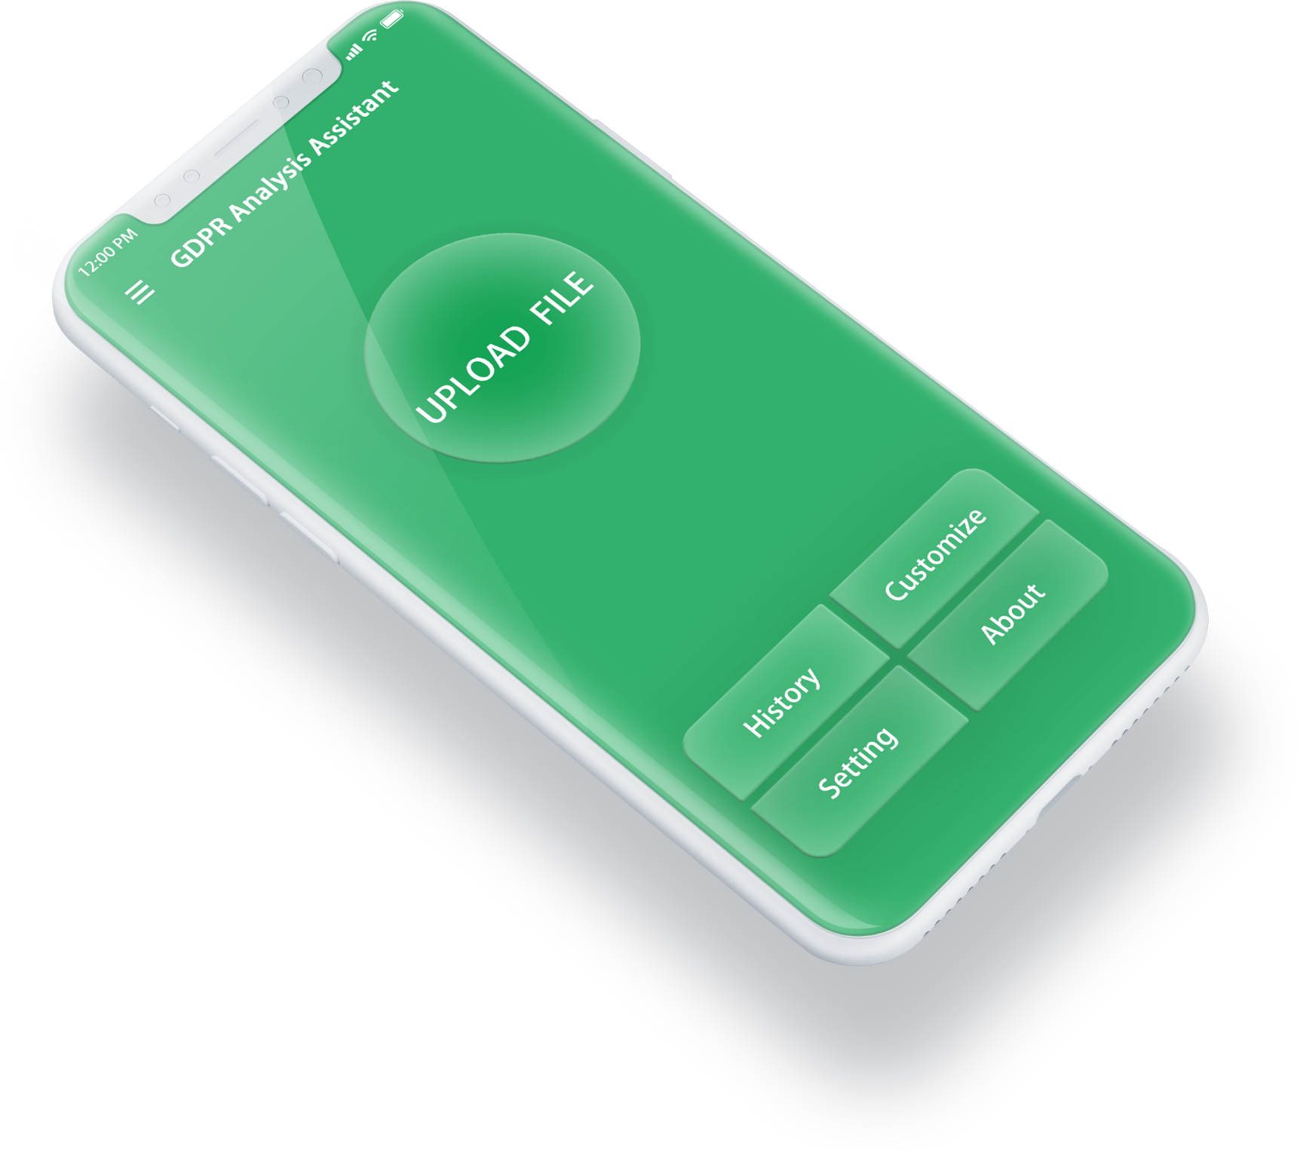
GDPR Analysis Assistant
——隐私政策文件智能GDPR缺陷分析AI
CDUT Dino团队

Slide 2
目录
CONTENTS
第一部分
第二部分
第三部分
第四部分
GDPR
Thoughts
Problems
Future

Slide 3
1
第一部分
What is the GDPR
- 用户有权要求企业把自己的个人数据删除，如果资料已经被第三方获取，用户可以进一步要求它们删除。
- 用户在个人隐私方面的知情权
- 用户具有数据移植权
- 个人数据泄露后，企业要在72小时内向监管部门报告，企业还要配备熟悉GDPR条款的数据保护专员，和监管部门保持沟通。

Slide 4
What we should do
Find the defect in Privacy Policy by AI
Judge the Privacy Policy is adapted to GDPR

Slide 5

2
第二部分
The Thoughts of Us
A large number of privacy policy documents are collected and classified into goodshape, fairlyok and pretty muchbad.
And extract the keywords that can be used as the distinguishing standard. Input into excel.The keywords are converted into data, and the final weight is calculated according to the user-defined weight.
Do supervised learning according to the label.Use lad + word2vec to extract similar keywords.Finally, KNN algorithm is used to predict the test data set.

Slide 6
3
第三部分
The Problems
Have never been exposed to Finnish before, and encountered great difficulties in identifying the privacy policy of Finnish.
Time is limited, not enough data sets were found.Previously, we seldom contact NLP and encounter some problems in the algorithm implementation.
GDPR Analysis Assistant

Slide 7

4
第四部分
The Future
Optimization model and algorithm
(KNN is not good enough for this model)

Slide 8
THANKS
——By CDUT Dino

