Slide 1
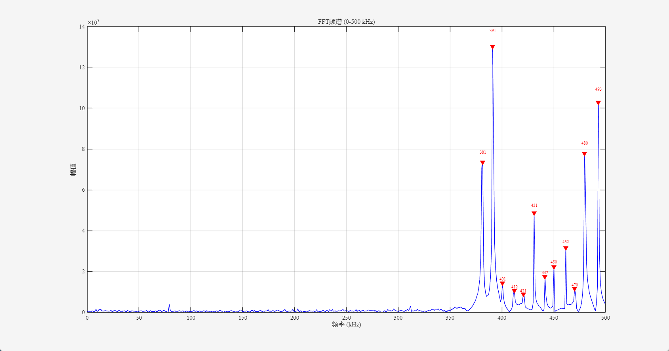
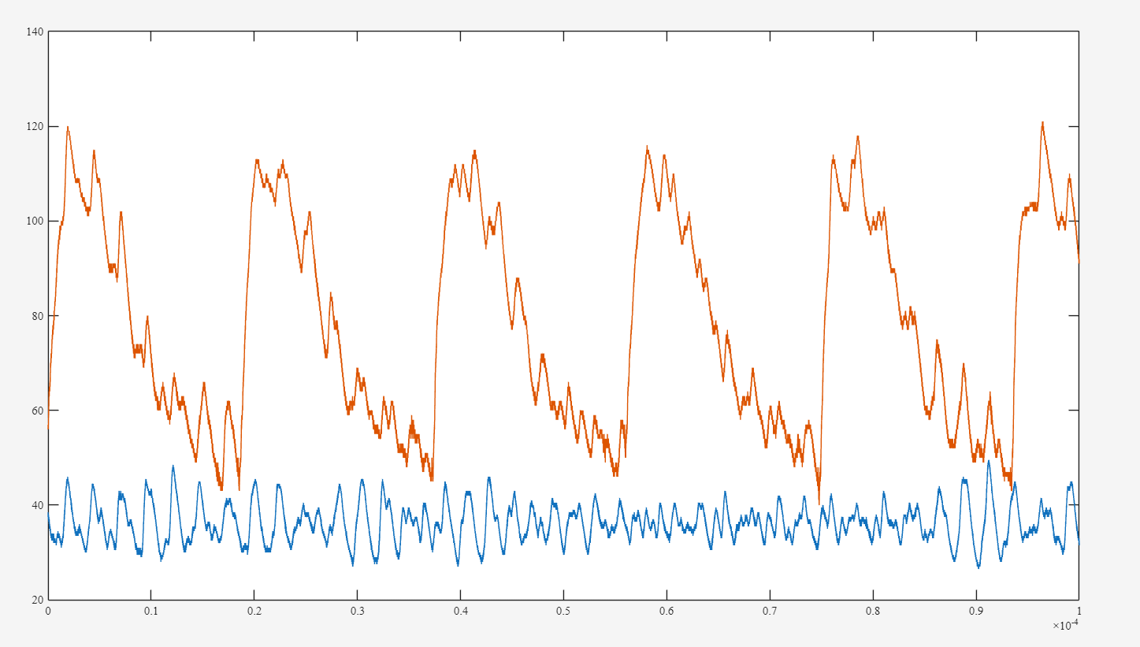
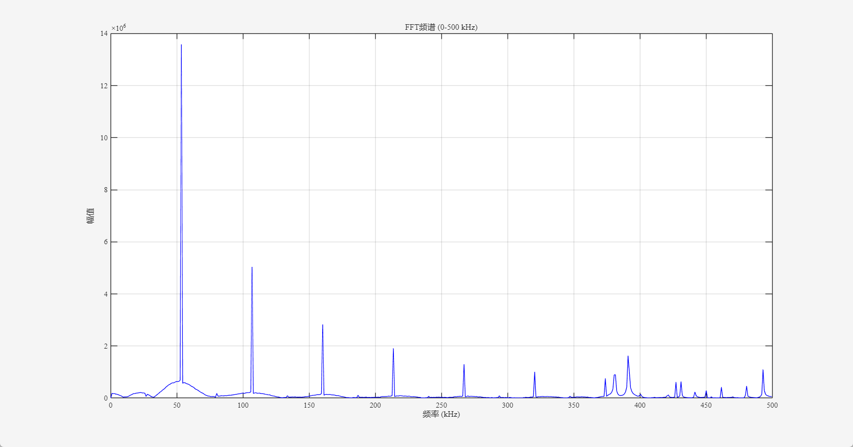

Slide 2
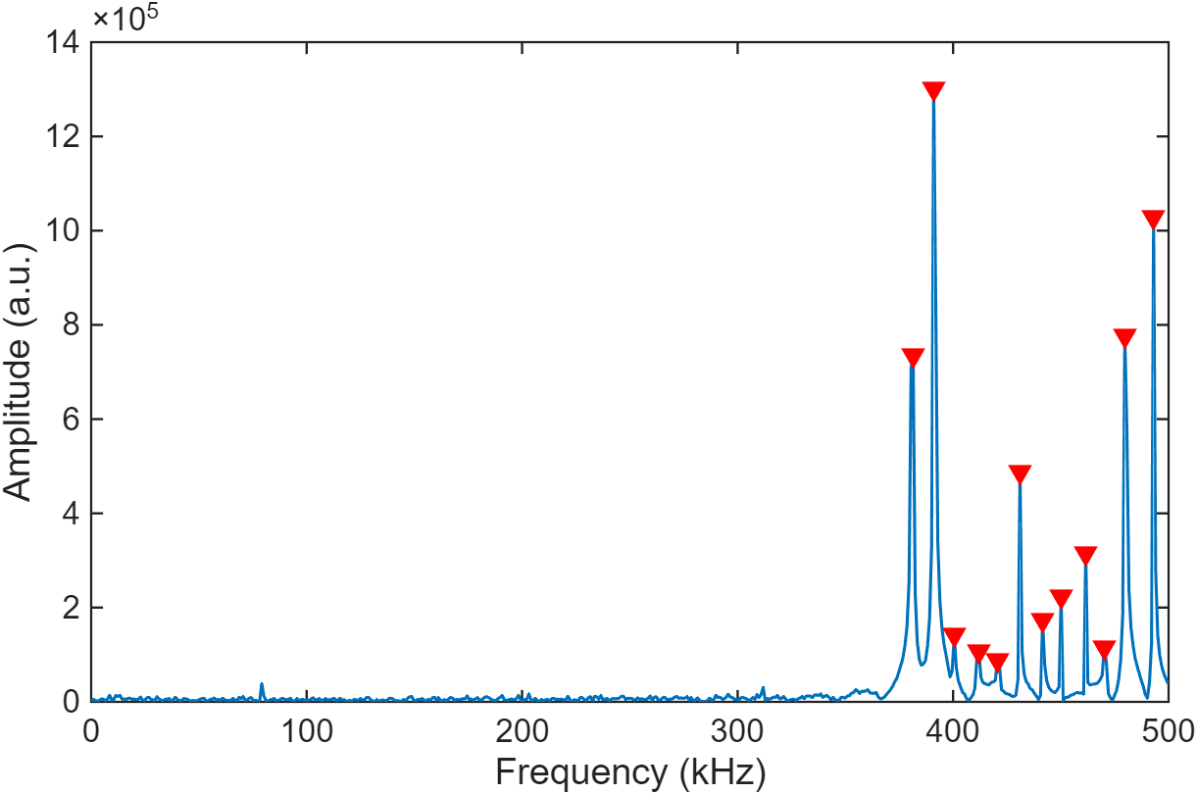
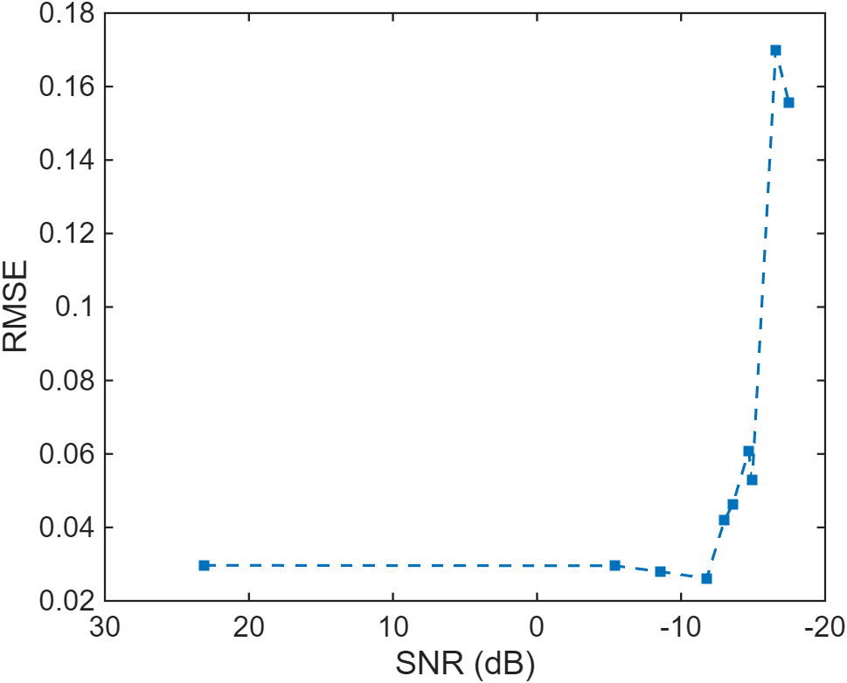
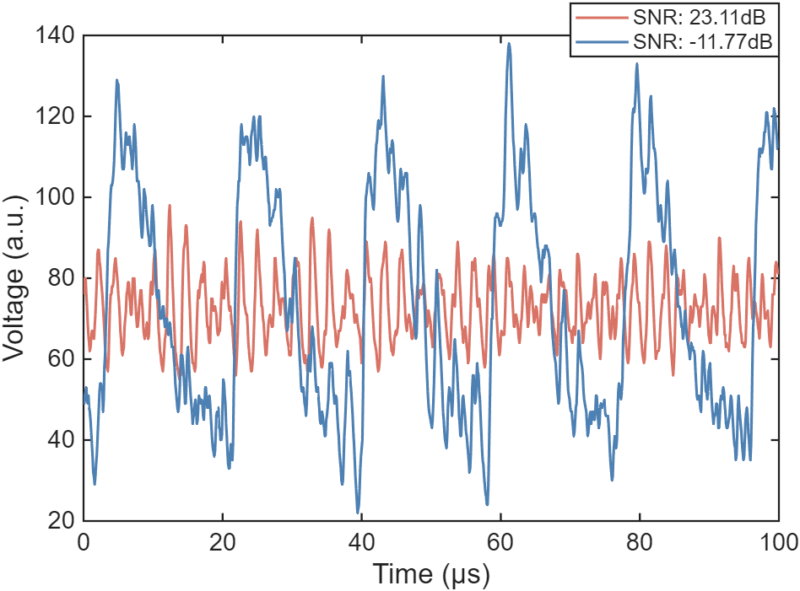
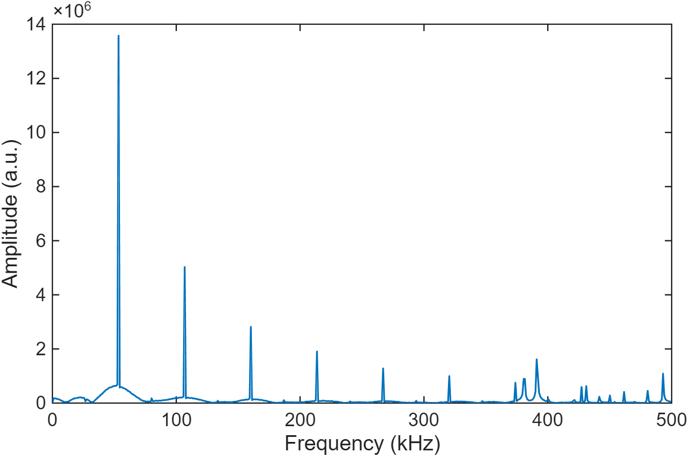
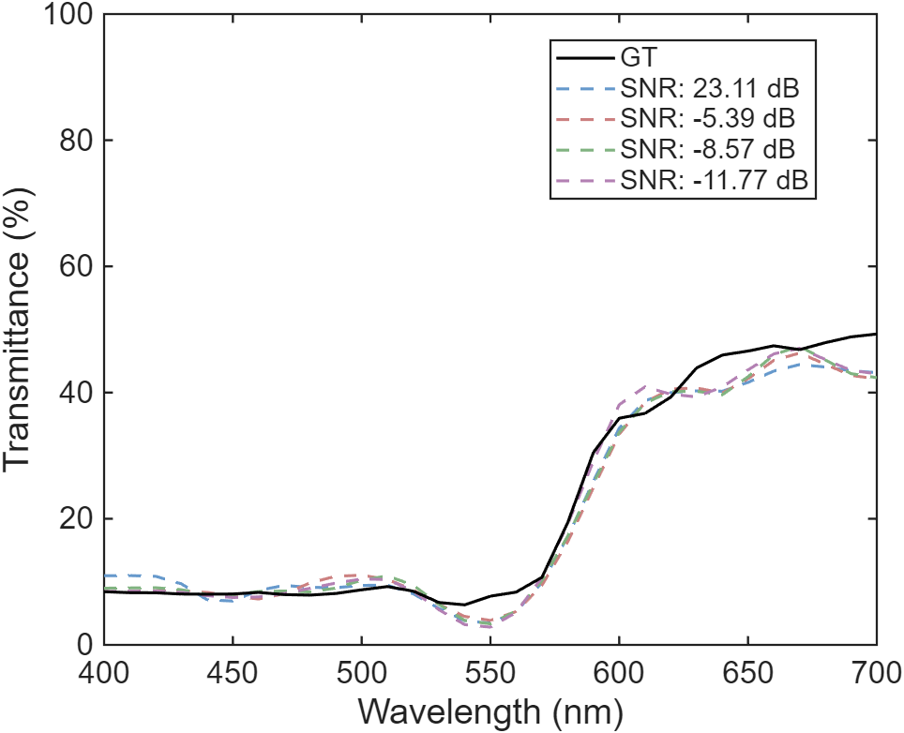
b
d
a
(-11.77, 0.0261)
c
e
Signal Area

Slide 3
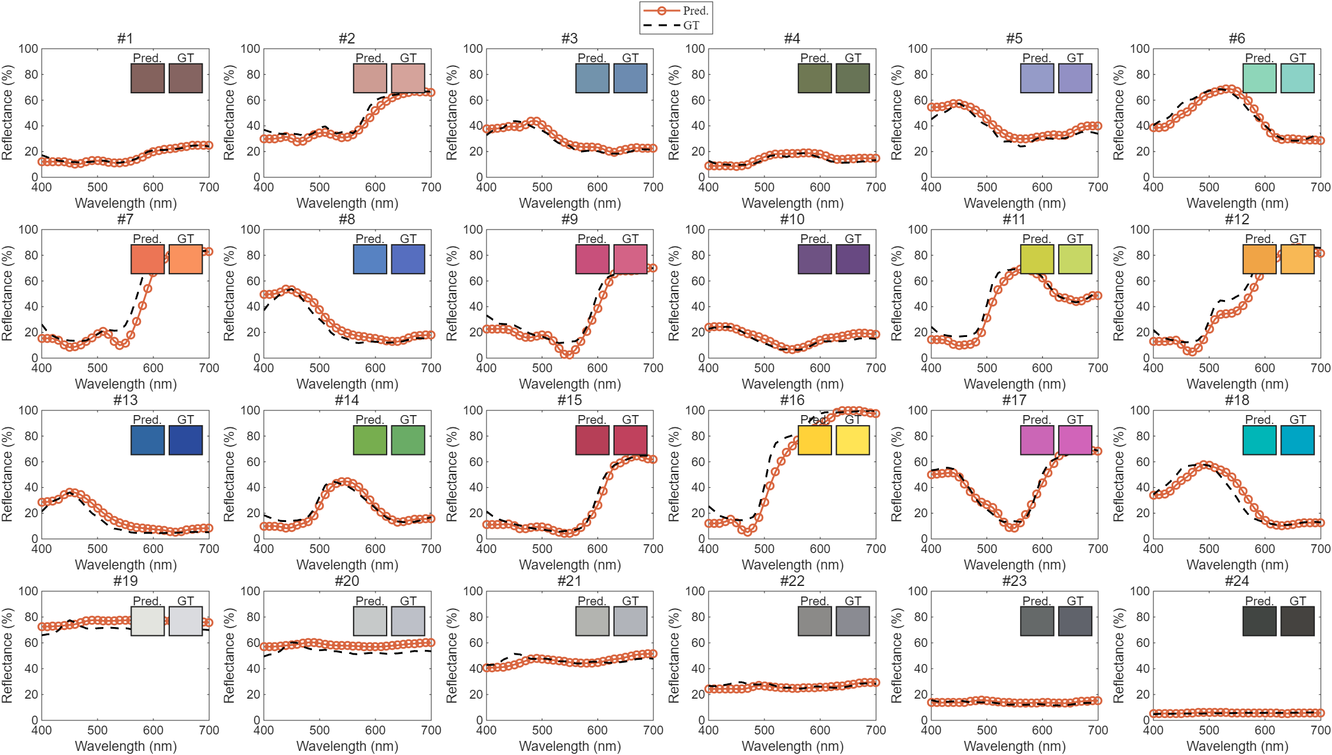

Slide 5
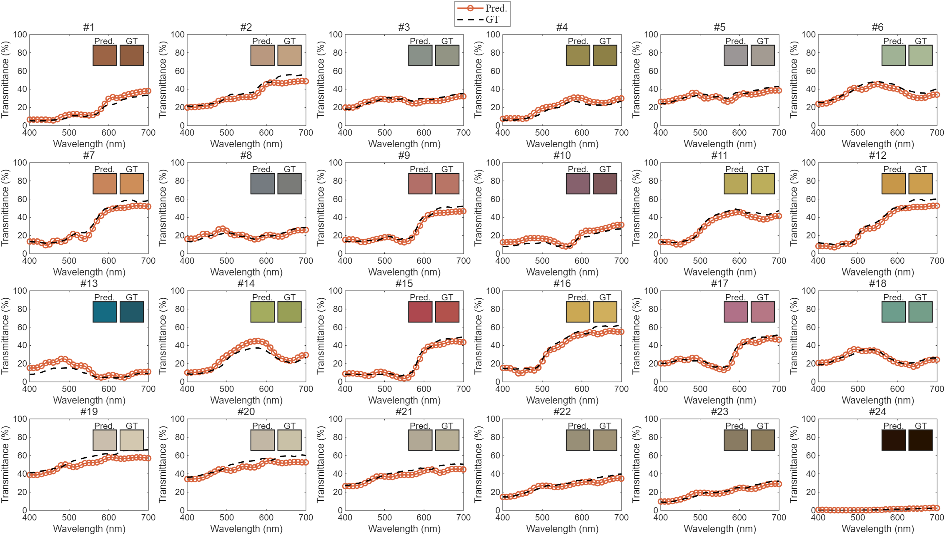
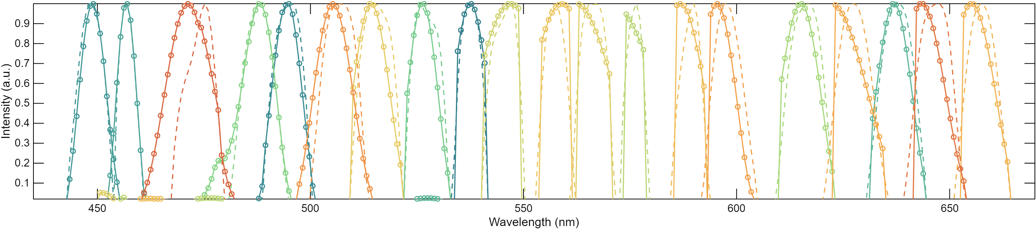
a
b

Slide 6
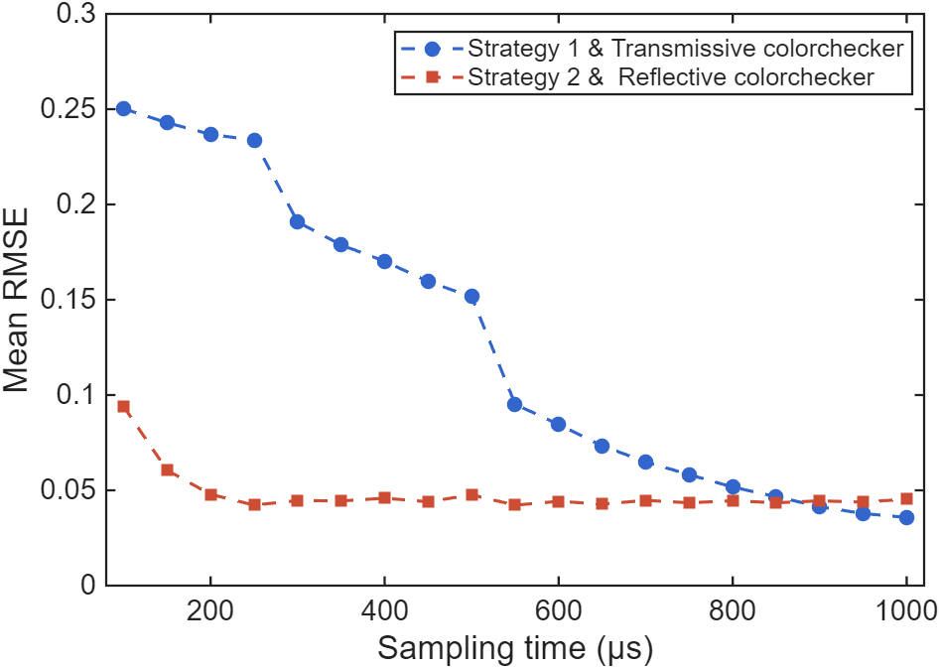
(250, 0.0422)
(1000, 0.0358)

Slide 7
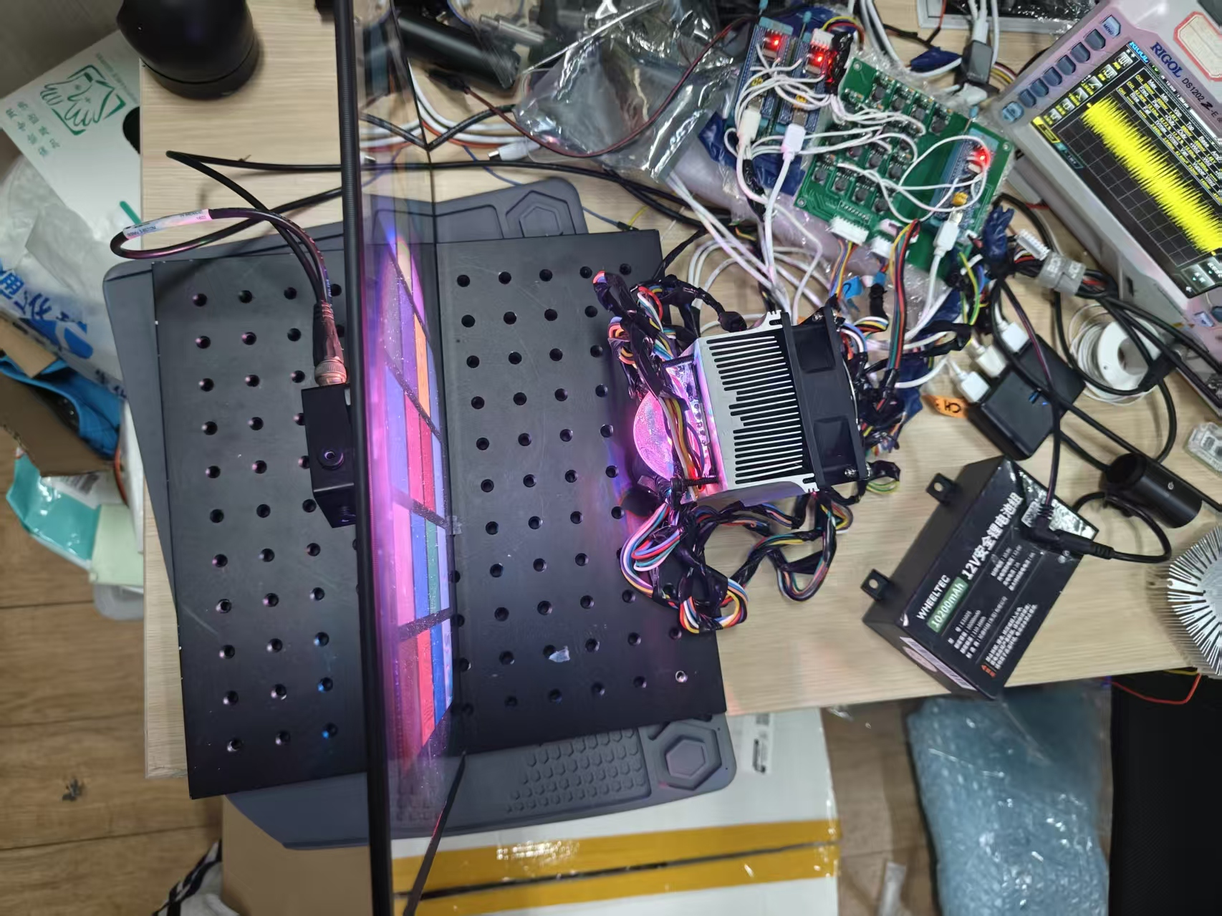
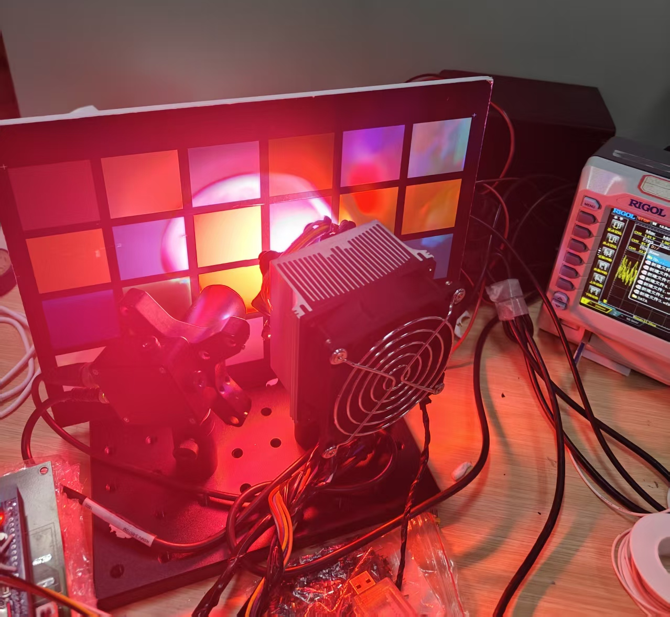
Tr colorchecker
Oscilloscope
Photodiode
Reflective colorchecker
Driver circuit
LED Array
LED Array
Photodiode
Oscilloscope
Transmissive colorchecker

Slide 8
a
d
(-11.77, 0.0261)
e

Slide 9
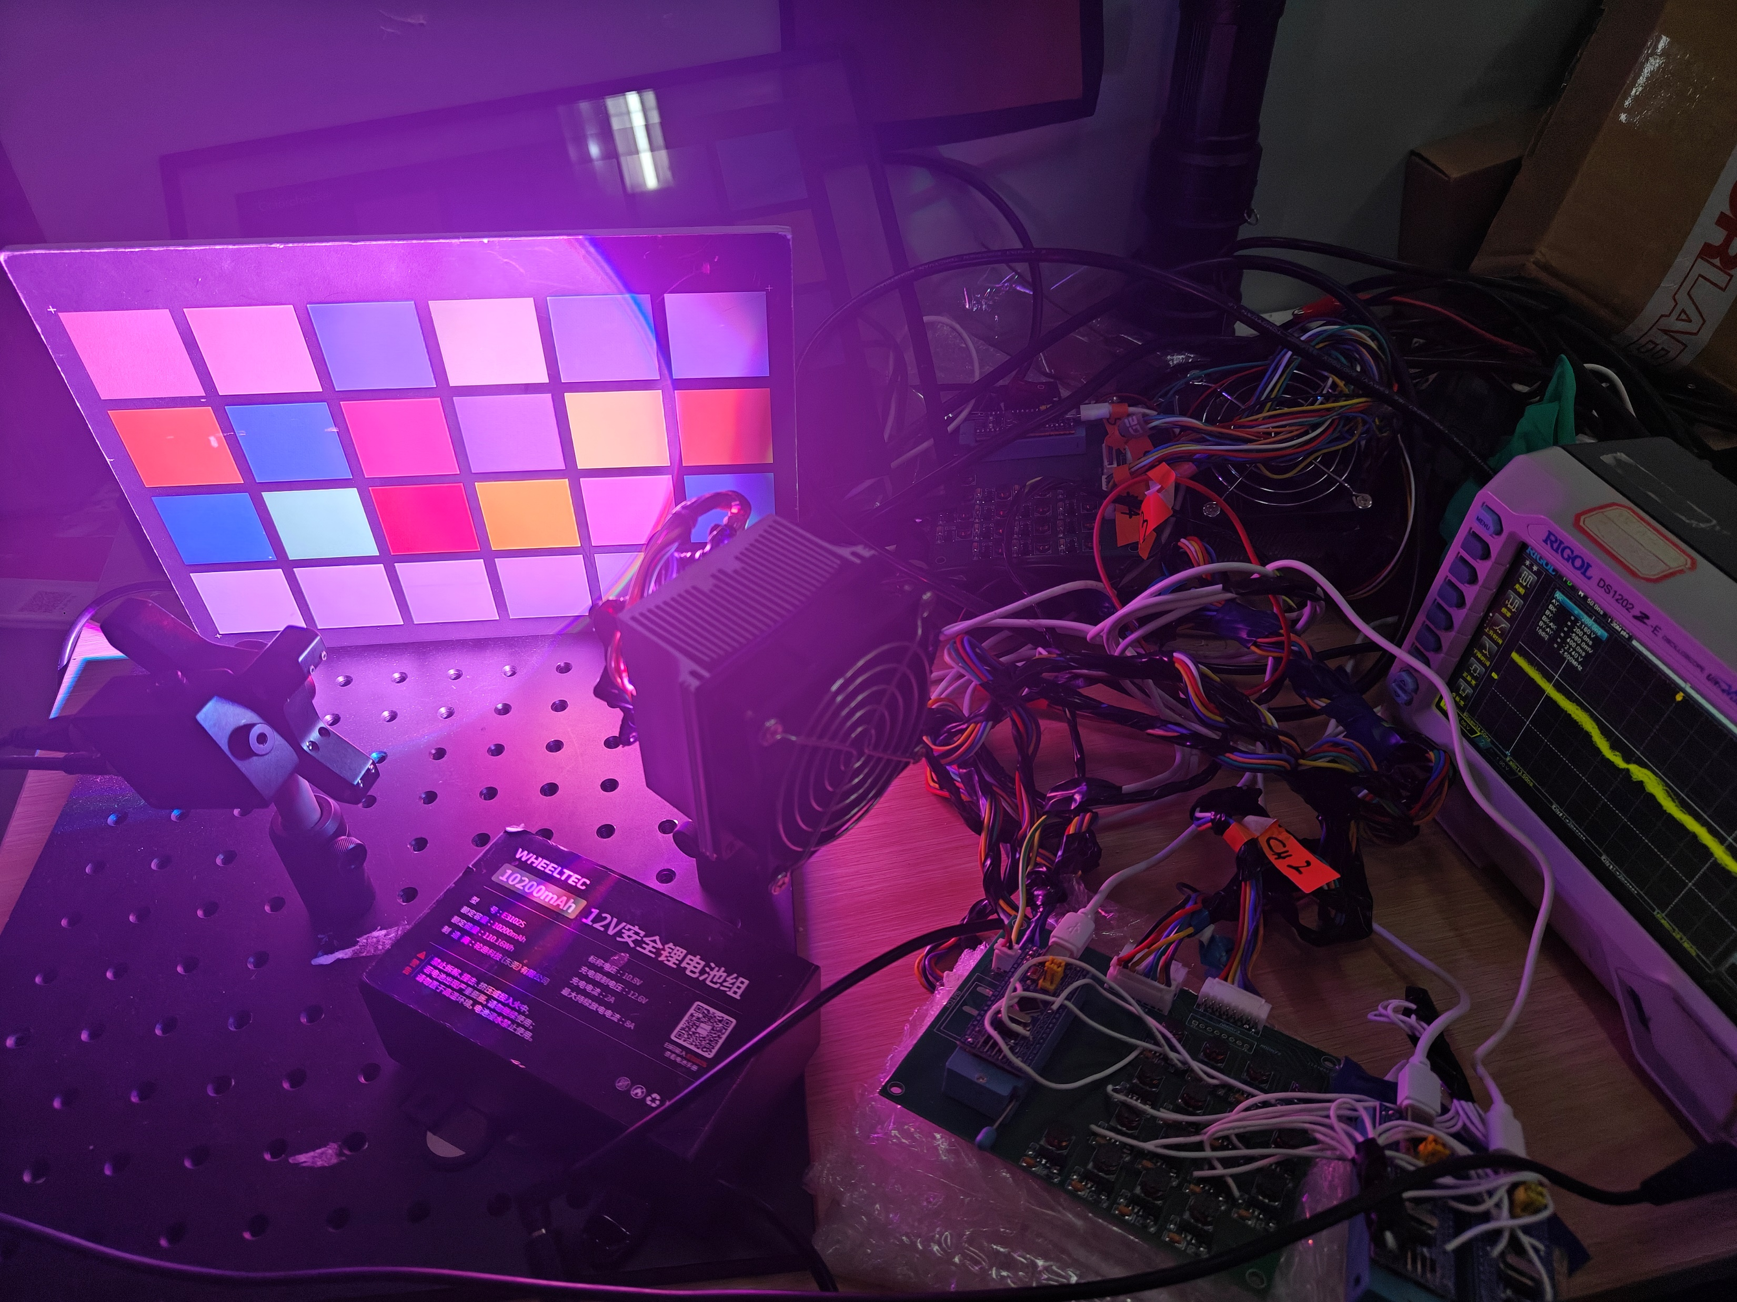
a
b
Transmissive colorchecker
Oscilloscope
Reflective colorchecker
Driver circuit
Oscilloscope
Photodiode
(PD)
LED array
LED array
Photodiode
(PD)
Driver circuit

