Slide 1
Measuring an Eclipse Depth in an HST Light Curve
Alex Zhao

Slide 2
The Problem & Cleaning the Data
HST’s 95.48-min orbit, the target is visible only part of each orbit with sparse, intermittent light curve across 6 visits
Known contaminants: photon noise, linear trend, hours-timescale stellar sinusoid, cosmic-ray outliers
Outlier rejection: moving-median filter (window=11) + 3σ MAD clip.
  4.98% of points flagged as outliers

Slide 3
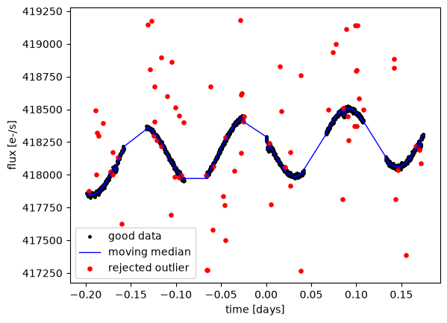

Slide 4
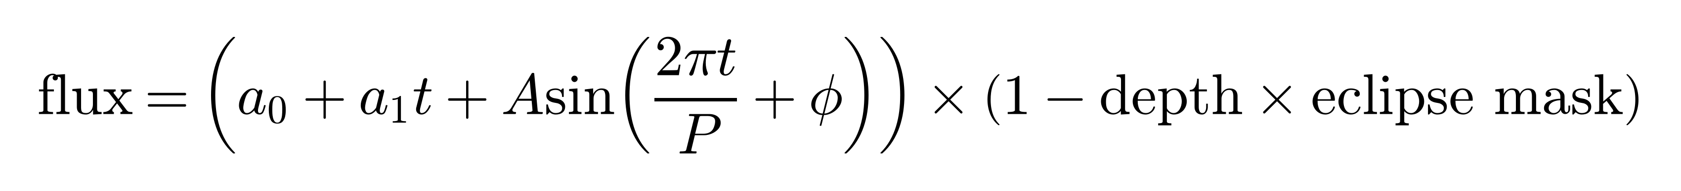
Method & Headline Result
Model: Measuring flux via the equation seen below
Period found via periodogram: P ≈ 2.80 hr
Fit all parameters jointly via MCMC → depth posterior automatically includes trend/sinusoid uncertainty
Eclipse depth = 119.5 ± 3.0 ppm

Slide 5
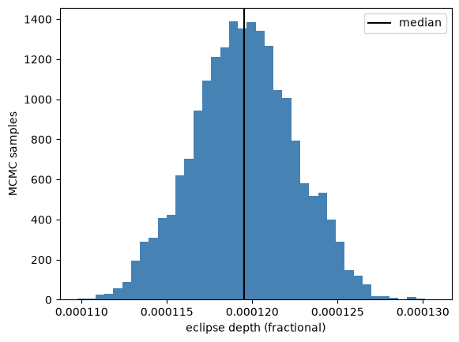

Slide 6
Cross-Checks
Parametric weighted-average: 119.8 ± 3.0 ppm (agrees with MCMC)
Non-parametric (kernel regression): plateaus at 105–111 ppm over a narrow bandwidth range; degrades/flips sign outside it
Parametric + MCMC trusted more: known functional form, full uncertainty propagation

Slide 7
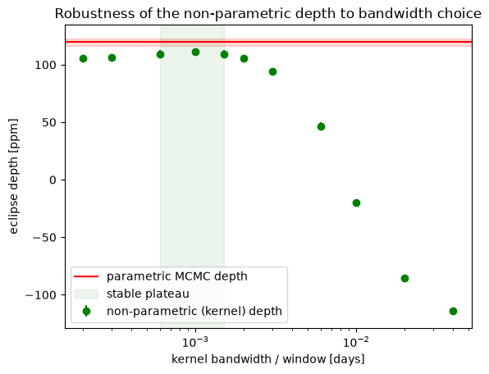

Slide 8
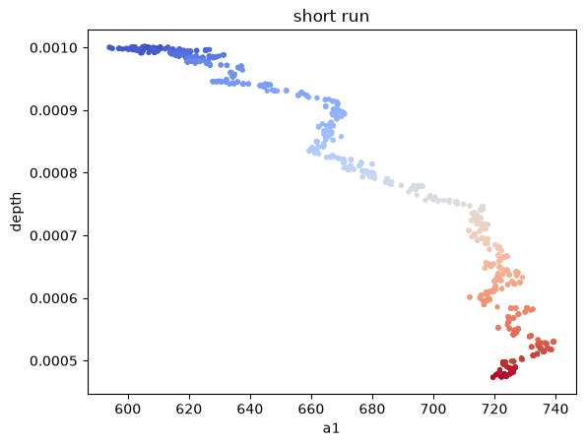
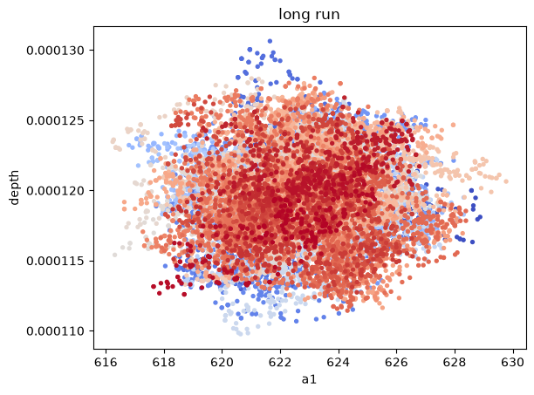

Slide 9
Verification
Full light curve can’t show a 120 ppm dip by eye
Divided out best-fit continuum, phase-folded on known eclipse period, zoomed to ±15 min
Binned points clearly drop inside the eclipse window, tracking the fitted model
Fit quality confirmed: RMS-vs-bin-size matches white noise; weighted residuals ≈ unit Gaussian (mean −0.002, std 0.979)

Slide 10
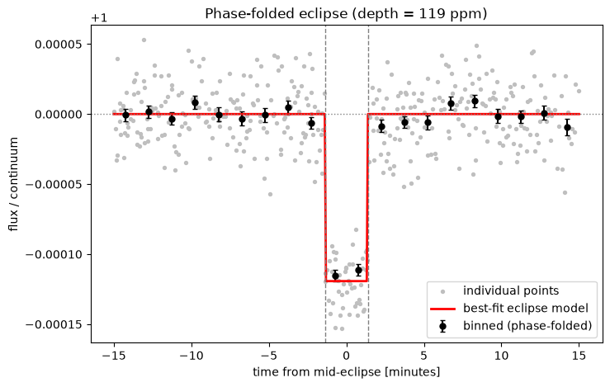

Slide 11
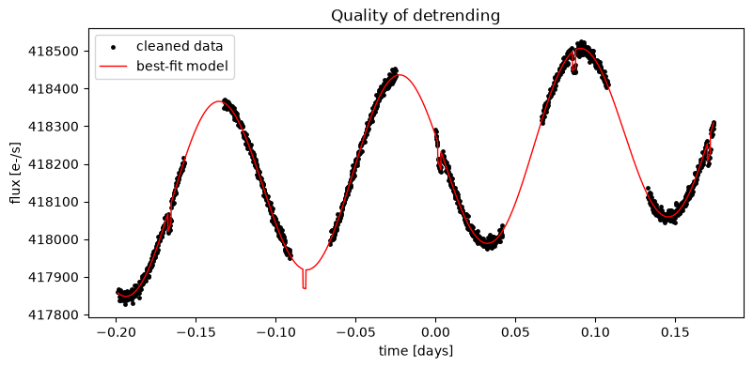

Slide 12
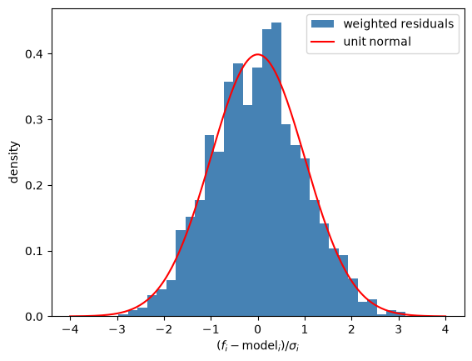

Slide 13
Conclusion
Eclipse depth = 119.5 ± 3.0 ppm: a ~40σ detection, despite being orders of magnitude smaller than the trend/sinusoid it’s buried in
Confirmed three independent ways: MCMC, parametric weighted-average, and non-parametric kernel regression all agree
Fit quality verified: white-noise RMS scaling, residuals consistent with a unit Gaussian
Parametric + MCMC preferred: the only approach that fully propagates detrending uncertainty into the final result

