Slide 1


Scientists Eli and Olivia are working on creating more of the digital code that humanity uses to accelerate crop production at a facility known as The Homestead.
After a breakthrough in the process, the once benign plants begin to corrupt and attack everything in sight.
Create a 2D platformer based on the final act of the story, where Eli and Olivia must traverse a forest teeming with corruption to reach a radio tower capable of broadcasting the kill code for the plants.

Slide 2
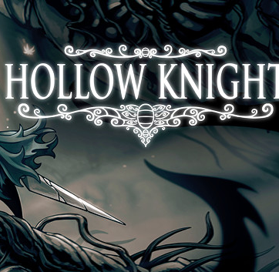
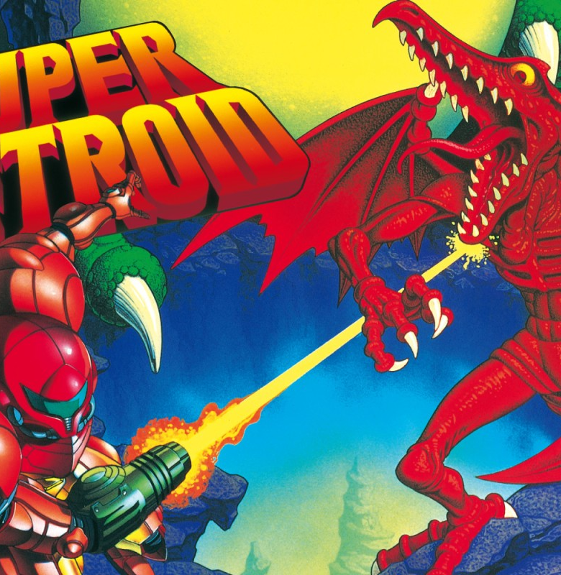
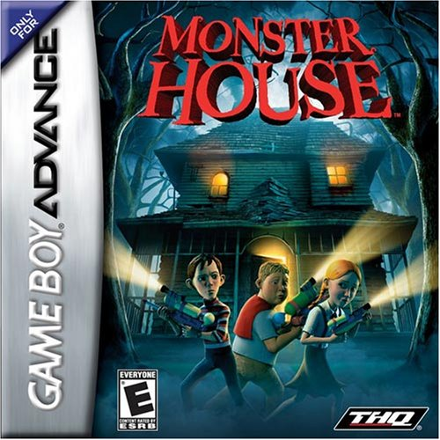

Gameplay precedent
Non-linear progression
Skill/Knowledge/Ability gates for progression
Evolving relationship with the world
Character swapping

Slide 3

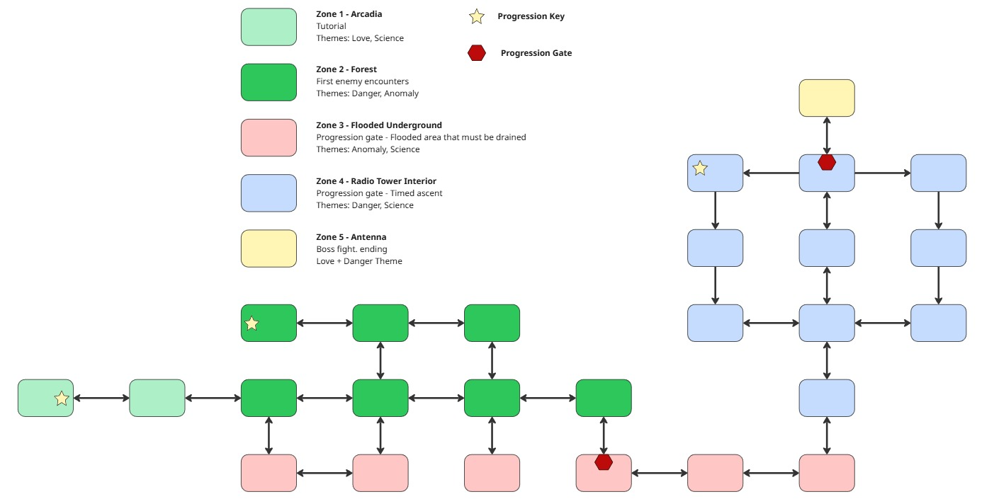





Root Access
Platform: PC
Engine: Unity
Genre: Action- Platformer Metroidvania
Release Date: 12/20/25
Root Access is a single player action-platformer metroidvania where two scientists navigate their way through a corrupted forest and up a radio tower, swapping quickly between Olivia’s tech focused utility and Eli’s acrobatic traversal abilities to put a stop to the spreading anomalies.
Objectives
MVP complete Does it work?
Prompt Adherent Does it match the prompt?
Genre features Is it a good metroidvania?
Character Swapping
Ability 1
Ranged Projectile
Ability 2 Corruption Cleanser
Ability 3 Hacking
Olivia
Eli
Ability 1
Double Jump
Ability 2 Kick
Ability 3 Directional Dash
Pillars
Relationship
Not only are Eli and Oliva in love, but they also cannot reach the tower by themselves, they need to work together
Dynamic World
The world is changing over time, increasing and decreasing in corruption, and the player’s relationship with the world is changing
Climactic
The game is the end of a longer story, the player gets a sense of the history and the importance of the present

Slide 4
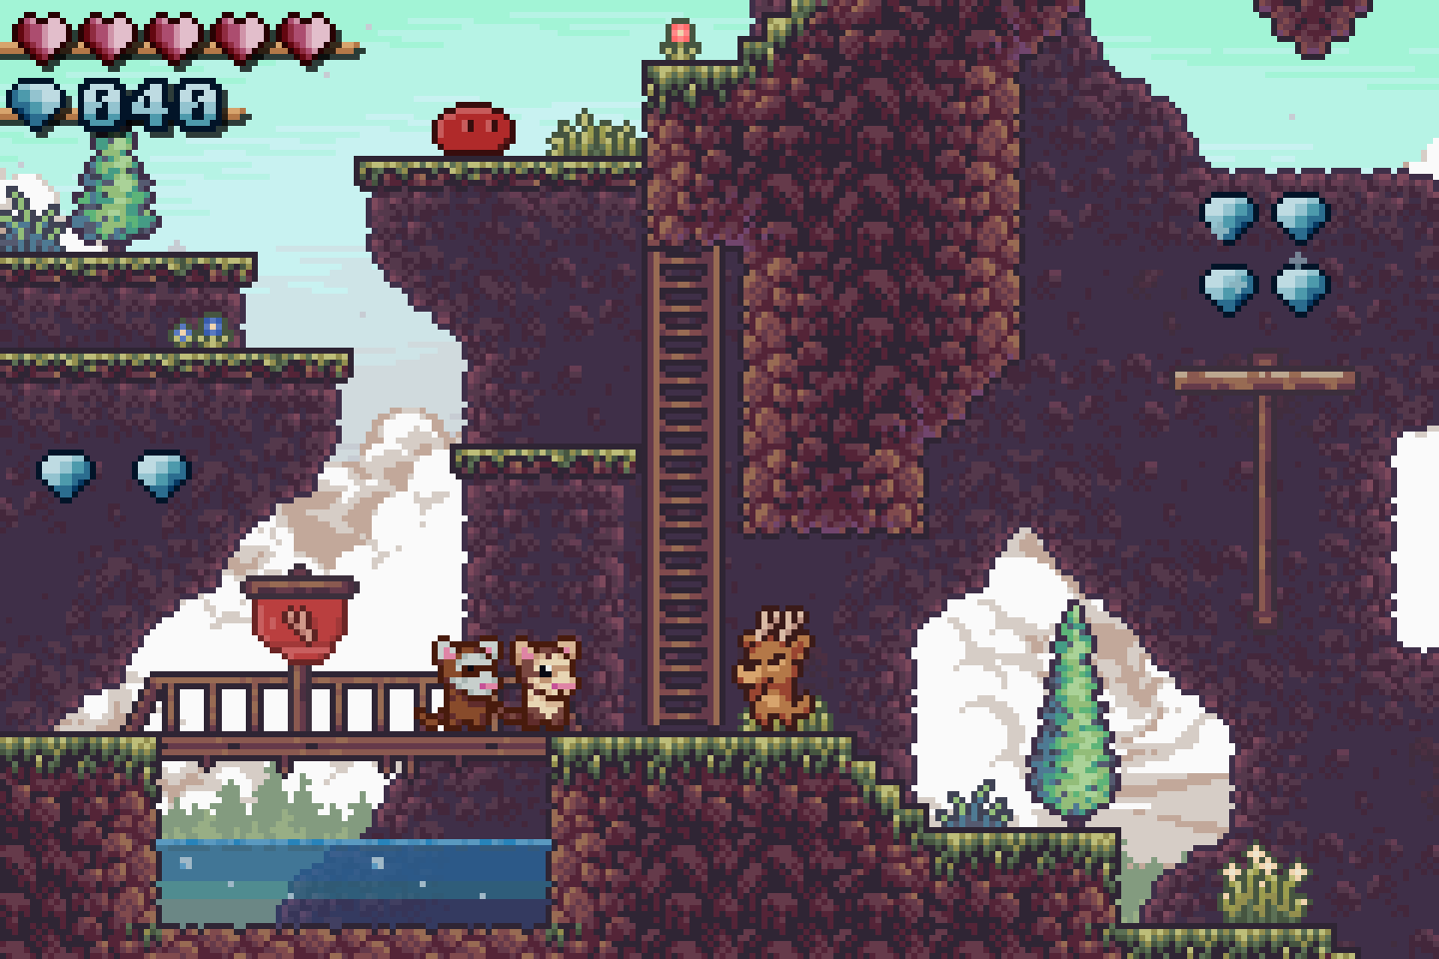
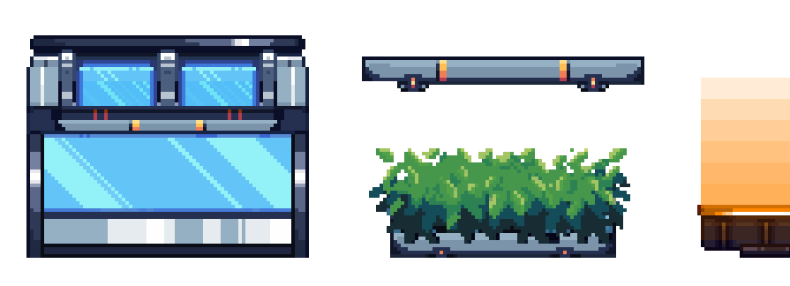
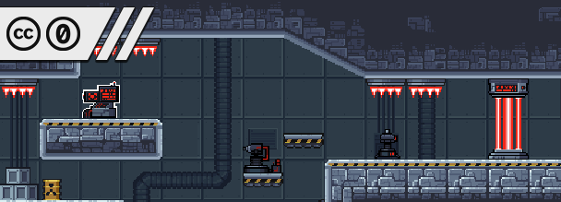
Art Precedent
14 Collective - Solarpunk platformer tileset
Foozle - Sci-fi Lab Tileset
Zephyrix - Ronny's Climb

