Slide 1

RVR & JC COLLEGE OF ENGINEERNG
Learn-Flow (AI-Powered Study assistant)
Mini Project
Team :
Mandava Pardha Saradhi (Y23CD114)
Kambampati Sridhar (Y23CD081)
Jagarlamudi Rohith (Y23CD069)

Slide 2
INTRODUCTION
The AI-Powered Study Assistant is a web-based intelligent learning platform designed to help students study more effectively. The system allows students to upload PDF study materials, from which it automatically extracts content and generates flashcards and quizzes using Artificial Intelligence.

Slide 3
Existing System :
In the existing system, students manually read textbooks or PDFs and prepare notes on their own. Revision is not adaptive, and doubts are resolved by searching the internet, which is time-consuming and inefficient.
Drawbacks of the existing system:
  Manual and repetitive work
  No personalised revision
  No intelligent doubt support

Slide 4
Proposed System :
The proposed system automates the learning process by allowing students to upload PDFs directly. The system extracts content, generates flashcards, schedules revisions intelligently, and provides AI-based doubt resolution within the same platform.
Main advantages:
  Fully automated content generation
  AI-powered doubt clarification
  Easy to use
  Helpful for revision

Slide 5
Potential Users :
The system is mainly designed for college and university students. It is also useful for competitive exam aspirants and self-learners who study through online resources. In the future, educational institutions can adopt this platform to enhance digital learning environments.
Unique Features of the System :
AI-generated flashcards and quizzes
Context-aware doubt solving
Performance-based repetition

Slide 6
Demand for the Product :
With the rapid growth of digital education, students need tools that reduce study time and improve learning efficiency. AI-based personalised learning platforms are increasingly in demand.
Reasons for high demand:
Growth of online education
Competitive academic environment
Need for smart study tools
Protection of Idea :
The idea and implementation of the project are protected through secure authentication, controlled access, and proper code ownership.

Slide 7
Review Findings :
    Existing learning systems lack automation and personalisation, relying heavily on manual processes.
    Manual study tools are time-consuming and do not adapt to individual learning patterns.
    There is a clear need for an end-to-end automated system that supports intelligent content generation and revision.
Objectives of the System :
  To automate the learning process and reduce the manual workload of students.
  To improve memory retention through AI-generated learning content and revision aids.
  To help students study efficiently in less time by providing instant AI-based clarification.

Slide 8
User Requirements:
Simple and intuitive interface
Fast content generation
Accurate AI responses
Clear progress visualisation
System Requirements:
Web browser with internet access
Node.js runtime
MongoDB database
AI API access (Groq Cloud)
Functional Requirements Analysis:
Upload and validate PDF files
Generate flashcards and quizzes
Store and retrieve study data
Update schedules based on user ratings
Answer doubts using Groq Cloud - API
Non Functional Requirements:
High performance and scalability
Secure data storage
Reliable AI integration
High system availability

Slide 9
Hardware Requirements:
Processor: Intel i3 or above
RAM: Minimum 8 GB
Storage: 10 GB free space
Software Requirements:
Frontend: HTML, CSS, JAVASCRIPT
Backend: Node.js (Express)
Database: MongoDB (currently using local storage)
OS: Windows/Linux/MacOS

Slide 10
Design Concepts and Constraints :
The system follows a modular and scalable architecture to simplify development and maintenance.
Components are loosely coupled, improving flexibility and ease of future enhancements.
Constraints include AI API usage limits and increased processing time for large PDF documents.
Conceptual Design :
The system is structured into three logical layers for better organization.
The presentation layer handles user interaction and interface management.
The application and data layers manage business logic, AI processing, and persistent data storage.

Slide 11
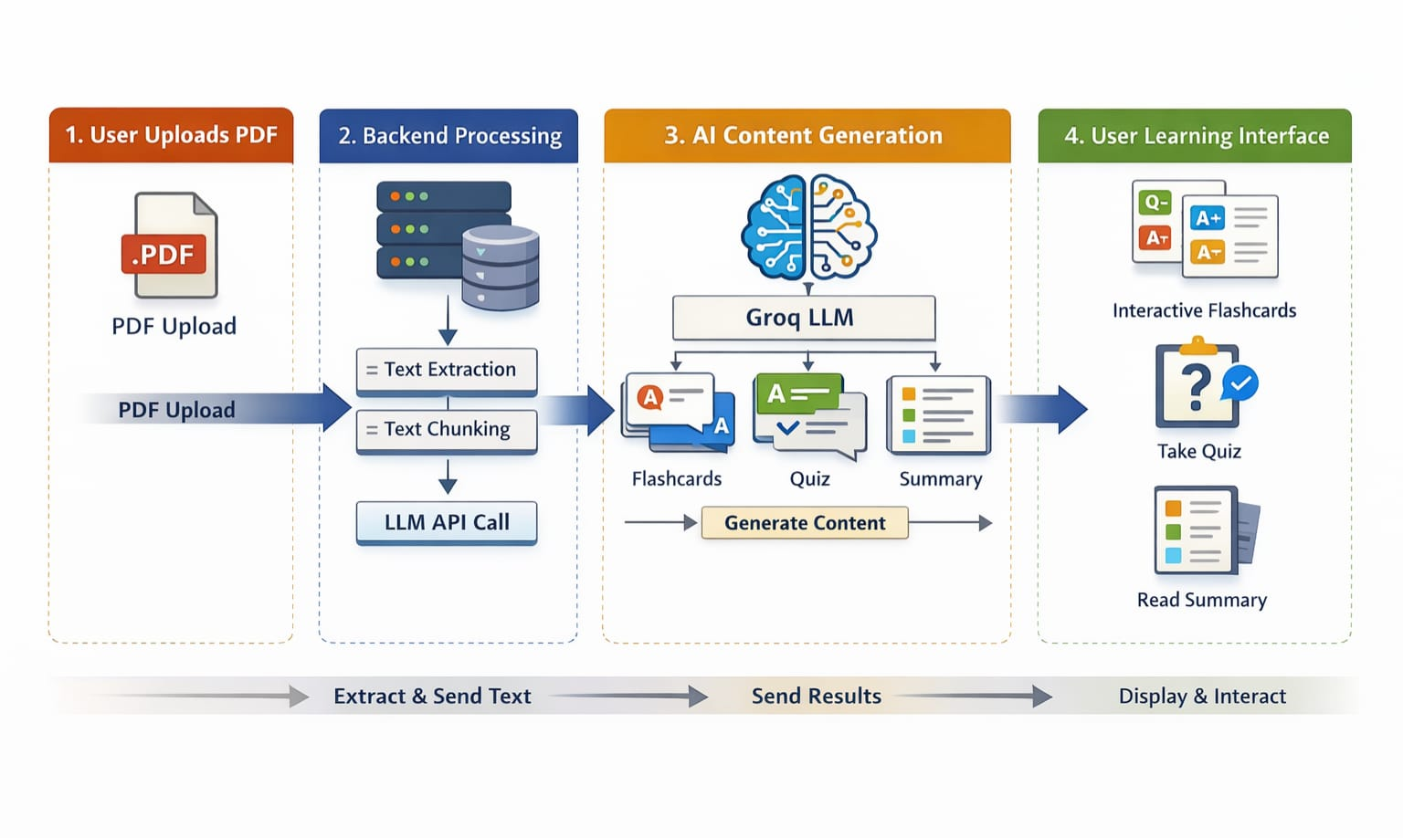
Design Diagram of the System :
The system uses a client-server architecture where the React frontend communicates with a Node.js backend. The backend interacts with a Python NLP service, MongoDB database, and external AI APIs.

Slide 12
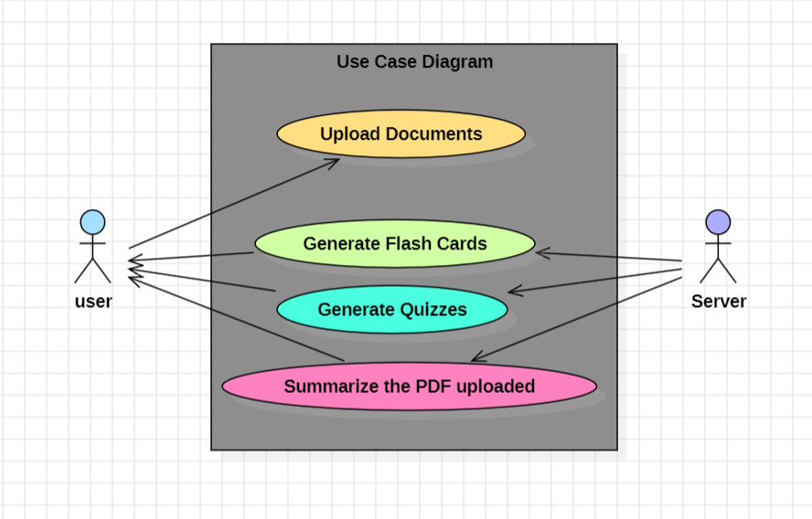
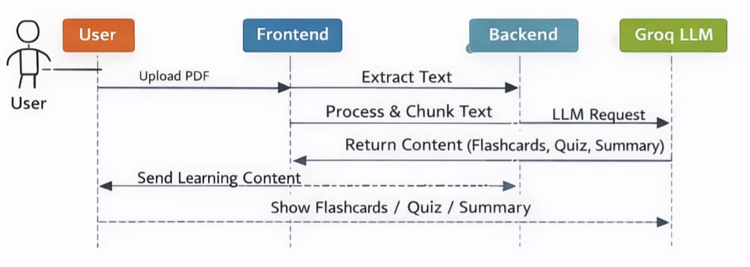
Database Design :
The database is designed using MongoDB and consists of collections for users, documents, flashcards, study schedules, and progress records. This design supports scalability and efficient data retrieval.
Logical Design :
Logical design is represented using use case diagrams, data flow diagrams, and sequence diagrams to illustrate interactions between users and system components.

Slide 13
CONCLUSION
The AI-Powered Study Assistant provides an intelligent and automated learning environment. By integrating AI, NLP, and spaced repetition, the system reduces manual effort, improves learning efficiency, and enhances student understanding, making it a powerful tool for modern education.

Slide 14
Thank You !

