Slide 1
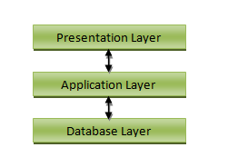
(The top level of the application which is the GUI. Its function is to translate tasks and results to user understandable interfaces.)
(The layer that coordinates the application, makes decisions, evaluations and calculations. It is also the layer that communicates with the database layer through DAL.)
(The layer where the information is stored. The information travels to the upper layers to be processed and to be presented to the user.)

