Slide 1


Slide 2
ONLINE FIRE REPORTING SYSTEM
Here is where your presentation begins

Slide 3
01
Abstract
02
Introduction
A quick summary of the project.
A general overview of the project and its background
Scope & Purpose
Existing System
03
04
Explains what the project includes and what it aims to achieve.
Provides an overview of the current method or system in use, along with its challenges and limitations.
05
06
SOFTWARE REQUIREMENT SPECIFICATION (SRS)
PROPOSED SYSTEM
Explains the new system and how it improves upon the existing one.
Specifies all technical and functional requirements needed to build the system
08
Conclusion
07
Modules
Includes user reporting and admin management functions.
A summary that wraps up the main points and finishes the report.

Slide 4
1.ABSTRACT
The Online Fire Reporting System (OFRS) is a web-based application designed to efficiently manage fire incident reports and coordinate rapid response efforts by dispatching appropriate fire rescue teams. The core objective of OFRS is to provide a centralized and systematic platform for recording, storing, and updating data related to fire emergencies and the corresponding fire department teams.
This system empowers citizens to report fire incidents instantly through an online interface, eliminating delays often associated with traditional reporting methods
OFRS represents a significant step forward in modernizing emergency response systems by leveraging technology to ensure swift communication, data accuracy, and improved resource allocation during critical incidents

Slide 5
INTRODUCTION
Online Fire Reporting System is a web-based application. This application is used to report fire incidents immediately. In Online Fire Reporting System, we use PHP and MySQL database. This is the project which keeps records of Teachers. Online Fire Reporting System has two modules i.e., admin and users.

Slide 6
3. SCOPE
The Online Fire Reporting System (OFRS) is developed as a web-based application, which means it is accessible through any internet-enabled device such as a computer, tablet, or smartphone. The system is designed to allow users—such as citizens, residents, or eyewitnesses—to report fire incidents online in real time from any location.

Slide 7
Fire Department Management: The system allows fire departments to manage incident data, track responses, and update the status of ongoing or resolved cases.
User Accessibility: Anyone can access the system through a web browser without the need to install any additional software
Incident Reporting: Users can submit detailed reports of fire incidents, including the location, severity, and type of fire.
Manual Alerts: Once a fire report is submitted, the system notifies the administrator, who then reviews the report and manually assigns the appropriate fire station or response team based on the location and severity of the incident
Incident Reporting: Users report fire incidents by entering the address in a dedicated address field. A separate description box is provided for additional details, where users can optionally include a link to their location for more accuracy.
Centralized Monitoring:
Offers a unified platform for managing multiple incidents simultaneously

Slide 8
PURPOSE
Online Incident Reporting
Automated Report Generation:
The system allows users to report fire incidents instantly through an online platform.
This reduces response time and eliminates the need for physical reporting, improving emergency handling
The application automatically generates detailed reports of fire incidents.
This helps authorities analyze data quickly and maintain accurate records for future reference

Slide 9
EXISTING SYSTEM

Slide 10
PROBLEMS
Delayed Reporting and Response
No Centralized Record
Keeping
Limited Accessibility
Calls to free phone numbers can be missed or delayed due to busy lines or unavailability of operators
Reports over phone are not systematically recorded, making tracking and follow-up difficult
People without phone access or in noisy /dangerous environments may be unable to report fires promptly
No Data Analytics or Reporting
No feedback Mechanism for Reporters
Limited Accessibility for Hearing Impaired
Lack of recorded data prevents analysis of fire trends, response times, or system improvements.
Callers cannot track the status of their reports or receive follow up information
People who are deaf or have hearing difficulties cannot easily use phone calls to report emergencies

Slide 11

PROPOSED SYSTEM

Slide 12
Accessibility for All Users
People with hearing or speech impairments can now report incidents through text-based forms, not just voice calls.
Location Accuracy
Users can enter the exact address and optionally share a Google Maps link
Faster Incident Reporting
The system can generate reports and analytics based on incident history, helping authorities identify fire-prone areas and allocate resources better.
Resource Allocation
Admin can assign teams manually, and in the future, integrate automatic suggestions.
Incident Tracking and Updates
Documentation and History
Admins can update the status of each report , helping teams and users track progress if needed.
All data is stored in a database with secure access and backup.

Slide 13
4. SOFTWARE REQUIREMENT SPECIFICATION(SRS)

Slide 14
Software Requirement
Server Side
Web Browser
Operating System
Database Server
Server side Language
Web Server
Google Chrome or any compatible browser
Windows or any equivalent OS
MYSQL
PHP5.6 or above version
APACHE

Slide 15
Client Side
Web Browser
Google Chrome or any compatible browser
Operating System
Windows or any equivalent OS

Slide 16
Hardware Configuration
30%
40%
50%
70%
Client Side
RAM
Hard disk
Processor
512 MB
10 GB
1.0 GHz
Server side
RAM
Hard disk
Processor
1 GB
20 GB
2.0 GHz

Slide 17
01
User Module
Users : User can visit the website and report any fire incidents.
Users can also track the fire incident reporting Status.

Slide 18
02
Admin Module

Slide 19
DASHBOARD
Displays a quick overview of recent fire incidents and key statistics to help the admin monitor activity at a glance
REPORTS
Enables the admin to search and view detailed fire incident reports within a selected date range
TEAMS
Allows the admin to manage response teams by adding, updating, or deleting team information as needed
WEBSITE SETTING
Lets the admin update website settings such
as logos, content, and display elements.

Slide 20
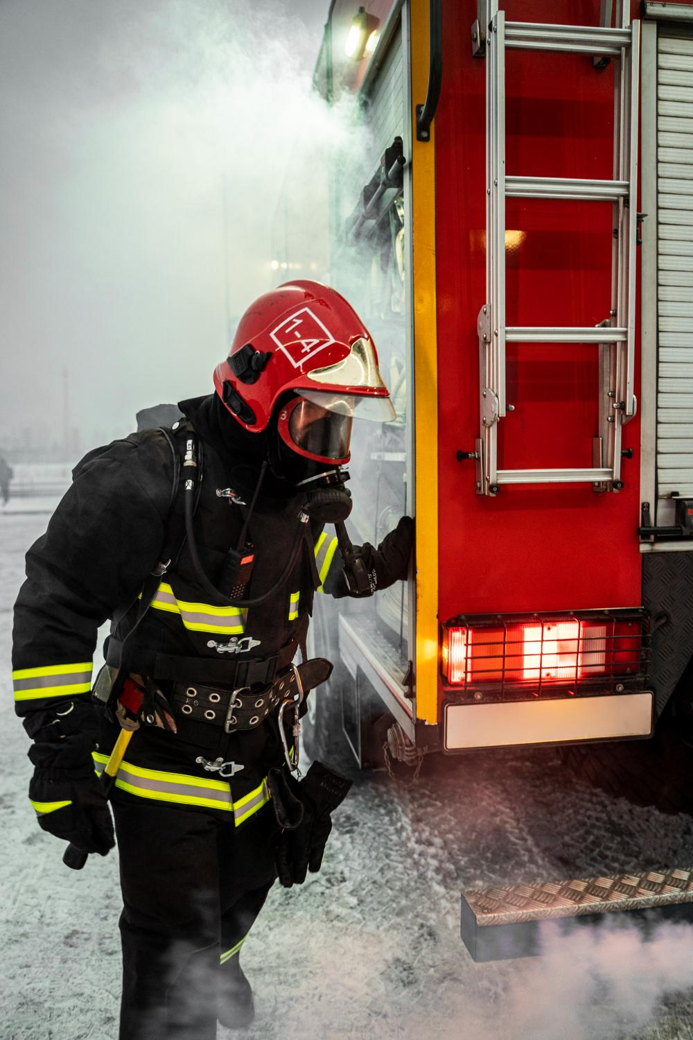
05
Data Flow Diagram

Slide 21
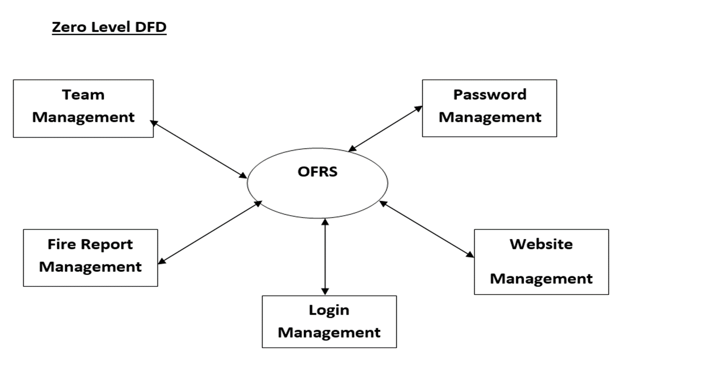

Slide 22
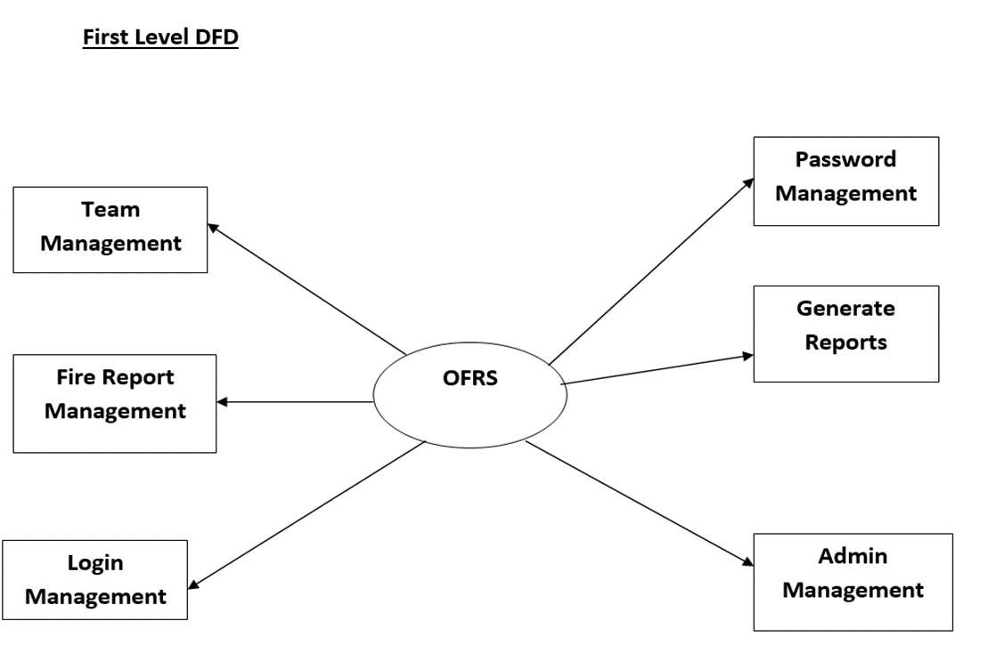

Slide 23
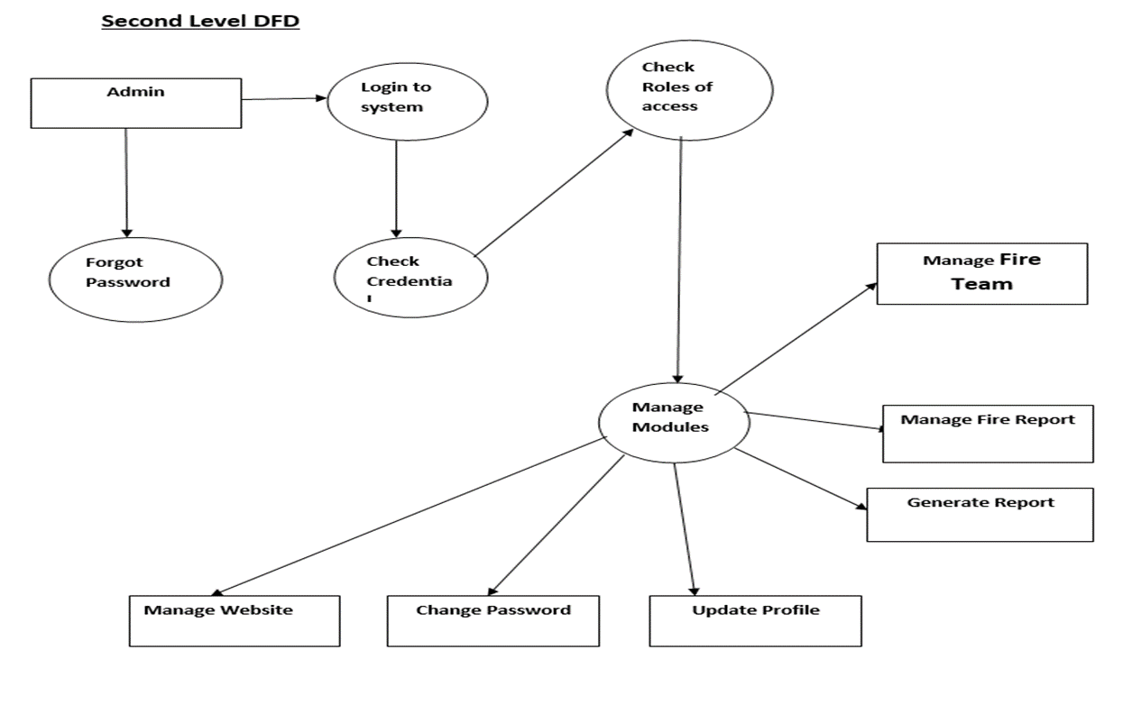

Slide 24
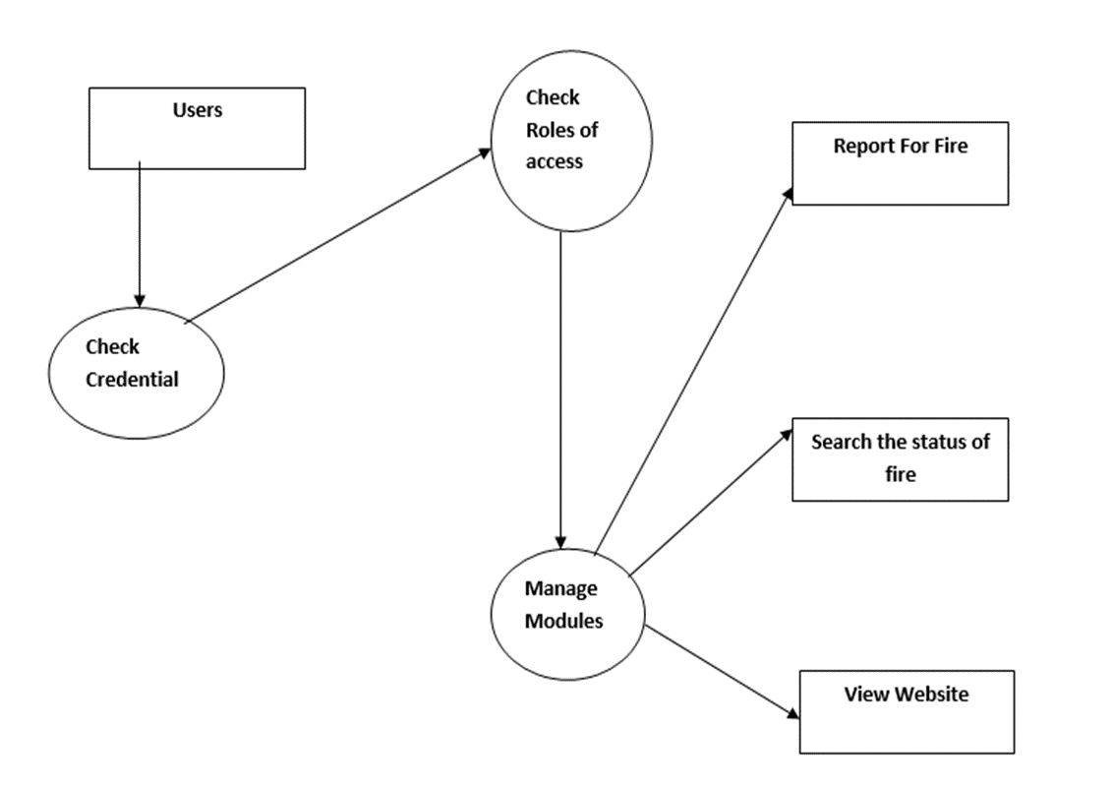

Slide 25
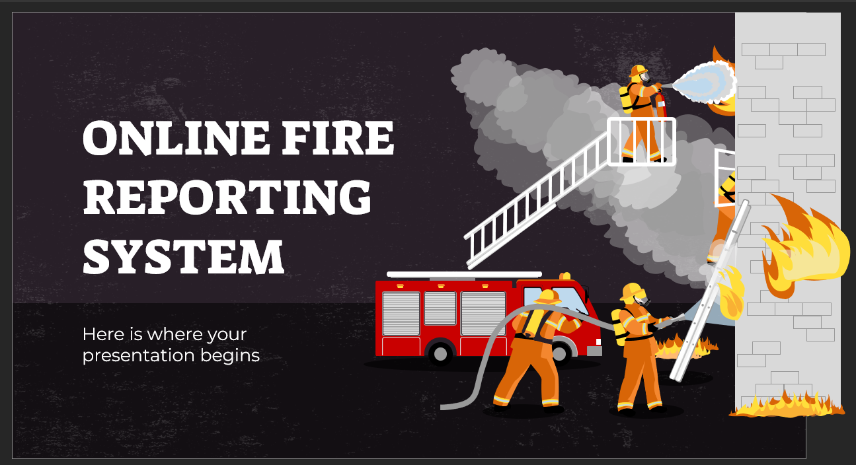

06.CONCLUSION
This Application provides an online version of Online Fire Reporting System which will benefit the fire handling team to maintain fire incidents details and fire team details. It makes entire process online and can generate reports. The Application was designed in such a way that future changes can done easily.

Slide 26
THANKS!
Do you have any questions?
shivalinga2raj@gamil.com
+91 8884266656
S H I V A L I N G A YADAV

