Slide 1


Slide 2
ONLINE FIRE REPORTING SYSTEM
Here is where your presentation begins

Slide 3
01
02
03
04
Abstract
Introduction
A quick summary of the project.
Background and aim of the project.
Scope
SOFTWARE Requirements
What the project will
Cover.
Tools needed for the project.
05
Data Flow Diagram
Conclusion
06
Flow of data within the system.
Key outcomes and final insights.

Slide 4
1.ABSTRACT
The Online Fire Reporting System (OFRS) is a web-based application designed to efficiently manage fire incident reports and coordinate rapid response efforts by dispatching appropriate fire rescue teams. The core objective of OFRS is to provide a centralized and systematic platform for recording, storing, and updating data related to fire emergencies and the corresponding fire department teams.
This system empowers citizens to report fire incidents instantly through an online interface, eliminating delays often associated with traditional reporting methods
OFRS represents a significant step forward in modernizing emergency response systems by leveraging technology to ensure swift communication, data accuracy, and improved resource allocation during critical incidents

Slide 5
INTRODUCTION
Online Fire Reporting System is a web-based application. This application is used to report fire incidents immediately. In Online Fire Reporting System, we use PHP and MySQL database. This is the project which keeps records of Teachers. Online Fire Reporting System has two modules i.e., admin and users.

Slide 6
3. SCOPE
The Online Fire Reporting System (OFRS) is developed as a web-based application, which means it is accessible through any internet-enabled device such as a computer, tablet, or smartphone. The system is designed to allow users—such as citizens, residents, or eyewitnesses—to report fire incidents online in real time from any location.

Slide 7
PURPOSE
Online Incident Reporting
Automated Report Generation:
The system allows users to report fire incidents instantly through an online platform.
This reduces response time and eliminates the need for physical reporting, improving emergency handling
The application automatically generates detailed reports of fire incidents.
This helps authorities analyze data quickly and maintain accurate records for future reference

Slide 8
EXISTING SYSTEM

Slide 9
Fire Department Management: The system allows fire departments to manage incident data, track responses, and update the status of ongoing or resolved cases.
User Accessibility: Anyone can access the system through a web browser without the need to install any additional software
Incident Reporting: Users can submit detailed reports of fire incidents, including the location, severity, and type of fire.
Automated Alerts: Once a fire report is submitted, the system will automatically notify the nearest fire station or team based on location data, helping to minimize response time
Real-Time Communication: Enables quick communication between the reporting person and emergency services, possibly including GPS tracking .
Centralized Monitoring:
Offers a unified platform for managing multiple incidents simultaneously

Slide 10

PROPOSED SYSTEM

Slide 11
Experienced Personnel
Structured Response Protocols
Local Presence
Fire departments are staffed with trained professionals who are skilled in handling emergencies, assessing fire severity, and carrying out rescue operations effectively
Most fire departments follow standardized procedures and protocols to prioritize calls and dispatch teams, which helps in managing resources efficiently.
Fire stations are typically distributed across cities and towns, allowing for physical proximity to potential incident areas, which can help reduce travel time for response teams.

Slide 12
4. SOFTWARE REQUIREMENT SPECIFICATION(SRS)

Slide 13
Software Requirement
Server Side
Web Browser
Operating System
Database Server
Server side Language
Web Server
Google Chrome or any compatible browser
Windows or any equivalent OS
MYSQL
PHP5.6 or above version
APACHE

Slide 14
Client Side
Web Browser
Google Chrome or any compatible browser
Operating System
Windows or any equivalent OS

Slide 15
Hardware Configuration
30%
40%
50%
70%
Client Side
RAM
Hard disk
Processor
512 MB
10 GB
1.0 GHz
Server side
RAM
Hard disk
Processor
1 GB
20 GB
2.0 GHz

Slide 16
01
User Module
Users : User can visit the website and report any fire incidents.
Users can also track the fire incident reporting Status.

Slide 17
02
Admin Module

Slide 18
Location Tracking
Fire Team Dashboard
The system captures the location of the fire using GPS or manual input, ensuring that the fire team can reach the site accurately and quickly
Fire department personnel have access to a dashboard where they can view incoming reports, assign teams, update incident statuses, and track responses in real time
Report Generation
Automated Record Management
The system can generate reports and analytics based on incident history, helping authorities identify fire-prone areas and allocate resources better.
All fire incidents, team dispatch details, and response status are digitally stored and updated in a centralized database, reducing the risk of lost or incomplete data.

Slide 19
DASHBOARD
Displays a quick overview of recent fire incidents and key statistics to help the admin monitor activity at a glance
REPORTS
Enables the admin to search and view detailed fire incident reports within a selected date range
TEAMS
Allows the admin to manage response teams by adding, updating, or deleting team information as needed
WEBSITE SETTING
Lets the admin update website settings such
as logos, content, and display elements.

Slide 20
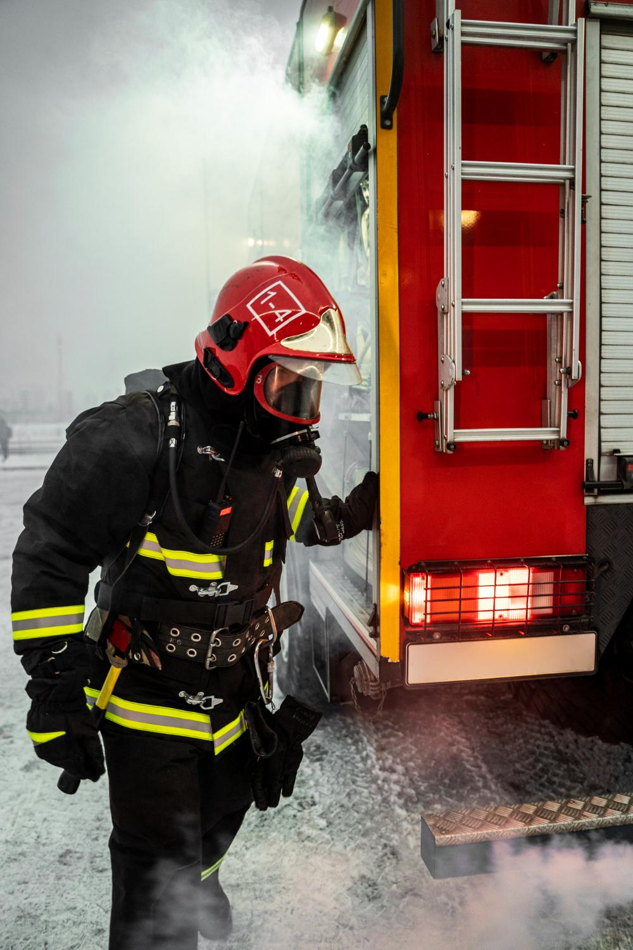
05
Data Flow Diagram

Slide 21
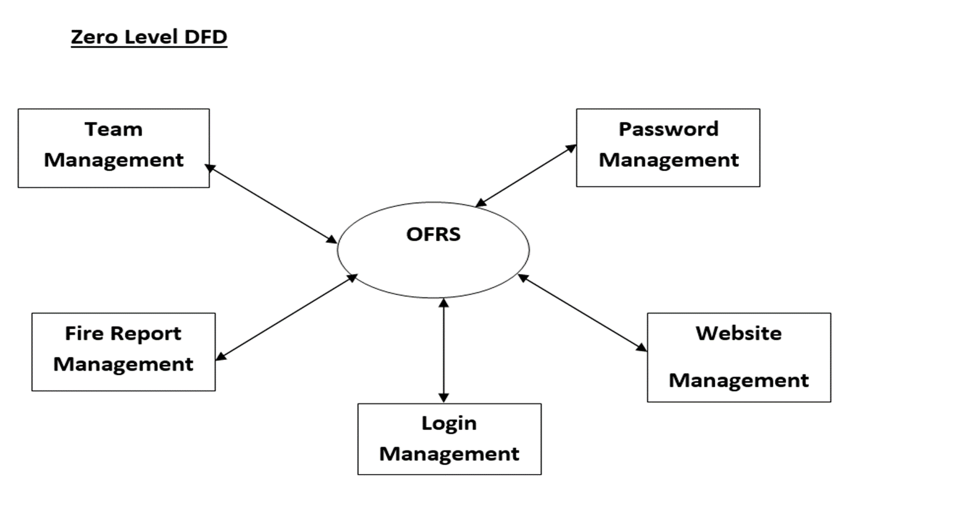

Slide 22
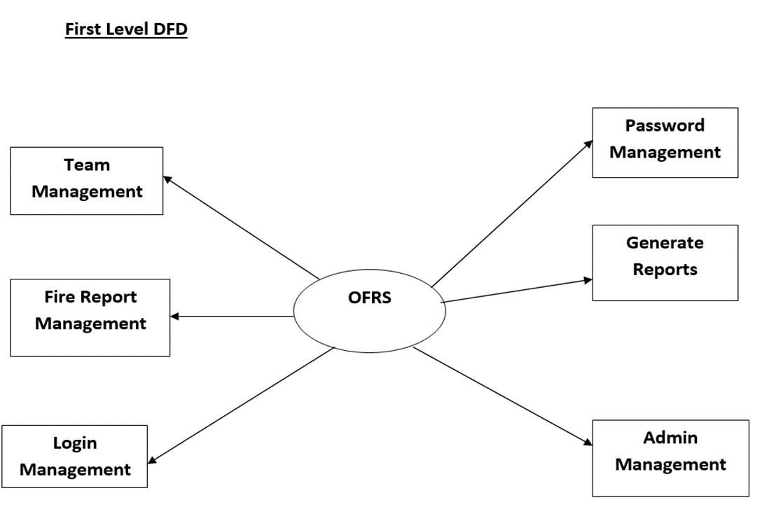

Slide 23
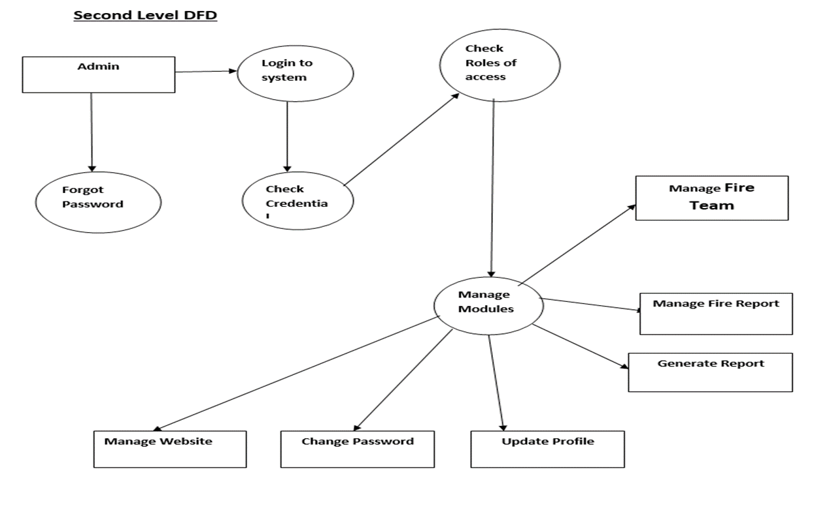

Slide 24
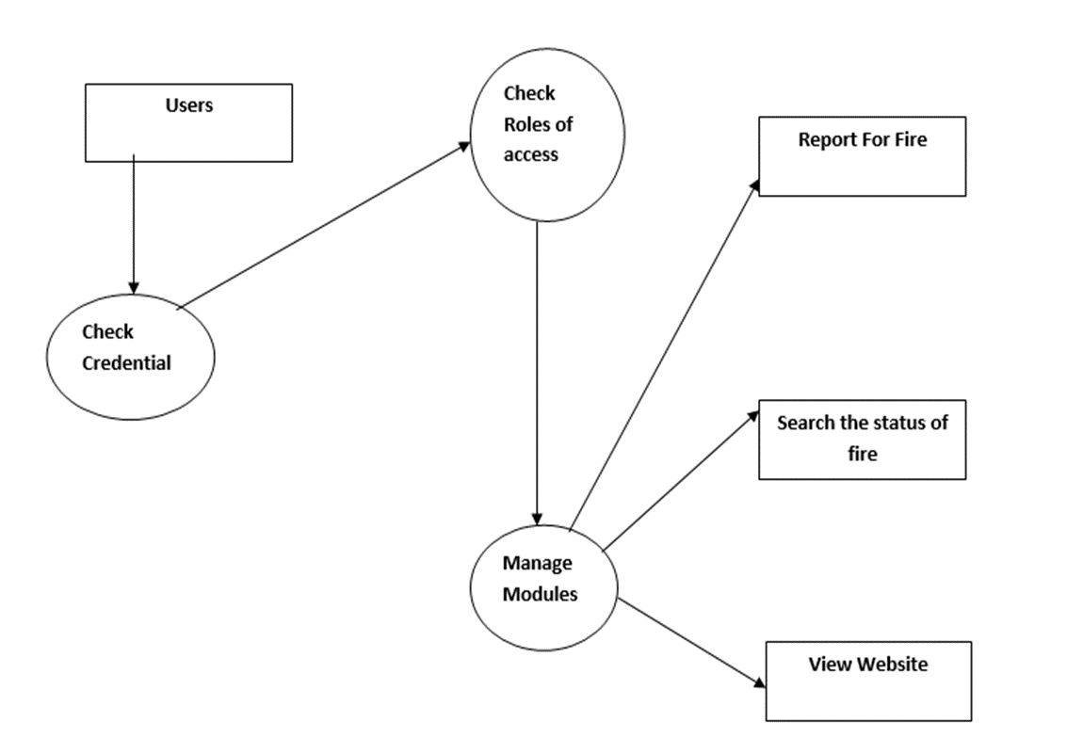

Slide 25
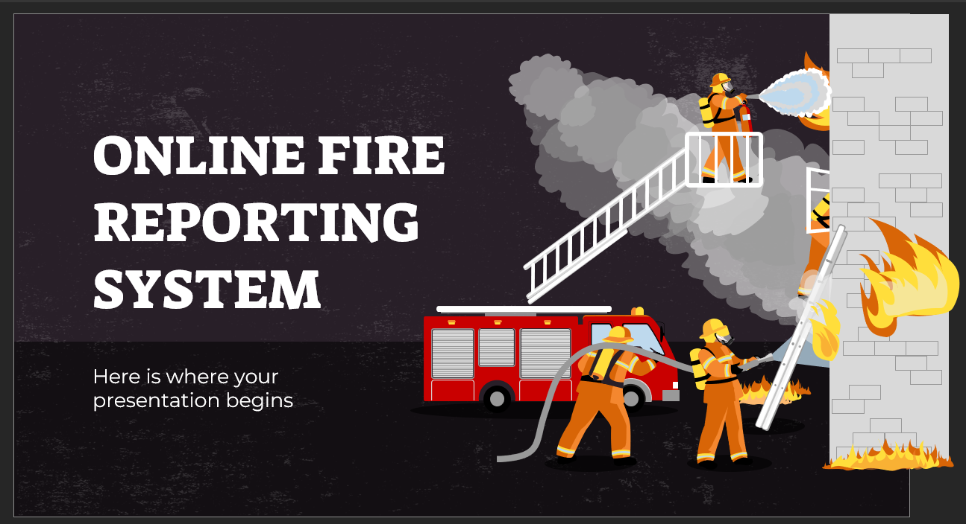

06.CONCLUSION
This Application provides an online version of Online Fire Reporting System which will benefit the fire handling team to maintain fire incidents details and fire team details. It makes entire process online and can generate reports. The Application was designed in such a way that future changes can done easily.

Slide 26
THANKS!
Do you have any questions?
shivalinga2raj@gamil.com
+91 8884266656
S H I V A L I N G A YADAV

