Slide 1
Contact curve based simulation of side chains from two amino acids in a protein molecule
Sanghun jeong, Ku-Jin Kim
School of computer science and engineering
kyungpook national university, korea
Notes:
Good afternoon! My name is Sanghun Jeong from KNU, Korea. I would like to present on this research.

Slide 2
Motivation
Protein molecules have flexibility
Simulating flexible molecules requires heavy computation efforts
Efficient simulating method is needed
We propose an efficient simulation method based on contact curve computation
Notes:
Protein molecules have flexibility. We often need to simulate flexible molecules, where it requires heavy computation efforts.
We propose an efficient simulation method for two flexible amino acids in a protein molecule.

Slide 3
Problem Definition
Find a method to efficiently simulate two flexible amino acids
Assumption
Fixed main chain and rotating side chains
Often used method for simplifying flexibility
Notes:
The problem is defined as finding a method to efficiently simulate two flexible amino acids, under the assumption that the flexibility is implemented by rotating side chains. Actually both main chain and side chain have flexibility, but the flexibility is often simplified by fixing main chains and rotating side chains.

Slide 4
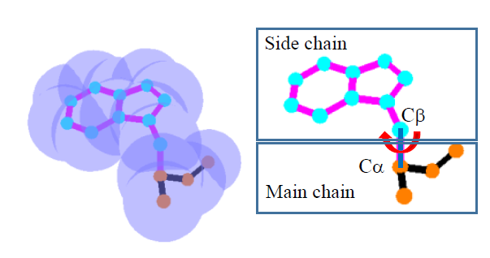
Preliminaries (1)
A protein is composed of amino acids
Amino acids are composed of atoms
Each atom can be represented as van der Waals spheres
Only covalent bonded atoms
have sphere intersections
Covalent bond
atom
Notes:
A protein is composed of amino acids, and amino acids are composed of atoms. Each atom can be represented as van der Waals spheres, and the spheres correspond to two atoms with covalent bond have intersection. There is no sphere intersection when there is no covalent bond between two atoms. In this figure, van der Waals spheres corresponding to atoms are shown. The covalent bond is represented as a line between two atom centers.

Slide 5
Preliminaries (2)
No collision cases
Collision case
atom
Covalent bond
Notes:
When two atoms have covalent bond, then corresponding spheres have an intersection. For this case, this is not considered as collision case. If two spheres do not have an intersection, then they area also considered having no collision. But, if two spheres have an intersection though corresponding atoms having no covalent bond, it causes collision, which must be avoided.

Slide 6
Preliminaries (3)
An amino acid has two parts
Main chain
Side chain
Main chain is fixed
Side chain rotates along the axis
containing centers of Cα and Cβ
Notes:
Every amino acid has two parts, main chain and side chain. Side chain rotates along the axis containing centers of atoms C-alpha and C-beta. Here is an animation showing a rotating side chain.

Slide 7
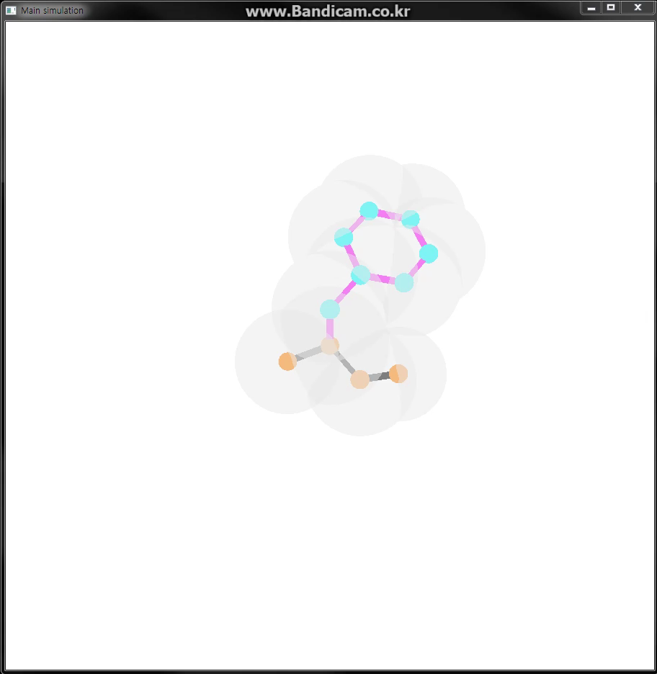
<Rotating side chain animation>

Slide 8
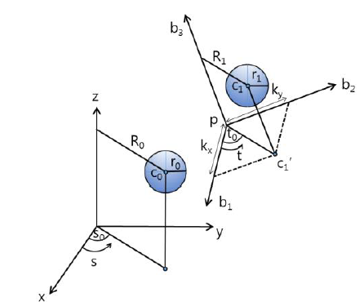
Collision region for two spheres(1)
Center location of rotating spheres A and B
A.c(s) = (R₀ cos (s + s₀), R₀ sin (s + s₀), z₀)
B.c(t) = p + R₁ cos (t + t₀) b₁ + R₁ sin (t + t₀) b₂ + ||c₁ – c₁’|| b3
Notes:
The collision region computation for two rotating spheres is based on the following equations. When center position of sphere A and B are represented as A.c(s) and B.c(t), the equations are like these.

Slide 9
Collision region for two spheres(2)
Case 1: Two spheres at (s*, t*) tangentially contact each other
||A.c(s*) – B.c(t*) ||² = (r₀ + r₁)²
Case 2: Two spheres at (s*, t*) have an intersection each other
||A.c(s*) – B.c(t*) ||² < (r₀ + r₁)²
Case 3: Two spheres at (s*, t*) are apart
||A.c(s*) – B.c(t*) ||² > (r₀ + r₁)²
A.c(s)
B.c(t)
r₀
r₁
A.c(s)
B.c(t)
r₀
r₁
A.c(s)
B.c(t)
r₀
r₁
Notes:
Then, by using the distance between sphere center positions and the radii of those spheres, we can classify three cases when two spheres tangentially contact each other, two spheres intersect each other, and two spheres are apart from each other.

Slide 10
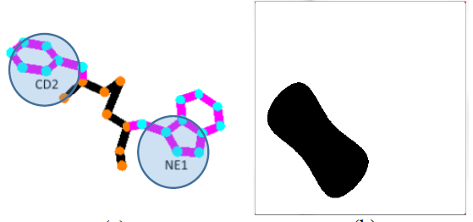
Collision region for two spheres(3)
t
Case 1
Case 2
Case 3
s
Notes:
The center position of two spheres can be represented in (st)-plane like as the right side figure. In this figure, if the center positions corresponds to intersection between two spheres, that is the case 2, the (s,t) position is spotted as a black point.

Slide 11
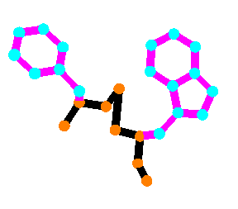
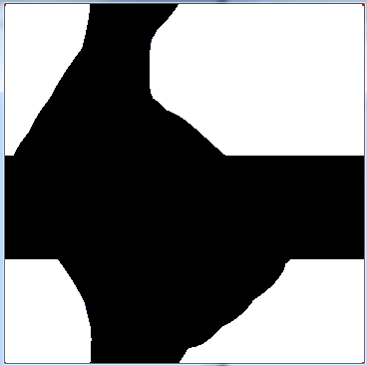
Contact curve for two amino acids (1)
t
Case 1
Case 2
Case 3
s
Notes:
We expand the collision region computing for two amino acids. The collision region in (st)-plane is generated by applying union the collision region for every pair of atoms from different amino acids. The (s,t) position for case 2 represents that two amino acids have intersection. When two amino acids are at (s,t) position at case 3, they are apart from each other. At case 1, two amino acids contact each other at some atom pairs.

Slide 12
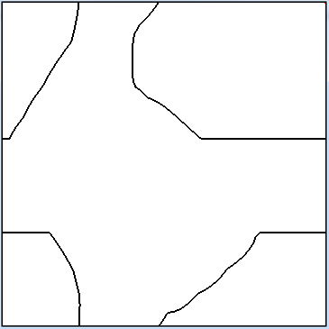
Contact curve for two amino acids (2)
Contact curve
Notes:
We compute the contact curve for two amino acids, by extracting the boundary curve of the collision region.

Slide 13
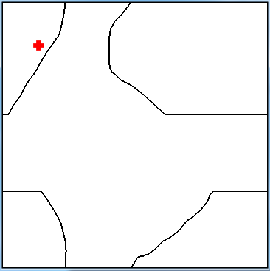
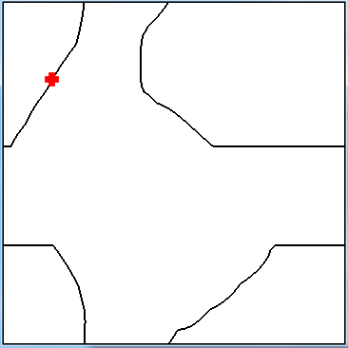
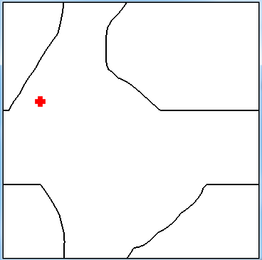
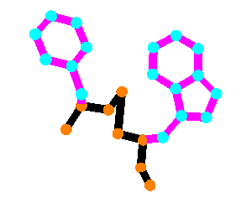
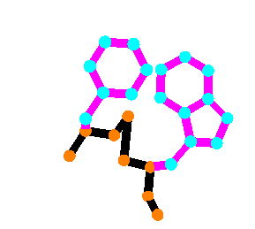
Simulation along contact curve (1)
Notes:
These are examples for the case of two amino acids having no collision, having a tangential contact, and having collisions.

Slide 14
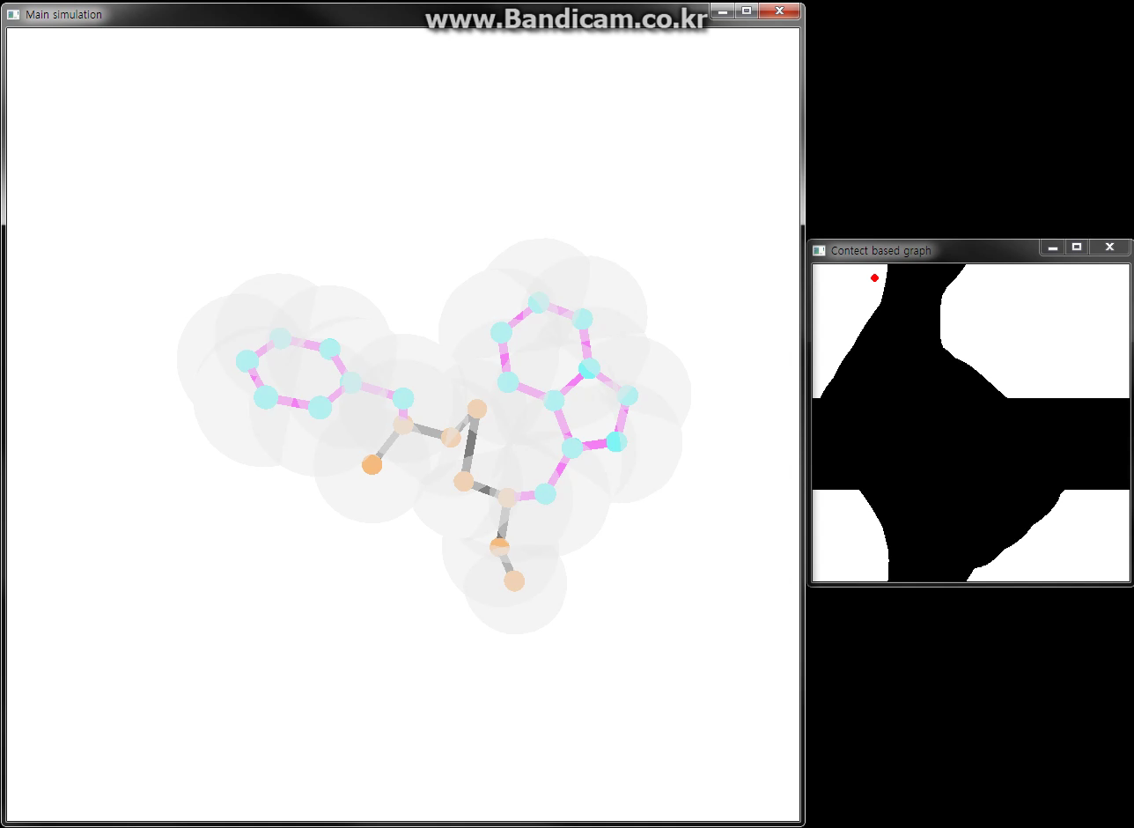
Simulation along contact curve (2)
Notes:
We simulated the movement of two amino acids with rotating side chains by following the (s,t) positions along the contact curve. This animation shows the simulating result. The right side figure is a contact curve for the amino acids of left side. Here is a red point that shows the configuration of the amino acids. The red point starts from here, and it moves to left lower position. According to the movement of the red point, the amino acids are simulated as like this.

Slide 15
Conclusion
Analysis of contact configuration of two amino acids
Computation of the contact curve
Simulation based on the contact curve
Notes:
In this paper, we presented a method to analyze the contact configuration of two amino acids with rotating side chains, and simulated the flexibility of two amino acids by using the contact curve. As a future work, we want to extend our research to the case of three or more amino acids.

Slide 16
Thank you
tkdgns3042@naver.com

