Slide 1

Predictive Modeling for Bitcoin Price Using Traditional Financial Indicators and Data Science Techniques

Slide 2
Research Question
How can traditional financial indicators combined with data science techniques be effectively used to develop a predictive model for Bitcoin prices?
Ladies and gentlemen, thank you for joining me today. I would like to discuss our research question, which is: How can traditional financial indicators combined with data science techniques be effectively used to develop a predictive model for Bitcoin prices? Our goal is to provide investors with more accurate predictions to make more informed decisions when buying or selling Bitcoin.

Slide 3
Background
Cryptocurrency market
Importance of accurate price predictions
Current challenges in predicting Bitcoin prices
Cryptocurrencies, such as Bitcoin, have become increasingly popular over the years. Many investors have started investing in Bitcoin, hoping to buy and sell at the best prices. However, Bitcoin prices can be highly volatile, with prices changing by as much as 10% on any given day. This makes it challenging for investors to predict the prices and make informed decisions. Our project aims to address this issue by developing a predictive model for Bitcoin prices using traditional financial indicators and data science techniques.

Slide 4
Prior Work
Junwei Chen's research comparing random forest regression and LSTM
Rajat Kumar Rathore's research comparing LSTM, ARIMA, and Fbprophet models
Before diving into our research, let's take a look at some prior work in this field. Junwei Chen conducted a study comparing two algorithms for predicting Bitcoin prices: random forest regression and LSTM. Surprisingly, he found that the random forest regression model performed better than LSTM, especially with an increasing amount of Bitcoin transaction history.
Another study conducted by Rajat Kumar Rathore compared LSTM and ARIMA models for predicting Bitcoin prices. He found that LSTM models were difficult to interpret, while ARIMA models were unsuitable for Bitcoin price data. Rathore then developed a new model called Fbprophet, which he found to be superior to both LSTM and ARIMA models.

Slide 5
Hypothesis
Predictive model using financial indicators and machine learning techniques
Refining the model using historical trends and key indicators
Based on the previous research, our hypothesis is that we can develop a predictive model with high accuracy for forecasting Bitcoin prices by analyzing financial indicators extracted from raw transaction data using statistical and machine learning techniques. Furthermore, we believe we can refine and optimize the predictive model by analyzing historical trends and identifying key indicators, such as market sentiment, trading volume, and technological developments.

Slide 6
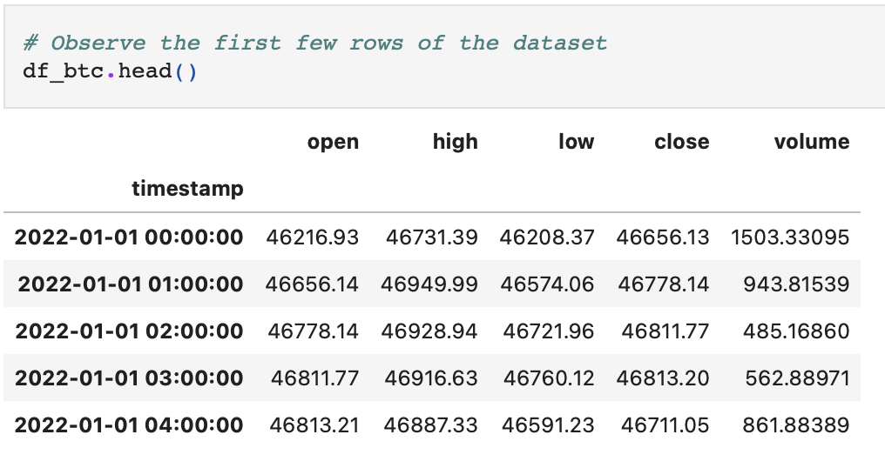
Data
Dataset "df_btc" generated using Binance API
Number of observations: 1534 rows at 2023-03-05 21:00:00
Variables considered: timestamp, open, high, low, close, and volume
For our project, we have identified a real dataset called "df_btc"
generated using the Binance API. This dataset collects data from
January 1st, 2023, up to the present date. It provides several
variables, but we will focus on the most important ones:
timestamp, open, high, low, close, and volume. This will allow our
model to stay up-to-date and provide useful insights for trading
decisions.

Slide 7
Ideal vs Real Datasets
Ideal dataset: Comprehensive and structured data
Real datasets: "df_btc" and "Bitcoin Historical Data" dataset from Kaggle
Ideally, our dataset would be comprehensive and include data from multiple sources. However, due to time and resource constraints, we are using the "df_btc" dataset from Binance API and the "Bitcoin Historical Data" dataset from Kaggle. These datasets provide essential information such as daily opening and closing prices, trading volume, and market cap, which will help us develop our predictive model.

Slide 8
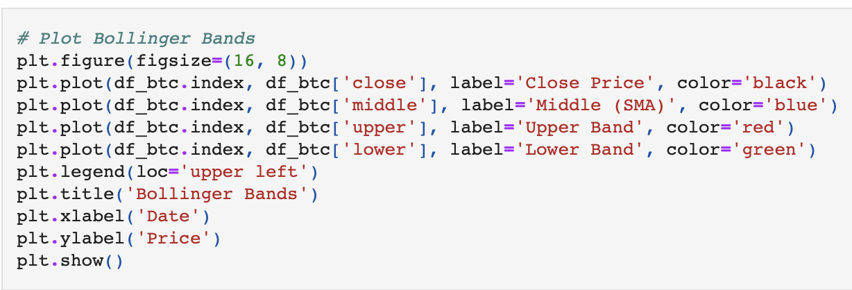
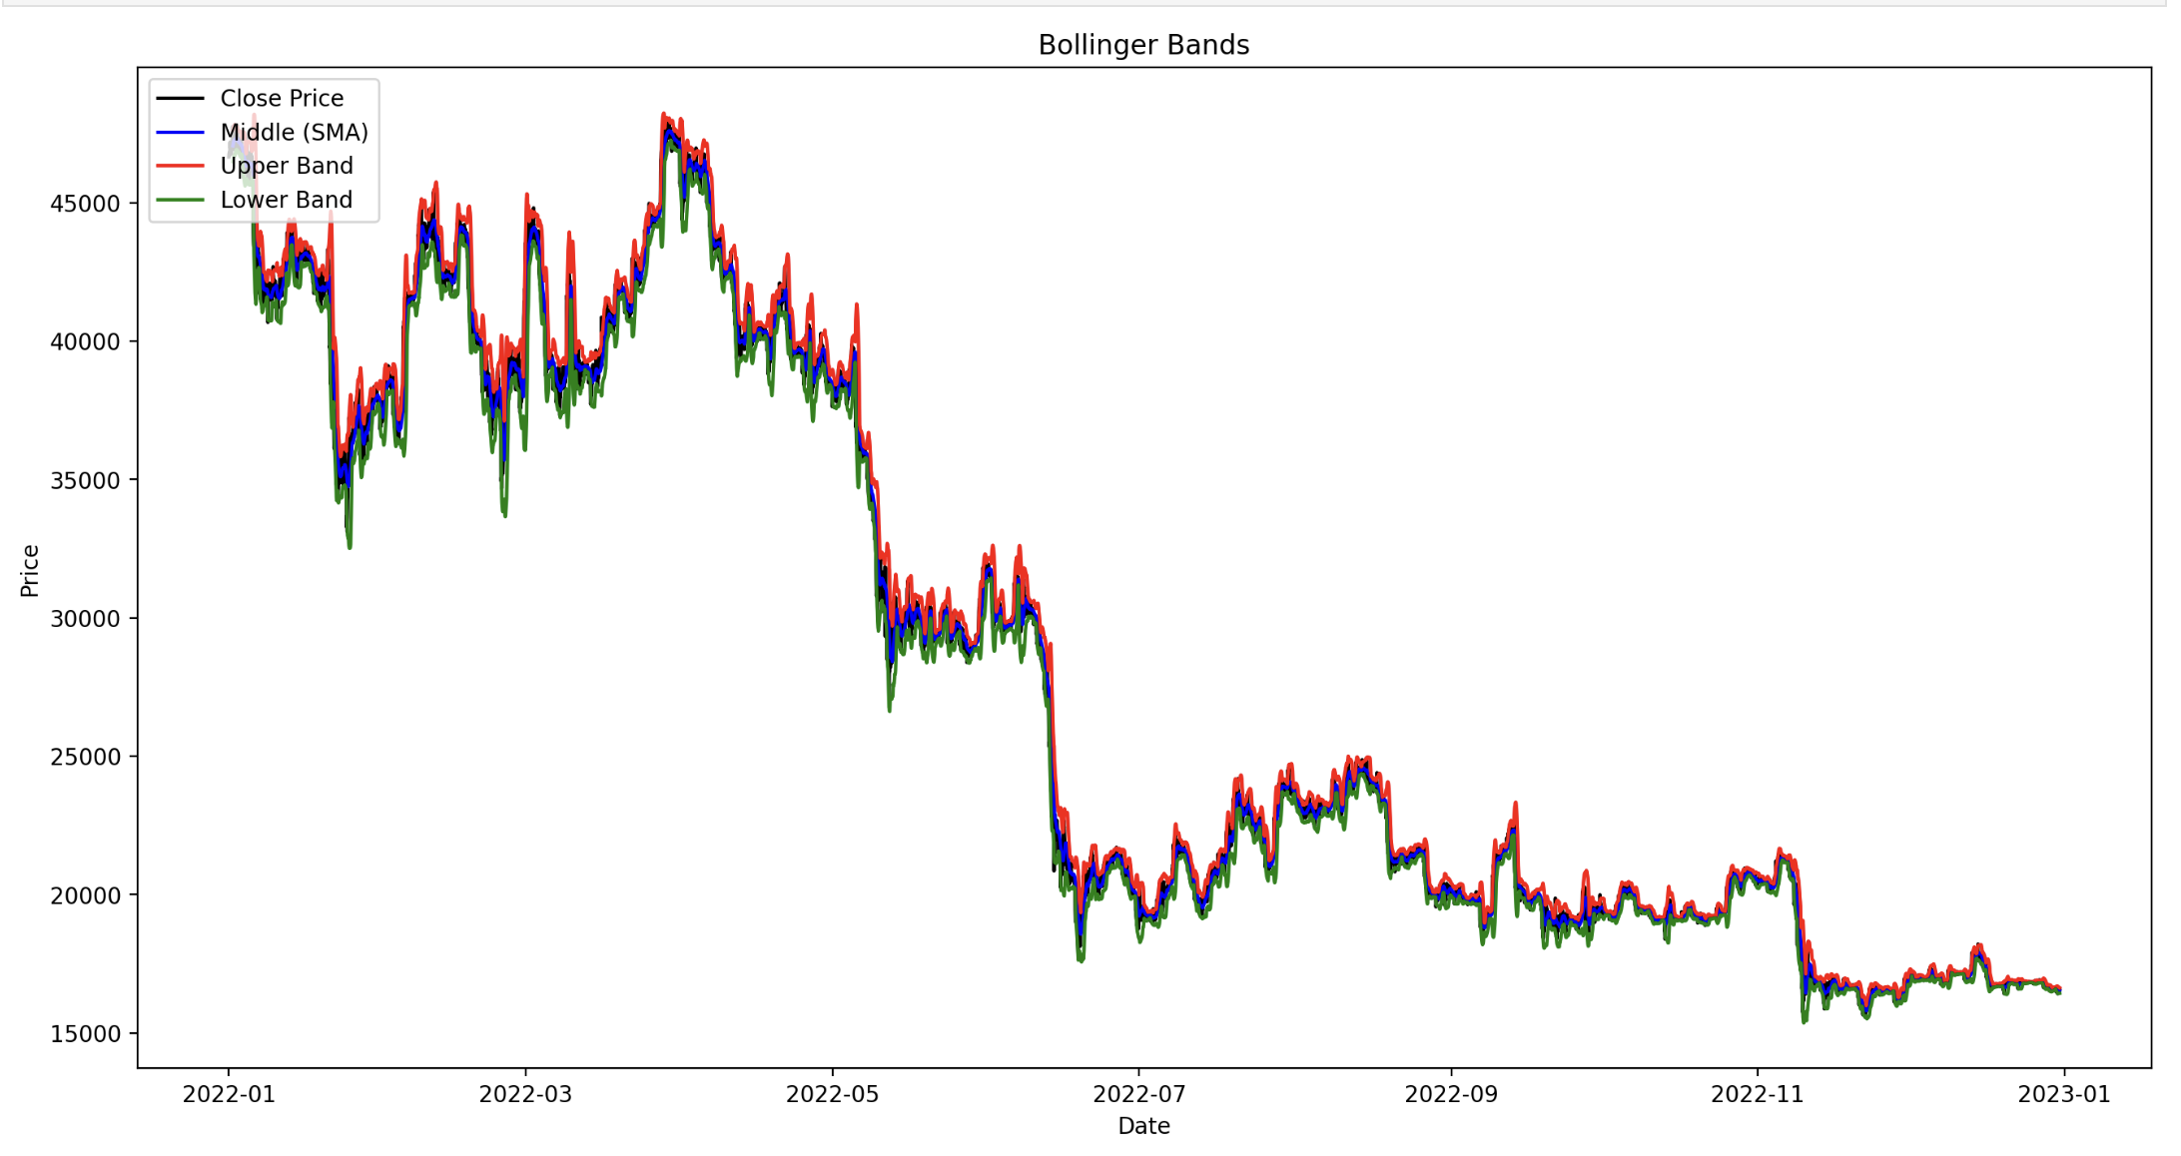
Data analysis
Used BIAS (Buy and Sell) indicator, RSI indicator, Moving Average Convergence Divergence (MACD), and Bollinger Bands indicator to analyze Bitcoin’s price changes and overall trend throughout the year.
These indicators help us predict the best time to buy and sell Bitcoin.
To show how we achieve this, see the code and graph for Bollinger Bands:

Slide 9
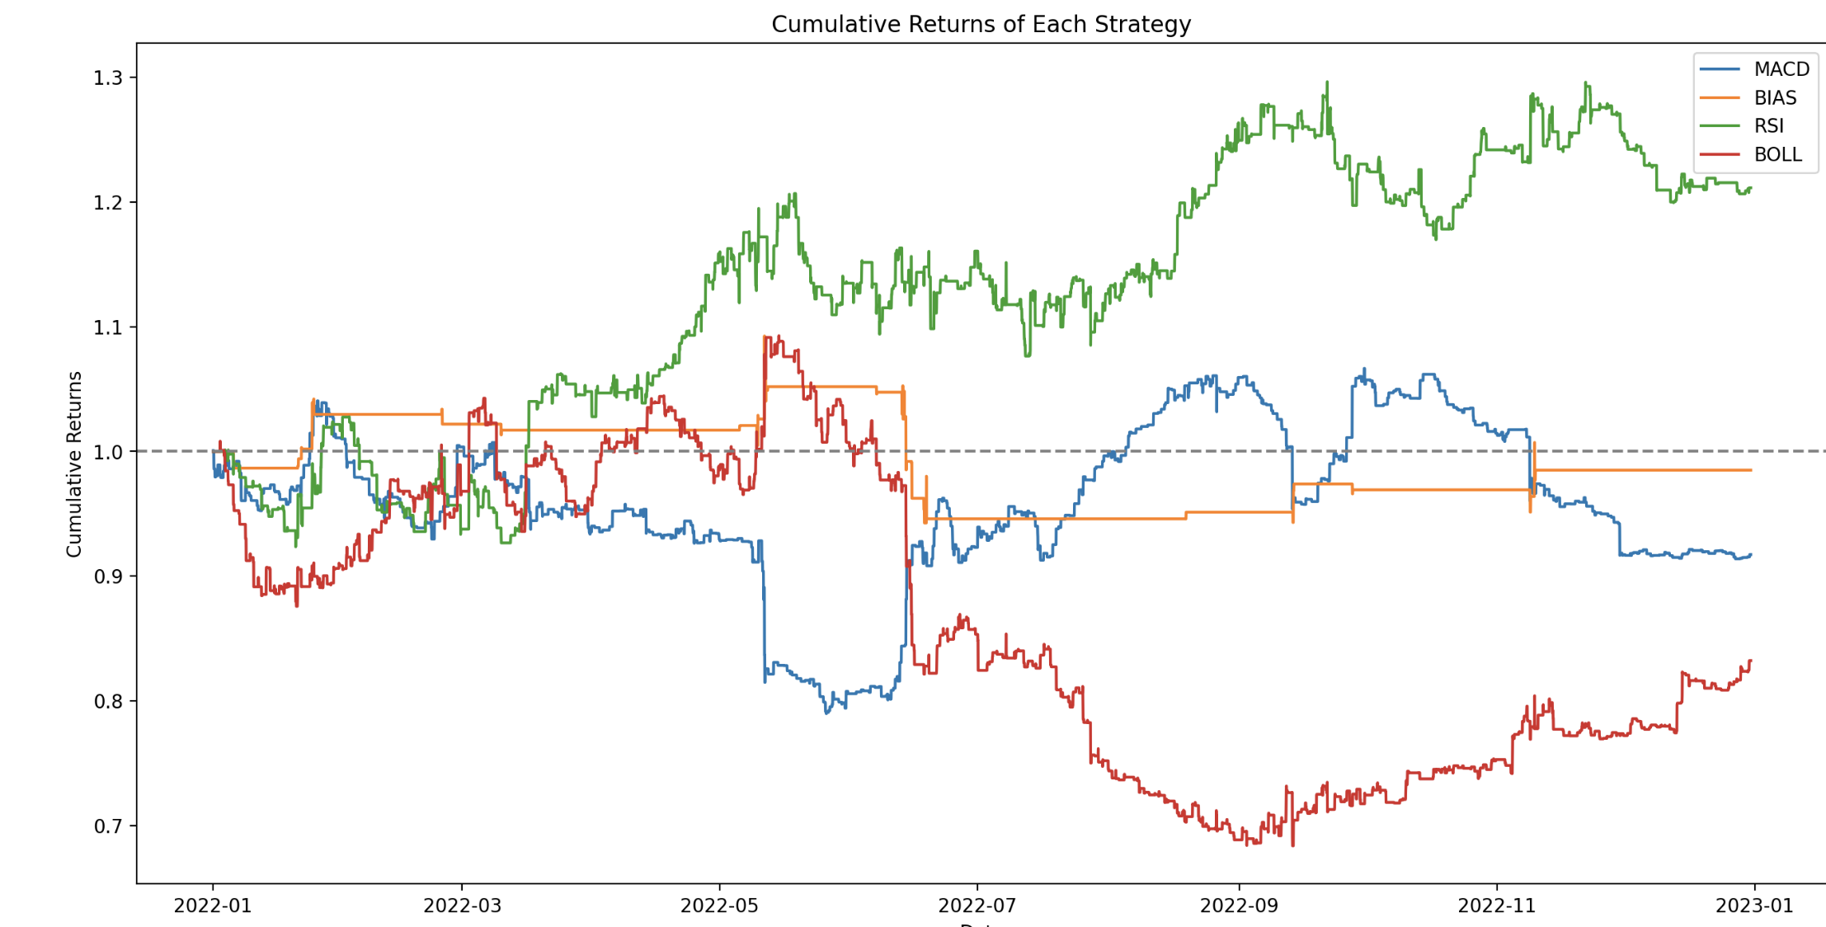
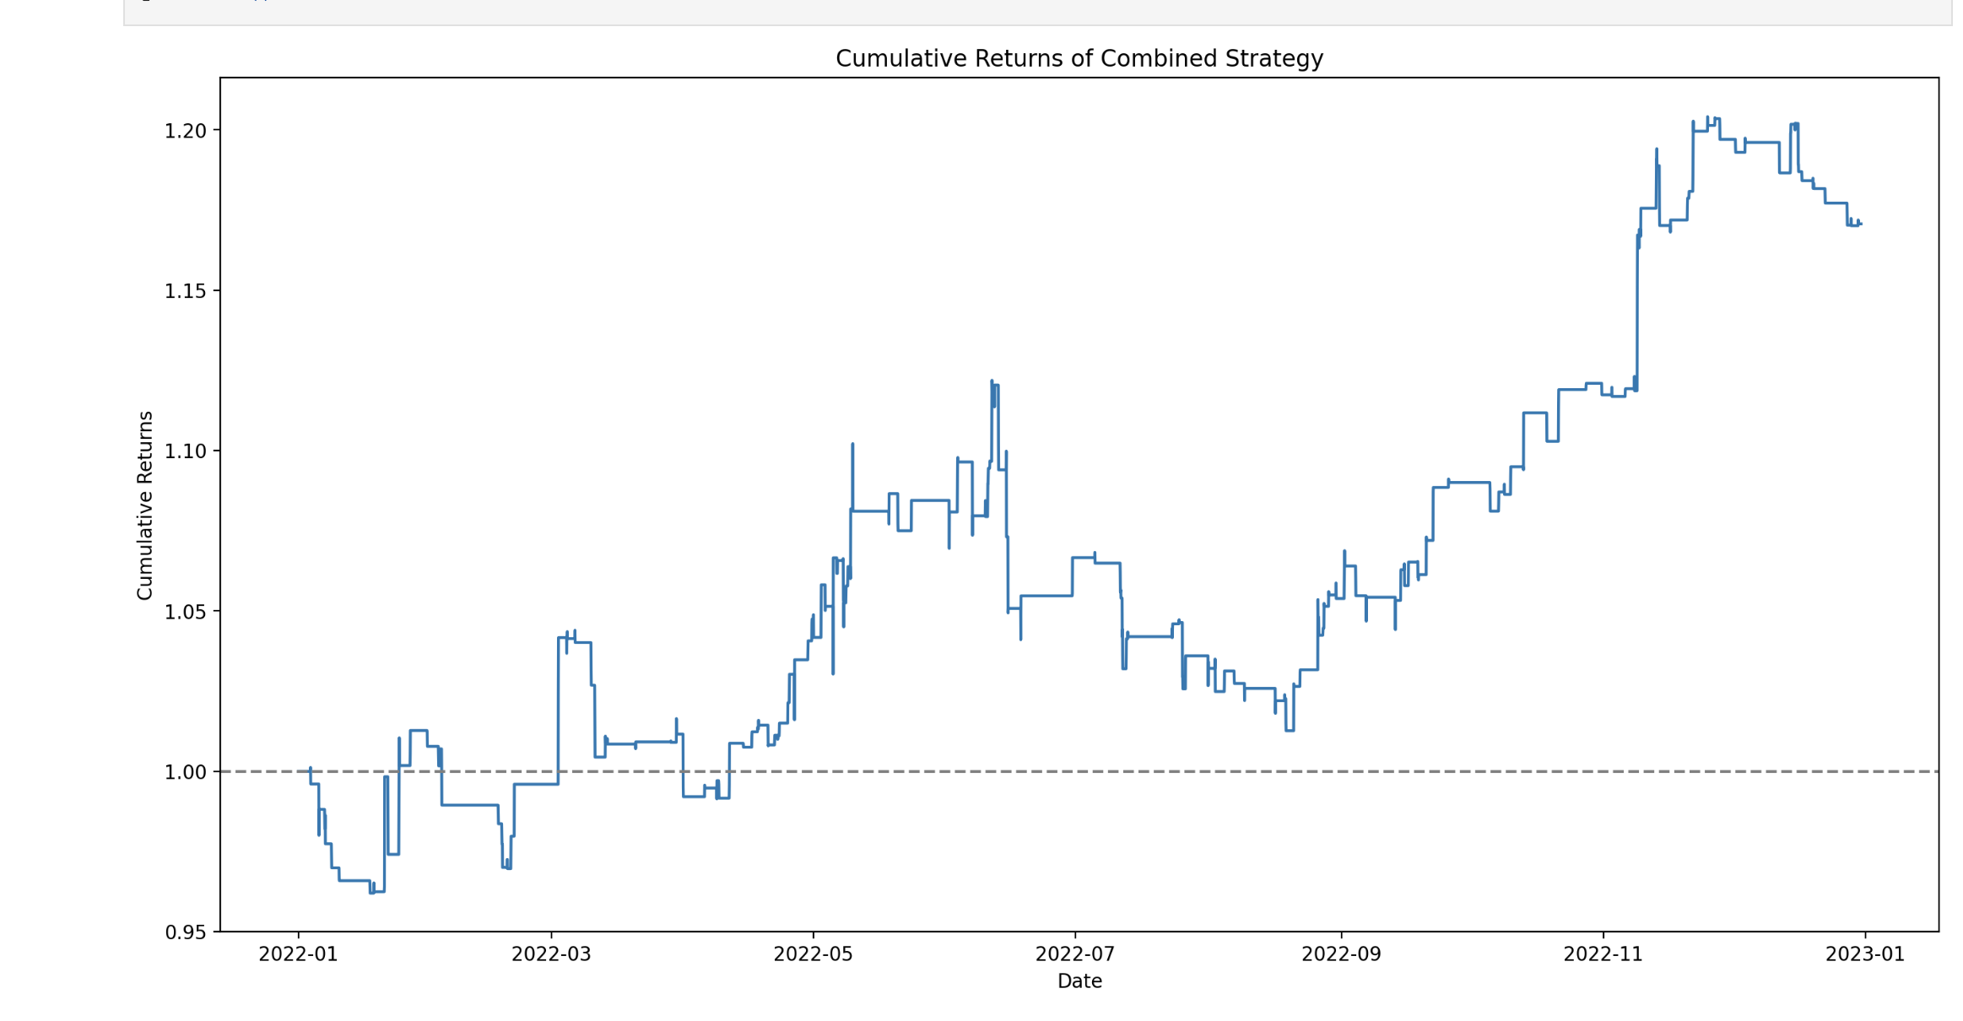
Results

Slide 10
Ethics & Privacy
Informed consent, anonymity, and PII exposure
Potential biases: Binance-specific data, limited factors considered, confirmation bias
Disclaimer for actual use
It is crucial to address the ethical and privacy concerns in our project. We ensure that the data we collect is anonymous, and there is no trading ID associated with each transaction, limiting PII exposure. However, there are potential biases in our data collection and analysis process, such as focusing only on Binance data and considering limited factors. Additionally, we will include a disclaimer in our project to prevent unintended use for actual price prediction.

Slide 11
Conclusion
Developing a predictive model for Bitcoin prices
Importance of accurate predictions for informed investment decisions
Contributions to existing research and potential for further improvements
In conclusion, our project aims to develop a predictive model for Bitcoin prices using traditional financial indicators and data science techniques. By doing so, we hope to we hope to gain a better understanding of the market while practicing our data analysis skills.

