Slide 1
MINI DATA SCIENCE PROJECT
Socioeconomic Factors
& Life Satisfaction
How strongly are income, education, employment, and wealth
associated with life satisfaction?
World Values Survey • Wave 7 (2017–2020) • 96,420 Respondents • 66 Countries
Multiple Linear Regression Analysis

Slide 2
PHASE 1 — RESEARCH QUESTION
What Are We Investigating?
“How strongly are income, education, employment, and wealth
associated with life satisfaction?”
Income
Education
Employment
Wealth
Is higher household income
associated with higher
life satisfaction?
Does educational attainment
relate to how satisfied
people report being?
Does employment status
independently predict
life satisfaction?
Is subjective financial
well-being linked to
overall life satisfaction?
⚠ Important: We study ASSOCIATIONS, not causation. This is observational data.

Slide 3
PHASE 2 — DATASET
World Values Survey — Wave 7
96,420
66
2017–2020
WVS v6.0
Respondents
(after cleaning)
Countries
& Territories
Data Collection
Period
Dataset
Version
Role
Variable
WVS Code
Scale
Dependent Variable
life_satisfaction
Q49
1–10 (1=dissatisfied)
IV — Income
income
Q288
1–10 (HH income decile)
IV — Education
education
Q275
0–8 (ISCED level)
IV — Employment
employment
Q279
1–8 (categorical)
Wealth Proxy A
social_class
Q287
1–5 (subjective class)
Wealth Proxy B
financial_satisfaction
Q50
1–10 (fin. satisfaction)
Control
age / female
Q262/Q260
Continuous / Binary

Slide 4
PHASE 3 — ANALYTICAL APPROACH
Multiple Linear Regression
Life Satisfaction = β₀ + β₁(Income) + β₂(Education) + β₃(Employment) + β₄(Wealth) + ε
Why Multiple Linear Regression?
What the model tells us:
• Examine multiple predictors simultaneously
■ Direction
Positive or negative relationship?
• Hold other variables constant while testing each one
• Quantify strength via standardized coefficients
■ Strength
How large is the association?
• Assess overall model fit (R²)
• Standard approach in well-being research
■ Significance
Is the result unlikely due to chance?
• Life satisfaction (1–10) treated as quasi-continuous
■ Relative
Which factor is strongest?
Key principle: All conclusions use 'associated with' — NOT 'causes'.

Slide 5
PHASE 4 — DATA PREPARATION
Cleaning the Dataset
Raw Dataset
Remove Duplicates
Fix Missing Values
Remove Missing DV
Final Dataset
→
→
→
→
97,220 obs
−94 obs
NaN coded
−506 obs
96,420 obs
Key Preparation Decisions
Missing values
Listwise deletion at regression stage — No imputation
Income is ordinal rank; mean imputation distorts meaning
WVS missing codes
Codes −1 to −5, −99999 converted to NaN
Standard WVS protocol; not real data
Outliers
NONE removed — all IQR flags retained
Scale extremes (1, 10) are valid responses
Log transform
NOT applied to income or wealth
Ordinal scales — log distorts relative spacings
Employment
One-hot encoded — 8 dummies (ref = full-time)
No natural ordering between categories
Education
Treated as ordinal continuous (ISCED 0–8)
Ordered scale; linear term standard

Slide 6
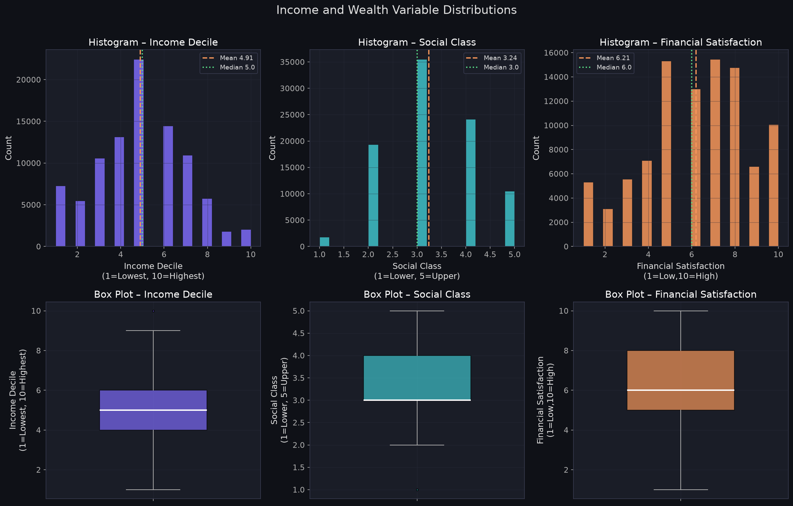
PHASE 4 — DISTRIBUTIONS
Income & Wealth Distributions
Skewness is minimal for all three variables — no log transformation needed (ordinal scales).

Slide 7
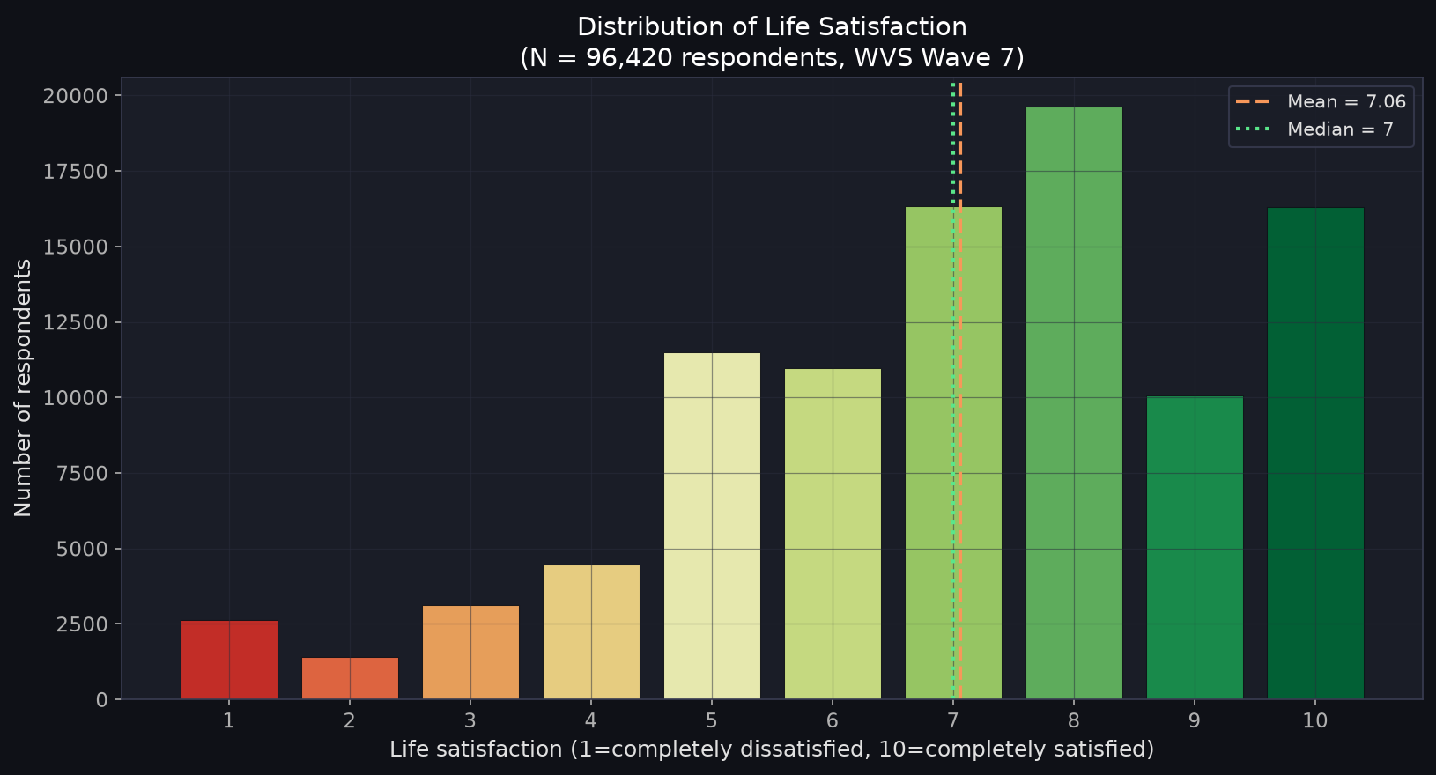
PHASE 8 — ANALYSIS
Life Satisfaction — Our Dependent Variable
Mean
7.06
Median
7.0
Std
2.24
Scale
1 – 10
N
96,420
Distribution is left-skewed:
most respondents report
moderate-to-high satisfaction.
This is typical in global
well-being surveys.

Slide 8
PHASE 8.2 — REGRESSION RESULTS
OLS Regression Model
R²
N
F-stat
SE type
0.320
88,546
2,069***
HC3 Robust
Variable
β (coef)
p-value
95% CI
Sig
Financial satisfaction [wealth B]
+0.518
<0.001
[+0.511, +0.525]
***
Employment: unemployed (vs. full-time)
−0.147
<0.001
[−0.204, −0.090]
***
Employment: student (vs. full-time)
−0.078
0.007
[−0.134, −0.022]
**
Employment: part-time (vs. full-time)
+0.064
0.007
[+0.018, +0.111]
**
Income decile
+0.011
0.006
[+0.003, +0.019]
**
Social class [wealth A]
−0.017
0.046
[−0.033, −0.000]
*
Education (ISCED 0–8)
−0.008
0.031
[−0.014, −0.001]
*
Age
+0.002
<0.001
[+0.001, +0.003]
***
Female
+0.052
<0.001
[+0.026, +0.079]
***
Note: Social class and education show negative signs due to suppression from financial_satisfaction dominating the model. Bivariate associations are positive.

Slide 9
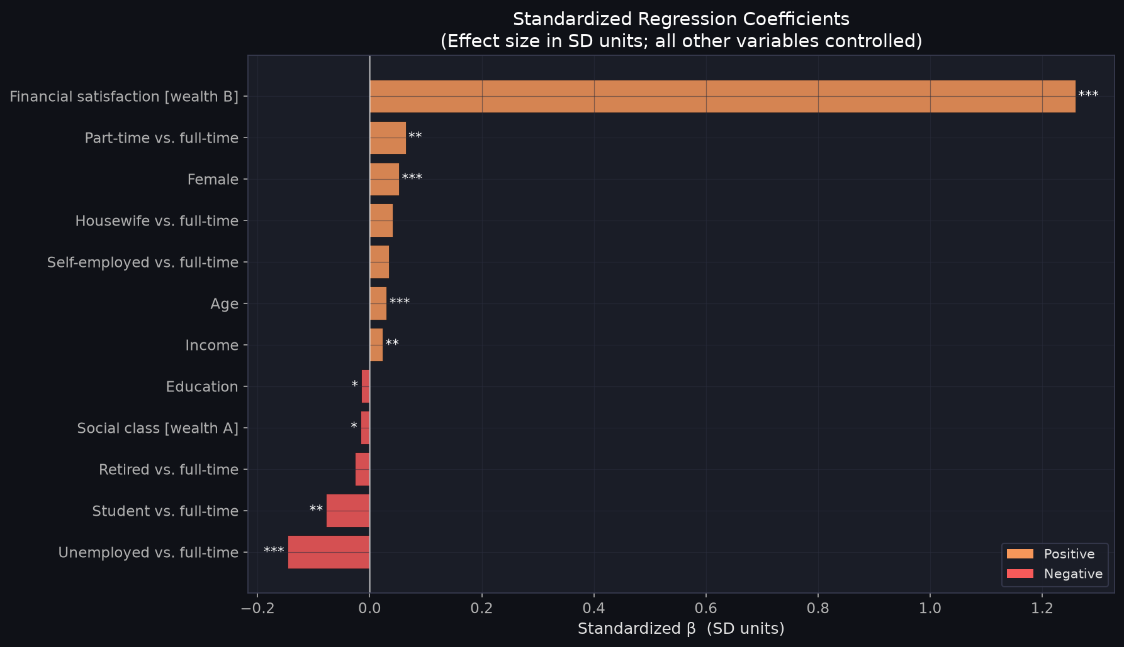
PHASE 8.3 — PREDICTOR COMPARISON
Which Factor Has the Strongest Association?
Standardized β Coefficients
Allow direct comparison across different scales.
"A 1-SD rise in X is associated with β SD change in life satisfaction."
#1
Financial satisfaction β = +1.26
Dominant by far — 13× income
#2
Unemployed penalty β = −0.15
Stronger than income rank
#3
Income β = +0.02
Positive, modest, significant
#4
Education β = −0.015
Small direct effect (suppression)

Slide 10
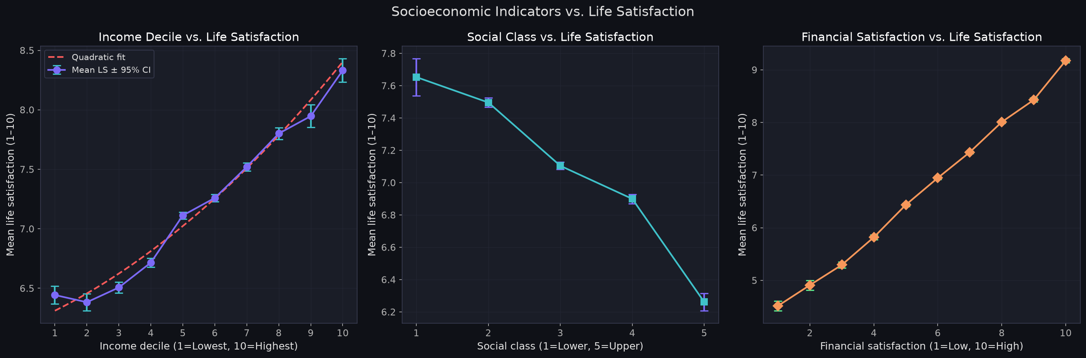
PHASE 8.6 — INCOME RELATIONSHIP
Income & Wealth vs. Life Satisfaction
Income range: mean LS = 6.38 (lowest decile) to 8.33 (highest) — a 1.95-point spread on the 10-point scale. | Relationship is approximately linear; slight acceleration at higher deciles.

Slide 11
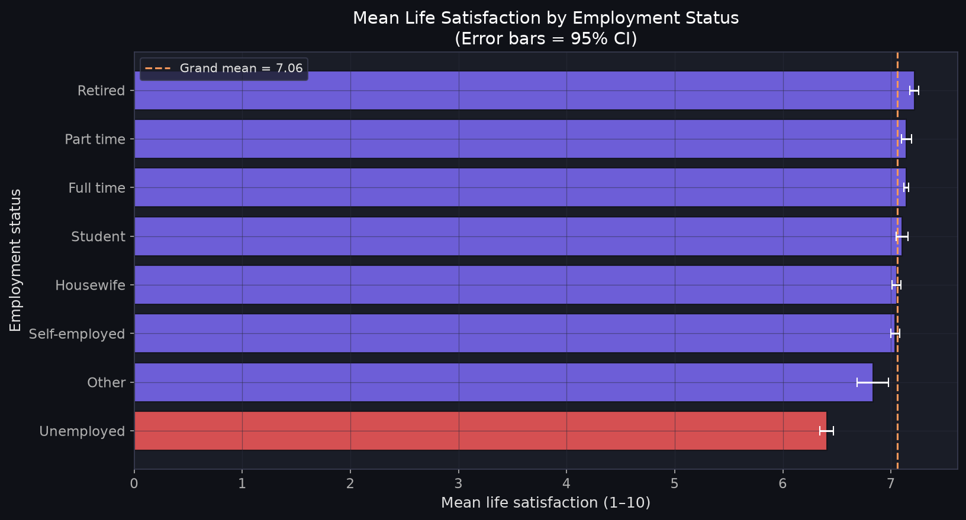
PHASE 8 — EMPLOYMENT ANALYSIS
Employment Status vs. Life Satisfaction
Key Takeaways
• Unemployed have the lowest mean LS
• Unemployment β = −0.147 (p<0.001)
• This is 13× larger than the income β
• Effect holds AFTER controlling for income
• Suggests employment provides well-being beyond income (purpose, identity, connection)
• Reverse causality possible — low satisfaction may reduce employment

Slide 12
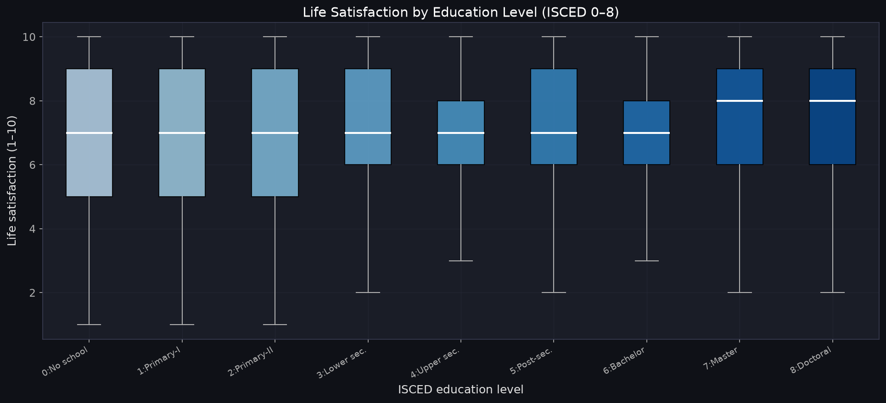
PHASE 8 — EDUCATION ANALYSIS
Education vs. Life Satisfaction
Key Takeaways
• Higher education linked to higher LS in raw data
• Bivariate: positive association
• Controlled β = −0.008 — sign flips
• This is a suppression effect from financial_satisfaction
• Education's effect partly operates through income & social class
• Direct effect is real but smaller after controlling other factors

Slide 13
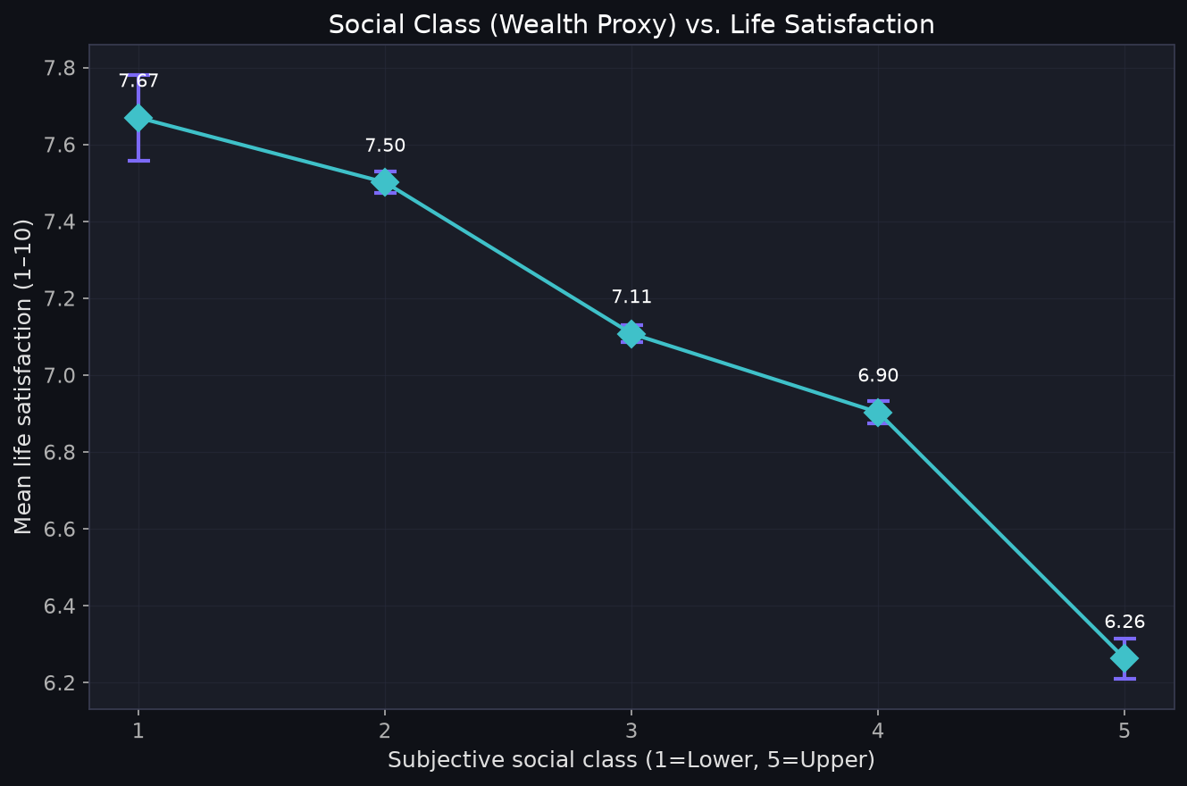
PHASE 8 — WEALTH ANALYSIS
Wealth (Financial Well-Being) vs. Life Satisfaction
Key Takeaways
• Strongest predictor in entire model
• β = +0.518, β_std = +1.26 (p<0.001)
• Adding wealth proxies: R² jumps from 0.046 to 0.320 (ΔR²=+0.274)
• HOW WELL people feel about finances matters more than their income rank
• Caution: reverse causality risk — happier people may rate finances better
• WVS has no direct monetary wealth measure; proxies used

Slide 14
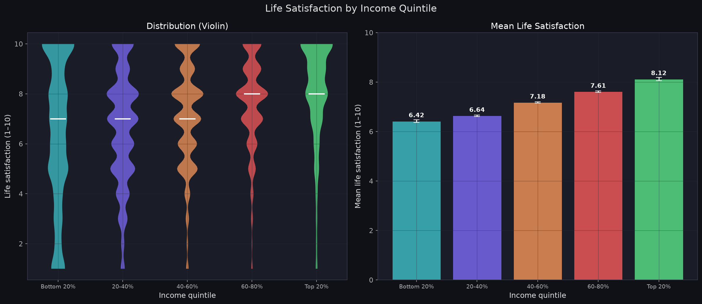
PHASE 8.7 — GROUP ANALYSIS
Life Satisfaction Across Income Quintiles
ANOVA Results
F = 999.92, p < 0.001
All quintile pairs significantly
different (Tukey HSD)
Mean LS by Quintile:
Bottom 20%
6.42
20–40%
6.64
40–60%
7.18
60–80%
7.61
Top 20%
8.12
Top vs. Bottom gap:
1.70 points

Slide 15
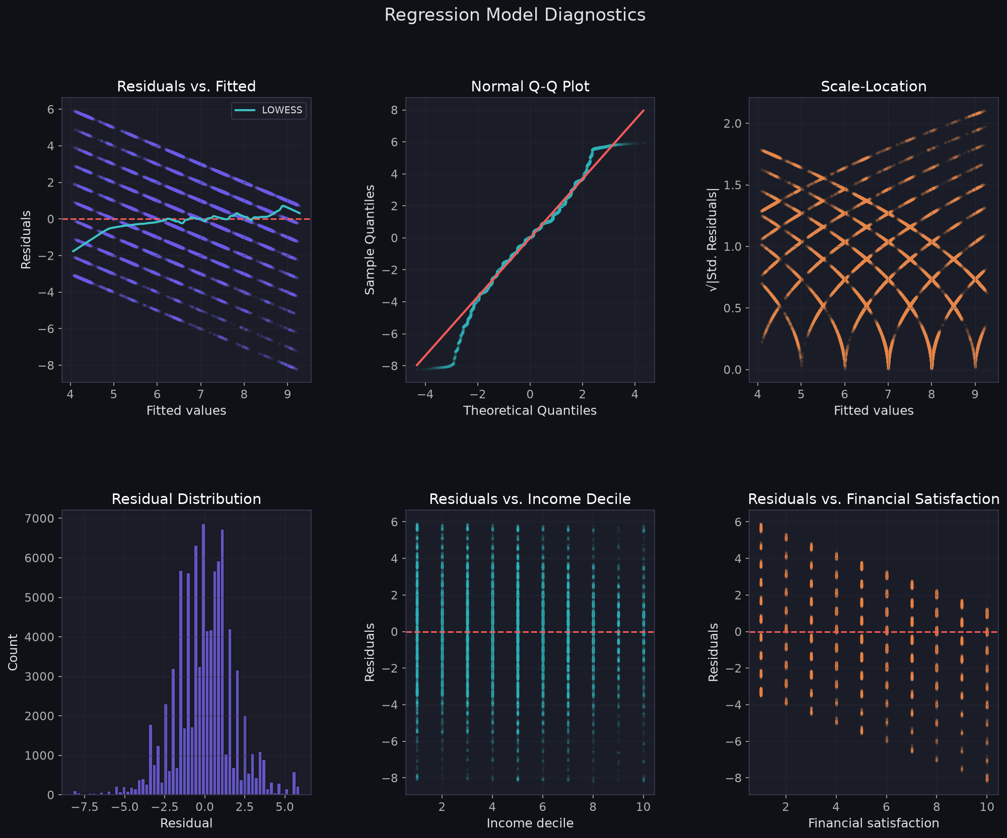
PHASE 8.5 — MODEL DIAGNOSTICS
Checking Model Assumptions
Diagnostic Summary
● VIF
All < 2.0 — No multicollinearity
● Linearity
Mild curvature at extremes — acceptable for bounded scale
● Normality
S-W rejects (large N) — Q-Q visually acceptable
● Homoscedasticity
Mild heteroscedasticity — addressed by HC3 robust SE
● Influence
N=88,546 — no single influential point
VERDICT: Assumptions reasonably met for
large-sample survey regression.

Slide 16
PHASE 8.9 — KEY FINDINGS
What the Data Tells Us
1
Financial well-being is the dominant predictor
β_std = +1.26 — Adding wealth proxies raises R² from 0.046 to 0.320 (ΔR² = +0.274)
2
Unemployment carries a well-being penalty beyond income
β = −0.147 — 13× larger than income coefficient — independent of income
3
Income is positively but modestly associated
β = +0.011 — Mean LS rises 6.38 → 8.33 across income deciles
4
Education's direct effect is partially mediated
Bivariate: positive. Controlled: small (operates via income & social class)
5
Socioeconomic factors explain ~32% of variance
R² = 0.320 — Remaining ~68% = personality, health, relationships, culture

Slide 17
CONCLUSION
Answering the Research Question
“How strongly are income, education, employment, and wealth
associated with life satisfaction?”
WEALTH
+1.26 β_std
Dominant factor — subjective financial well-being far outweighs income rank
EMPLOYMENT
−0.147 β
Unemployment penalizes satisfaction independently of income
INCOME
+0.023 β_std
Positively associated but modest; 1.95-point LS spread across deciles
EDUCATION
Partial
Direct effect smaller; partly mediated through income & social class
Together: R² = 0.32 — Socioeconomic factors explain ~32% of life satisfaction. The remaining ~68% lies in personality, health, relationships, culture, and meaning.

Slide 18
LIMITATIONS
What We Cannot Conclude
No Causation
This is cross-sectional observational data. We measure associations, not causes. "Higher income causes happiness" cannot be concluded.
Reverse Causality
Financial satisfaction may reflect life satisfaction rather than predict it. Happy people may rate finances more positively.
Country Effects
66 countries are pooled without fixed effects. Between-country differences (culture, GDP) are unmodelled.
No Direct Wealth
WVS Wave 7 has no monetary wealth variable. We used subjective proxies (social class, financial satisfaction).
Omitted Variables
Health and relationships are known strong predictors of well-being but are not in this model.

