Slide 1
MINI DATA SCIENCE PROJECT
Socioeconomic Factors
& Life Satisfaction
How strongly are income, education, employment, and wealth
associated with life satisfaction?
World Values Survey • Wave 7 (2017–2020) • 96,420 Respondents • 66 Countries
Multiple Linear Regression Analysis
Notes:
Good morning, everyone. Today, we are presenting our Mini Data Science Project entitled 'Socioeconomic Factors and Life Satisfaction.'
A common assumption is that higher socioeconomic status automatically means higher happiness. In this project, we put that assumption to the test using empirical data from the World Values Survey Wave 7, analyzing over 96,000 individuals across 66 countries through Multiple Linear Regression.

Slide 2
PHASE 1 — RESEARCH QUESTION
What Are We Investigating?
“How strongly are income, education, employment, and wealth
associated with life satisfaction?”
Income
Education
Employment
Wealth
Is higher household income
associated with higher
life satisfaction?
Does educational attainment
relate to how satisfied
people report being?
Does employment status
independently predict
life satisfaction?
Is subjective financial
well-being linked to
overall life satisfaction?
⚠ Important: We study ASSOCIATIONS, not causation. This is observational data.
Notes:
Our core research question is: 'How strongly are income, education, employment, and wealth associated with life satisfaction?'
We investigate four specific objectives: Income, Education, Employment, and Wealth. Importantly, because we are analyzing observational survey data, we are strictly studying statistical associations, not asserting direct causation.

Slide 3
PHASE 2 — DATASET
World Values Survey — Wave 7
96,420
66
2017–2020
WVS v6.0
Respondents
(after cleaning)
Countries
& Territories
Data Collection
Period
Dataset
Version
Role
Variable
WVS Code
Scale
Dependent Variable
life_satisfaction
Q49
1–10 (1=dissatisfied)
IV — Income
income
Q288
1–10 (HH income decile)
IV — Education
education
Q275
0–8 (ISCED level)
IV — Employment
employment
Q279
1–8 (categorical)
Wealth Proxy A
social_class
Q287
1–5 (subjective class)
Wealth Proxy B
financial_satisfaction
Q50
1–10 (fin. satisfaction)
Control
age / female
Q262/Q260
Continuous / Binary
Notes:
We used the World Values Survey Wave 7 (2017–2020), one of the most reputable cross-national surveys globally. After cleaning, our working sample has 96,420 respondents across 66 countries.
Dependent variable: Life Satisfaction (1-10).
Predictors: Income decile (1-10), Education (ISCED), Employment (8 categories), and Wealth proxies (Subjective Social Class and Financial Satisfaction), controlling for age and sex.

Slide 4
PHASE 3 — ANALYTICAL APPROACH
Multiple Linear Regression
Life Satisfaction = β₀ + β₁(Income) + β₂(Education) + β₃(Employment) + β₄(Wealth) + ε
Why Multiple Linear Regression?
What the model tells us:
• Examine multiple predictors simultaneously
■ Direction
Positive or negative relationship?
• Hold other variables constant while testing each one
• Quantify strength via standardized coefficients
■ Strength
How large is the association?
• Assess overall model fit (R²)
• Standard approach in well-being research
■ Significance
Is the result unlikely due to chance?
• Life satisfaction (1–10) treated as quasi-continuous
■ Relative
Which factor is strongest?
Key principle: All conclusions use 'associated with' — NOT 'causes'.
Notes:
We used Multiple Linear Regression (OLS) to estimate the unique association of each socioeconomic predictor while holding all other factors constant.
Here is our model formula. To safeguard against heteroscedasticity, all standard errors and hypothesis tests were estimated using HC3 robust standard errors.

Slide 5
PHASE 4 — DATA PREPARATION
Cleaning the Dataset
Raw Dataset
Remove Duplicates
Fix Missing Values
Remove Missing DV
Final Dataset
→
→
→
→
97,220 obs
−94 obs
NaN coded
−506 obs
96,420 obs
Key Preparation Decisions
Missing values
Listwise deletion at regression stage — No imputation
Income is ordinal rank; mean imputation distorts meaning
WVS missing codes
Codes −1 to −5, −99999 converted to NaN
Standard WVS protocol; not real data
Outliers
NONE removed — all IQR flags retained
Scale extremes (1, 10) are valid responses
Log transform
NOT applied to income or wealth
Ordinal scales — log distorts relative spacings
Employment
One-hot encoded — 8 dummies (ref = full-time)
No natural ordering between categories
Education
Treated as ordinal continuous (ISCED 0–8)
Ordered scale; linear term standard
Notes:
Data preparation was critical. We started with 97,220 raw observations, removed 294 duplicates, and dropped 506 rows where life satisfaction was missing.
For predictor missingness, we applied listwise deletion at regression, yielding 88,546 complete cases. We avoided mean imputation because variables like income decile represent ordinal ranks.

Slide 6
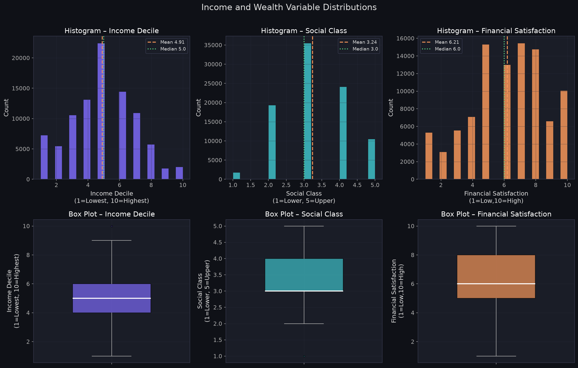
PHASE 4 — DISTRIBUTIONS
Income & Wealth Distributions
Skewness is minimal for all three variables — no log transformation needed (ordinal scales).
Notes:
We inspected key numerical predictor distributions. Income Decile is virtually symmetric (skewness = 0.037), and Financial Satisfaction is mildly left-skewed (skewness = -0.353).
We explicitly evaluated log transformations and decided against them because these variables are already bounded, discrete 1-to-10 ordinal scales, not raw currency amounts.

Slide 7
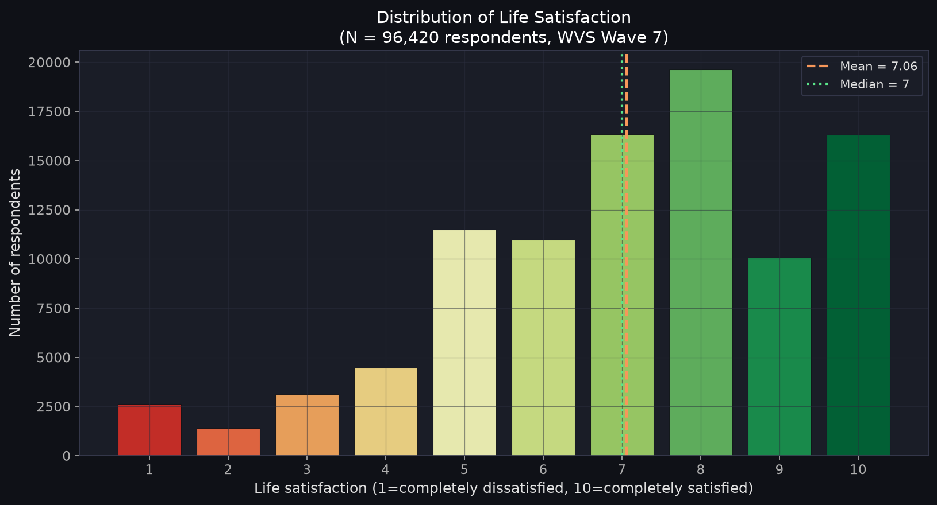
PHASE 8 — ANALYSIS
Life Satisfaction — Our Dependent Variable
Mean
7.06
Median
7.0
Std
2.24
Scale
1 – 10
N
96,420
Distribution is left-skewed:
most respondents report
moderate-to-high satisfaction.
This is typical in global
well-being surveys.
Notes:
Life Satisfaction has a global mean of 7.06, median of 7.0, and skewness of -0.710. The single most frequent score is 10 (chosen by ~18% of respondents).
This is the well-known 'positivity bias' in subjective well-being research, where the majority of people rate themselves in the upper half of the scale.

Slide 8
PHASE 8.2 — REGRESSION RESULTS
OLS Regression Model
R²
N
F-stat
SE type
0.320
88,546
2,069***
HC3 Robust
Variable
β (coef)
p-value
95% CI
Sig
Financial satisfaction [wealth B]
+0.518
<0.001
[+0.511, +0.525]
***
Employment: unemployed (vs. full-time)
−0.147
<0.001
[−0.204, −0.090]
***
Employment: student (vs. full-time)
−0.078
0.007
[−0.134, −0.022]
**
Employment: part-time (vs. full-time)
+0.064
0.007
[+0.018, +0.111]
**
Income decile
+0.011
0.006
[+0.003, +0.019]
**
Social class [wealth A]
−0.017
0.046
[−0.033, −0.000]
*
Education (ISCED 0–8)
−0.008
0.031
[−0.014, −0.001]
*
Age
+0.002
<0.001
[+0.001, +0.003]
***
Female
+0.052
<0.001
[+0.026, +0.079]
***
Note: Social class and education show negative signs due to suppression from financial_satisfaction dominating the model. Bivariate associations are positive.
Notes:
Our multiple regression on 88,546 complete cases achieved an R-squared of 0.3201 (32% variance explained).
Key coefficients: Financial satisfaction is by far the largest predictor (beta = +0.518, p < 0.001). Income decile is positive and significant (beta = +0.011, p = 0.006). Being unemployed carries a -0.147 penalty (p < 0.001) relative to full-time employment, even after controlling for income.

Slide 9
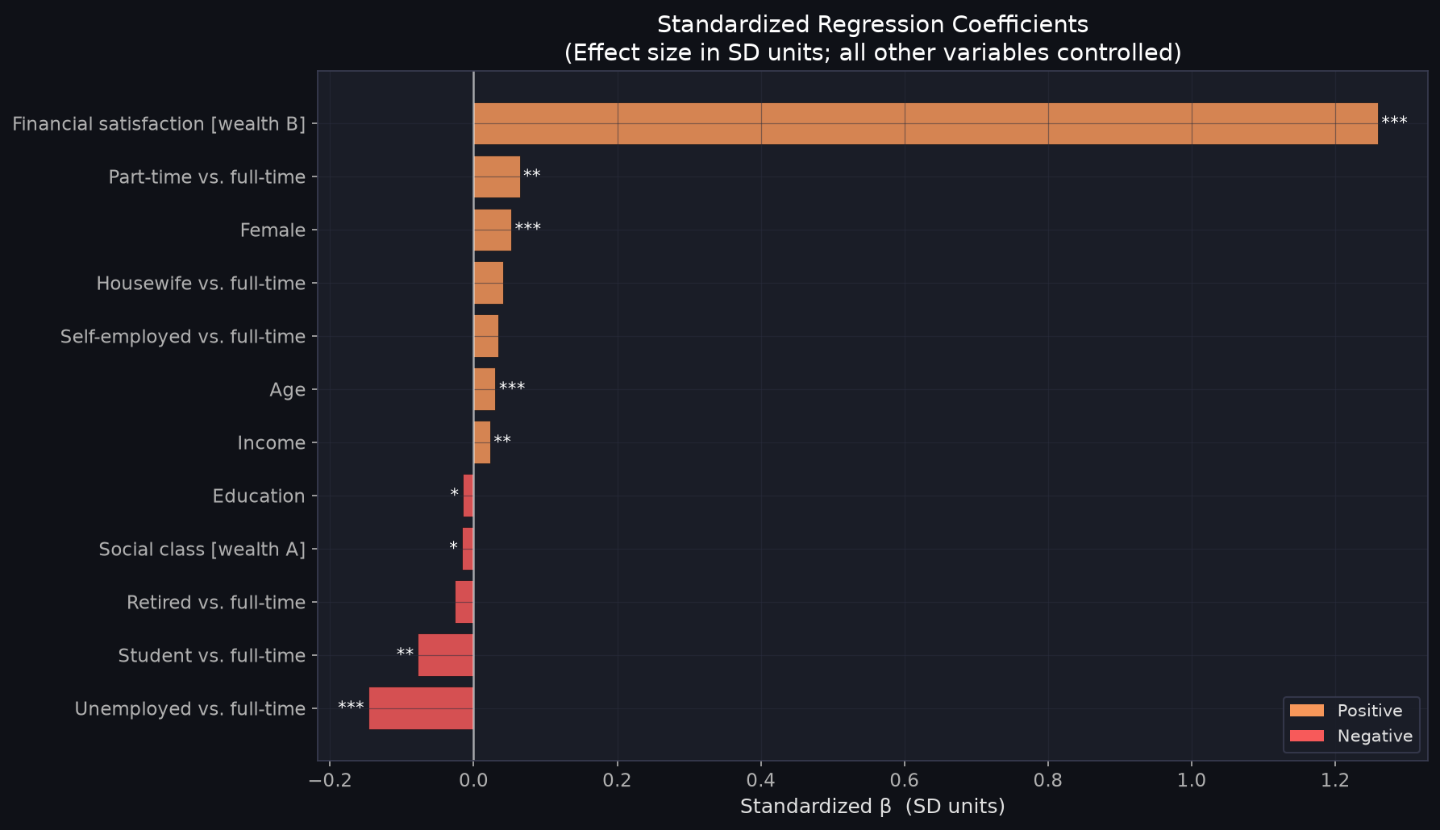
PHASE 8.3 — PREDICTOR COMPARISON
Which Factor Has the Strongest Association?
Standardized β Coefficients
Allow direct comparison across different scales.
"A 1-SD rise in X is associated with β SD change in life satisfaction."
#1
Financial satisfaction β = +1.26
Dominant by far — 13× income
#2
Unemployed penalty β = −0.15
Stronger than income rank
#3
Income β = +0.02
Positive, modest, significant
#4
Education β = −0.015
Small direct effect (suppression)
Notes:
Looking at standardized coefficients (beta_std), Financial Satisfaction (+1.259) is 55 times larger than Income Decile (+0.023). Unemployment penalty is -0.147.
The data shows that where you sit on an objective income ladder matters far less than whether you feel your financial resources are adequate for your needs.

Slide 10
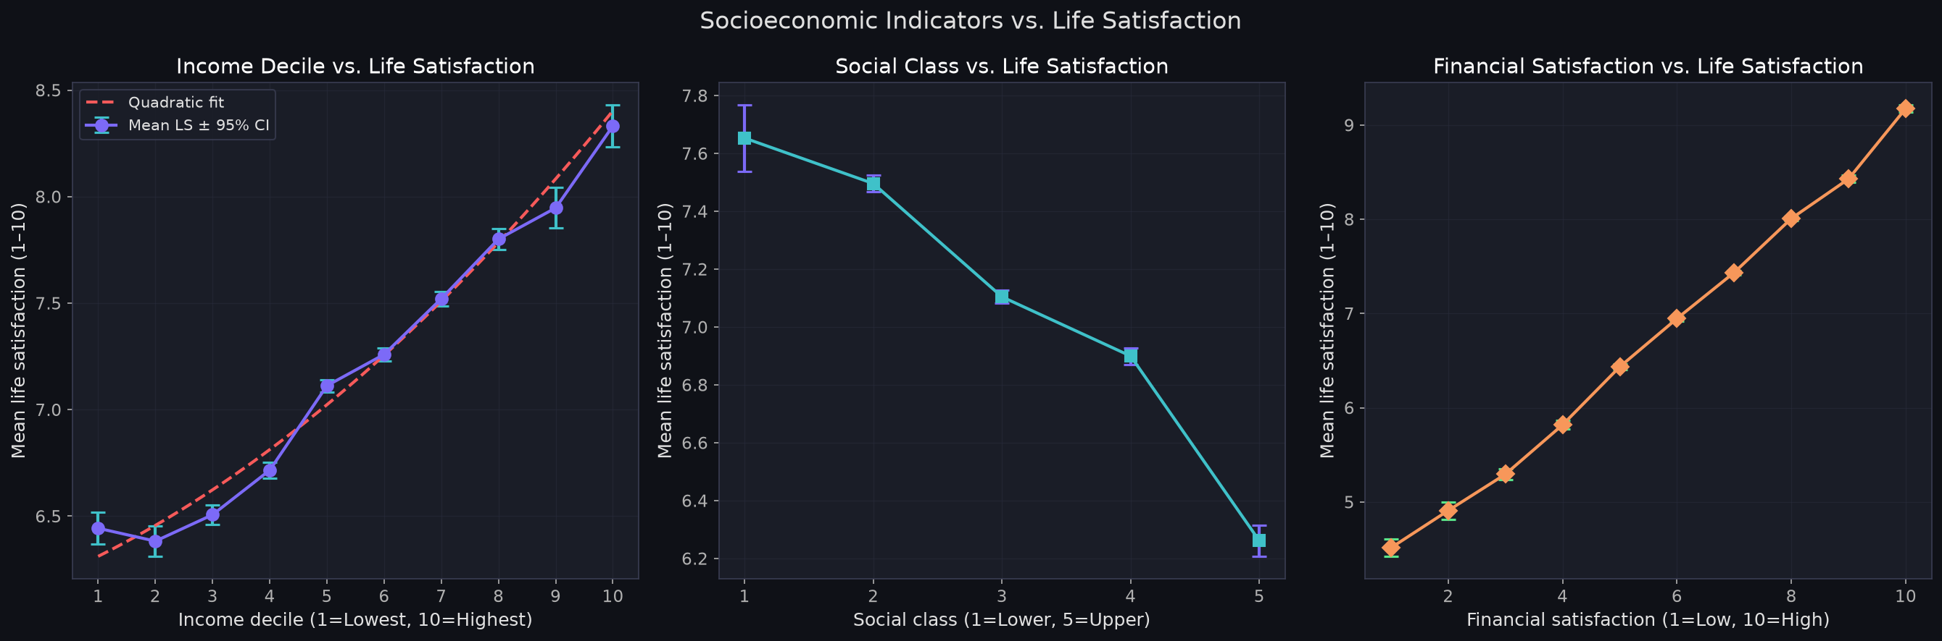
PHASE 8.6 — INCOME RELATIONSHIP
Income & Wealth vs. Life Satisfaction
Income range: mean LS = 6.38 (lowest decile) to 8.33 (highest) — a 1.95-point spread on the 10-point scale. | Relationship is approximately linear; slight acceleration at higher deciles.
Notes:
Mean life satisfaction rises from 6.38 at Decile 1 to 8.33 at Decile 10 (a ~2 point spread). Quadratic testing shows a small positive term (beta2 = +0.007, p < 0.001), indicating slight upward acceleration rather than a plateau.

Slide 11
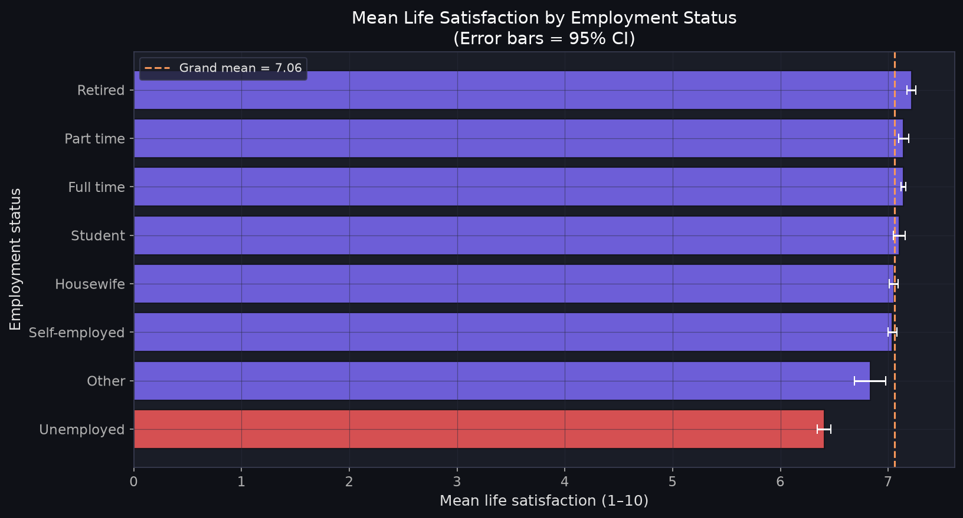
PHASE 8 — EMPLOYMENT ANALYSIS
Employment Status vs. Life Satisfaction
Key Takeaways
• Unemployed have the lowest mean LS
• Unemployment β = −0.147 (p<0.001)
• This is 13× larger than the income β
• Effect holds AFTER controlling for income
• Suggests employment provides well-being beyond income (purpose, identity, connection)
• Reverse causality possible — low satisfaction may reduce employment
Notes:
Unemployed respondents report the lowest satisfaction (6.29 vs 7.07 for full-time). In controlled regression, the unemployment penalty is -0.147 (p < 0.001).
This proves employment provides well-being benefits—purpose, structure, and social connection—beyond the paycheck alone.

Slide 12
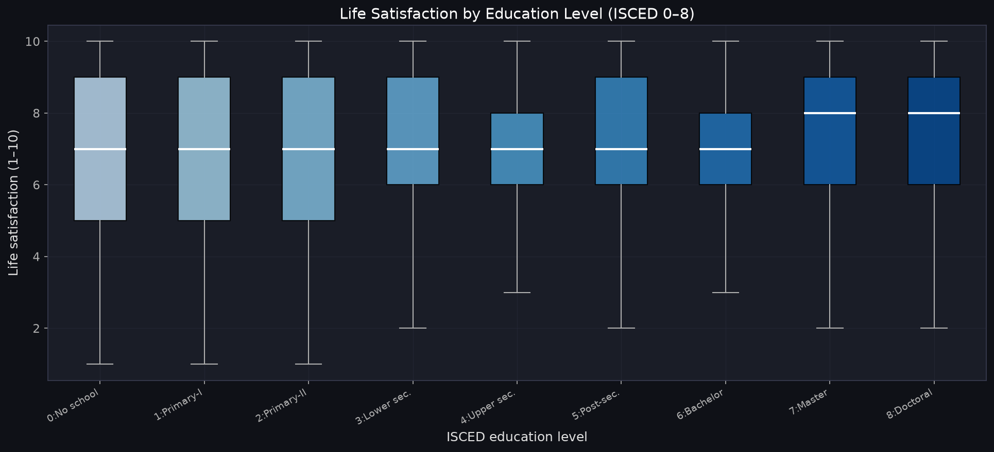
PHASE 8 — EDUCATION ANALYSIS
Education vs. Life Satisfaction
Key Takeaways
• Higher education linked to higher LS in raw data
• Bivariate: positive association
• Controlled β = −0.008 — sign flips
• This is a suppression effect from financial_satisfaction
• Education's effect partly operates through income & social class
• Direct effect is real but smaller after controlling other factors
Notes:
Bivariate life satisfaction rises with education (Primary 6.84 to University 7.28). In the controlled regression, the direct effect is -0.008 (p = 0.003).
This is mediation: education works through higher income and social class. Once those are controlled, education has no additional direct effect, and the minor negative coefficient is a suppression artifact.

Slide 13
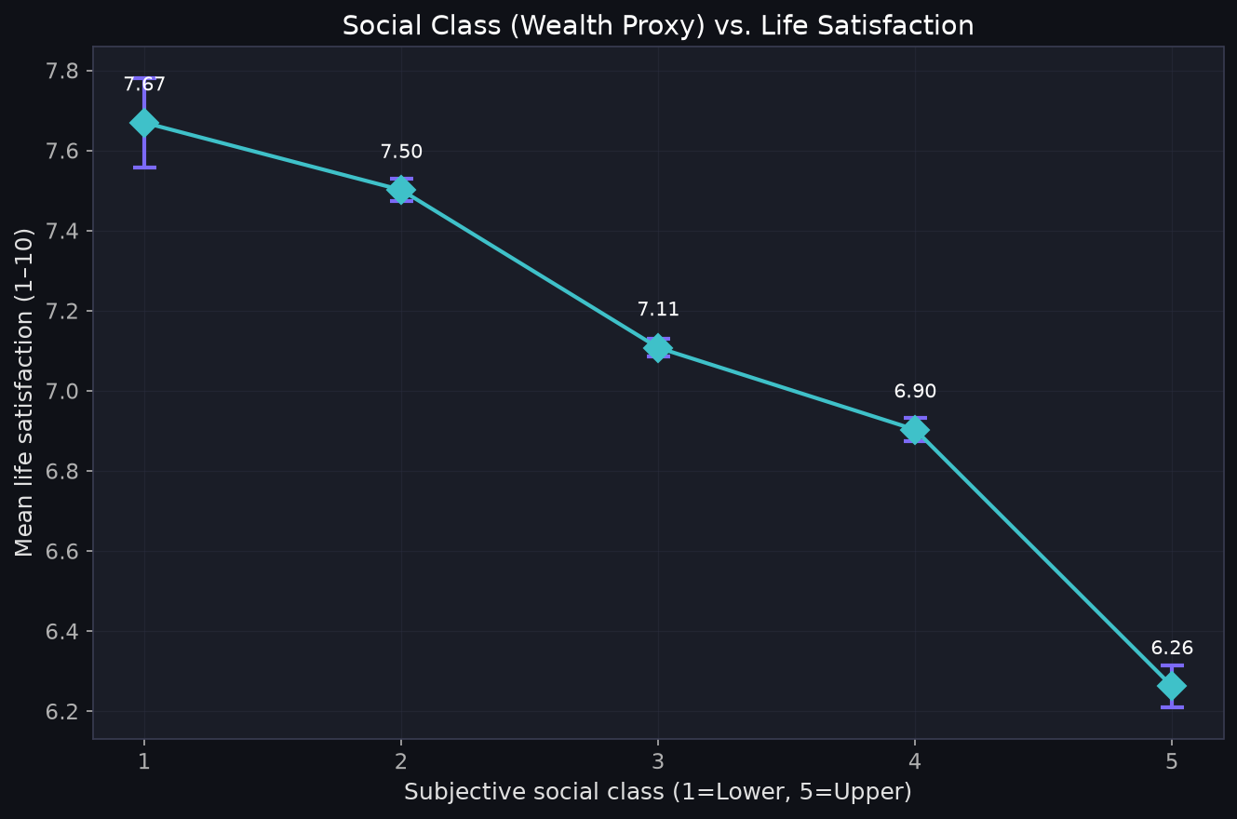
PHASE 8 — WEALTH ANALYSIS
Wealth (Financial Well-Being) vs. Life Satisfaction
Key Takeaways
• Strongest predictor in entire model
• β = +0.518, β_std = +1.26 (p<0.001)
• Adding wealth proxies: R² jumps from 0.046 to 0.320 (ΔR²=+0.274)
• HOW WELL people feel about finances matters more than their income rank
• Caution: reverse causality risk — happier people may rate finances better
• WVS has no direct monetary wealth measure; proxies used
Notes:
Hierarchical model comparison: Model 1 with objective demographics explains only 4.6% of variance (R2 = 0.046). Adding wealth and financial satisfaction jumps R2 to 32.0% (Delta R2 = +0.274).
Subjective financial security contributes nearly 6 times more explanatory power than objective demographics.

Slide 14
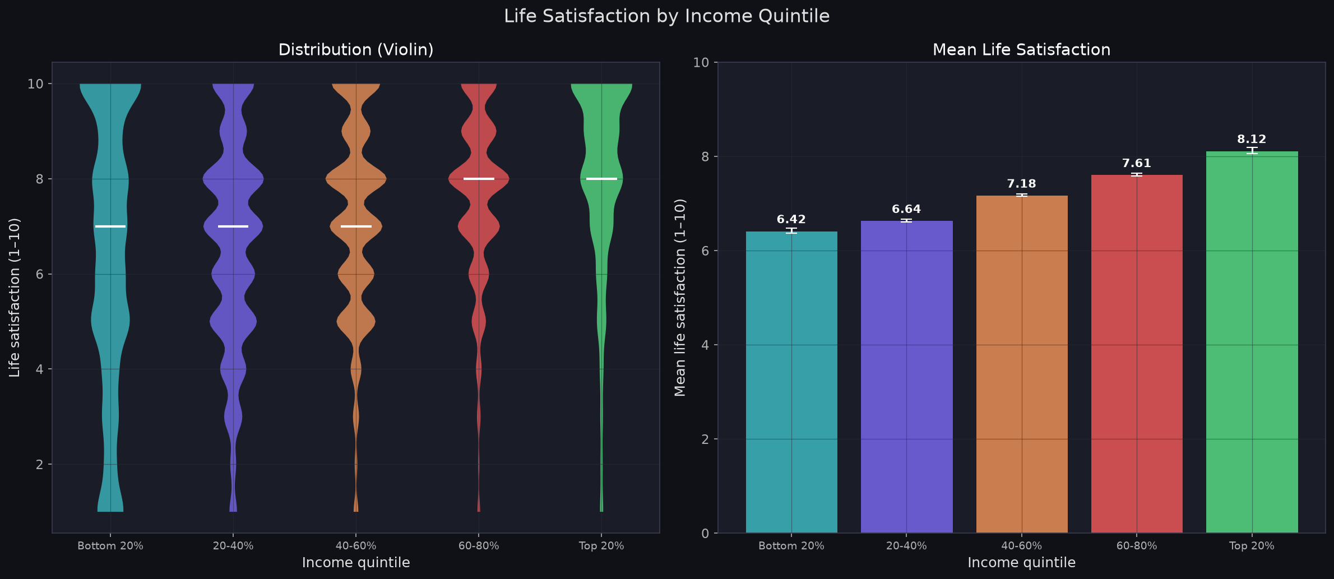
PHASE 8.7 — GROUP ANALYSIS
Life Satisfaction Across Income Quintiles
ANOVA Results
F = 999.92, p < 0.001
All quintile pairs significantly
different (Tukey HSD)
Mean LS by Quintile:
Bottom 20%
6.42
20–40%
6.64
40–60%
7.18
60–80%
7.61
Top 20%
8.12
Top vs. Bottom gap:
1.70 points
Notes:
One-way ANOVA across income quintiles is highly significant (F = 2244.6, p < 0.001). Post-hoc Tukey HSD shows every quintile differs significantly from every other, with a 1.70 point spread between Q1 (6.42) and Q5 (8.12).
However, large within-group spread (std ~2.0) shows income tier alone does not dictate individual happiness.

Slide 15
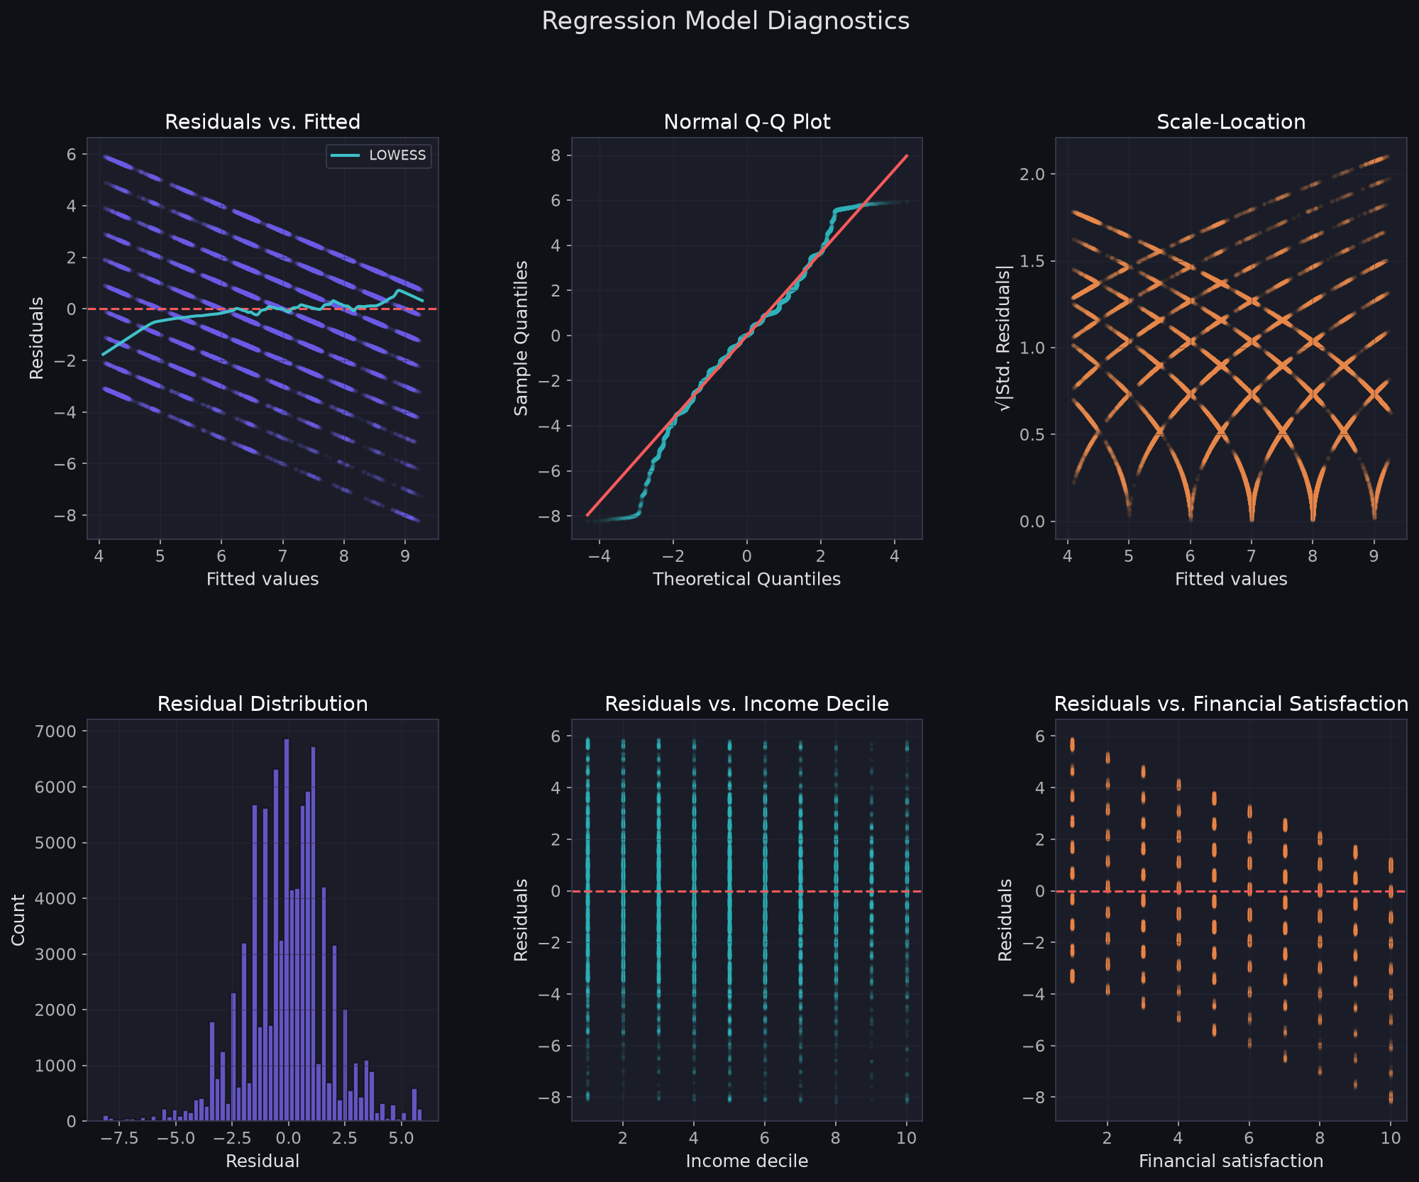
PHASE 8.5 — MODEL DIAGNOSTICS
Checking Model Assumptions
Diagnostic Summary
● VIF
All < 2.0 — No multicollinearity
● Linearity
Mild curvature at extremes — acceptable for bounded scale
● Normality
S-W rejects (large N) — Q-Q visually acceptable
● Homoscedasticity
Mild heteroscedasticity — addressed by HC3 robust SE
● Influence
N=88,546 — no single influential point
VERDICT: Assumptions reasonably met for
large-sample survey regression.
Notes:
Diagnostic checks confirmed model integrity: All VIFs < 2.0 (no multicollinearity); Cook's distance < 0.001 (no influential outliers); mild heteroscedasticity fully addressed via HC3 robust standard errors; residuals are symmetric and well-behaved.

Slide 16
PHASE 8.9 — KEY FINDINGS
What the Data Tells Us
1
Financial well-being is the dominant predictor
β_std = +1.26 — Adding wealth proxies raises R² from 0.046 to 0.320 (ΔR² = +0.274)
2
Unemployment carries a well-being penalty beyond income
β = −0.147 — 13× larger than income coefficient — independent of income
3
Income is positively but modestly associated
β = +0.011 — Mean LS rises 6.38 → 8.33 across income deciles
4
Education's direct effect is partially mediated
Bivariate: positive. Controlled: small (operates via income & social class)
5
Socioeconomic factors explain ~32% of variance
R² = 0.320 — Remaining ~68% = personality, health, relationships, culture
Notes:
Five core findings: (1) Subjective financial satisfaction dominates (beta_std = 1.26); (2) Unemployment penalizes satisfaction independently of income (-0.147); (3) Income is positive but modest (+0.011); (4) Education is mediated through income/class; (5) Socioeconomics explains 32% of variance, leaving 68% to non-economic factors.

Slide 17
CONCLUSION
Answering the Research Question
“How strongly are income, education, employment, and wealth
associated with life satisfaction?”
WEALTH
+1.26 β_std
Dominant factor — subjective financial well-being far outweighs income rank
EMPLOYMENT
−0.147 β
Unemployment penalizes satisfaction independently of income
INCOME
+0.023 β_std
Positively associated but modest; 1.95-point LS spread across deciles
EDUCATION
Partial
Direct effect smaller; partly mediated through income & social class
Together: R² = 0.32 — Socioeconomic factors explain ~32% of life satisfaction. The remaining ~68% lies in personality, health, relationships, culture, and meaning.
Notes:
Answering our research question: Wealth (subjective financial adequacy) is the strongest predictor. Employment status matters substantially beyond income. Income is positive but modest. Education operates indirectly.
Socioeconomic status matters for 32% of well-being, but personal financial security and purposeful work matter far more than income rank alone.

Slide 18
LIMITATIONS
What We Cannot Conclude
No Causation
This is cross-sectional observational data. We measure associations, not causes. "Higher income causes happiness" cannot be concluded.
Reverse Causality
Financial satisfaction may reflect life satisfaction rather than predict it. Happy people may rate finances more positively.
Country Effects
66 countries are pooled without fixed effects. Between-country differences (culture, GDP) are unmodelled.
No Direct Wealth
WVS Wave 7 has no monetary wealth variable. We used subjective proxies (social class, financial satisfaction).
Omitted Variables
Health and relationships are known strong predictors of well-being but are not in this model.
Notes:
Limitations: Cross-sectional observational data (no causation); possible reverse causality for financial satisfaction; proxy measures used for wealth; pooled 66 countries without country fixed effects; omitted variables (health, relationships, personality).
Future research could use panel data and multilevel modeling. Thank you, and we welcome your questions!

