Slide 1
JSON Data Processing and Visualization in Graphs
Presenter: 202439437 GANGABRIEL 컴퓨터공학과
Presentation Date: 2025-06-06
Class: Web Programming
Professor: MAJEED ABDUL
가천대학교 GACHON UNIVERSITY
가천대학교 GACHON UNIVERSITY

Slide 2
Project
-> Take Form data (String)
-> Send form data to database
-> Parse database data as JSON
-> Display database data in graphs/charts
Notes:
“UPDATE tablename SET datacolumn=‘hello’ datacolumn2=‘world’ WHERE id=‘3’ ” . 3 is row location

Slide 3
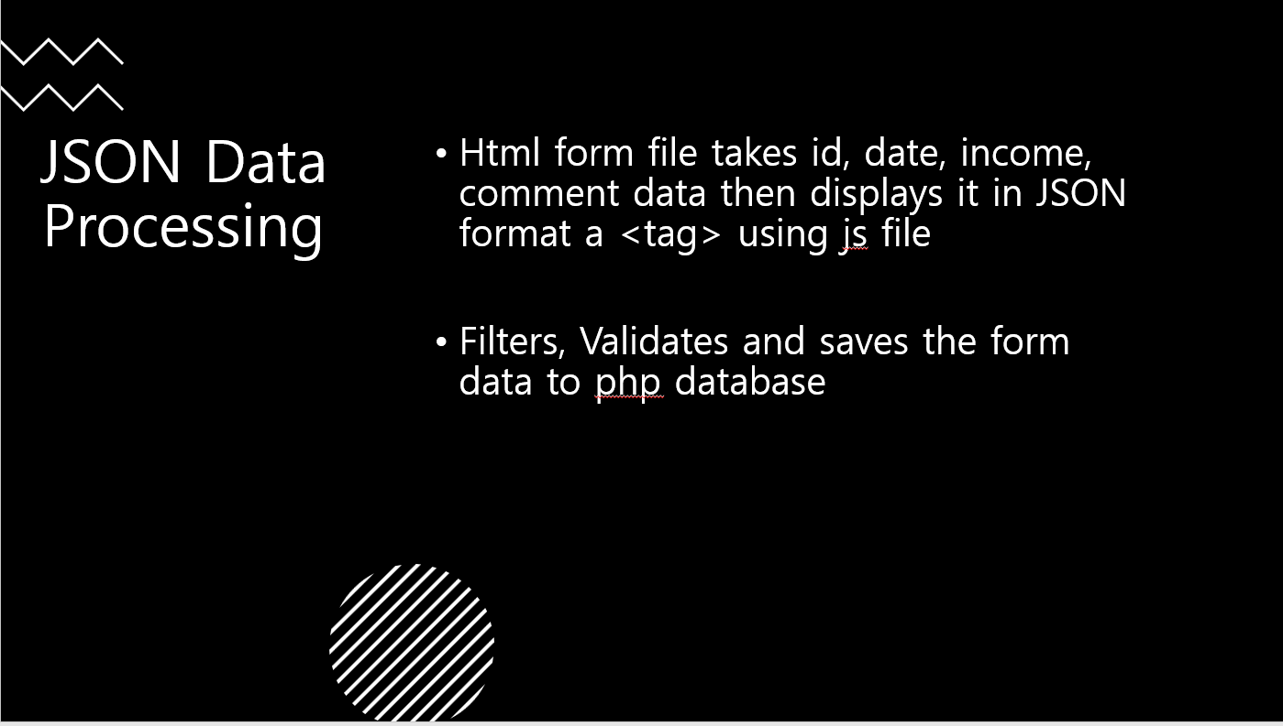
JSON Data Processing
Challenges
-Label date range accustoming to dataset (moderate)
-data validation (little)
-JSON traversing (little)

Slide 4
What is JSON?
JavaScript Object Notation
Language independent text format used for storing and transporting data

Slide 5
JSON Data Processing
Html form file takes id, date, income, comment data then displays it in JSON format a <tag> using js file
Filters, Validates and saves the form data to php database

Slide 6
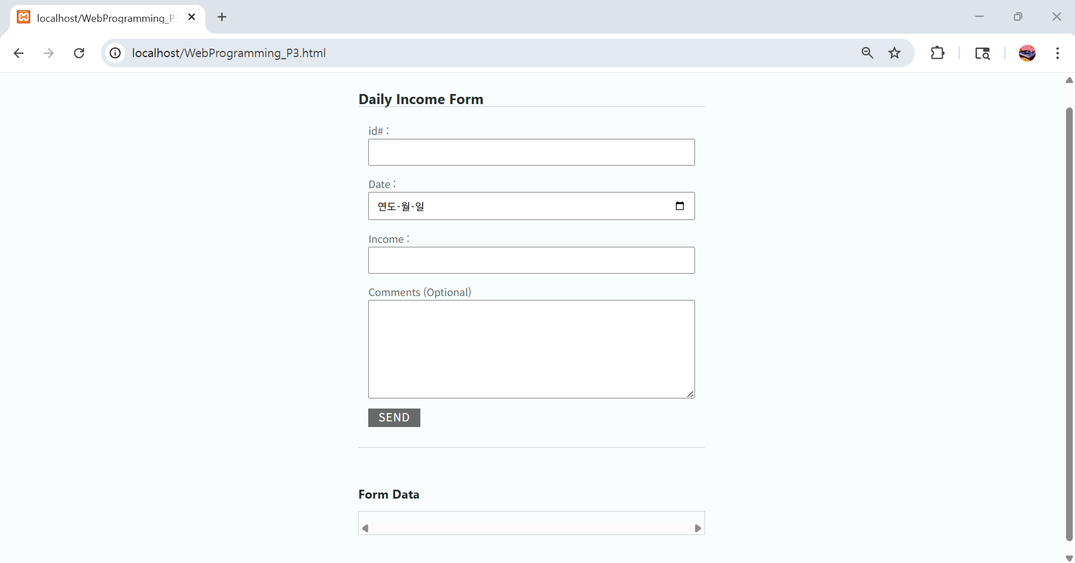
JSON Data Processing

Slide 7
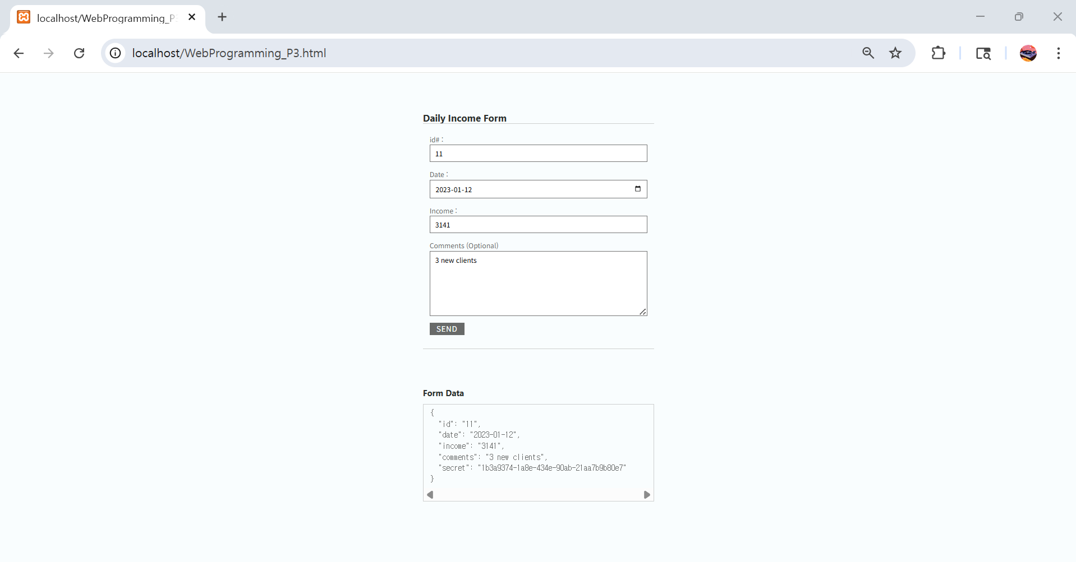
JSON Data Processing

Slide 8
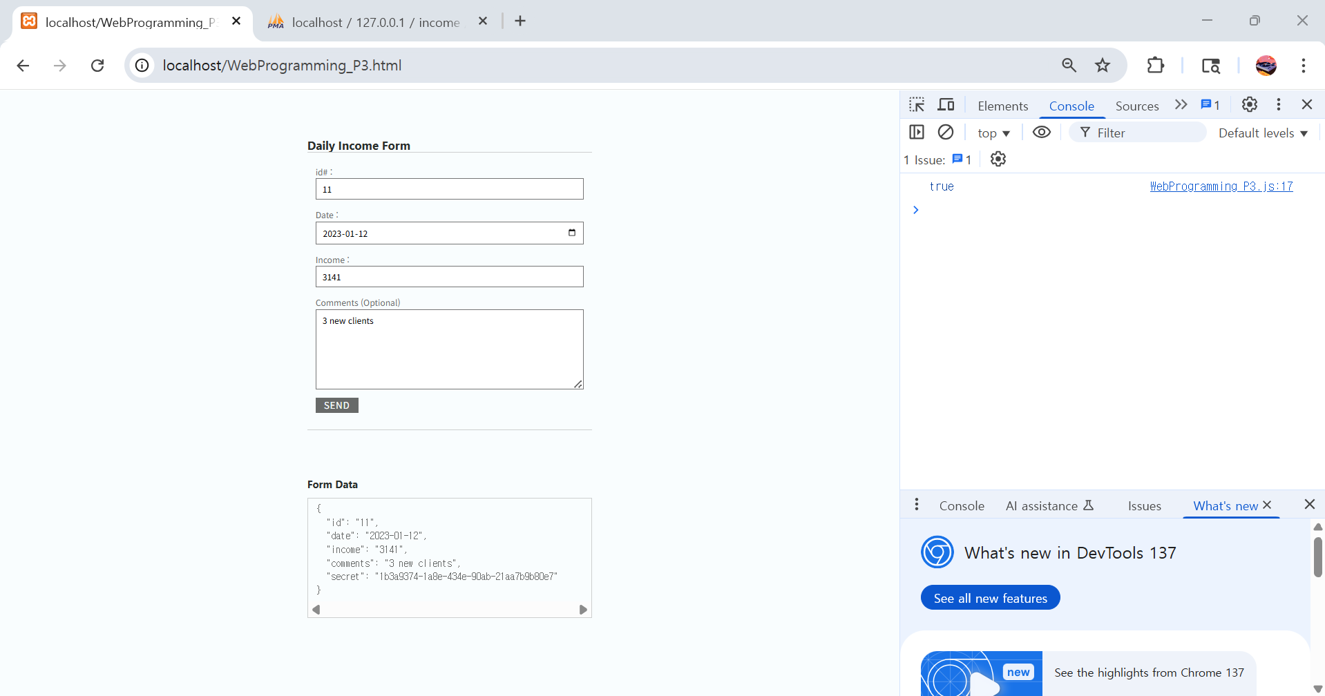
JSON Data Processing

Slide 9
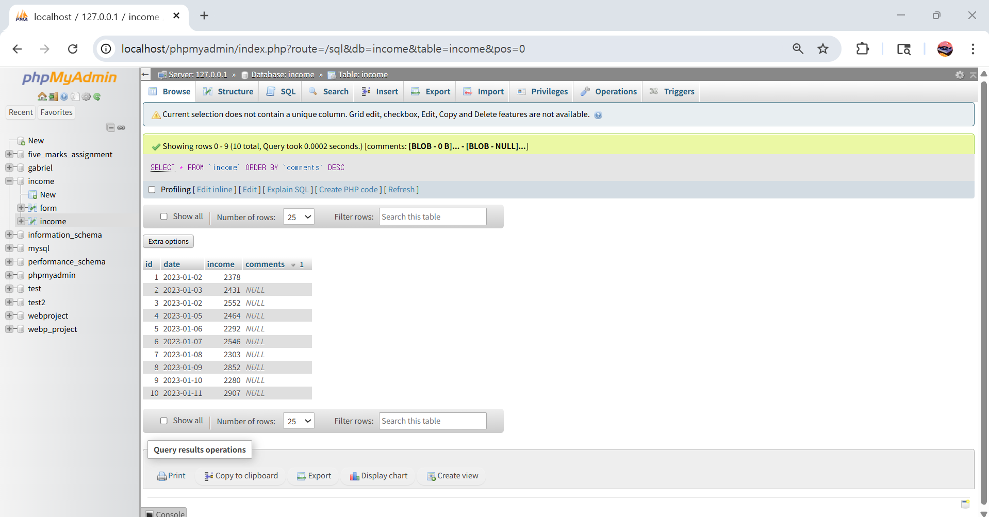
JSON Data Processing

Slide 10
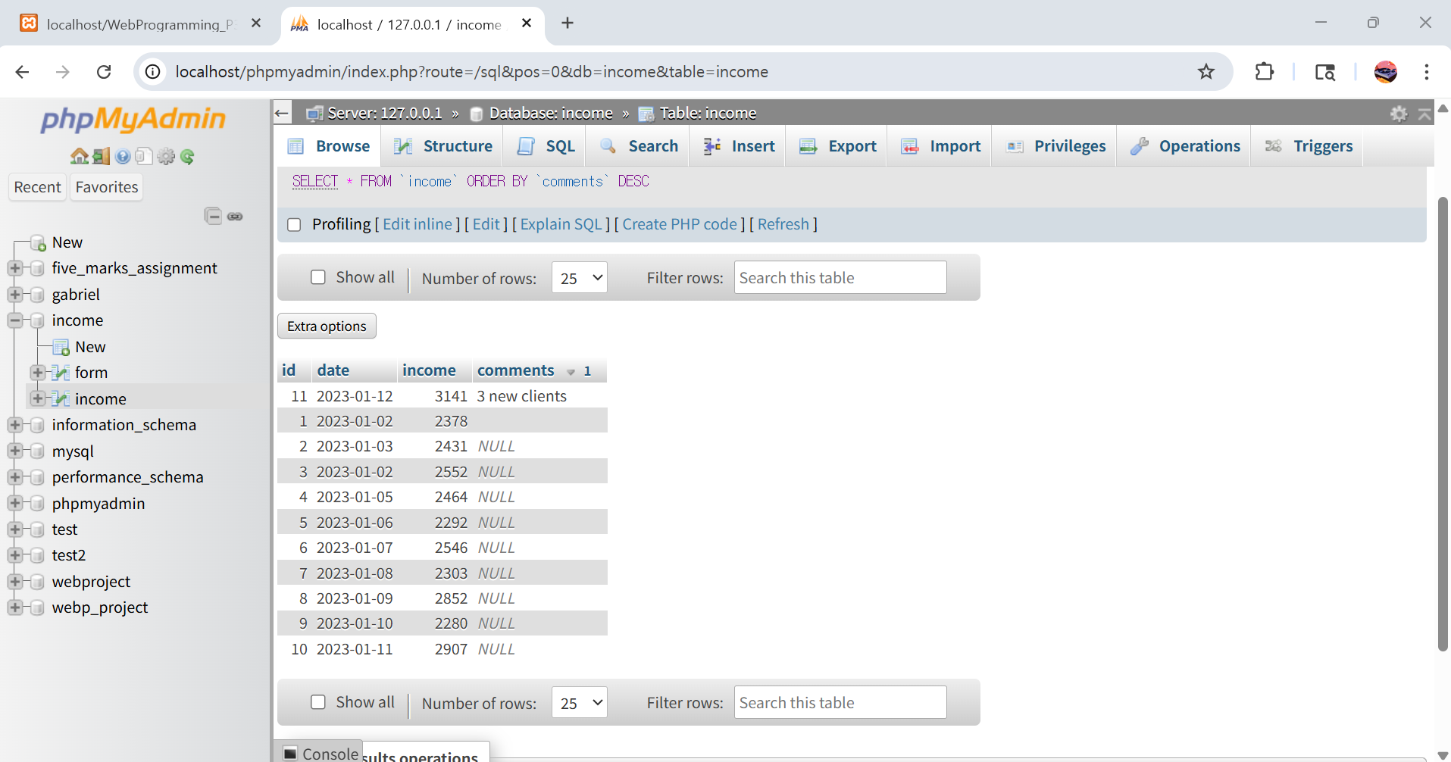
JSON Data Processing

Slide 11
Visualization
Displays JSON formatted database data in 6 Charts

Slide 12
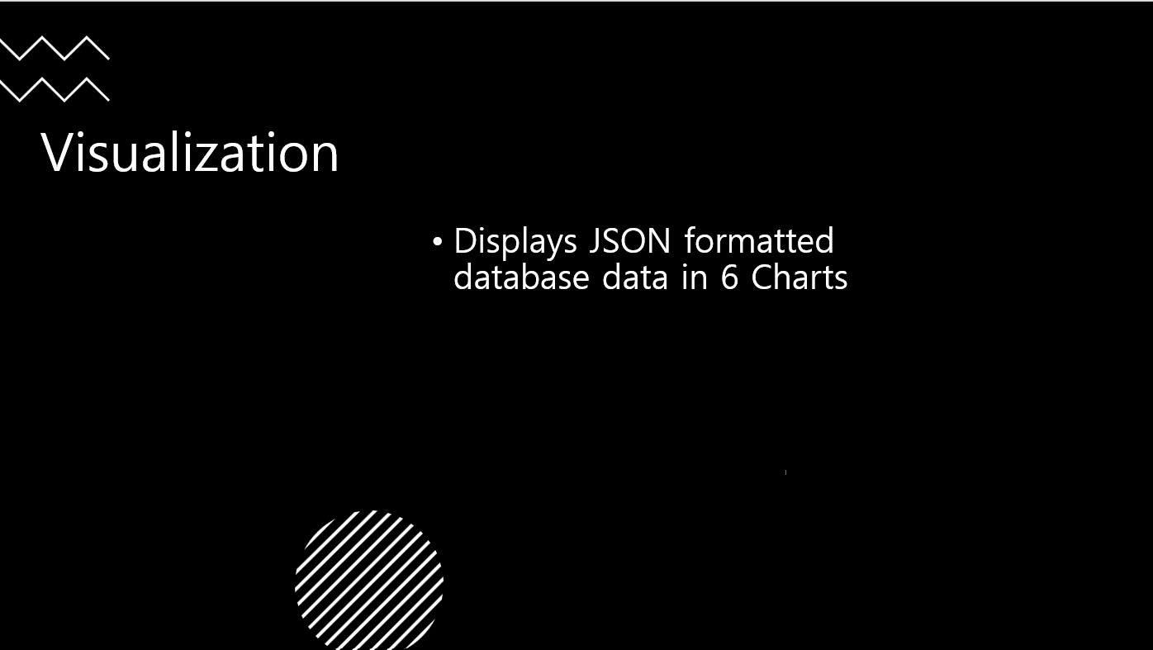
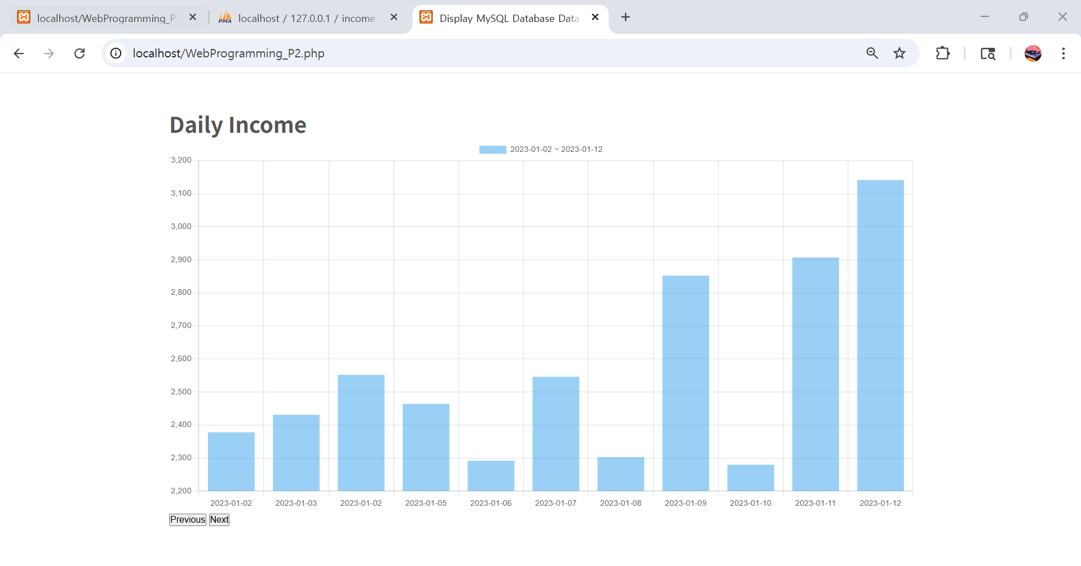
Visualization
Displays JSON formatted database data in 6 Charts

Slide 13
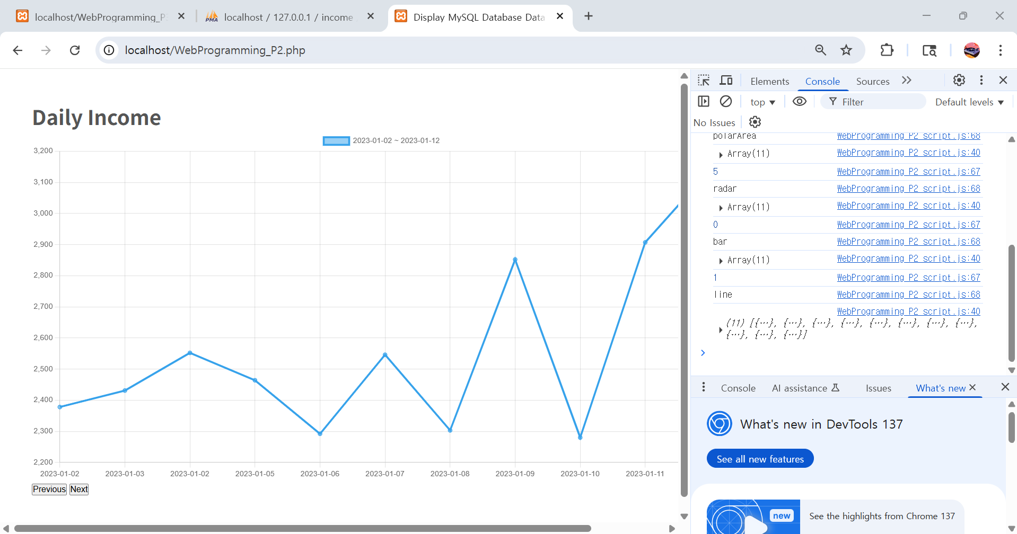
Visualization
Displays JSON formatted database data in 6 Charts

Slide 14
JSON Data Processing
Future Enhancement
-Overall broader subject, by traversing/modifying/using multi-dimensional JSON file. Such as adding monthly key for daily keys

Slide 15
References
https://www.youtube.com/watch?v=herKZzGfEZY
=> How to Display MySQL Database Data in Chart.js Using PHP and JavaScript
https://www.youtube.com/watch?v=Y9yE98etanU
=> Save HTML Form Data to a MySQL Database using PHP

