Slide 1
Medical Aid in War Torn Regions
Leveraging Drone Technology

Slide 2
First Informant
*Soldiers present at the war-site will deliver the locations of the recent places of military combat (or bombings), since these sites would be the ones requiring medical help with the most urgency.
*Local Informants present amongst the citizens in the residential regions, as well as the war shelters, will provide intel with the help of their radios, and communication devices provided to them.
*The regions which still have telecommunication services available to them, can also access the website directly and place a request for a medical assist.

Slide 3
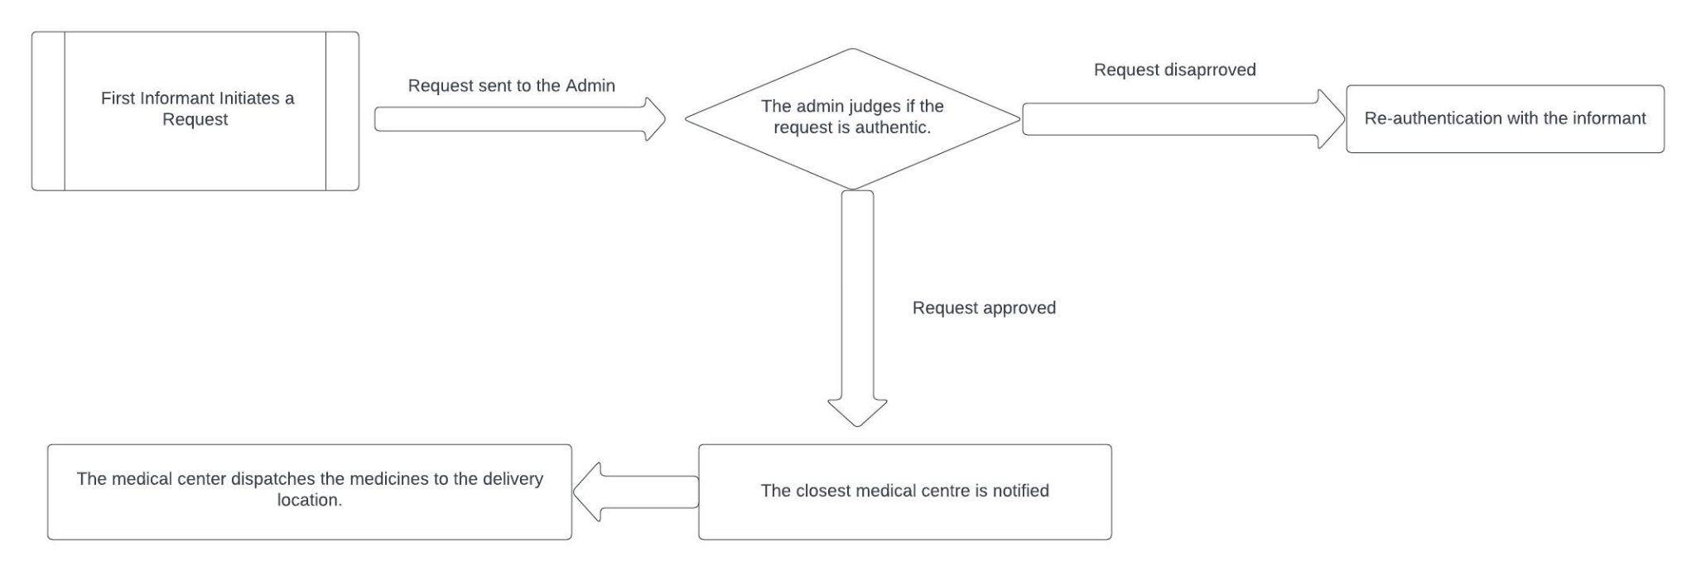

Slide 4
Plan of Action
*As soon as the intel is received via the website or a local informant, every request will be classified into urgency sets, (which will be an inbuilt and necessary feature of the website.)
*All the medical facilities located in the proximity of the location will be informed about the request and they will revert to us about the availability of the supplies.
*The website will contain the information of various medical facilities (whether they have the stock of a particular supply) and will function so as to allow us to restock these facilities, with the help of our own reserves at a remote location, which will be transported through roads to the medics.

Slide 5
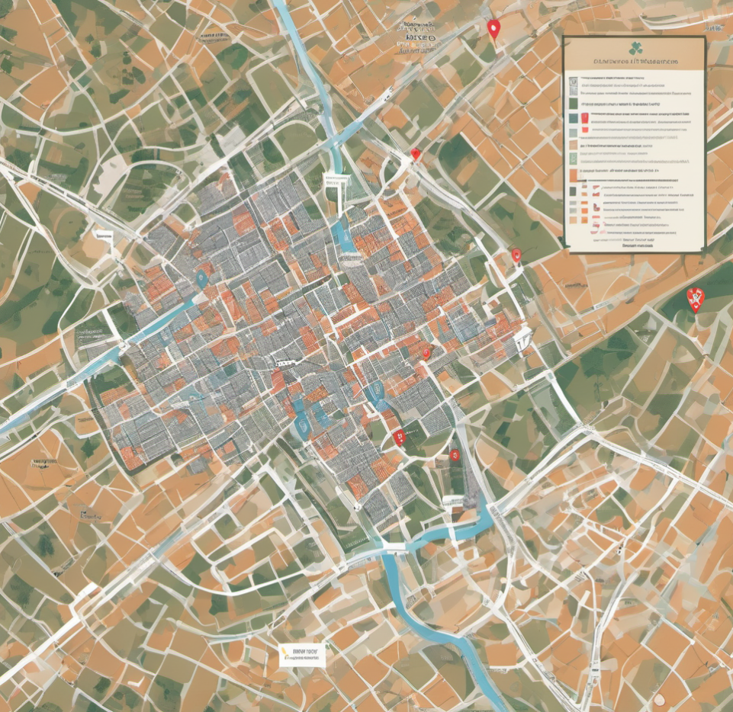
A map of the region with the location of delivery marked along with the medical facilities located in its proximity.

Slide 6
Accessing the information
*The first page of the website will require the informant to submit their contact information and a valid identification number, which will prove crucial for the admin’s authentication, which will take place after the request has been placed.
*Then the interface will ask the informant to mention the supplies they need, (a list of which will be available to them on the website).
*It will also require them to submit the location of delivery.
*A measure of urgency is also required, which will be provided by the informant (as per the selections allowed by the website), this will be used to sort the requests received as per priority later on.

Slide 7
Administrator’s role
*When the request is submitted on the informant’s interface, the admin will be notified of the request on the admin’s page.
*Now the admin must cross verify the authenticity of the request. He can do so with the help of contact and personal information provided to him by the informant.
*In case of any dubious factors, the admin may ask for further information from the informant in the informant’s page. If a satisfactory response is not received, the admin may scratch the request all together.

Slide 8
For an authentic request
*The admin will search for an appropriate medical center (which has a stock of the supplies required and is in reasonable proximity of the delivery location.
*A detailed report of the request along with the supplies dispatched will also be sent to the main warehouse (containing the medical supplies).
*When the request is received by the medical center they will use their drone delivery system (that was put in place prior to the war) to deliver the medicines to the delivery location, and then notify the authorities.

Slide 9
Medical facilities
*The medical facilities will be required to carefully maintain a record of the supplies available to them, and notify the main base or the warehouse in case the center runs out of a supply.
*If the medical facility does not respond within two days of an admin’s request, an inspector will be sent to the facility.
*The facilities can update the information regarding their stocks and request for a restock through the website’s interface.

