Slide 1
IR-Board
Requirements Management Platform
Javier Carrasco Arango – UO294532

Slide 2
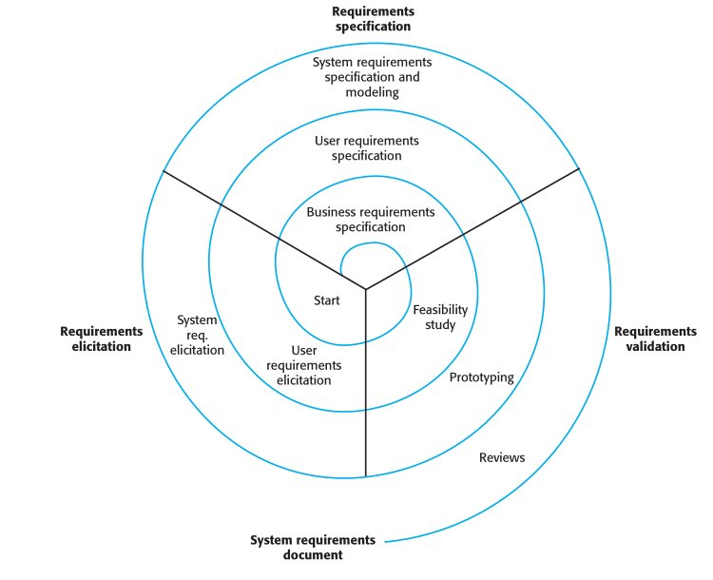
Context
IR-Board is an MVP of a Requirements Management System
Several stakeholders – conflicting
IEEE 830 & ISO 29148
Notes:
Explain what irboard is -> as many of you know, a requirement is used on requirements engineering to model the expected behaviour of a system,
Requirement specification is a discipline due to how often several stakeholders are involved, and most times they have conflicting interests that must be reconciled
Therefore it is an iterative process, and the tool provides support on the process
As generally it is done by hand on a text editor

Slide 3
Introduction
Current tools follow either traditional requirements engineering or agile practices, and those who bridge the gap are proprietary and costly.
Designed to provide:
  Strong traceability and state management
  Alignment with IEEE 830 and ISO 29148
  Document management for agile or traditional artifacts
  Serious security
  Collaborative safeguards
Notes:
1. Currently most of the industry is split into either this approach or agile practices via use cases. – read rest of second line
2. IR-board is an open-source minimum viable product that leans more into traditional requirements approach but would attempt to bridge the gap, at this point via the document management for agile artifacts

Slide 4
Scope and initial schedule
Modules:
  Security and access control
  Requirement management
  Project and project elements management
  User management
  Document management
  Basic search and filtering
  Entity Locking module.
Extras:
  Basic observability stack
  SonarQube integration
  Draw.io integration
  Load testing
  Manuals
300 hours
Notes:
On the right we can see how the initial schedule handled work division, the 300 hours into the different Rational Unified Process disciplines (documentation is not a discipline but it was clearly separated to estimate its effort)
A gantt chart and more detailed deep-dive is provided on the documentation on 4.4 initial planning.

Slide 5
Budget
Created a fictional client’s petition and fictional provider company to appropriately identify stakeholders, risks, and design the schedule and budget.
Staff member | Hourly rate (without profit)
Project manager | 49,78 €
Service coordinator | 46,75 €
Systems analyst | 42,16 €
Technology consultant | 45,22 €
Software architect | 49,15 €
Senior developer | 43,85 €
Junior developer | 38,55 €
IR-Board costs
Cat. Num | Category | Total
01 | IR-Board development costs breakdown | 13.026,52 €
02 | Other | 172,50 €
Total |  | 13.199,02 €
Profit (25%) |  | 3.299,75 €
Amount to be increased on the first category |  | 3.472,25 €
Total hours |  | 300,00
Dilution increase per billable hour |  | 11,58 €
Client budget overview
Project management | 1.840,86 €
Analysis | 2.932,53 €
Design | 2.863,95 €
SonarQube setup | 166,28 €
Development | 5.602,80 €
Testing | 1.364,15 €
Documentation | 1.729,94 €
Total | 16.500,52 €
Complete theoretical provider’s financial situation over on appendix 13.1.1
Notes:
To make a more professionally useful budget and schedule, the project was approached as if a professional team were to execute the project, and therefore a basic fictional client was designed.
It describes a custom development that gives context to the scope and allows to appropriately identify stakeholders, and design the schedule and budget.
Similarly, a fictional provider was designed, whose financial reality can be observed on the excel sheet, and it provides the following hourly rates for the professional profiles:

Slide 6
Analysis
ReBAC differentiates the following roles:
System-wide administrator
Project manager
Requirement engineer
Stakeholder
The highest permission prevails.
Traceability via dynamic identifier, & identity slug.
Notes:
Diagrams can be found on the análisis section 5.2 páge 54 and domain pág 61

Slide 7
Architecture & technologies
Spring Boot vs Express.js and FastAPI
Familiarity and strong conventions
Database integration capabilities
Personal preference for java
React + Typescript vs Angular
Moderate learning curve, already familiar
High flexibility
PostgreSQL vs MongoDB
Native support from Ory ecosystem
Unlikely to change schema
Out of the box traceability

Slide 8
Architecture & technologies
Notes:
The frontend is organized in the default vite package structure.

Slide 9
Architecture & technologies
Notes:
A complete diagram of the resulting database schema can be found on 6.4: database design, or on page 101 of the documentation.
The backend Clean Architecture, to facilitate maintainability by enabling infrastructure components, such as databases, external services, or web frameworks, to be replaced without affecting the application's core business logic.

Slide 10
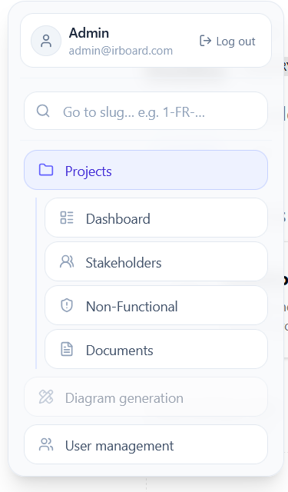
Design process
Frontend
  Hand-drawn sketches
  Navigability diagram
Minimalism, good contrast, neutral palette
Reveal information via exploration
Every main design decision was checked with the tutors/clients

Slide 11
Testing
Unit testing & quality gate
JUnit5 + Mockito
80% coverage, no critical code smells
Integration & Acceptance
E2E for full user journeys
Playwright, limited scope
Load testing
Gatling, 500 concurrent users with no request >0.7s
Accessibility & usability testing
Lighthouse audits, targeting 80+
4 usability testing sessions
Notes:
On E2E, multi-user access control and concurrency scenarios, and entity search were not automated, but manually verified.
On Load testing, initial requirement asked for a minimum of 20 stable concurrent users. Also, the scope was not to find the limit of the system but rather a comfortable user amount, keeping requests under 0.7s
All issues found were documented and corrected (entity slug tooltip), or stated for future work (keyboard navigation, sound feedback)

Slide 12
Risk analysis - Mitigations
Risk: Modification of weekly working schedule
Project management: Schedule – 0.81
Controlled redistribution of working hours to follow an acceptable weekly workload.
Risk: Erroneous identification of requirements
Technical: Requirements – 0.45
Close involvement with the project tutors during identification and periodic alignment meetings.
Opportunity: Benefits gained through Ory
Technical: Security / Architecture – 0.39
Align system design with native flows.
Risk: Lack of experience with the Ory
Technical: Complexity and interfaces – 0.28
Allocation of self study hours and early prototyping of the Ory ecosystem integrations.
Risk: Incompatibility of design with Ory
Technical: Architecture / Integration – 0.42
Introduce an abstraction layer between the application domain and the ecosystem services.

Slide 13
Issues encountered
Infrastructure complexity
SonarQube/CI coverage bug
Document upload technical debt
Ory domain requirement
Deciding which services to place behind Oathkeeper
CI ran standard tests, not coverage-instrumented ones
No test coverage reached SonarQube
The uploads are routed through the backend.
Documented as future work.
Most of its features are built around cookies
Required domain purchase for deployment
Typst nested-list compatibility
MinIO dependency went into maintenance mid-project, future work
Time constraints caused cut decisions
Other
Plugin was used to avoid switching technologies
Notes:
Grafana expected the request signature to remain unchanged for security, and it quickly grew in complexity due to how I had configured oathkeeper, so it was set to be accessed directly from traefik.
The object storage was set the same way due to similar reasons.

Slide 14
Results
Weekly schedule risk
Erroneous requirements identification
Lack of Ory/ReBAC experience
Ory workflow incompatibility
Ory integration opportunity
Typst risk and opportunities
Unaccounted for, materialized
Improved documentation speed
Taken advantage of
Materialized but controlled
Did not materialize
Materialized but low impact, contained
Partially materialized, the abstraction from the driver allowed for workarounds
Schedule deviations
Budget deviation
  Total effort:
  300h -> 310h (+3%)
  Testing:
  27h -> 35h (+29%)
  Project man.:
  30h -> 24h (-20%)
  Analysis: +6%
  Design: +4%
  Documentation: -7%
  Development cost breakdown deviated +3%
  Actual profit:
  25% -> ~22% (-11%)
  No extra budget or contingency reserve was needed.

Slide 15
Future work and conclusions
What was achieved
Full lifecycle coverage
Serious zero-trust perimeter
Lessons learned
Trust boundaries
Future work
Hardening for production
Testing/UX extension
Feature completion
Architecture patterns
Full containerized stack
Self-managed execution
Notes:
The system went well beyond the minimum scope set, given the effort to correct the issues detected on usability/accessibility, SonarQube, to setup the observability stack and to comfortably handle 500 concurrent users, and the different user manuals and licensing documentation.
The frontend patterns such as hooks, contexts, appropriate to each situation, and revisiting clean architecture from scratch, without a prior skeleton
Self-managed : the discipline of modelling the project as if executed by a team, managing risks and taking decisions on whether to stop developing a feature like the draw.io integration to pursuit testing corrections.
Features to be completed: Draw.io integration, pdf export.
Now, if you’ll let me, I’ll show a quick demo of the system.

Slide 16
Demo
System login & signup
Requirement creation
Requirement nesting
Identity slug searching
Horizontal traceability
Modification and state changes
User management & invitation

