Slide 1
SQL Select
Yu Liu (Yu.Liu02@xjtlu.edu.cn)

Slide 2
SELECT: Overview
The select statement is designed to allow database clients to look up data from tables.
Many behaviours of SELECT can be described using arrays and loops in C/Java.
Database is simply a more sophisticated program
SELECT [DISTINCT | ALL]
column-list FROM table-names
[WHERE condition]
[ORDER BY column-list]
[GROUP BY column-list]
[HAVING condition]
This lecture

Slide 3
Contents
Filtering rows and columns.
The where clause
Cartesian product
Alias
Self-join
Subqueries
Handling set

Slide 4
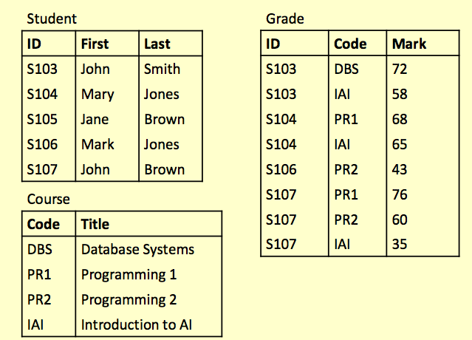
Examples SEL-1

Slide 5
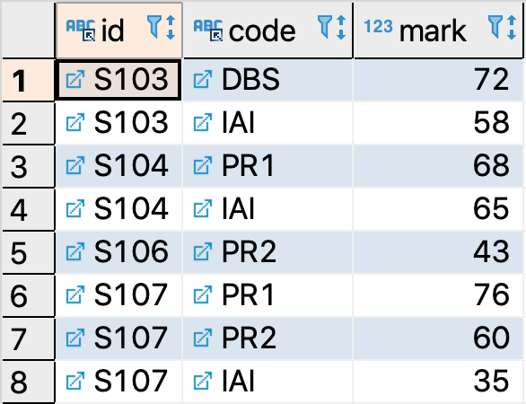
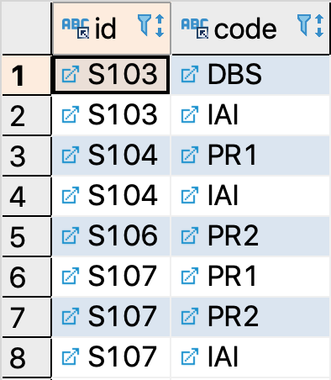
SELECT
In its most basic form, SELECT is able to fetch the columns and rows of a table.
To filter columns of a table:
Example SEL-1:
SELECT col1[,col2…] FROM table-name;
select id, code
from grade;

Slide 6
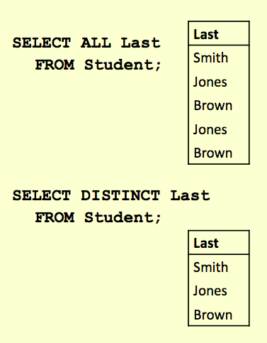
DISTINCT and ALL
By default, select keeps duplicate tuples.
Using DISTINCT after the SELECT keyword removes duplicates .
Using ALL retains duplicates
ALL is used as a default if neither is supplied
These will work over multiple columns.

Slide 7
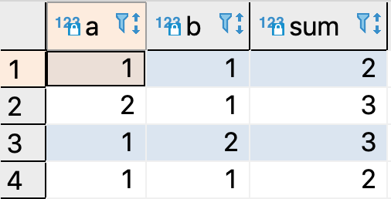
Expressions in SELECT
You can put simple expressions in SELECT statements.
The AS keyword is explained later. It simply gives a column a new name.
Code is in example SEL-1
select a, b, a+b as sum
from dup_test;

Slide 8
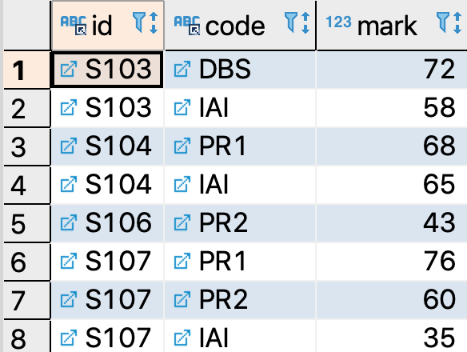
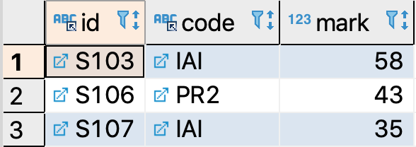
Where
To filter rows of a table:
Asterisk (*) means getting all columns of that table.
Example SEL-1:
SELECT * FROM table-name
WHERE predicate;
select * from grade
where mark < 60;

Slide 9
The WHERE Clause
A WHERE clause restricts rows that are returned
It takes the form of a Predicate.
Predicate: can be understood as an expression that either returns a true or false (for numbers, non-zero or zero).
Only rows that satisfy the condition will appear in the final result.
Expression | Meaning
Mark < 40 | The value of column `mark` is less than 40
First = 'John' | The value of column `First` equals to 'John'
First = Last | `First` equals to `Last`
First IS NULL | `First` column has no value
First != 'John' First <> 'John' | The value of column `First` NOT equals to 'John'
(First = 'John') AND (Last = 'Smith') | `First` equals to 'John' and `Last` equals to 'Smith'
(Mark < 40) OR (Mark > 70) | Mark is lower than 40 or higher than 70

Slide 10
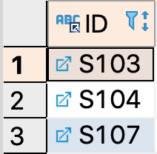
WHERE: Evaluation Process
The evaluation process of select:
Get the table (the FROM part)
For each tuple, assess the WHERE clause.
True (or non-zero values) -> accepted
False (or zero)-> filtered
Get columns (the SELECT part)
SELECT DISTINCT ID
FROM Grade
WHERE Mark >= 60;

Slide 11
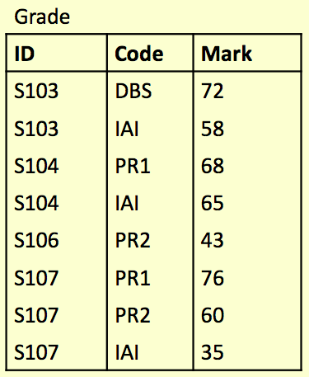
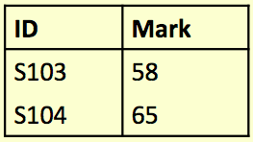
Question
Write an SQL query to find a list of the ID numbers and Marks for students who have passed (scored 50% or more) in IAI.
?
Notes:
SELECT student_id FROM students WHERE module = 'IAI'
UNION
SELECT student_id FROM students WHERE module = 'PR2';

Slide 12
SELECT ID, Mark FROM Grade
WHERE (Code = 'IAI') AND (Mark >= 50);

Slide 13
Word Search
Commonly used for searching product catalogues etc.
Need to search by keywords
Might need to use partial keywords
For example: given a database of books, searching for “crypt” might return
“Cryptonomicon” by Neil Stephenson
“Applied Cryptography” by Bruce Schneier
We can use the LIKE keyword to perform string comparisons in queries
Like is not the same as ‘=’ because it allows wildcard characters like %, _
It is NOT normally case sensitive
SELECT * FROM books
WHERE bookName LIKE '%crypt%';

Slide 14
LIKE
The ‘%’ character can represent any number of characters, including none
The following example will return “Cryptography Engineering” and “Cryptonomicon” but not “Applied Cryptography”
The ‘_’ character represents exactly one character
The following example will return “Clouds” but not “Cloud” or “cloud computing”
bookName LIKE 'crypt%'
bookName LIKE 'cloud_'

Slide 15
LIKE
Sometimes you might need to search for a set of words
To find entries with all words you can link conditions with AND
To find entries with any words use OR
SELECT * FROM books WHERE
bookName LIKE '%crypt%'
AND bookName LIKE '%cloud%';
SELECT * FROM books WHERE
bookName LIKE '%crypt%'
OR bookName LIKE '%cloud%';

Slide 16
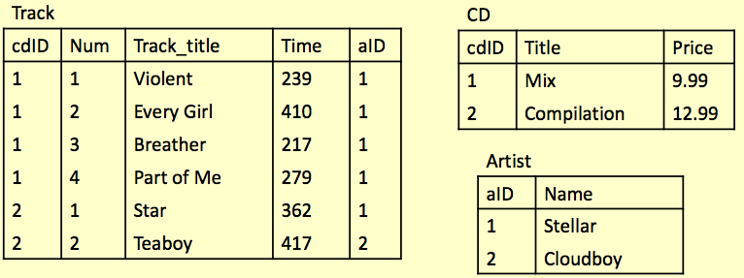
Example
There are three tables below.
Write a query to find any track title containing either the string ‘boy’ or ‘girl’.

Slide 17
Solution
Step 1: decide the table you need.
Step 2: decide the rows you want.
Step 3: decide the columns you need.
SELECT * FROM Track;
SELECT * FROM Track WHERE
Track_title LIKE '%boy%'
OR Track_title LIKE '%girl%';
SELECT Track_title FROM Track WHERE
Track_title LIKE '%boy%'
OR Track_title LIKE '%girl%';
Notes:
Check: SELECT Track_title FROM Track WHERE
Track_title LIKE '%boy%'
OR '%girl%';

Slide 18
Dealing with Date and Time
The comparison of date and time can be done just like numbers.
But you can also search for dates like a string:
Check the example SEL-1
SELECT * FROM table-name
WHERE date-of-event < '2012-01-01';
SELECT * FROM table-name
WHERE date-of-event LIKE '2014-11-%';

Slide 19
Logical Statements in SELECT
All statements that return Boolean values can also be placed in the SELECT section:
SELECT postcode LIKE ‘gb%’ FROM places;
SELECT id BETWEEN 1 AND 5 FROM staff;
…
What are the results of these? Design some tables and find them out ☺.

Slide 20
More about the WHERE Clause
In the WHERE expression, you can use any of the functions and operators that MySQL supports.
except for aggregate (group) functions.
Aggregate functions will be introduced later.
The full list of supported operations can be found at:
https://dev.mysql.com/doc/refman/8.0/en/expressions.html
Do your own experiments to find out how they works.

Slide 21
Question: Logical Operatons
What are the results of the following expressions and their corresponding Boolean value?
1 + 12 > 30
(True AND False) OR False
(False OR 12) AND True
(NOT True) AND (NOT False)
7 + 12
True + 1
False + 2
39 <> False
27 AND False
0 OR TRUE
When true is evaluated as a number, it will be 1
Notes:
0 (false)
0 (false)
1 (true) non-zero numbers (like 12) are considered True, so this part evaluates to True.
0 (false)
19 (true)
2 (true)
2 (true)
1 (true)
0 (false)
1 (true)

Slide 22
Select and Cartesian Product
Combining multiple tables

Slide 23
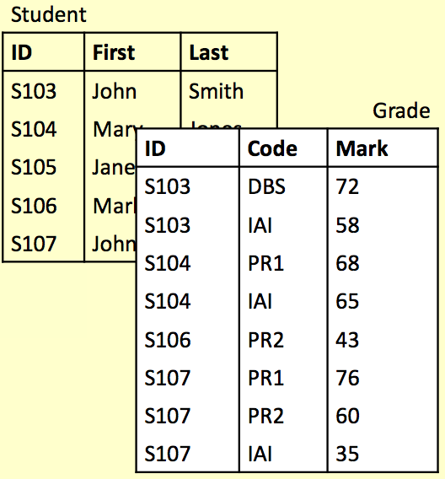
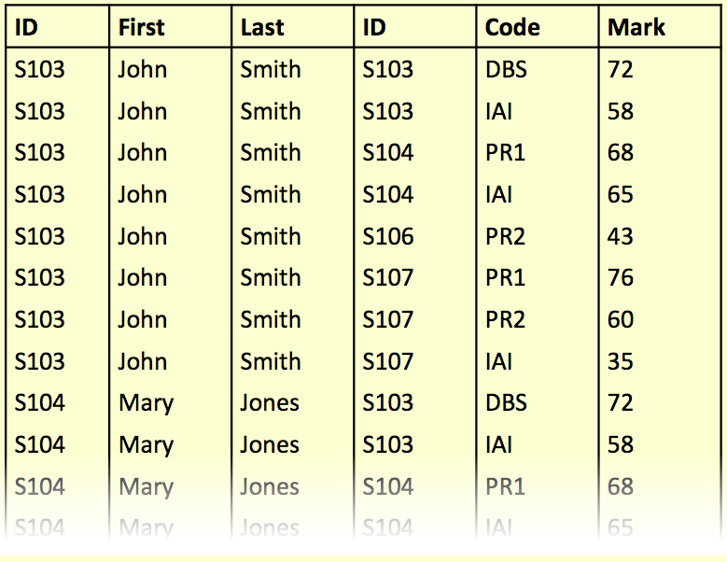
SELECT and Cartesian Product
Cartesian product of two tables can be obtained by using:
SELECT * FROM Student, Grade;
=SELECT * FROM Student CROSS JOIN Grade;
Notes:
In SQL, the Cartesian product is achieved using a CROSS JOIN. When you perform a CROSS JOIN between two tables, it returns the Cartesian product of the two, which means it pairs every row from the first table with every row from the second table; You can also achieve the same result by simply selecting from multiple tables without an explicit join condition:

Slide 24
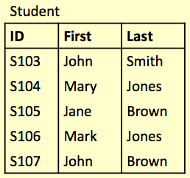
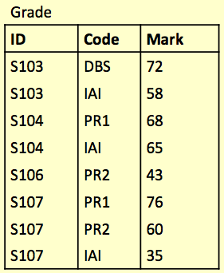
student[0]
student[1]
student[2]
student[3]
student[4]
SELECT * FROM Student, Grade;
grade[1]
grade[1]
…
student[0] + grade[0]
student[0] + grade[1]
student[0] + grade[2]
student[0] + grade[3]
student[0] + grade[4]
student[0] + grade[5]
student[0] + grade[6]
student[0] + grade[7]
student[1] + grade[0]
student[1] + grade[1]
student[1] + grade[2]
student[1] + grade[3]
student[1] + grade[4]
…
40 rows in total !

Slide 25
SELECT and Cartesian Product
If the tables have columns with the same name, ambiguity will result.
This can be resolved by referencing columns with the table name:
TableName.ColumnName
For example:
The statement below is wrong (ambiguous):
SELECT Student.ID FROM Student, Grade WHERE Student.ID = Grade.ID;
SELECT ID FROM Student, Grade
WHERE Student.ID = Grade.ID;

Slide 26
Cartesian Product: Practical Example
In this example, we want to find the names and marks of students.
SELECT
First, Last, Mark
FROM Student, Grade
WHERE
(Student.ID = Grade.ID)
AND (Mark >= 40);

Slide 27
SELECT ... FROM Student, Grade WHERE ...

Slide 28
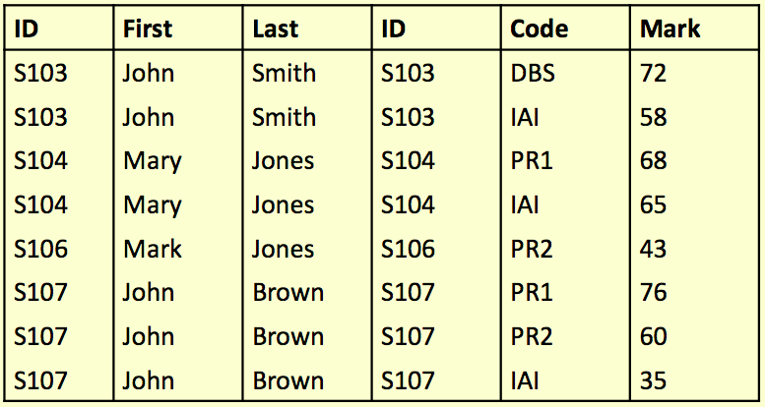
SELECT ... FROM Student, Grade WHERE
(Student.ID = Grade.ID) AND ...

Slide 29
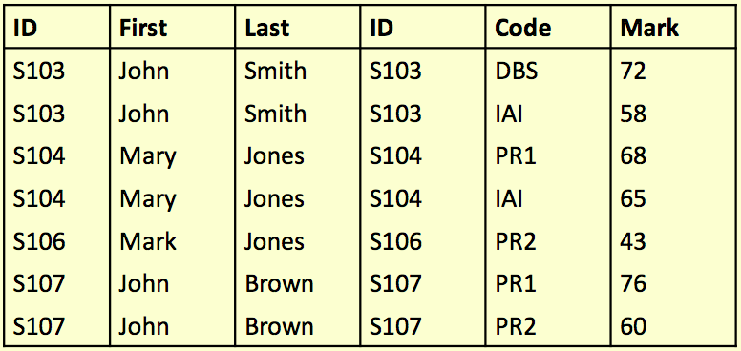
SELECT ... FROM Student,Grade
WHERE (Student.ID = Grade.ID)
AND (Mark >= 40)

Slide 30
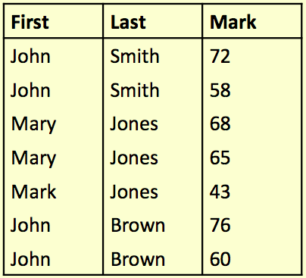
SELECT First, Last, Mark
FROM Student, Grade
WHERE (Student.ID = Grade.ID)
AND (Mark >= 40)

Slide 31
SELECT from Multiple Tables
WHERE clause is a key feature when selecting from multiple tables.
Unrelated combinations can be filtered out.
Another query example with 3 tables:
SELECT * FROM
Student, Grade, Course
WHERE
Student.ID = Grade.ID AND
Course.Code = Grade.Code

Slide 32
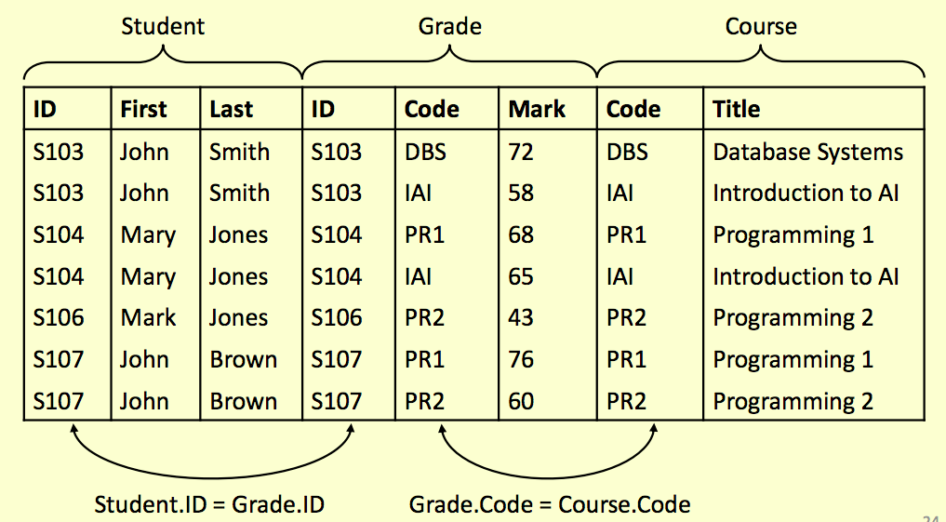

Slide 33
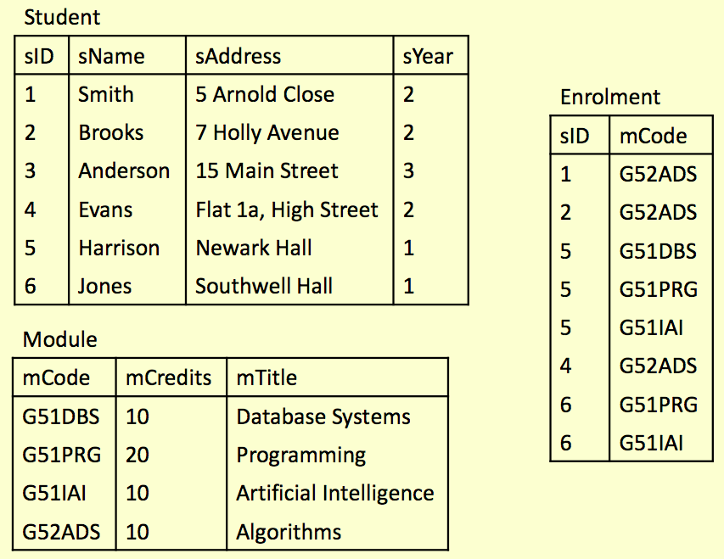

Slide 34



Try It Yourself
Write SQL statements to do the following:
Produce a list of all student names and all their enrolments (module codes)
Find a list of module titles being taken by the student named “Harrison”
Find a list of module codes and titles for all modules currently being taken by first year students

Slide 35
SELECT sName, mCode
FROM Student, Enrolment
WHERE Student.sID = Enrolment.sID;
SELECT mTitle
FROM Module, Student, Enrolment WHERE(Module.mCode = Enrolment.mCode)
AND(Student.sID = Enrolment.sID)
AND Student.sName = ‘Harrison’;
SELECT Module.mCode, mTitle
FROM Enrolment, Module, Student
WHERE (Module.mCode = Enrolment.mCode)
AND (Student.sID = Enrolment.sID)
AND sYear = 1;

Slide 36
Aliases
Aliases rename columns or tables
Can make names more meaningful
Can shorten names, making them easier to use
Can resolve ambiguous names
Column alias
Table alias
SELECT column [AS] new-col-name
The AS keyword is optional
SELECT * FROM table [AS] new-table-name

Slide 37
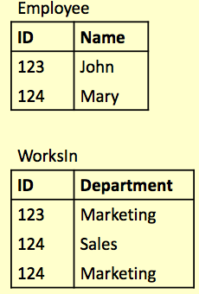
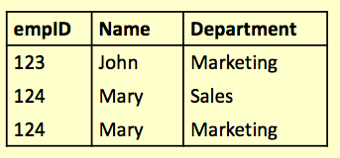
Alias Example
SELECT
E.ID AS empID,
E.Name, W.Department FROM
Employee E,
WorksIn W
WHERE
E.ID = W.ID;
Note: You cannot use a column alias in a WHERE clause:
...WHERE E.ID AS empID = W.ID;
Wrong!
Notes:
Question:
Since the where clause is the second step, can you use empID in the where clause?

Slide 38
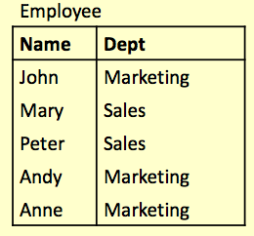
Aliases and ‘Self-Joins’
Aliases can be used to copy a table, so that it can be combined with itself.
The example below finds the names of all employees who work in the same department as Andy.
SELECT A.Name FROM
Employee A,
Employee B
WHERE
A.Dept = B.Dept
AND
B.Name = 'Andy';

Slide 39
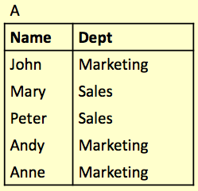
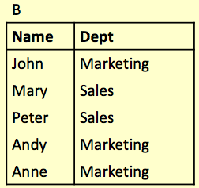
Aliases and ‘Self-Joins’
Employee A
Employee B

Slide 40
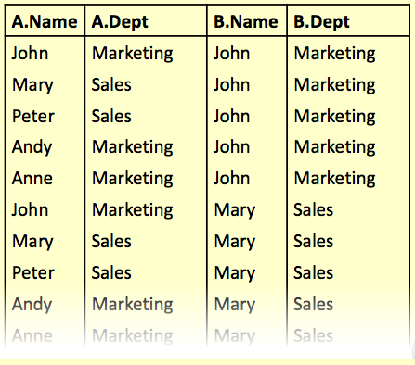
Aliases and ‘Self-Joins’
SELECT ... FROM Employee A, Employee B ...

Slide 41
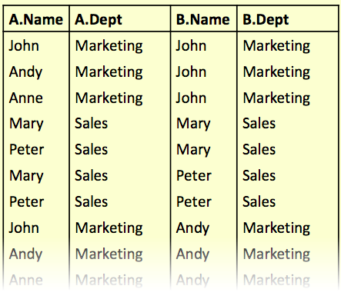
Aliases and ‘Self-Joins’
SELECT ... FROM Employee A, Employee B
WHERE A.Dept = B.Dept ...

Slide 42
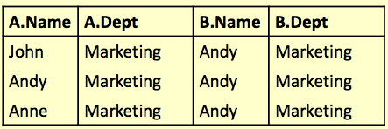
Aliases and ‘Self-Joins’
SELECT ... FROM Employee A, Employee B
WHERE A.Dept = B.Dept
AND B.Name = 'Andy';

Slide 43

Aliases and ‘Self-Joins’
SELECT A.Name
FROM Employee A, Employee B
WHERE A.Dept = B.Dept
AND B.Name = 'Andy';
Names of all employees who work in the same department as Andy.

Slide 44
Subqueries
Handling sets returned by subqueries

Slide 45
Subqueries
A SELECT statement can be nested inside another query to form a subquery
The results of the subquery are passed back to the containing query
For example, retrieve a list of names of people who are in Andy’s department:
SELECT Name FROM Employee
WHERE Dept =
(SELECT Dept FROM Employee
WHERE Name = 'Andy')

Slide 46
Subqueries
The first FROM part is evaluated.
For each row of Employee, we check whether Dept equals to the result of:
Then the columns will be filtered with the SELECT expressions.
SELECT Dept FROM Employee WHERE Name = 'Andy')
3
1
SELECT Name FROM Employee
WHERE Dept =
(SELECT Dept
FROM Employee
WHERE Name = 'Andy')
2.4
2.3
2
2.1
2.2

Slide 47
Subqueries and Aliases
You can use a subquery between FROM and WHERE.
But the result must be renamed:
SELECT * FROM
(SELECT name, email FROM teachers) AS t
WHERE t.email IS NOT NULL;
This is because that the result of a subquery does not have a table name.

Slide 48
Subqueries
Often a subquery will return a set of values rather than a single value
We cannot directly compare a single value to a set. Doing so will result in an error
Options for handling sets
IN : checks to see if a value is in a set
EXISTS : checks to see if a set is empty
ALL/ANY : checks to see if a relationship holds for every/one member of a set
NOT : can be used with any of the above 4

Slide 49
Handling sets: IN
Using IN we can see if a given value is in a set of values
NOT IN checks to see if a given value is not in the set
The set can be given explicitly or can be produced in a subquery
SELECT columns FROM tables
WHERE col IN set;
SELECT columns FROM tables
WHERE col NOT IN set;
SELECT id FROM student
WHERE id IN ('S103', 'S104');

Slide 50
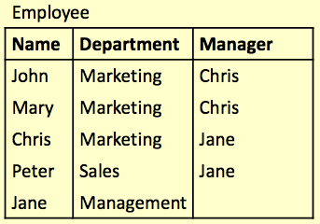
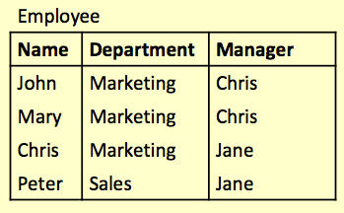
SELECT * FROM Employee
WHERE Department IN ('Marketing', 'Sales');

Slide 51
SELECT * FROM Employee
WHERE Department = 'Marketing'
OR Department = 'Sales';

Slide 52
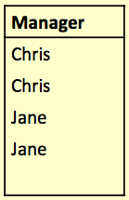
Handling sets: NOT IN
SELECT * FROM Employee
WHERE Name NOT IN
(SELECT Manager
FROM Employee);
The query is equivalent to:
SELECT * FROM Employee
WHERE Name NOT IN
('Chris', 'Jane');

Slide 53
Handling sets: EXISTS
Using EXISTS we can see whether there is at least one element in a given set.
NOT EXISTS is true if the set is empty
The set is always given by a subquery
SELECT columns
FROM tables
WHERE EXISTS set;
SELECT columns
FROM tables
WHERE NOT EXISTS set;

Slide 54
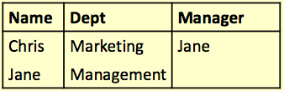
Handling sets: EXISTS
Retrieve all the info for those employees who are also managers:
SELECT * FROM
Employee AS E1
WHERE EXISTS
(SELECT * FROM
Employee AS E2
WHERE E1.Name = E2.Manager);
Notes:
the subquery for each employee returns a boolean result (True or False), indicating whether that employee manages at least one other employee. The final result only includes employees who are managers.

Slide 55
Handling sets: ANY and ALL
ANY and ALL compare a single value to a set of values
They are used with comparison operators like = , >, <, <>, >=, <=
val = ANY (set)
is true if there is at least one member of the set equal to value
val = ALL (set)
is true if all members of the set are equal to the value

Slide 56
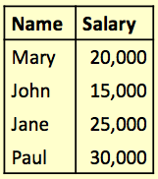

Handling sets: ALL
Find the name(s) of the employee(s) who earn the highest salary
Employee:
SELECT Name
FROM Employee
WHERE Salary >=
ALL (
SELECT Salary
FROM Employee);

Slide 57
Handling sets: ANY
Find the name(s) of the employee(s) who earn more than someone else

Slide 58

Handling sets: ANY
Find the name(s) of the employee(s) who earn more than someone else
SELECT Name
FROM Employee
WHERE Salary >
ANY (
SELECT Salary
FROM Employee);

