Slide 1

Group G97-MuseumMate
Team members:
Xibei Chen
Lian Feng
Jingqi Hong
Wenping Tu
Churi Yang

Slide 2
Project Overview
MuseumMate is an AI-driven intelligent museum navigation system designed to address two core pain points in traditional museum visits—crowd congestion and homogenized experiences—through personalized route planning and contextual storytelling.
Core Philosophy
Adopting a "people-centric" approach, the system leverages AI technology to deliver dynamic navigation and immersive interactions, enhancing the accessibility and inclusivity of cultural resources.

Slide 3
2.Problem & Solution
Problem 1: Inefficient Visitor Flow
Overcrowding at popular exhibits
Underutilization of less-visited artifacts
Poor visitor experience & resource waste
Our AI Solution: MuseumMate
Smart Routing
AONSGA algorithm optimizes for distance + congestion [3]
Contextual Narration
RAG framework ensures accurate, traceable storytelling [2]
Problem 2: Lack of Personalization
Standardized audio guides fail to adapt
No consideration for time, interest, or accessibility
References:
[2] Y. Xu et al., "Multi-objective Route Planning based on Improved NSGA-II," 2021.
[3] Y. Hu, "MuseRAG++: A Deep Retrieval-Augmented Framework," 2025.

Slide 4
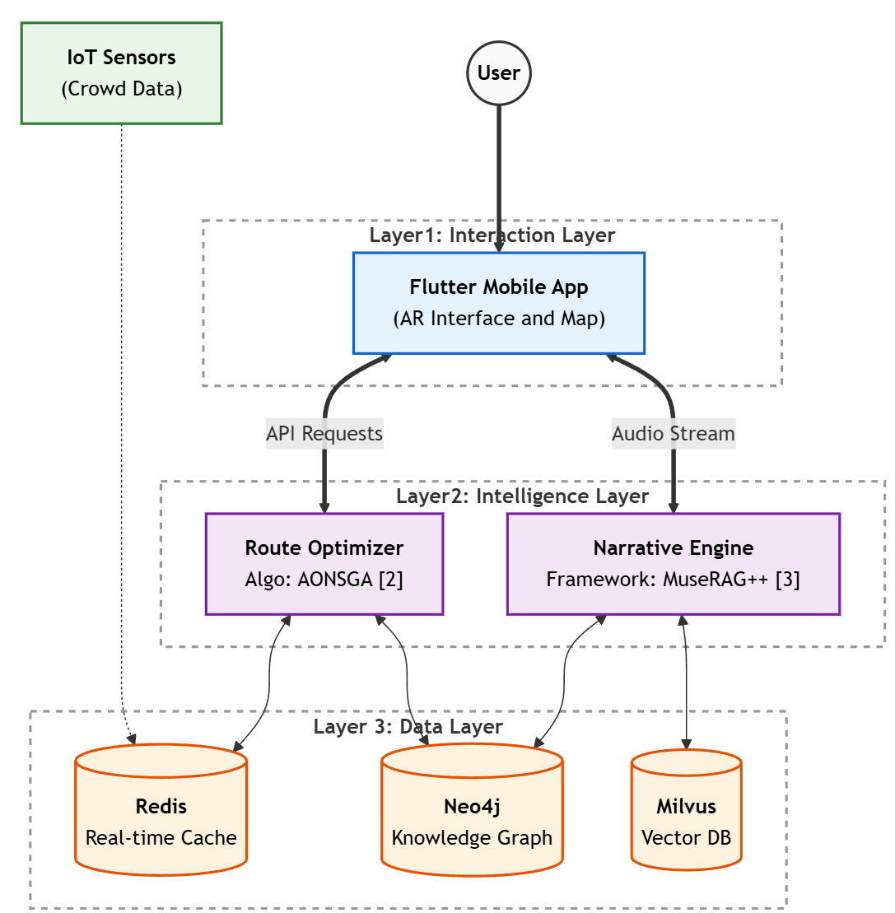
3.Operating Principles: Hybrid Microservices Architecture
System Architecture: A Hybrid Microservices Architecture structured into three layers: Interaction, Intelligence, and Data.
Dynamic Routing: Powered by the AONSGA algorithm [2] as a backend service, enabling multi-objective optimization to balance real-time crowd density and distance.
Trustworthy Storytelling: Driven by the MuseRAG++ framework [3], utilizing hybrid retrieval (BM25 + Vector) and provenance-aware generation to eliminate AI hallucinations.
References:
[2] Y. Xu et al., "Multi-objective Route Planning based on Improved NSGA-II," 2021.
[3] Y. Hu, "MuseRAG++: A Deep Retrieval-Augmented Framework," 2025

Slide 5
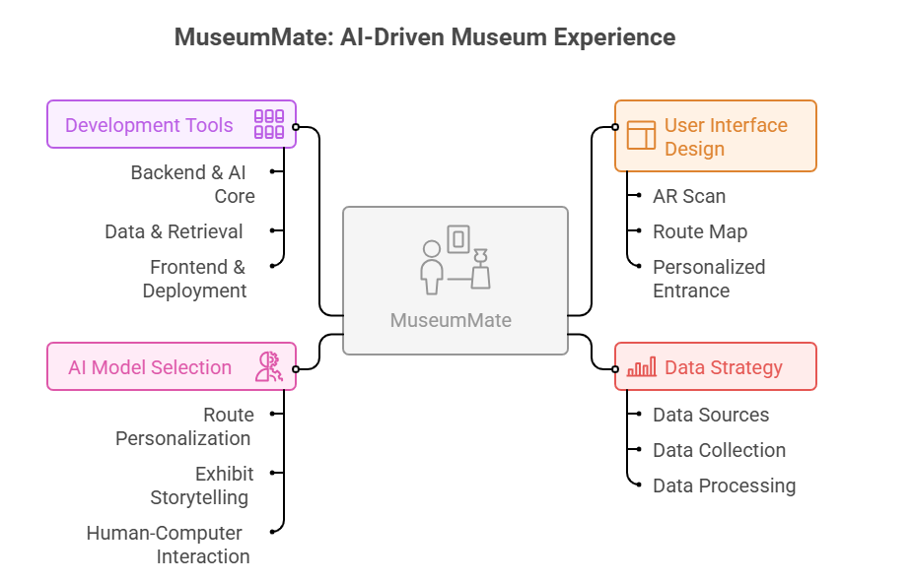
4. Technical Development
Reference
Vasic, I., et al. (2024). LLM-aided museum guide: Personalized tours based on user preferences
3. Xu, Y., Guo, Q., Tan, A., Xu, L., Tu, Y., & Liu, S. (2021). Multi-objective Route Planning of Museum Guide based on an Improved NSGA-II Algorithm.

Slide 6
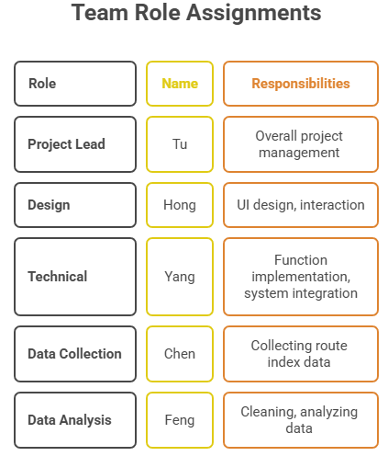
Assignment
Proper role assignments ensure efficient progress and complementary capabilities.
Additionally, leveraging the study of the SAT101 course, the other 4 team members also actively participate in the AI development.

Slide 7
5. Summary, Future Directions & Implications
Summary: Museum Mate leverages AI technology to enable personalized guidance and immersive interaction, enhancing both visitor experiences and museum operational efficiency.
Future Directions:
1. Expand to more museums and cultural heritage scenarios
2. Integrate additional AR/VR interactive features
3. Optimize multilingual and accessibility support
Social Value:
1. Promote equitable access to cultural resources
2. Enhance museums’ educational function , a practical embodiment of the concept that "AI-generated characters can become invaluable educational tools when thoughtfully implemented." [1]
and social inclusivity aligns with research showing that "Such systems improve user engagement and interpretability across diverse groups." [2]
References:
[1] S. Wang et al., "ArtRAG: Structured Context Retrieval-Augmented Framework for Artwork Explanation Generation," University of Amsterdam.
[2] Y. Xu et al., "Multi-objective Route Planning based on Improved NSGA-II," 2021.

Slide 8

THANK YOU

