Slide 1
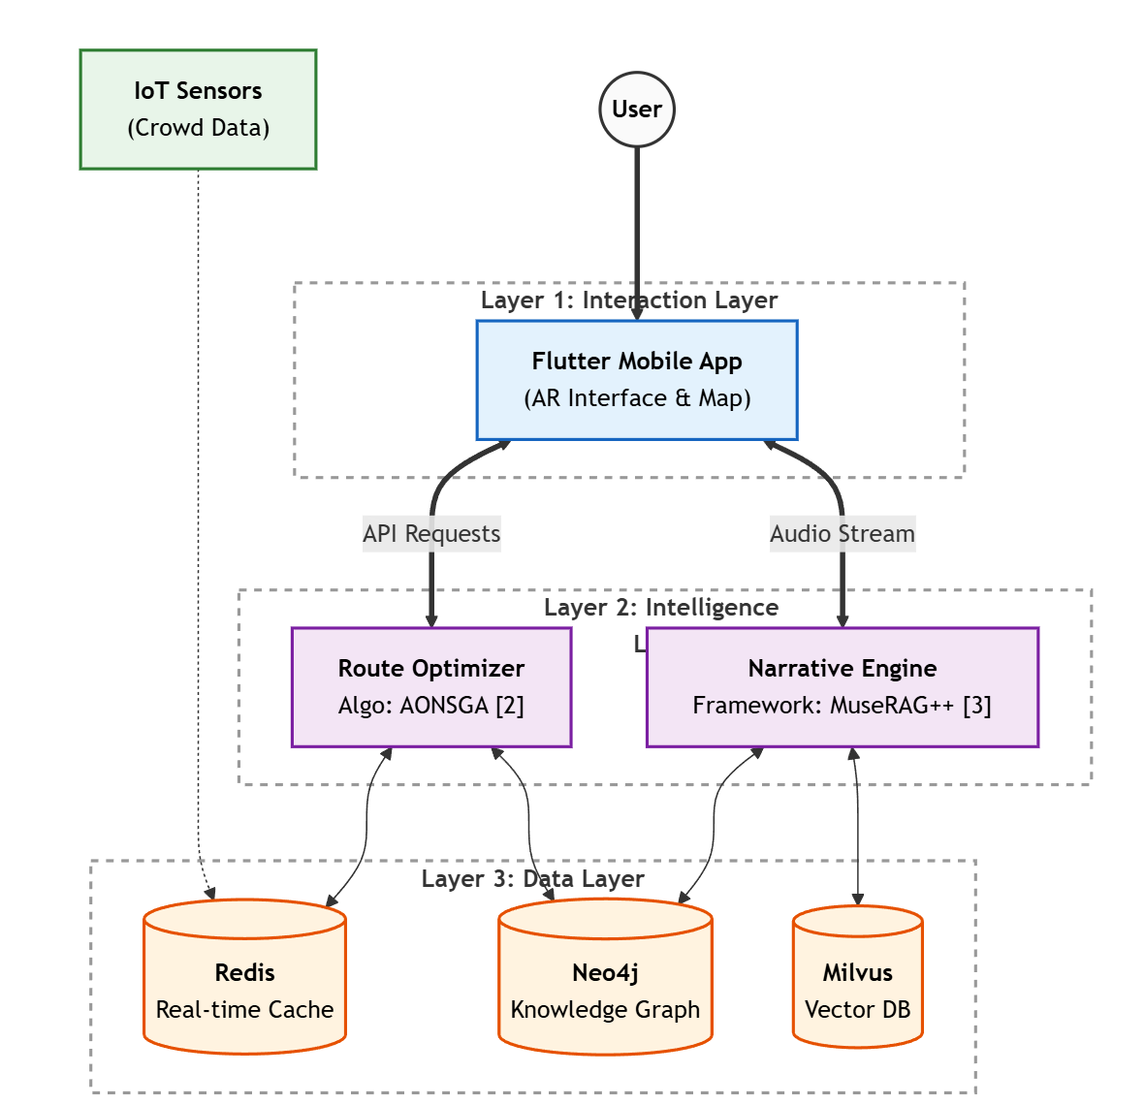
3.Operating Principles: Hybrid Microservices Architecture
System Architecture:A Hybrid Microservices Architecture structured into three layers: Interaction, Intelligence, and Data.
Dynamic Routing: Powered by the AONSGA algorithm [2] as a backend service, enabling multi-objective optimization to balance real-time crowd density and distance.
Trustworthy Storytelling: Driven by the MuseRAG++ framework [3], utilizing hybrid retrieval (BM25 + Vector) and provenance-aware generation to eliminate AI hallucinations.
References:
[2] Y. Xu et al., "Multi-objective Route Planning based on Improved NSGA-II," 2021.
[3] Y. Hu, "MuseRAG++: A Deep Retrieval-Augmented Framework," 2025

