Slide 1
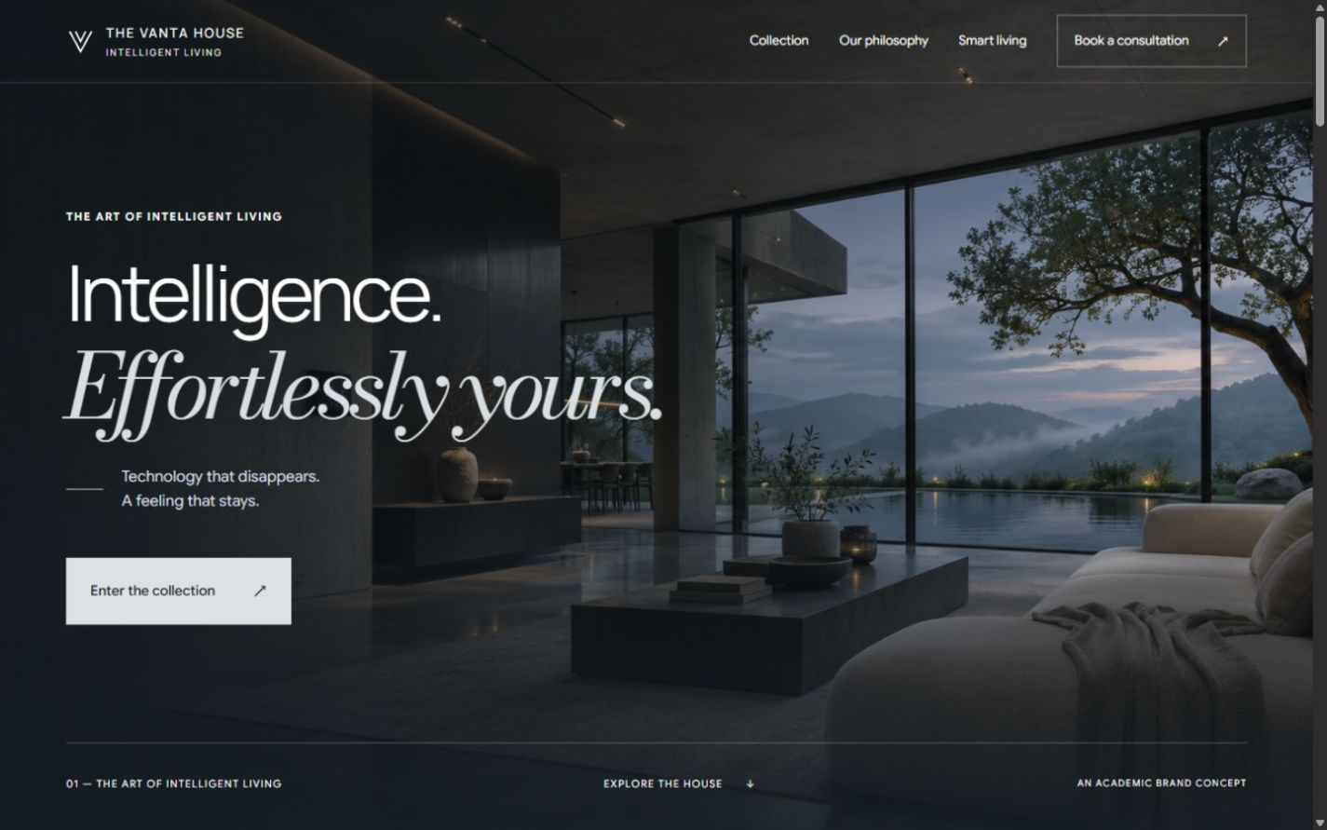
PART 03 / WEBSITE DEVELOPMENT OVERVIEW
A Digital Showroom for Intelligent Living in India
Introduction, Core Brand Purpose and Strategic Project Objectives
PROJECT CONTEXT & OBJECTIVES
Brand Introduction: The Vanta House is an Indian premium smart-home technology academic concept, blending architectural minimalism with ambient intelligence.
Core Purpose: Create an ultra-refined, pitch-black digital presence that elevates smart living from cluttered gadgets into timeless architectural objects.
Key Objectives: Establish brand credibility, showcase 4 proprietary titanium devices, maintain zero-friction responsive browsing, and generate high-intent consultation leads.
Team Role & Attribution: Designed & developed by Y7XIFIED, encompassing full-stack web development, SEO keyword mapping, on-page optimization, and lead handling.
FIGURE 1.1: Live Homepage Hero Interface (Pitch-Black Aesthetic)
THE VANTA HOUSE · DIGITAL MARKETING ASSIGNMENT
DESIGNED & DEVELOPED BY Y7XIFIED
01 / 10

Slide 2
PART 03 / WEBSITE STRUCTURE
Information Architecture & Navigation Flow
Comprehensive Sitemap: Five Core Destinations and Ten Pre-Rendered Routes
01
02
03
04
05
Home Page (/)
Collection (/products/)
Smart Living (/smart-living/)
Philosophy (/philosophy/)
Contact (/contact/)
BRAND FOUNDATION
HARDWARE SHOWCASE
EXPERIENTIAL CONTEXT
BRAND AUTHORITY
LEAD ACQUISITION
Cinematic hero, brand manifesto, interactive 3D residence model, spatial gallery, and conversion gateway.
Filterable catalog featuring all four titanium concepts, clear pricing, specifications, and direct enquiry CTAs.
Time-sequenced domestic scenarios (07:00, 09:00, 14:00, 18:30) demonstrating subtle automation routines.
Articulating three pillars: Design with Restraint, Intelligence with Purpose, and People at the Centre.
Interactive consultation request form with multi-tier input validation and real-time verification.
USER CONVERSION FUNNEL: AWARENESS (Home) ➔ INTEREST (Smart Living) ➔ CONSIDERATION (Collection & Product Details) ➔ CONVERSION (Consultation Enquiry)
THE VANTA HOUSE · DIGITAL MARKETING ASSIGNMENT
DESIGNED & DEVELOPED BY Y7XIFIED
02 / 10

Slide 3
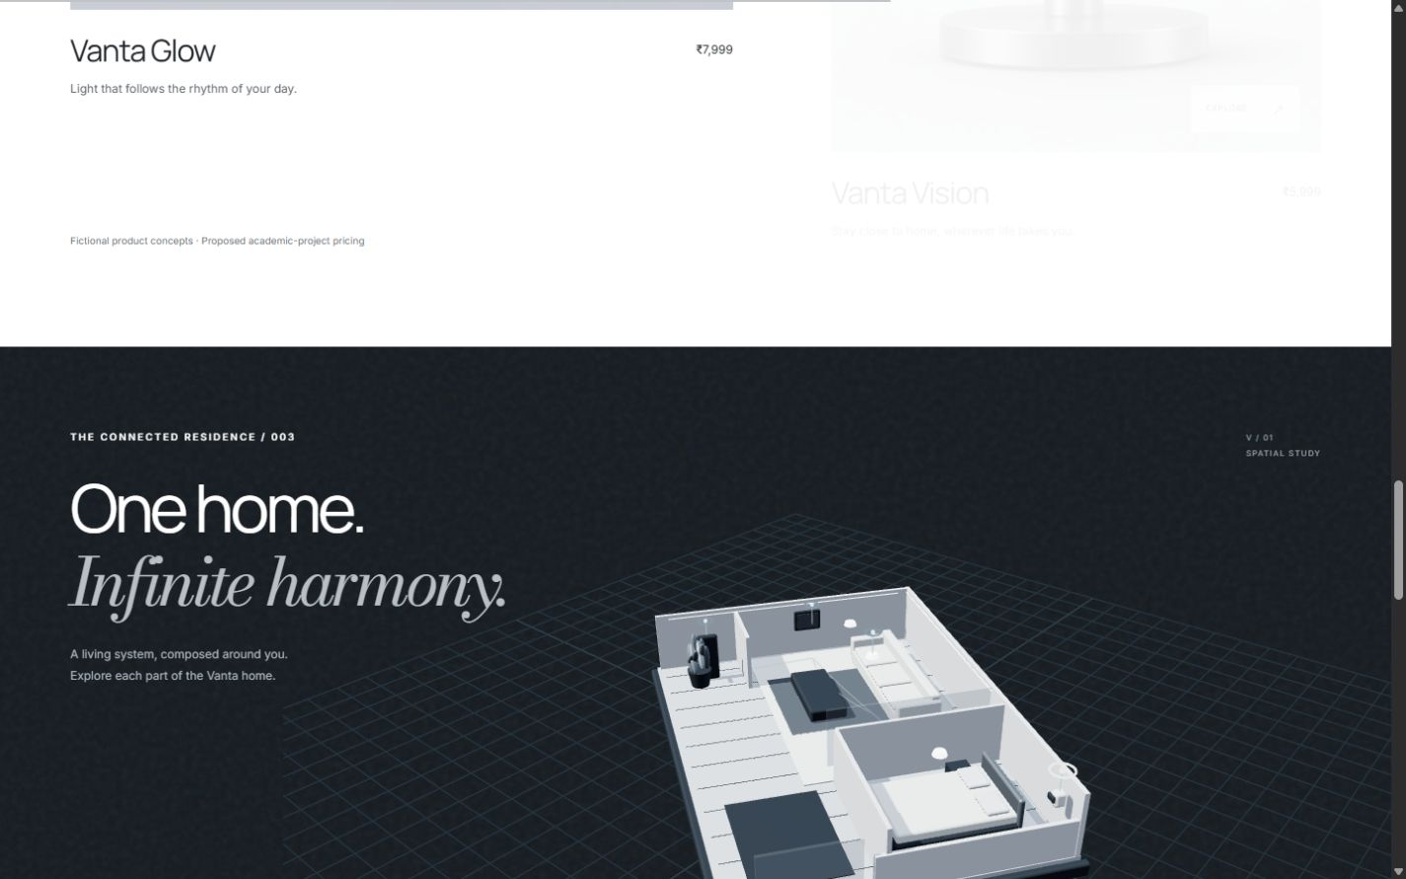
PART 03 / HOMEPAGE DESIGN
Homepage Layout, Branding & High-Intent CTA System
Restrained Luxury Aesthetic Combining Pitch-Black Canvas with Smooth Micro-Interactions
Titanium Minimalism Styling: Crafted with a pitch-black background (#000000), deep titanium graphite accents, and high-contrast typography in Google Sans Flex.
Hero Architecture & Layout: Features cinematic architecture, an unhurried editorial headline, and dual call-to-actions ("Enter the collection" and "Explore the house").
Kinetic Brand Marquee: A continuously gliding marquee showcasing "CONSIDERED DESIGN ✳ INTUITIVE LIVING ✳ QUIET INTELLIGENCE" in crisp white bold font with glowing star marks.
Interactive 3D Spatial Canvas: WebGL Three.js architectural house model allowing visitors to drag, rotate, inspect room routines, and trigger live lighting cues.
FIGURE 3.1: Interactive 3D Connected Residence Model (Three.js WebGL)
THE VANTA HOUSE · DIGITAL MARKETING ASSIGNMENT
DESIGNED & DEVELOPED BY Y7XIFIED
03 / 10

Slide 4
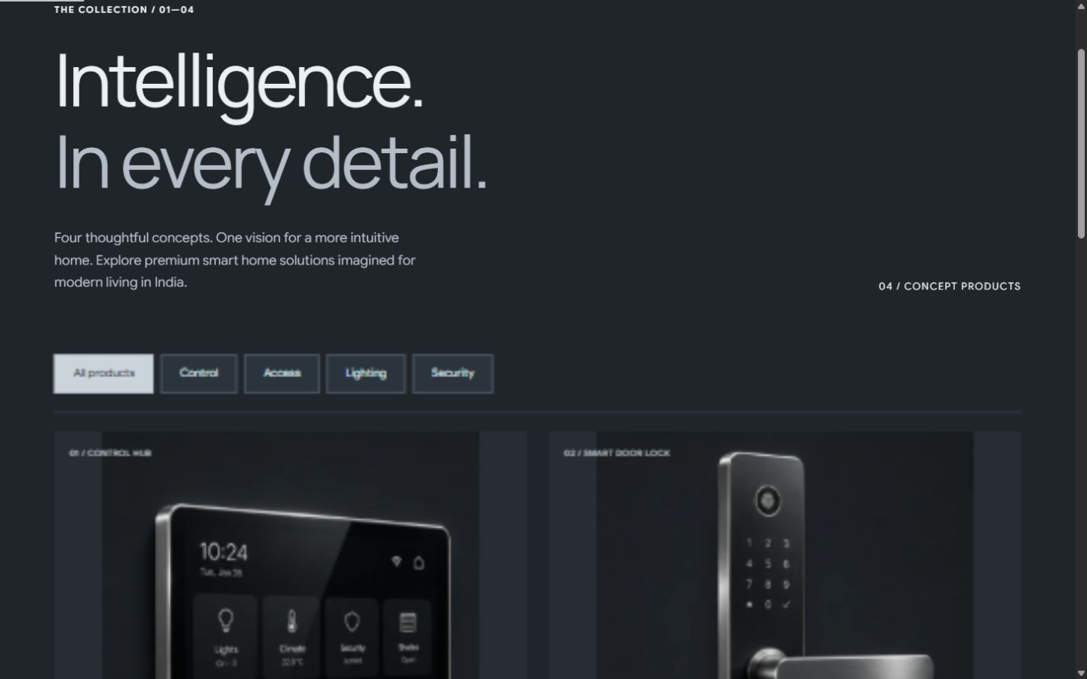
PART 03 / PRODUCT SHOWCASE
The Titanium Collection: Four Smart Home Devices
Hardware Specifications, Balanced 4-Column Presentation and Transparent Academic Pricing
CONTROL HUB
SMART DOOR LOCK
SMART LIGHTING
SECURITY CAMERA
Vanta Core
₹24,999
Vanta Secure
₹14,999
Vanta Glow
₹7,999
Vanta Vision
₹5,999
Central touchscreen hub · Climate & lighting automation · Scene selector · Ambient sensor array
Biometric fingerprint scanner · Backlit PIN pad · Encrypted RFID entry · Titanium deadbolt
Circadian rhythm synchronization · Flush architectural ceiling mount · Smooth warm dimming
Discreet 4K HDR vision · On-device edge privacy processing · Physical mechanical privacy shutter
COLLECTION SHOWCASE FEATURES:
• Balanced 4-Column Showcase: Eliminated awkward gaps with an evenly-spaced, compact luxury card layout.
• Dedicated Squircle Geometry: Curved 22px squircle radiuses applied directly to image frames to ensure smooth edges.
• Frictionless Conversion Bridge: Each device card links directly to a pre-filled consultation enquiry form.
THE VANTA HOUSE · DIGITAL MARKETING ASSIGNMENT
DESIGNED & DEVELOPED BY Y7XIFIED
04 / 10

Slide 5
PART 03 / HTML, CSS & JAVASCRIPT
Frontend Architecture, Technologies & Code Snippets
Zero-Bloat Semantic HTML5, Modular CSS Design System & ES6+ Modules
Semantic HTML5 Architecture: Built using semantic containers (<main>, <section>, <article>, <dialog>) compiled into production-ready static HTML at build time for instant loading.
CORE ARCHITECTURE CODE SNIPPET (render.mjs / dark.css)
/* 1. Balanced 4-Column Showcase Grid */
.catalog .product-grid {
display: grid !important;
grid-template-columns: repeat(4, minmax(0, 1fr)) !important;
gap: 20px !important;
max-width: 1400px !important;
}
/* 2. Squircle Image Geometry */
.product-visual img {
width: clamp(120px, 12vw, 160px) !important;
aspect-ratio: 1 / 1 !important;
border-radius: 20px !important;
mix-blend-mode: normal !important;
}
// 3. Client Validation & Submission
const res = await fetch('/api/enquiry', {
method: 'POST',
headers: { 'Content-Type': 'application/json' },
body: JSON.stringify(formData)
});
CSS Design Tokens & Modern Grids: Modern CSS custom properties define squircle curvature (--squircle-md: 22px) and AMOLED dark surfaces, combined with dynamic CSS Grid and Flexbox.
Lightweight Client-Side JavaScript: Native ES6+ modules power dynamic collection category filters, modal dialog previews, and real-time form validation without bulky third-party frameworks.
GSAP Motion & Three.js 3D Engine: Fluid scroll choreographies driven by GSAP ScrollTrigger paired with an interactive Three.js canvas for architectural residence exploration.
THE VANTA HOUSE · DIGITAL MARKETING ASSIGNMENT
DESIGNED & DEVELOPED BY Y7XIFIED
05 / 10

Slide 6
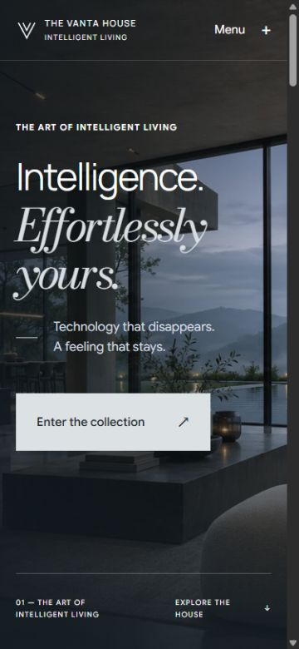
PART 03 / RESPONSIVE WEB DESIGN
Mobile, Tablet & Desktop Viewport Adaptability
Rigorous Cross-Device Testing: 30 Route & Viewport Checks with Zero Overflow
Mobile Optimization (375px - 480px): Seamless single-column reflow, comfortable 44px+ touch targets, full-screen slideout menu drawer, and compact squircle product cards.
Tablet Adaptability (768px - 1024px): Balanced 2-column grid adaptation, fluid clamp() typography scaling, and streamlined multi-step enquiry layouts.
Desktop Canvas (1280px - 1440px+): Spacious 4-column product showcase, expansive Three.js 3D stage, and interactive spatial carousel with hover elevation.
Accessibility & Reduced Motion: Full compliance with prefers-reduced-motion media queries, accessible high-contrast text ratios, and skip-to-content keyboard bypass.
FIGURE 6.1: Side-by-Side Mobile (375px) and Desktop (1440px) Viewport Renders
THE VANTA HOUSE · DIGITAL MARKETING ASSIGNMENT
DESIGNED & DEVELOPED BY Y7XIFIED
06 / 10

Slide 7
PART 03 / SEO KEYWORD RESEARCH
Strategic Search Intent Architecture & Keyword Mapping
Targeting High-Intent Discovery, Brand Affinity & Consultation Searches across India
INFORMATIONAL / DISCOVERY
PRIMARY KEYWORD: "Premium smart home solutions"
Homepage (/)
SECONDARY KEYWORDS: Smart home automation India, intelligent living, architectural automation concepts
COMMERCIAL INVESTIGATION
PRIMARY KEYWORD: "Smart home devices India"
Collection (/products/)
SECONDARY KEYWORDS: Luxury home automation systems, smart home hardware ecosystem, titanium smart devices
HIGH-INTENT TRANSACTIONAL
PRIMARY KEYWORD: "Smart home control hub India (Core)"
Product Pages (/products/*)
SECONDARY KEYWORDS: Biometric smart door lock (Secure), smart lighting solutions (Glow), home security camera (Vision)
QUALIFIED LEAD CONVERSION
PRIMARY KEYWORD: "Smart home consultation India"
Contact (/contact/)
SECONDARY KEYWORDS: Custom home automation enquiry, luxury residential consultation, smart villa automation
THE VANTA HOUSE · DIGITAL MARKETING ASSIGNMENT
DESIGNED & DEVELOPED BY Y7XIFIED
07 / 10

Slide 8
PART 03 / ON-PAGE & TECHNICAL SEO
Metadata Architecture, Semantic Markup & Technical Indexing
Implemented Standards Verified Directly in Source Code without Speculative Overpromising
Unique Titles & Descriptions: Every route possesses handcrafted, high-relevance title tags and meta descriptions reflecting targeted consumer search intent.
ACTUAL SEO SOURCE CODE EVIDENCE (<head> Metadata)
<title>The Vanta House | Premium Smart Home Technology India</title>
<meta name="description" content="Explore premium smart home
technology by The Vanta House. Discover intelligent lighting,
smart security and connected home control concepts.">
<link rel="canonical" href="https://thevantahouse.vercel.app/">
<!-- Open Graph Social Protocol -->
<meta property="og:title" content="The Vanta House">
<meta property="og:type" content="website">
<meta property="og:image" content="/assets/hero.webp">
<!-- Schema.org Structured Data -->
<script type="application/ld+json">
{
"@context": "https://schema.org",
"@type": "WebSite",
"name": "The Vanta House",
"url": "https://thevantahouse.vercel.app"
}
</script>
Strict Heading Hierarchy: Strict adherence to single <h1> architecture per page, supported by structured <h2> and <h3> subheadings for clear crawler indexing.
Accessible Image Metadata: All WebP visuals incorporate descriptive alt attributes, alongside explicit width and height dimensions to eliminate Cumulative Layout Shift (CLS).
Technical Infrastructure: Automated /sitemap.xml generation, clean /robots.txt routing, self-referential canonical tags, and Schema.org WebSite JSON-LD structured data.
THE VANTA HOUSE · DIGITAL MARKETING ASSIGNMENT
DESIGNED & DEVELOPED BY Y7XIFIED
08 / 10

Slide 9
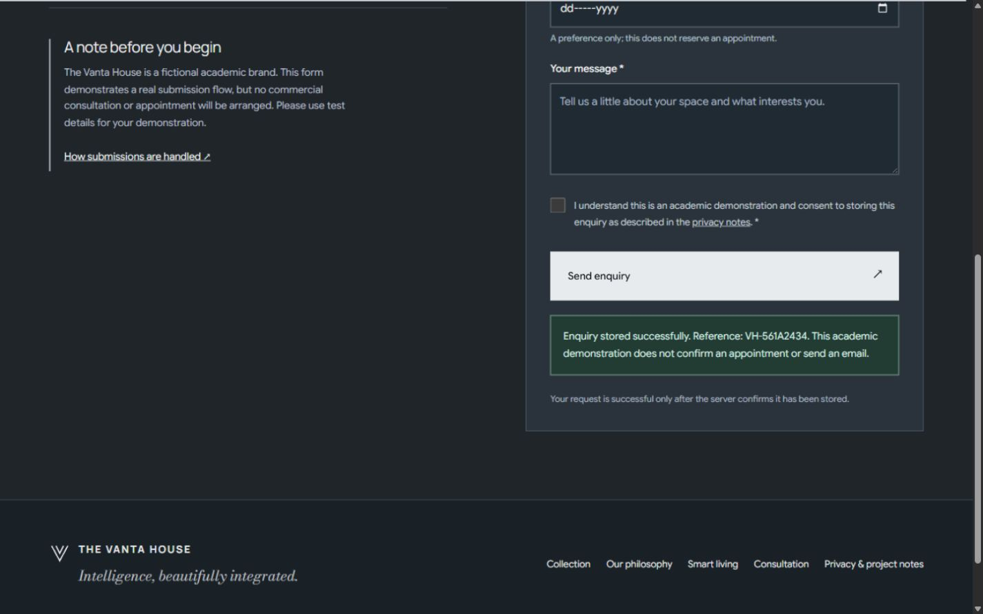
PART 03 / CUSTOMER ENQUIRY FORM
Customer Enquiry Form, Multi-Tier Validation & Lead Storage
Frictionless Consultation Requests Backed by Server-Side Verification and Duplicate Protection
Comprehensive Lead Form Fields: Captures Full Name, Email, Indian Phone (+91 validation), City, Product Interest dropdown, Enquiry Type, Date preference, and Project Message.
Indian Mobile & Regex Validation: Validates Indian 10-digit mobile phone numbers with optional +91 prefix while actively rejecting synthetic or malformed phone submissions.
Anti-Spam & Bot Defense: Employs a hidden honeypot trap field and minimum completion timestamp checks to thwart headless scrapers and automated bots.
Verified Storage & Idempotency: Form confirmation is generated only after server-side JSON persistence; identical retries return existing confirmation tokens without duplicates.
FIGURE 9.1: Live Submission Evidence with Unique Reference Confirmation
THE VANTA HOUSE · DIGITAL MARKETING ASSIGNMENT
DESIGNED & DEVELOPED BY Y7XIFIED
09 / 10

Slide 10

PART 03 / WEBSITE TESTING & CONCLUSION
Rigorous Quality Assurance, Live Deployment & Project Deliverables
Automated Test Suite Verification, Live Website Link and Mobile Scannable QR Code
AUTOMATED QA & PRODUCTION AUDIT METRICS
5 / 5
Backend Tests Passed
Validation, idempotency, spam defense, and cross-origin security
30 / 30
Route Viewport Checks
Zero layout shift or horizontal overflow across 375px, 768px, 1440px
0
Console Errors Observed
Clean runtime execution with smooth graceful fallbacks
PROJECT SUMMARY: The Vanta House successfully demonstrates how restrained aesthetic design, modern web architecture, and evidence-backed digital marketing converge into an effective, conversion-focused digital ecosystem.
SCAN TO EXPLORE LIVE WEBSITE
https://thevantahouse.vercel.app
GitHub: https://github.com/Y7XIFIED/thevantahouse
Author & Lead Developer: Y7XIFIED
THE VANTA HOUSE · DIGITAL MARKETING ASSIGNMENT
DESIGNED & DEVELOPED BY Y7XIFIED
10 / 10

