Slide 1
Stat 115 Lab 2
Phillip Nicol

Slide 2
Outline
STAR and SLURM
RseQC
RSEM and Salmon
Feel free to download slides on Canvas and login to Cannon.

Slide 3
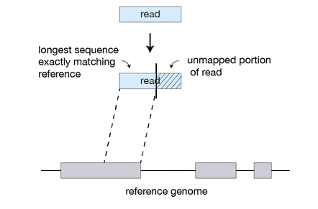
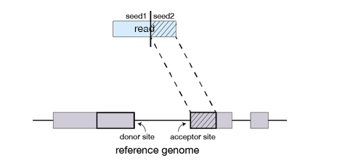
STAR (Spliced Transcripts Alignment to a Reference)
In RNA-seq, reads come from non-contiguous locations in the genome (due to splicing). An aligner must be aware of this.

Slide 4
STAR
Fast at the expense of being memory intensive (~30GB of RAM required for alignment human genome).
Therefore, the computation needs to be done on Cannon.
STAR Reference manual: https://physiology.med.cornell.edu/faculty/skrabanek/lab/angsd/lecture_notes/STARmanual.pdf

Slide 5
Cannon
Simple version: Cannon is a lot of small computers (nodes) combined to be one giant computer.
Login nodes are for logging on to the cluster and browsing files. No intensive computations should (can) be run on login nodes.
Compute nodes are for doing intensive computations (like STAR).

Slide 6
SLURM
How do I get from the login node to a compute node?
You need to specify what you need (RAM, CPUs). Other users are also asking for resources.
SLURM (Simple Linux Utility for Resource Management) manages user requests on Cannon.

Slide 7
SLURM
For STAR, I might want to ask for 64GB of RAM and 16 CPUs for 2 hours
srun --nodes=1 --ntasks-per-node=1 --mem=64G --cpus-per-task=8 --time=02:00:00 --pty bash -i

Slide 8

SLURM
For STAR, I might want to ask for 64GB of RAM and 16 CPUs for 2 hours
srun --nodes=1 --ntasks-per-node=1 --mem=64G --cpus-per-task=8 --time=02:00:00 --pty bash -i

Slide 9
SLURM
The more resources you ask for, the longer it takes. Try to run the following small job now:
srun --nodes=1 --ntasks-per-node=1 --mem=8G --cpus-per-task=1 --time=00:10:00 --pty bash -i
Type exit to go back to the login node.

Slide 10
STAR Guide – 1. Start the job and load module
Start an interactive job with sufficient resources. Batch jobs are also possible but harder to troubleshoot.
Go to your home directory if you are not already there by typing cd ${HOME}
Load STAR with module load STAR/2.6.0c-fasrc01
The basic command is STAR followed by a list of options.

Slide 11
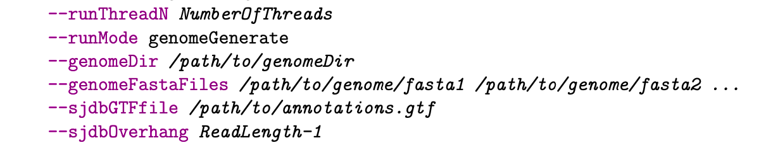
STAR Guide – 2. Make the index (NOT REQUIRED FOR HW)
We have already done this for you and have saved the output to /n/stat115/2021/HW1/index/star_hg38_index
If you want to try it yourself (in your home folder), the raw human genome sequence files are in /n/stat115/2021/HW1/index/hg38_raw

Slide 12
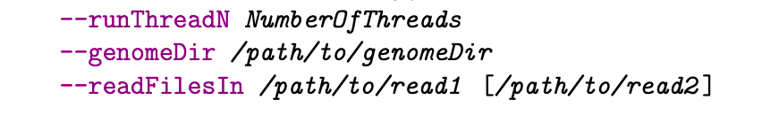
STAR Guide – 3. Perform alignment
STAR –-genomeDir <INDEX PATH> --readFilesIn <FASTQ FILES> --runThreadN 8
Run time is around 15 minutes.

Slide 13
STAR Guide – 4. View the results
STAR will create some output files that will be useful for answering problem 1 on the homework. What is the fastest way to view the contents of a file?

Slide 14
STAR Guide – 4. View the results
STAR will create some output files that will be useful for answering problem 1 on the homework. What is the fastest way to view the contents of a file?
cat <filename>

Slide 15
STAR Guide – 4. View the results
STAR will create some output files that will be useful for answering problem 1 on the homework. What is the fastest way to view the contents of a file?
cat <filename>
For Problem 1, please include the relevant parts of the output file as well as the commands that you used to generate the results.

Slide 16
Common mistakes on homework
Not specifying adequate time for the job (default is 5 minutes, you will want to specify at least 30 minutes, probably more).
Choosing runThreadN to be larger than --cpus-per-task (I normally choose threads to be half of the number of cpus I’ve requested).
Saving the output to /n/stat115 (Save the output to your home folder, we will delete any output saved to Stat 115).

Slide 17
RSeQC
mRNA is an unstable molecule. It is important to check if your sample has been degraded before performing further analysis.
RSeQC is a Python package (collection of scripts) that provides some measures of sample/transcript quality:
tin.py computes the Transcript Integrity Number (TIN), which is a measure of quality for each transcript. MedTIN takes the median transcripts across samples.
geneBody_coverage.py makes a gene body coverage plot.

Slide 18
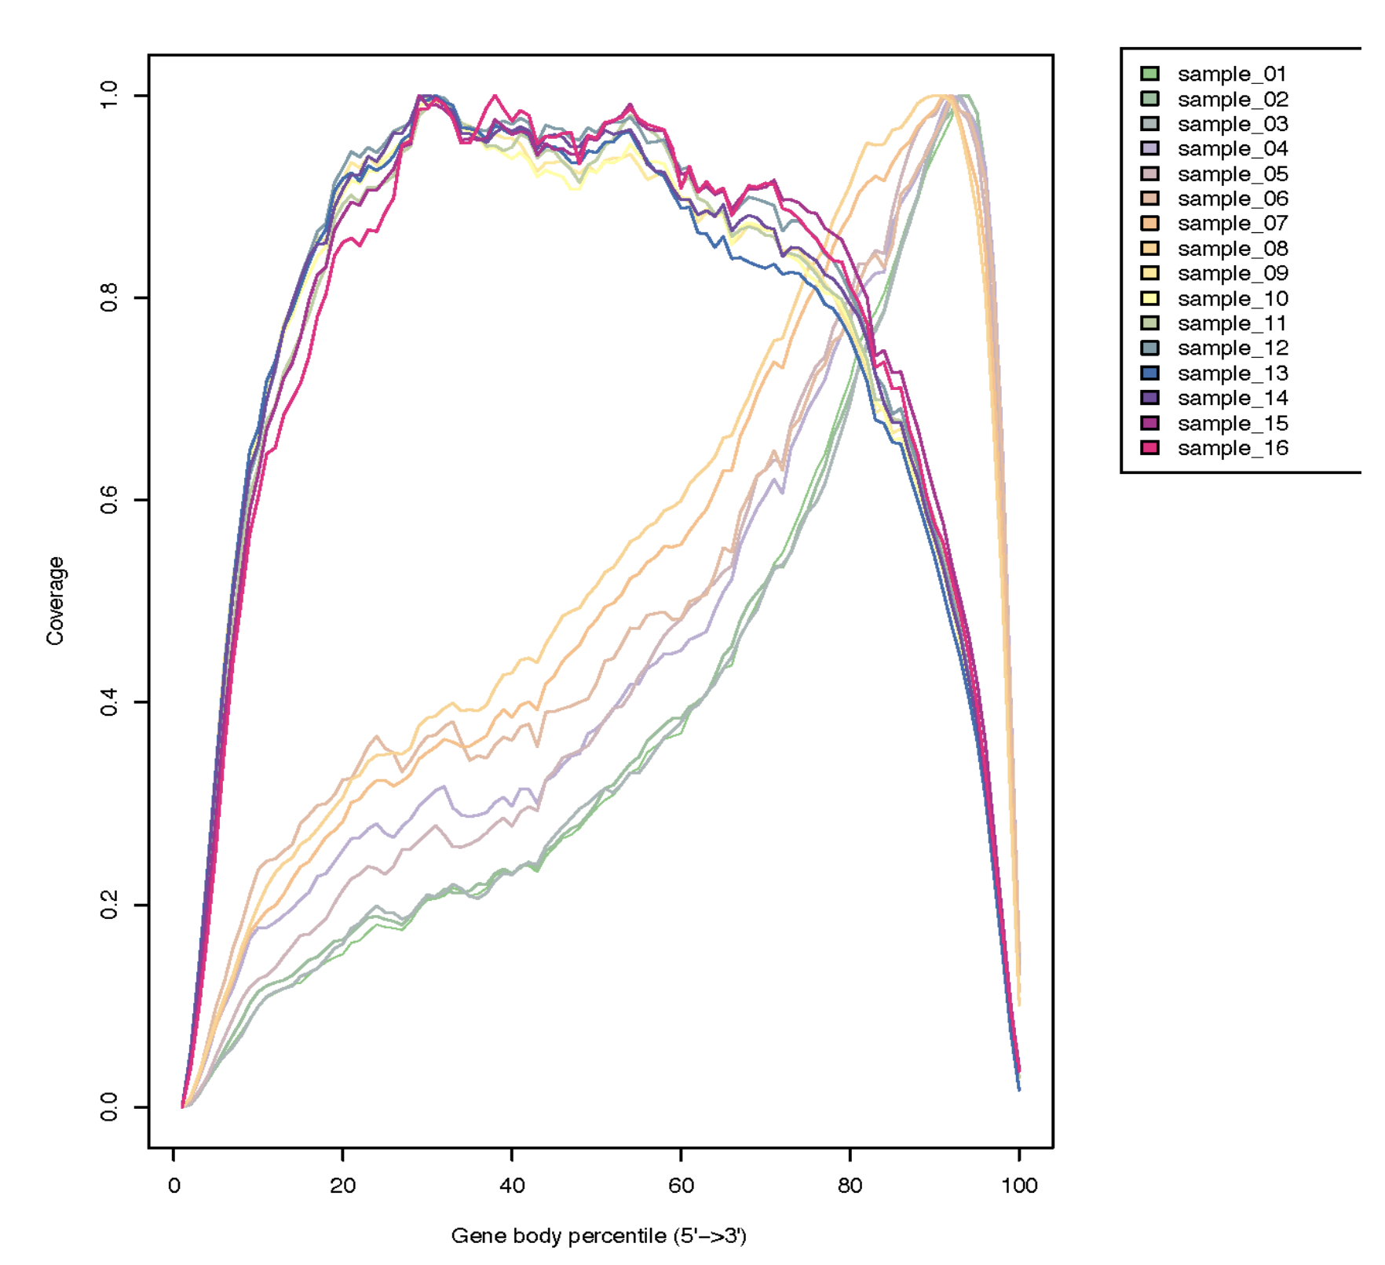
Gene Body Coverage
According to this plot, which samples may have been degraded and why?

Slide 19
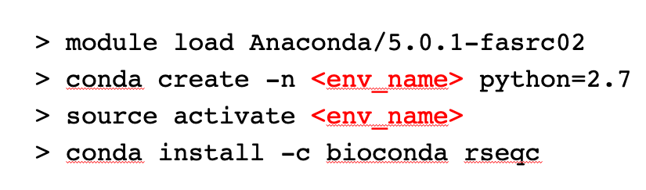
How to install RseQC
The relevant python files are then contained in ${HOME}/.conda/envs/<env_name>/bin

Slide 20
How to run RseQC
As usual, go to a compute node. Then module load Anaconda/5.0.1-fasrc02 and source activate <env_name>

Slide 21
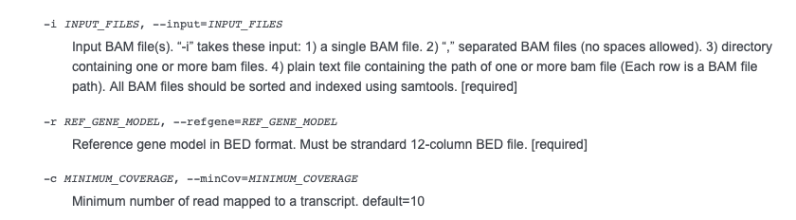
Running tin.py
Housekeeping genes are stored in the raw_data2 folder, please use these for reference genes. Runtime is approximately 30 minutes.

Slide 22
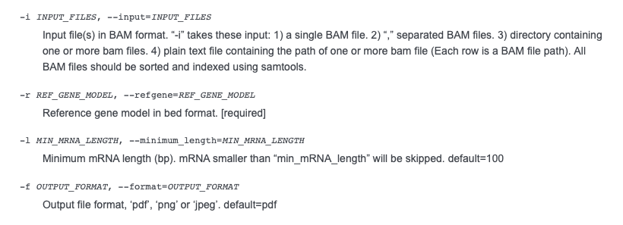
Running geneBodyCoverage.py
Also run module load R before calling this script, since it will automatically make plots for you.

Slide 23
Transferring files from Cannon to your computer
To do problem 2 and 3, you may want to transfer the files to your local computer so that you can make plots easier.
(This probably only works for Mac OS/Linux users): from the terminal of my computer, I can type
scp pnicol@login.rc.fas.harvard.edu:<PATH TO FILE ON CANNON> <DESTINATION_PATH>

Slide 24
Tips for Problem 3 (Python)
The values in the text file output by geneBody_coverage.py are not standardized to be between 0 and 1. You should divide by the maximum coverage in each sample.
Creating subplots in Python: https://matplotlib.org/3.1.0/gallery/subplots_axes_and_figures/subplots_demo.html

Slide 25
Salmon and RSEM
Salmon and RSEM are algorithms for RNA-seq quantification.
What are two confounders of read count?

Slide 26
Salmon and RSEM
Salmon and RSEM are algorithms for RNA-seq quantification.
What are two confounders of read counts?
Counts are influenced by gene length and the number of reads per sample.
Normalization methods such as CPM (Counts per million), RPKM (Reads per kilobase million), FPKM (Fragments per kilobase million), TPM (Transcripts per million) are commonly used for accurate quantification of gene expression.
RNA-seq blog (from lecture): https://rna-seqblog.com/rpkm-fpkm-and-tpm-clearly-explained/

Slide 27
Running Salmon
We can use the .fastq file as input.
Start a job.
module load salmon/0.12.0-fasrc01
The main command is salmon quant
-i Path to index (in Stat 115 index folder)
-r Path to Input reads (as FastQ)
-p Number of threads
-l A Automatically detect if input data is paired-end or single-end
-o Name of output directory (your choice)

Slide 28
Salmon output
The file quant.sf contains the expression levels (TPM, effective length, read counts).
You will have to compute FPKM (for problem 6). Alternatively, you could install a newer version of Salmon (using bioconda), where it seems like FPKM is given automatically.
The file quant.sf is large, type head –10 quant.sf to see the first 10 lines

Slide 29
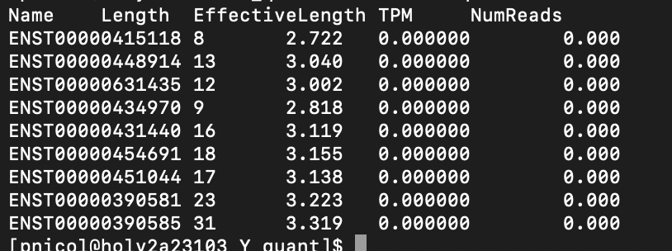
Salmon output
Part of the problem asks you to identify the gene with the highest expression. However, the output here is in ENSEMBL Transcript ID

Slide 30
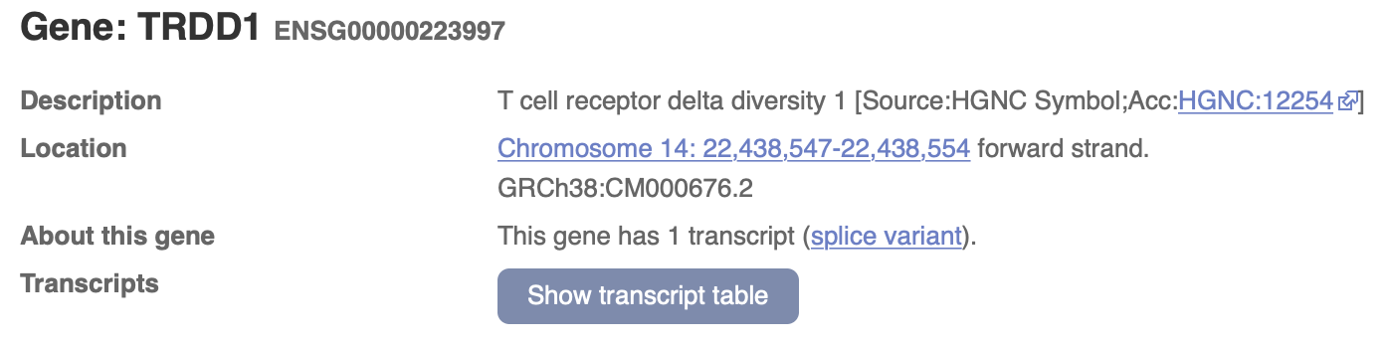
Use BioMart to get gene symbol from Transcript ID
BioMart: https://m.ensembl.org/biomart
For example, the first transcript ID on the last slide is ENST00000415118.

Slide 31
Running RSEM
For RSEM, you should first run STAR on the fastQ file to get a BAM file containing the alignment.
STAR *Other parameters* --quantMode transcriptomeSAM --outSAMtype BAM SortedByCoordinate
This creates a file Aligned.toTranscriptome.out.bam that can be used as input to RSEM.

Slide 32
Running RSEM
The main command for RSEM (load the module first) is rsem-calculate-expression
--no-bam-output
--time Output a .time file giving the runtime (useful for Problem 5).
--bam Input is a bam file
-p Number of threads
[input file] Name of input file
[reference_name] Reference (in Stat115 index folder)
[sample_name] Name of the sample (for output)

Slide 33
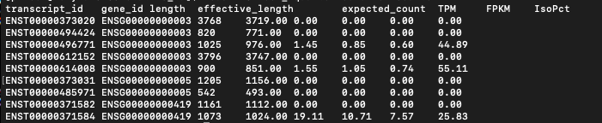
RSEM output
Output is in a file ending with .isoforms.results

Slide 34
How to answer Problem 6?
It is open ended, but answering the following questions (with plots) is one possible way
Are the metrics for gene expression (TPM, FPKM, etc) correlated?
Do the outputs of RSEM and Salmon agree?
A heatmap showing correlations between the metrics could be a good idea.

