Slide 1

Neural Style Transfer with TensorFlow
A journey into the world of deep learning and artistic creativity, where algorithms blend content and style, transforming images into breathtaking masterpieces.
YM
by Yashika Maligi

Slide 2
Introduction to Neural Style Transfer
What is Neural Style Transfer (NST)?
NST harnesses the power of deep learning, specifically Convolutional Neural Networks (CNNs), to achieve this. It works by extracting and recombining features from different images, ultimately generating a new image that blends the desired content and style.
Imagine taking the content of one image, like a photograph of a mountain, and merging it with the artistic style of another image, like a painting by Van Gogh. Neural Style Transfer (NST) allows us to do just that, creating visually stunning images that are both familiar and unique.

Slide 3

Components of Neural Style Transfer
1
Content Image
2
Style Image
The original image that provides the main subject or scene. It's the visual foundation upon which we'll apply the desired style.
This image provides the artistic features that we want to transfer, including textures, colors, and patterns. It's the source of artistic inspiration for our transformation.
3
Generated Image
The final output image, where the content from the first image has been transformed with the artistic style of the second. It's a unique blend of the two sources, creating something entirely new.

Slide 4




Process Overview
Preprocess Images
Feature Extraction with CNN
Loss Functions
Optimization
Prepare the content and style images for the model. This involves resizing, normalizing pixel values, and transforming them into formats suitable for the CNN.
Mathematical formulas are used to calculate the difference between the generated image and the desired content and style features. These losses guide the model to create a final image that closely resembles the targeted elements.
The model iteratively adjusts the generated image by minimizing the total loss. This process refines the image, gradually incorporating the desired style while preserving the original content.
A pre-trained CNN, like VGG19, analyzes the images, extracting features that represent both content and style. It's like the model "understanding" the visual information in each image.

Slide 5
CNN and VGG19 for Feature Extraction
VGG19 Model
VGG19 has been specifically trained on ImageNet, a benchmark dataset for image classification. This means it's adept at identifying objects and scenes in images. We use this capability to extract meaningful features from both content and style images.
VGG19 is a Convolutional Neural Network (CNN) that's been trained on a massive dataset of images, allowing it to recognize and classify visual patterns. In NST, we leverage this pre-trained model to extract features relevant to content and style.

Slide 6
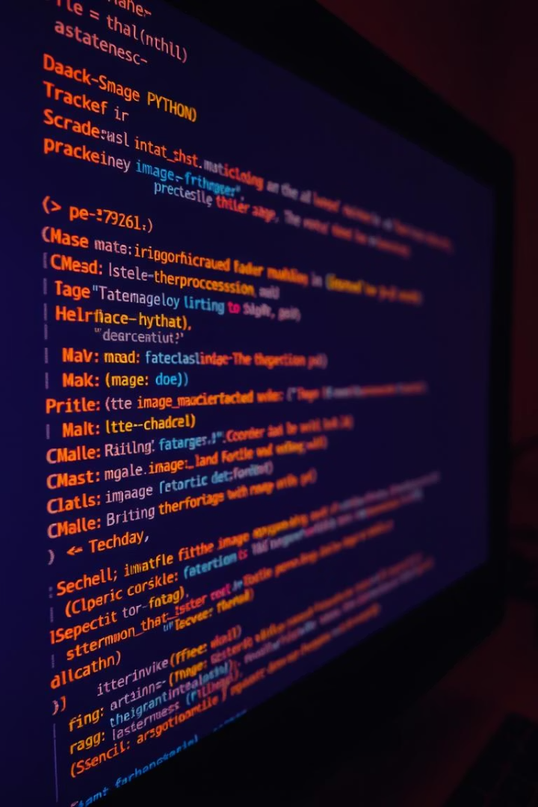
Image Preprocessing
Loading and Processing Images
Preprocess Input
We convert the color channels from RGB to BGR, as VGG19 is trained on images in this format. We also normalize pixel values by subtracting the mean and dividing by the standard deviation. This helps the model learn more efficiently.
Using Keras functions, we load the content and style images into the model. We then preprocess them, ensuring their formats and dimensions are compatible with the CNN.
Display Images
Visualizing the images before and after preprocessing allows us to understand the changes and ensure that the images are correctly formatted for the model.

Slide 7
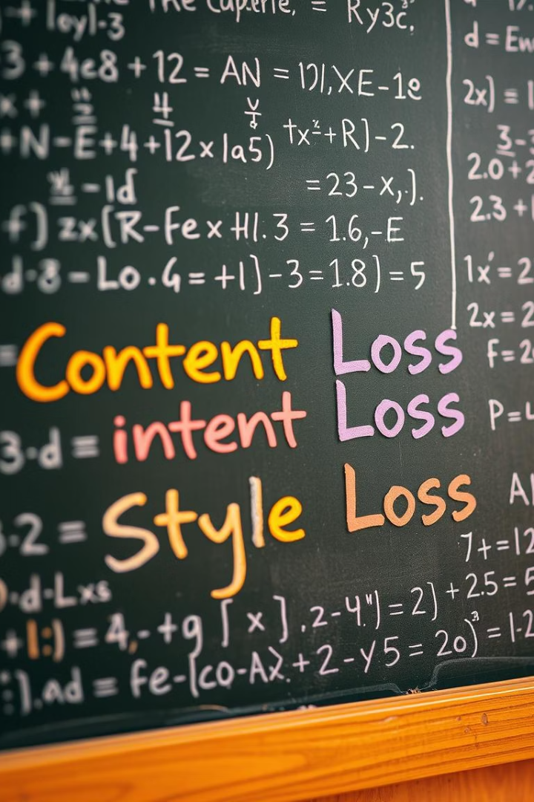


Content and Style Loss
Content Loss
Style Loss
This loss function measures the difference between the content features of the content image and the generated image. It ensures that the final image retains the essence of the original subject matter.
The style loss function focuses on the artistic features. It compares the style features of the style image and the generated image, ensuring the generated image mimics the desired textures, colors, and patterns.

Slide 8

Training the Model
1
Optimization
The model uses gradient descent to minimize the total loss, which is a combination of the content and style losses. This involves iteratively adjusting the generated image to better match the desired features.
2
Adam Optimizer
The Adam optimizer is a popular algorithm for optimizing the model's parameters. It effectively adjusts the learning rate and ensures efficient training.
3
Iterations
The model undergoes multiple training iterations, progressively refining the generated image. Each iteration reduces the loss and brings the generated image closer to the desired content and style.

Slide 9
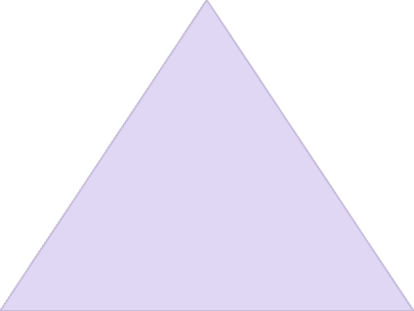

Results and Outputs
Generated Images
The training process produces a sequence of generated images, showcasing the model's progress in blending content and style. These images can be visually analyzed to assess the quality of the transformation.
1
Best Generated Image
After all training iterations, the model produces the final generated image. This image represents the optimal balance between content and style, showcasing the model's ability to effectively combine the desired features.
2

Slide 10
Challenges and Future Directions
Challenges
Future Applications
Neural Style Transfer often demands significant computational resources, typically requiring specialized hardware like GPUs or TPUs. Additionally, fine-tuning the balance between content and style loss can be complex and require careful experimentation.
NST has potential for real-time style transfer in videos, enabling dynamic artistic transformations. It can also be used to develop interactive art creation tools, allowing users to explore different styles and personalize their creations. Furthermore, NST can be integrated into various creative fields, such as gaming and film production, to enhance visuals and storytelling.

