Slide 1

BDM CAPSTONE PROJECT — VIVA VOCE
Data-Driven Insights for Kalka Dairy Farm
Analysis Process, Findings, and Strategic Recommendations
Submitted by Yadvendra Pal | Roll No. 24f1000137
IITM BS Degree Program • Indian Institute of Technology, Madras

Slide 2
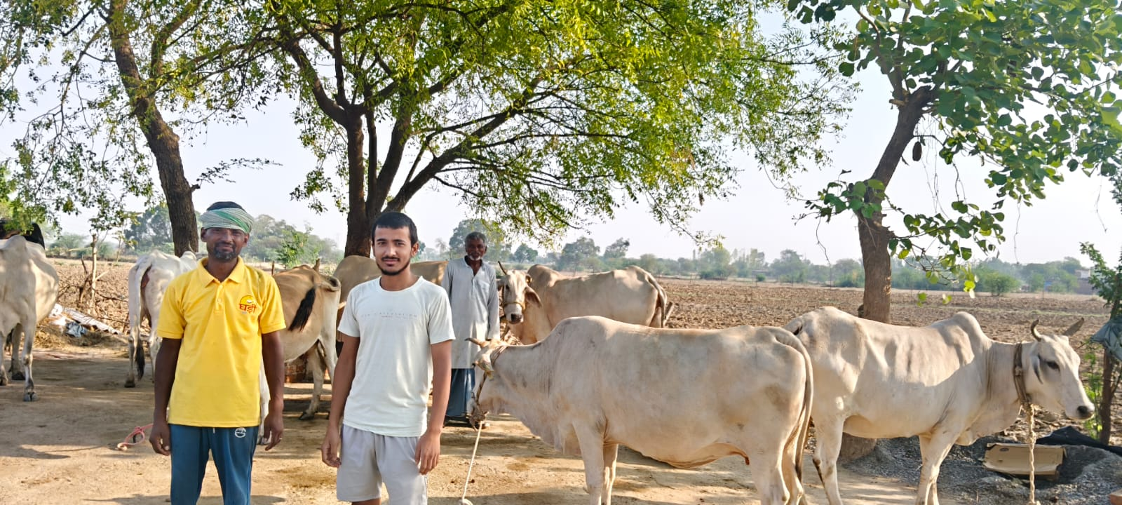
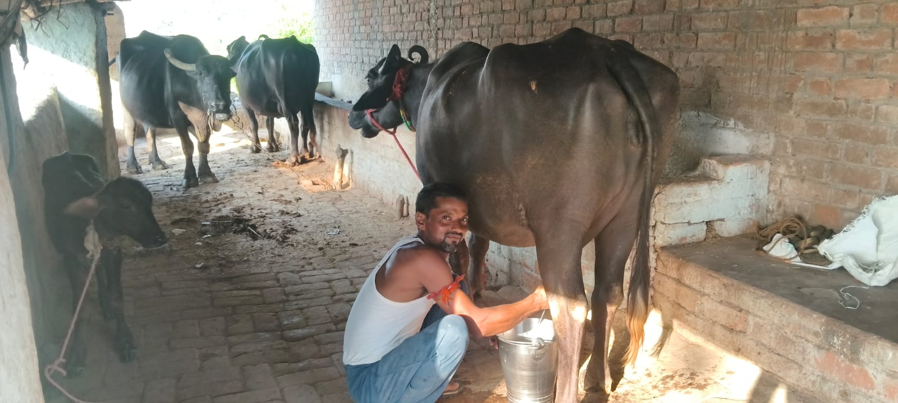
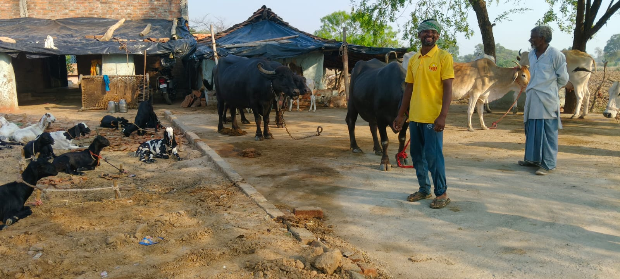
About Kalka Dairy Farm
OWNER
Mr. Kalka Prashad
LOCATION
Ingohata, Hamirpur, Uttar Pradesh
HERD SIZE
~10 dairy animals (cows and buffaloes)
DAILY PRODUCTION
35 - 40 litres/day (~10,00 L/month capacity)
MONTHLY REVENUE (TYPICAL)
Rs 60,000 - Rs 70,000
The Business
A small dairy business managing milk production, animal health, customer sales, feed consumption and operational expenses — for years run entirely on manual, paper-based registers.
On-site visit, daily milking, and the full dairy herd — Ingohata village, Hamirpur
1 / 10

Slide 3
Problem Statement & Objectives
Problem Statement
Objective
3.1 Establish a centralized business data management system for accurate, organized records of dairy animals, milk production, customer transactions, feed consumption and operational expenses.
Use data-driven analysis of production, sales, feed and expenses to identify operational issues early and support evidence-based, sustainable decision-making at Kalka Dairy Farm.
Methods Applied
3.2 Strengthen operational efficiency and business decision-making by improving financial monitoring, reducing record-keeping errors, and enabling effective analysis of farm performance.
Descriptive Statistics
Trend Analysis
Cost & Profitability
Customer & Sales Analysis
KPI / Dashboard
SWOT / Root-Cause
2 / 10

Slide 4
NATURE OF DATA COLLECTED
Metadata & Descriptive Statistics
DATASETS (10 sheets, ~4,883 rows | Jan-Jun 2025)
KEY DESCRIPTIVE STATISTICS
Animal_Master
10 rows
Variable
N
Mean
Std Dev
Min
Max
Daily_Milk_Production
1,448 rows
Total Milk (L)
1448
10.77
1.18
8.20
12.90
Milk Sold (L)
1086
4.51
2.97
1.50
10.00
Customers
40 rows
Sale Amount (Rs)
1086
265.79
170.84
90
580
Milk_Sales
1,086 rows
Feed Cost (Rs)
1448
141.75
43.89
96
224
Vet Cost (Rs)
74
629.05
172.21
350
850
Feed_Consumption
1,448 rows
Expense Amt (Rs)
724
982.75
1273.89
55
4979
Veterinary_Records
74 rows
Expenses
724 rows
Monthly_Summary / KPI
6 + 7 rows
Data Forms: Numerical (milk quantities, sales, cost), Categorical (types, categories), Date, and Monthly Summary data.
3 / 10

Slide 5
Data Cleaning & Analysis Process
Before analysis, datasets were checked for missing values, duplicates, incorrect data types, inconsistent dates and categorical inconsistencies. A reconciliation step compared transaction-level records with summary tables.
Data
Collection
→
Cleaning &
Validation
→
Descriptive
Statistics
→
Production &
Sales Analysis
→
Cost &
Profitability
→
KPI &
Dashboard
Tools: Microsoft Excel (Pivot Tables, dashboards, KPI cards) + Python / Google Colab (cleaning, statistical analysis, visualization)
Why These Methods
Descriptive stats give the required performance baseline before decisions are made
Trend analysis reveals month-to-month change that a single average would hide
Cost & profitability analysis directly targets the financial-monitoring objective
KPI/dashboard converts detailed records into a quick management view
4 / 10

Slide 6
ANALYSIS 1 OF 2
Production & Financial Trends (Jan-Jun 2025)
Reading: Milk production dipped in Feb (1,088 L) and peaked in May (1,201 L). Revenue and profit closely tracked production, and profit margin stayed stable (51.2%-52.3%) throughout.
5 / 10

Slide 7
ANALYSIS 2 OF 2
Sales, Customer & Animal Productivity
Reading: Retail customers (85%) dominate the base. Selling rate stays tightly near Rs 60/L, so revenue changes track quantity sold, not price. Animal productivity ranges from 8.8 to 12.3 L/day (avg 10.78 L/day) — worth tracking animal-wise, not just as a farm-wide average.
6 / 10

Slide 8
Key Insights & Findings
February was the consistent low point across production, revenue and profit
May was the strongest month on every major performance measure
1
2
Revenue and profit closely followed the production trend all six months
Stable selling prices mean sales performance is driven by quantity, not price
3
4
Profitability stayed positive every month — resilient, not fragile, performance
Feed cost is the single largest expense driver (~56.6% of monthly spend)
5
6
7 / 10

Slide 9
Recommendations & Action Plan
1
Daily digital record keeping
Immediate
2
Monthly KPI review (production, revenue, expense, profit, margin)
Monthly
3
Compare each animal's production with feed & health status
Weekly/Monthly
4
Categorize & review unusual expenses; feed cost vs. milk output
Weekly/Monthly
5
Follow up the 44 pending transactions (Rs 11,854)
Weekly
6
Standard formats, unique IDs, validation rules & backups
Continuous
8 / 10

Slide 10
CONCLUSION
A Stable, Profitable Farm — and a Clear Path to Better Data Discipline
Kalka Dairy Farm generated Rs 2,17,480 net profit on Rs 4,17,800 revenue (~52.1% margin) over six months, with production and profit strengthening after a February dip and peaking in May.
The farm does not need a complex analytical system — a disciplined digital record structure, regular KPI review, animal-wise monitoring, and consistent expense tracking are enough to protect profitability and support future growth.
Thank You
Yadvendra Pal | 24f1000137 | IITM BS Degree Program

