Slide 1
Privatizing Public Infrastructures
BRIC countries from 1994 to 2016

Slide 2
Description of the report
This graphical report reflects how privatization in emerging economies (BRIC) has evolved with the development of financial institutions overtime. Financial development indices are cross-examined with measures of privatization of public infrastructures in 4 sectors: utilities, energy, transport and Information and Communications Technologies.

Slide 3
Key Indices
The report uses
IMF-published Financial Development Index (FDI) as a measure of the robustness of a country’s financial institution. The FDI is an aggregate reflecting the efficacy, depth and access of financial institutions.
Volume of investment spending to quantify privatization

Slide 4
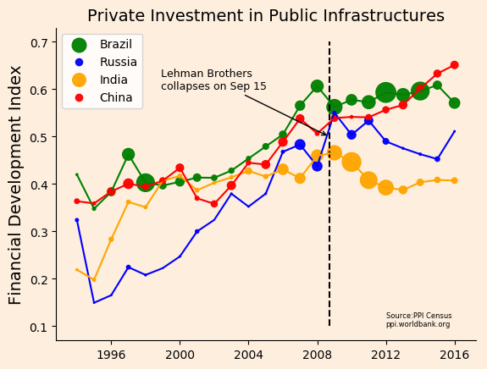

Slide 5
Observations
1. development of domestic financial environment, as measured by the financial development index, stalls or even contracts since post-2008
2. the above observation does not apply to China
3. Russian and Chinese public infrastructures are least privatized; volume of investment is shown by the size of the bubbles

