Slide 1
Data Lab 2025
QC in PLINK2 | GWAS | Meta-Analysis

Slide 2
PLINK2.0 alpha
31 mar 2025 | Lab 1 – Introduction to HPC and QC in PLINK/PLINK2
A new version of PLINK: a free, open-source whole genome association analysis tool
Association tests (GWAS), genetic data preprocessing, post-GWAS processing
For GWAS: supports quantitative (continuous) and dichotomized qualitative (binary) traits
Not for genotype calling or result visualization
Not taking genetic relatedness into account: need to remove related individuals if any
Available on UPPMAX HPC
More reference: https://www.cog-genomics.org/plink/2.0/

Slide 3
31 mar 2025 | Lab 1 – Introduction to HPC and QC in PLINK/PLINK2
UPPMAX HPC
High-Performance Computing: using supercomputers and computer clusters to solve advanced computational problems.
UPPMAX: The computer center of Uppsala University, part of NAISS (The National Academic Infrastructure of Supercomputing in Sweden)
Three clusters:
Bianca: sensitive data, e.g., real patient data, not connected to internet
Rackham: for local projects with PIs at UU, and for courses
Snowy: for courses and some local projects
https://docs.uppmax.uu.se/

Slide 4
31 mar 2025 | Lab 1 – Introduction to HPC and QC in PLINK/PLINK2
Log in to Rackham/Snowy
Most convenient: From the laptop’s terminal with SSH:
ssh <username>@rackham.uppmax.uu.se
Enter your password
Use regular Linux commands
The lab materials: /crex/proj/uppmax2024-2-1/DATA_LAB/data
Website: ThinLinc (https://rackham-gui.uppmax.uu.se/)
Need to set up a two-factor authentication
Not necessary
https://docs.uppmax.uu.se/getting_started/login_rackham/
https://docs.uppmax.uu.se/cluster_guides/snowy/
Download results from Rackham:
sftp <username>@rackham.uppmax.uu.se
get <filename> (assumed it is at your home directory: /home/<username>)
To upload: put <filename>
To logout: exit

Slide 5
31 mar 2025 | Lab 1 – Introduction to HPC and QC in PLINK/PLINK2
Handling big datafiles and jobs
When you log in, you are at the “login node”:
It is shared
Only do short and light things: editing, deleting, moving files
Start interactive session
Schedule jobs (sbatch)
Jobs
Performing computational jobs with large datafiles and abundant codes
Developing computational scripts with many line, for large datafiles
Interactive session (write command lines one-by-one)
interactive -A uppmax2024-2-1 -M snowy -t 2:00:00 -n 2
Using 2 cores (no more than 16) for 2 hours
When you finish, type exit to quit the interactive nodes
Job scheduler (when you have prepared a shell script, and when your job will take hours)
sbatch -M snowy -A uppmax2024-2-1 your_analysis.sh

Slide 6
31 mar 2025 | Lab 1 – Introduction to HPC and QC in PLINK/PLINK2
Job scheduler
In your .sh script:
#! /bin/bash -l
#SBATCH -A <project-number>
#SBATCH -p core
#SBATCH -n 2
#SBATCH -t 3:00:00
#SBATCH -J <your-job-name>
#SBATCH --mail-type=ALL
#SBATCH --mail-user=<your-uppmax-account-email>
module load <packages-you-need>
some_path_variable=“/crex/proj/uppmax2024-2-1/DATA_LAB/data"
plink2 <analysis-you-will-be-running>
Rscript <an-R-script.R>
You can write this offline and paste to your editor on Rackham:
nano your-analysis.sh
When you finish, press keys ‘ctrl’ and ‘o’, then ‘Enter’; and ‘ctrl’ and ‘x’
You can then access by ${some_path_variable} in following lines
Example plink commands in later slides

Slide 7
31 mar 2025 | Lab 1 – QC in PLINK/PLINK2
Software for Lab on Rackham
PLINK2:
module load bioinfo-tools
module load plink2
Note: If you are running against a binary phenotype, don’t use this latest version on UPPMAX: plink2/2.00-alpha-5-20230923
Instead: module load plink2/2.00-alpha-3.7-20221024
There were fatal bugs for binary phenotype in that version
Check version: plink2 --version
R:
module load R_packages/4.2.1
Type R to enter the coding interface

Slide 8
31 mar 2025 | Lab 1 – QC in PLINK/PLINK2
Data
Location: data_loc=“/crex/proj/uppmax2024-2-1/DATA_LAB/data”
You will be able to use a shortcut ${data_loc} after typing the line above
What’s inside the directory: ls ${data_loc}
PLINK1 files for a quick view of how genotype files look like: .ped and .map files in tab- or space-delimited formats, could be visualized by text editors, or simply:
head ${data_loc}/test.ped | column –t
You can see the number of lines or rows by:
awk ‘END {print NR}’ ${data_loc}/test.ped
.ped: individual genotypes; .map: description of SNPs.
They are headerless (no column names).
PLINK2 genotypes:
.psam: sample information (Family ID; Individual ID; Sex); equivalent of .fam in PLINK1.9
.pvar: variant information (SNP positions, alleles); equivalent of .bim in PLINK1.9
.pgen: genotype data (compressed, efficient); equivalent of binary format .bed in PLINK1.9
epihealth.psam, epihealth.pvar, epihealth.pgen
Note: if your filename contains space, must add quotes “${data_loc}”
To make it visually pleasing by aligning the columns in view
awk is a very efficient tool for checking text-files

Slide 9
31 mar 2025 | Lab 1 – QC in PLINK/PLINK2
Quality control (QC)
Prior to an association analysis, the genetic data has to be checked and filtered to avoid errors or poor quality
“Data quality control in genetic case-control association studies.” (Anderson et al. 2010, Nature Protocols 5: 1564-73)
QC criteria
Missing genotype rates
--geno [max per-variant]: filter out variants with missing call rates exceeding the threshold
--mind [max per-sample]: does the same for samples
Individual call rate: --mind 0.05 removes individuals with >5% missing genotypes
plink2 --pfile ${data_loc}/test --mind 0.05 --make-pgen --out filtered_file
SNP call rate “--geno”: sometimes the genotyping of a single SNP is not working properly, such as primer problems; filter SNPs with low genotyping rate from the dataset: --geno 0.05 removes SNPs with >5% missing genotypes.
Just add flags to the PLINK2 command line
Note: if all input files have the same suffix, i.e., “test”, you can use the flag --pfile, otherwise you need to specify each by --pgen, --psam, --pvar; --make-pgen means to generate the filtered files; --out you can specify the output suffix

Slide 10
31 mar 2025 | Lab 1 – QC in PLINK/PLINK2
Quality control (QC) cont.
QC criteria (cont.)
Minor allele frequency (MAF)
--maf [minimum freq]: filters out variants with allele frequency below the threshold
MAF≥0.05 Common variants, for large GWAS, well-powered studies, sample size ~5000+
MAF≥0.01 Low frequency variants, for mixed GWAS, disease risk analyses, sample size ~10,000+
MAF≥0.001 Rare variants, for sequencing studies, burden tests, sample size ~100,000+
--maf 0.05
Hardy-Weinberg equilibrium (HWE)
--hwe [p]: filters out variants which have HWE exact test p-value below the threshold
--hwe 1e-4; --hwe 0.0001

Slide 11
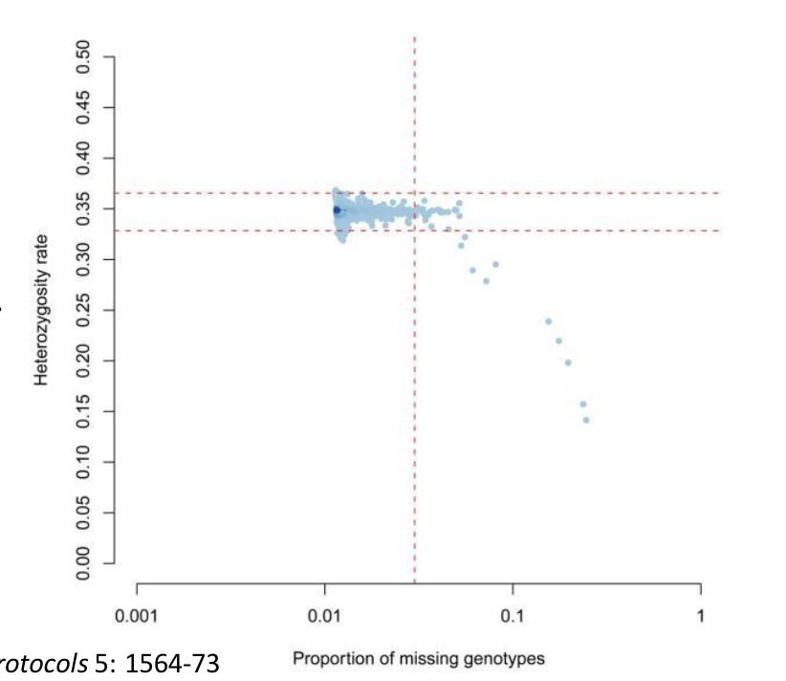
31 mar 2025 | Lab 1 – QC in PLINK/PLINK2
Additional steps for raw datasets
“Inbreeding”
--het
Computes observed and expected homozygous/heterozygous genotype counts for each sample, reports method-of-moments F coefficient estimates
1-(<observed het. count> / <expected het. count>)
Low degree of heterozygosity is a sign of bad genotyping
Sex imputation
--check-sex
Checks if sex assignments corresponds to Chr X genotypes
Genetic males cannot be heterozygous
Duplicate variants
--rm-dup
removes all but one instance of each duplicated-ID variant
Duplicated or related individuals
--make-king: KING-robust kinship estimator
Duplicated samples: kinship 0.5
1st-degree: ~0.25; 2nd-degree: ~0.125
Anderson et al. 2010, Nature Protocols 5: 1564-73

Slide 12
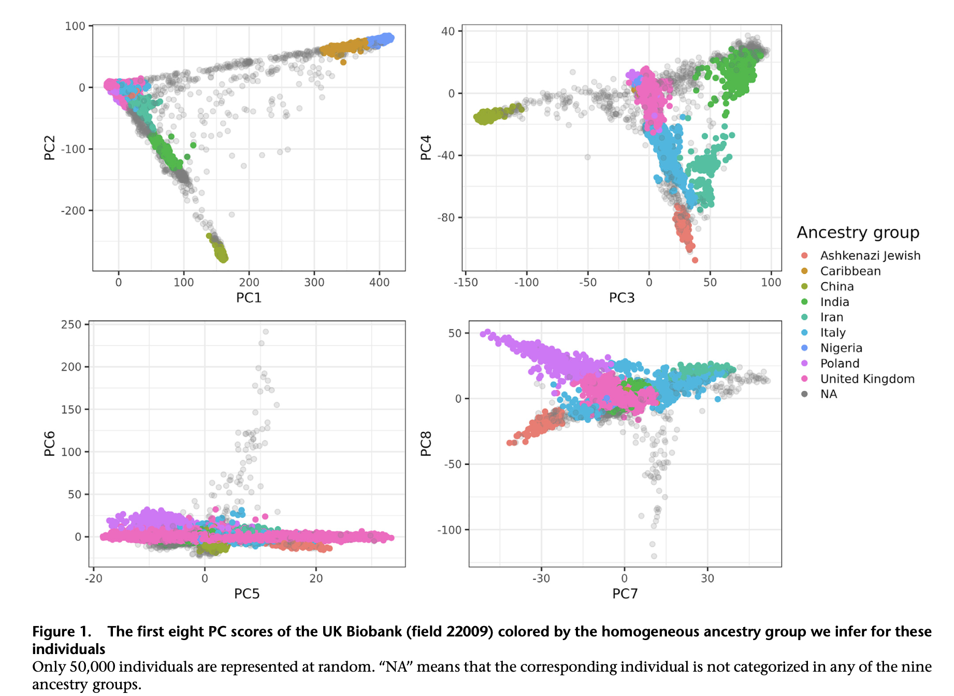
31 mar 2025 | Lab 1 – QC in PLINK/PLINK2
Additional steps for raw datasets
Divergent ancestry
Check principal components (PCs); --pca
E.g. in UK Biobank
Privé et al. 2022, The American Journal of Human Genetics 109: 12-23

Slide 13
31 mar 2025 | Lab 1 – QC in PLINK/PLINK2
Other useful commands
--extract <one-column text-file containing the SNP IDs with specific interest>
--keep <text-file containing individual IDs to be tested>
First line: #FID #IID; tab-delimited format
--export: creates new fileset, after sample/variant filters have been applied, in the formats such as:
A: [--export A] Sample-major additive (0/1/2) coding, suitable for loading from R. By default, REF alleles are now counted.
This can be adjusted with --export-allele <one-column file with A1 specified>
AD: sample-major additive (0/1/2) + dominant (het=1/hom=0)coding
--make-bed: gives binary file of PLINK1 format.
In the shell script, you can break lines instead of having everything in one long line as
plink2 \
--pfile … \
--maf … \
--out … \

Slide 14
31 mar 2025 | Lab 1 – QC in PLINK/PLINK2
Instructions for the lab:
https://github.com/YADengUU/Data_Lab_2025

Slide 15
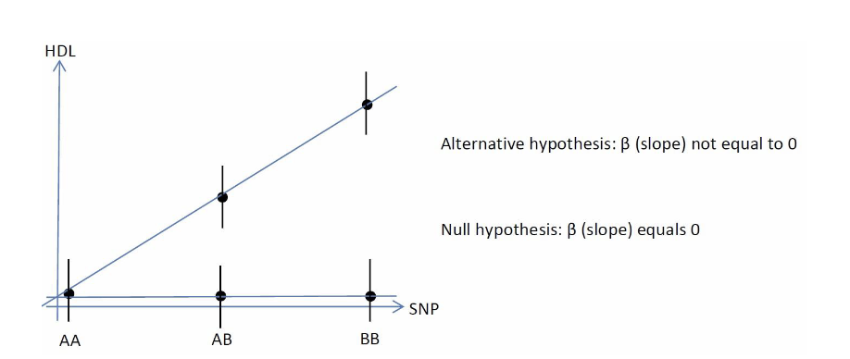
1 apr 2025 | Lab 2 – GWAS with PLINK2
Association test
Identify the SNPs associated with HDL levels
Input data:
QC-ed Genotype data created in Lab 1
Flags to read files: --pfile (PLINK2); --bfile (PLINK1 binary)
If the 3 files don’t share the same name, specify by pgen/psam/pvar; bed/bim/fam
Phenotype file: epihealth_hdl.pheno
Covariate file: epihealth_pcs.covar
Preview the phenotype and covariates to see the names of phenotype and covariates:
head ${data_loc}/epihealth_hdl.pheno | column –t
Is it a binary or continuous phenotype?
head ${data_loc}/epihealth_pcs.covar | column –t

Slide 16
1 apr 2025 | Lab 2 – GWAS with PLINK2
Association test
--glm hide-covar cols=+a1freq,+ax,+beta
--glm is the flag to perform association analysis
In the options behind you choose what to show in your results
--pheno <phenotype-path>
--pheno-name <name-of-phenotype>
--covar <covariate-path>
--covar-name <list the covariates, separated by a space in between>
--out <your customized output name>
Altogether
plink2 --glm hide-covar … --pfile … --pheno … --pheno-name … --covar … --covar-name … --out …
Path = directory/filename
Trick: you don’t need the separately created genotype data, the QC flags can be included together in the PLINK2 command line

Slide 17
1 apr 2025 | Lab 2 – GWAS with PLINK2
Read the results
As mentioned, awk is a highly efficient tool to check data saved as space/tab-delimited form
awk ‘$N<5e-8’ gwas-result-filename
Replace N with the actual column number containing the p-values
If you want to save the quick result: add “ > quick-result-name” at the end
To sort in ascending order, such as for the 3rd-column:
awk ‘$N<5e-8’ gwas-result-filename | sort –gkN > quick-result-name
-gkN: numerically (-g) by the N-th column (-kN)
Read and visualize data In R:
gwas_result <- read.table(“gwas-result”, header=TRUE)
dim(gwas_result) # check how many rows and columns, if not correct, need to modify sep=“\t” or sep=“ ” in read.table().
library(qqman)
png(file=“Manhattan-plot.png”, width=80, height=50, units=“mm”, res=300)
manhattan(gwas_result, chr=“column-of-chrom-num”,bp=“column-of-SNP-position”, p=“column-of-p-val”, snp=“column-of-SNP-ID”)
dev.off()
Q-Q plot: qq(gwas_result[, “column-of-p-val”])
Package “qqman” for visualizing GWAS results
Adjust the figure size in png() before plotting; alternatively, if you have saved the GWAS results in your local computer, you can directly plot without png() or dev.off() and see your figures in RStudio

Slide 18
2 apr 2025 | Lab 3 – Meta-analysis
Meta-analysis of GWAS
Most GWAS identify SNPs with small effect sizes and a larger number of statistical tests are performed
The statistical power to detect a true association between outcome and SNP is low if the sample size is small
To increase the statistical power, GWAS results from multiple studies are typically combined using meta-analysis

Slide 19
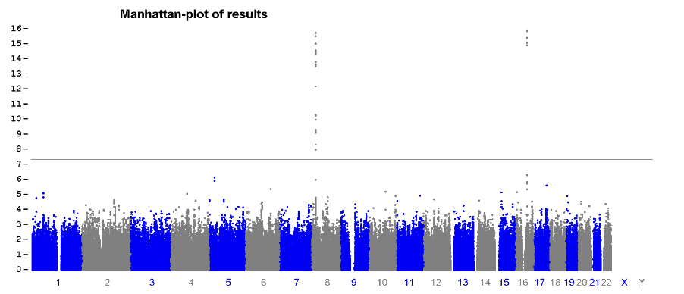
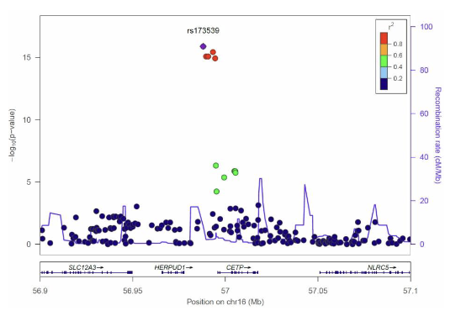
2 apr 2025 | Lab 3 – Meta-analysis
Meta-analysis in METAL
In this data lab, the regression results from two studies will be combined using a fixed-effects, inverse-variance weighted meta-analysis
See instructions for the lab (https://github.com/YADengUU/Data_Lab_2025) for:
Create a METAL script file, which is a sample.txt file, using text-editor, not Word.
Run the METAL program
Plot meta-analysis results genome-wide
Or for a selected region
R package qqman
Input: meta-analysis results file with a chr and position column added
Use web-based tool Locuszoom
Meta-analysis results for a selected region around the CETP gene will be used

