Slide 1
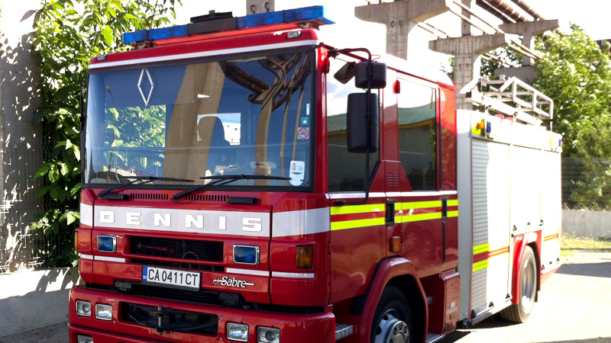
Our project
Created by: The Flame Guardians

Slide 2
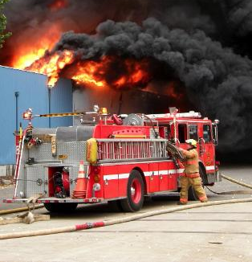
The steps of our work
Role managament
Organization
Reazisation

Slide 3
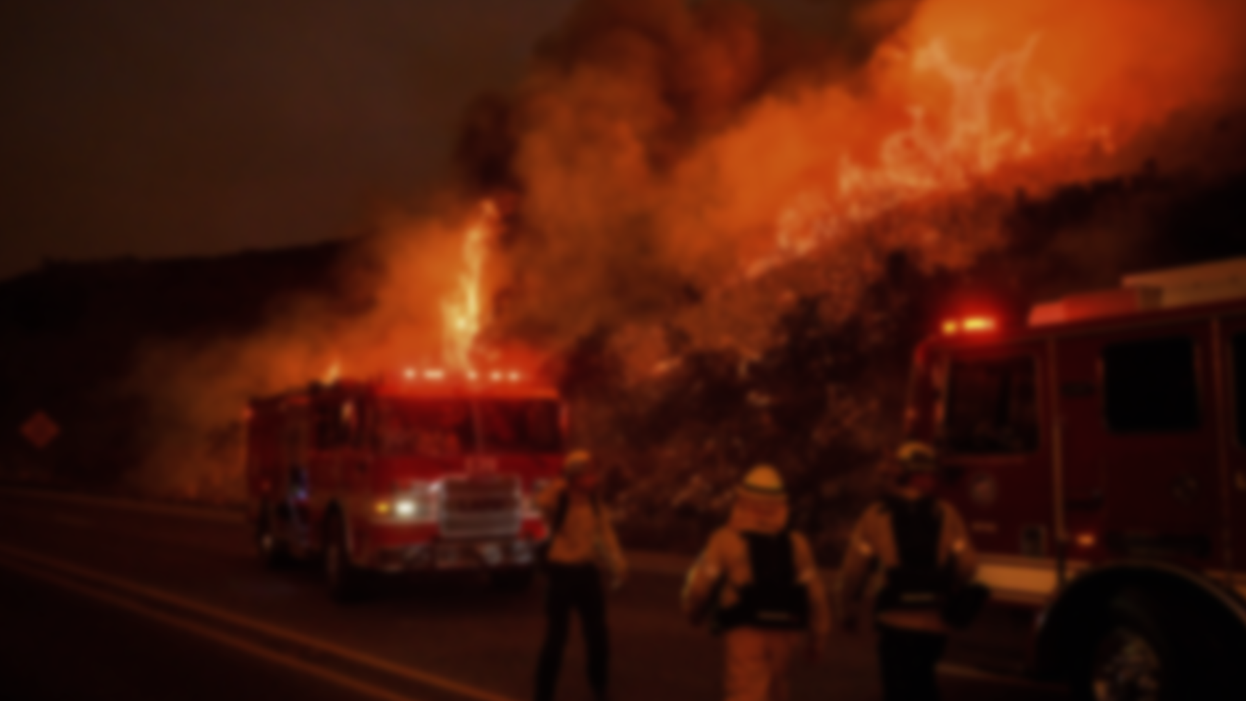
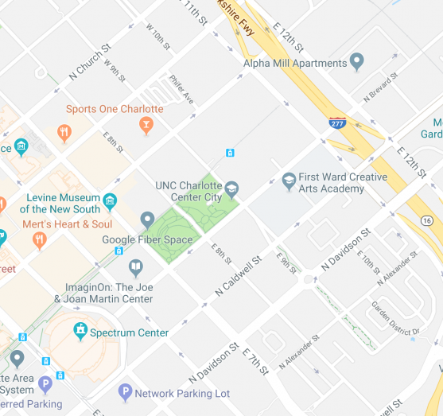
And now let us show you our website
Presentation made by Daniel Kolev

