Slide 1
Intelligent HR Reporting Assistant
AI-Powered Natural Language HR Reporting System
Student Information
Project Overview
Name :- Yaksh Makwana
Harsh Makwana
Team Id:-95
Team Name:-TalentIQ
Enrollment no :- 202500719010160
202500719010159
A web-based HR reporting system that enables users to ask questions about employee data using natural language — no SQL knowledge required. The system automatically converts plain-English questions into safe, validated SQL queries and returns data-driven answers.
"Ask HR questions in natural language and receive data-driven answers securely."
User
AI Assistant
Natural language question
Query understanding & SQL generation
HR Database
Answer
Secure, validated execution
Data-driven result on dashboard

Slide 2

Problem Statement & Objectives
The Problem
Project Objectives
Traditional HR reporting creates a dependency on technical expertise. Non-technical HR users are locked out of direct data access and must rely on IT or analysts for even routine queries.
1
Natural Language Interface
Allow users to ask HR questions in plain English without SQL
Knowledge of SQL syntax and database schema structure
Understanding of table relationships and join logic
2
Filter Understanding
Understand department, job title, status, and hire date filters
Complex filtering, aggregation, and date-range logic
Manual report preparation, validation, and delivery
3
Automatic SQL Generation
Convert understood intent into appropriate SQL queries
Careful handling of sensitive employee information
4
SQL Safety Validation
Validate every generated query before execution
Non-technical HR users should not need SQL to answer: "How many Software Developers were hired during 2018–2020?"
5
Dataset Isolation
Restrict all queries to the user-selected dataset only
6
RAG Knowledge Retrieval
Retrieve relevant HR knowledge for complex query context
7
Local AI Model
Use Ollama + Gemma 3:4B for on-premise query generation
8
React Dashboard
Display results in an interactive, user-friendly interface

Slide 3
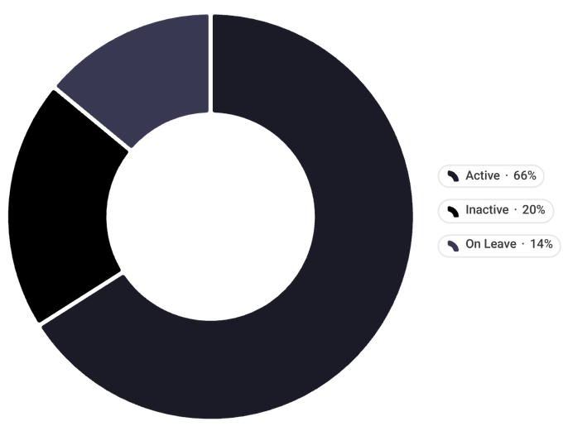
HR Data & Dataset Management
Employee Information Tracked
Test Dataset Statistics
Identity
hr_employee_dataset_250_unique — Dataset ID: 6
Employee ID, First Name, Last Name, Email
250
Temporal
Total Employees
Hire Date, Effective Start Date, Effective End Date, Dataset ID
Primary test dataset
Role & Status
165
HR Knowledge Base
Department Table
Active
Department, Job Title, Employee Status (Active / Inactive / On Leave)
Currently employed
50
Inactive
Separated / exited
35
On Leave
Temporarily absent
Additionally tested with datasets of 100 and 250 employee records for multi-dataset validation.

Slide 4

System Architecture
Complete Processing Pipeline
Frontend
API
React app for user interaction and dashboard.
Django REST handles auth and dataset selection.
Query Engine
Storage
Processes queries then routes to builder or RAG.
SQL validated queries stored in MySQL database.
RAG Knowledge Sources
Core Database Tables
HR Reports — Saved reports and business descriptions
Business Rules — Effective dating, status conditions
reports_employee — Employee records with all attributes including dataset_id
reports_department — Department names and descriptions joined on department_id
Security Rules — Dataset restrictions, query constraints
Key Design Decision: Not all questions route to the AI model. Common HR queries use the deterministic Fast SQL Builder for faster, predictable, and fully controlled execution — AI is only invoked for complex, multi-condition queries.

Slide 5
Natural Language → HR Answer
Complete AI Workflow — Step by Step
01
02
User Input
Normalization
User enters natural-language question: "How many Software Developers in the IT department were hired between 2018-01-01 and 2020-12-31?"
System cleans, normalizes, and prepares the question text for intent extraction
03
04
Condition Extraction
Fast SQL Builder Check
Identifies: Department = IT · Job Title = Software Developer · Hire Date Range: 2018-01-01 → 2020-12-31 · Status and Historical Date (if specified)
Determines if query can be handled by the deterministic Fast SQL Builder directly without involving the AI model
05
06
RAG + AI Generation
SQL Validation & Execution
For complex queries: retrieves relevant HR reports, business rules, and security rules via RAG; Gemma 3:4B generates the required SQL
All generated SQL is validated for safety and dataset security, then executed on MySQL; results returned to the React dashboard
🔒 Security Rule — Strictly Enforced
Only SELECT queries permitted. Blocked operations: INSERT · UPDATE · DELETE · DROP · ALTER · CREATE · TRUNCATE · GRANT · REVOKE · Multiple Statements

Slide 6
Core Features & Query Capabilities
Natural Language Filtering
Analytics & Aggregation Capabilities
Count employees — total, by department, by job title
Distinct / unique job-title counts per department
Department & Job Title
Filter by any department name or job title string — exact matching and fuzzy normalization
Highest / lowest employee count ranking across departments
Active / inactive / on-leave distribution analysis
Date & Date Ranges
Historical active employee analysis using effective dates
Hire-date trend analysis across time periods
Hire date filtering, multi-year ranges, and historical point-in-time analysis
Employee Status
Full support for ACTIVE, INACTIVE, and ON_LEAVE status categories with effective dating rules
Platform & System Features
Multi-Dataset
Fast SQL Builder
RAG Knowledge
Isolated dataset support; switch between HR datasets seamlessly
Deterministic handler for common queries — no AI latency
Business and security rule retrieval for complex AI-routed queries
CSV Export
Auth & Sessions
Export query results as CSV for downstream reporting
User registration, login, and session management

Slide 7
Security & Data Protection
Authentication & Access Control
Dataset-Level Security
Every query requires a dataset_id. The SQL engine enforces dataset isolation at the query level:
User login and registration with session-based authentication
WHERE e.dataset_id = selected_dataset_id
All API endpoints are protected — unauthenticated requests return 403 Forbidden
This prevents any cross-dataset data leakage, ensuring users can only access records within their selected dataset.
Session cookie issued upon successful login
SQL Safety Validation
CSRF Protection — Verified Results
✅ Permitted
🚫 Blocked
Test | Result
Unauthenticated request | ✓ 403 Forbidden
Session cookie after login | ✓ Active
CSRF token on POST requests | ✓ Supplied
CSRF endpoint pre-login | ✓ Accessible
Final CSRF endpoint test | ✓ HTTP 200 OK
SELECT-only reporting queries with dataset isolation enforced
INSERT · UPDATE · DELETE · DROP · ALTER · CREATE · TRUNCATE · GRANT · REVOKE · Multiple Statements
Business Rule Security
  Active employee queries automatically apply effective dating logic
  Historical queries use the user-requested date rather than the current system date

Slide 8
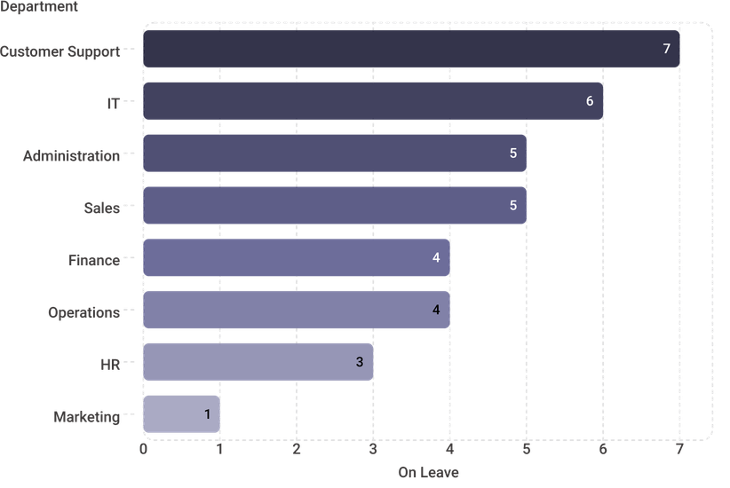
Testing — Real HR Questions & Verified Results
Dataset: hr_employee_dataset_250_unique (ID: 6) — 250 Total Records
# | Natural Language Question | Verified Result
Q1 | How many employees are in the IT department? | 30
Q2 | How many different job titles are in the IT department? | 6
Q3 | Which department has the highest number of employees? | Marketing (36)
Q4 | Which department has the fewest employees? | HR (25)
Q5 | Which department has the highest number of inactive employees? | Operations (10)
Q6 | Which department has the fewest inactive employees? | IT (3)
🏆 Latest End-to-End Test — Key Achievement
Q8: "How many Software Developers in the IT department were hired between 2018-01-01 and 2020-12-31?"
1
Verified employee count
Multi-condition query combining Department + Job Title + Hire Date Range — successfully converted to safe SQL and executed against 250 records.
Q7: Employees On Leave — By Department
All 8 test questions returned verified, accurate results. System correctly handles simple counts, rankings, distribution queries, and complex multi-condition filtering.

Slide 9
Implementation & End-to-End Testing
Live Demonstration Flow
API Testing — All Endpoints Verified
01
Latest Query — Generated SQL & Response
API Endpoint | Response | Status
Authentication API | HTTP 200 OK | ✓ Pass
Dataset API | HTTP 200 OK | ✓ Pass
Dataset Retrieved | hr_employee_dataset_250_unique (ID: 6, 250 employees) | ✓ Pass
Assistant API | HTTP 200 OK | ✓ Pass
Start MySQL
Database server initialized
02
Start Django
REST API backend running
03
Start React
Question: "How many Software Developers in the IT department were hired between 2018-01-01 and 2020-12-31?"
Frontend application launched
SELECT COUNT(*)
FROM reports_employee e
JOIN reports_department d
ON e.department_id = d.id
WHERE e.dataset_id = 6
AND d.name = 'IT'
AND e.job_title = 'Software Developer'
AND e.hire_date >= '2018-01-01'
AND e.hire_date <= '2020-12-31'
04
Login
Authenticate as test user
05
CSRF Token
Retrieve token from backend
API Response
Query Source
06
employee_count = 1
fast_sql
Load Datasets
Django System Check
API returns available datasets
0 issues identified ✓
07
Select Dataset 6
Status: Core project implemented and working end-to-end. Ready for presentation and live demonstration.
250-employee dataset selected
08
Submit Question
Natural-language query entered
09
Route & Execute
Fast SQL Builder → MySQL
10
Display Result
Answer rendered on React dashboard

Slide 10
Conclusion & Future Scope
Project Summary — Implemented & Working
🏆 Key Achievement
A complex multi-condition query combining Department + Job Title + Date Range was successfully converted to safe, validated SQL and returned the correct verified result:
Frontend
Backend
1 Employee
React.js with responsive dashboard for natural-language input and result display
Django REST Framework with session authentication and protected API endpoints
Demonstrating reliable end-to-end natural language → SQL → answer capability.
Database
AI / ML
Future Scope (Not Currently Implemented)
MySQL with dataset-level security; all queries scoped to selected dataset_id
RAG knowledge retrieval + Ollama + Gemma 3:4B for local, on-premise SQL generation
Advanced HR charts and visual analytics dashboard
More sophisticated semantic RAG with embedding models
Security
Query Engine
Report history, saved conversations, and PDF export
SQL validation, CSRF protection, dataset isolation, SELECT-only enforcement
Fast SQL Builder for common queries + AI-powered handling for complex multi-condition queries
Additional HR modules, expanded NLU, and production deployment
Thank You — Questions Welcome
Non-technical users can now ask HR questions without writing SQL, while database access remains controlled, validated, and dataset-specific.

