Slide 1
What’s the difference between HTML5 and previous HTML.

Slide 2
Introduction
Can’t you feel difficulty in previous presentation?
And so, let us talk about easier topic in 10 minutes.
Topic on the first attempt is
“What’s the difference between HTML5 and previous HTML”.

Slide 3
What is HTML?
HTML is an abbreviation for
“Hyper Text Markup Language”.
HTML is the standard markup language
used to create web pages.

Slide 4
What is HTML?
Hypertext is text displayed on a computer display or other electronic devices.
Instructions of Markup Language are expressed directly by tags or "instruction text encapsulated by tags".

Slide 5
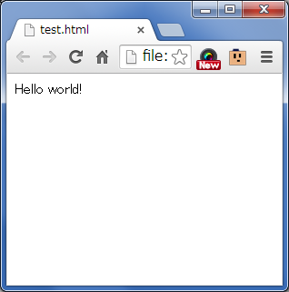
What is HTML?
<html>
<head>
</head>
<body>
Hello world!
</body>
</html>

Slide 6
Then what is HTML5?

Slide 7
What is HTML5?
HTML5 is also the standard markup language
used to create web pages.

Slide 8
What is HTML5?
HTML5 is also the standard markup language
used to create web pages.
However

Slide 9
What is HTML5?
HTML5 is also the standard markup language
used to create web pages.
However
HTML5 can accomplish what HTML never did.

Slide 10
What is new feature?
Offline / Storage
-Web Storage, Web SQL Database…
Real time / Communication
-Web Socket…
File / Hardware Access
-Geo location, Device Orientation…
Semantics & Markup
- ex: <div id = “header”> ⇒ <header>
Graphics / Multimedia
CSS3
Nuts & Bolts

Slide 11
What is new feature?
Offline / Storage
-Web Storage, Web SQL Database…
Real time / Communication
-Web Socket…
File / Hardware Access
-Geo location, Device Orientation…
Semantics & Markup
- ex: <div id = “header”> ⇒ <header>
Graphics / Multimedia
CSS3
Nuts & Bolts

Slide 12
What is new feature?
Offline / Storage
-Web Storage, Web SQL Database…
Real time / Communication
-Web Socket…
File / Hardware Access
-Geo location, Device Orientation…
Semantics & Markup
- ex: <div id = “header”> ⇒ <header>
Graphics / Multimedia
CSS3
Nuts & Bolts
DEMO

Slide 13
What is new feature?
There are many others.
Can do this much a little problem.
You might take HTML5 out for a spin.
For details to here.
http://slides.html5rocks.com/#landing-slide

