Slide 1

BACHELOR OF TECHNOLOGY
IN
Artificial Intelligence and Machine Learning
Video Summarization Using Natural Language Processing
Project Guide Batch no:80
Prof. T. Thanish Kumar T. RAM MOHAN - 2011CS020368
Y. CHANDRA SHEKAR - 2011CS020435
A. SRI RAM - 2011CS020434
Y. BHAVITH REDDY - 2011CS020443
Department of AIML, School of Engineering
Malla Reddy University

Slide 2
ABSTRACT
The explosion of online video content creates a challenge in efficiently consuming and understanding the information it conveys.
This project proposes an automated video summarization system that utilizes Natural Language Processing (NLP) techniques to generate concise and informative summaries. The system will address the challenges of extracting meaningful information from both audio and visual elements, identifying salient points within the video, and producing high-quality summaries.
We propose a multi-step approach involving text extraction from video, NLP techniques for content analysis, and the application of summarization algorithms. The project aims to contribute to the field of NLP and video information retrieval by developing a tool that facilitates efficient video content consumption.
These extracted features are then used to generate a summary in natural language, providing a human-readable overview of the video content.

Slide 3
PROBLEM STATEMENT
With the ever-growing volume of online video content, effectively consuming and extracting information from videos presents a significant challenge. While traditional methods involve manually watching the entire video, this approach is time-consuming and inefficient. This project aims to develop an automated video summarization system that leverages Natural Language Processing (NLP) techniques to generate concise and informative summaries of video content. This project will contribute to the field of NLP and video information retrieval by developing a tool that facilitates efficient video content consumption. Potential applications include Educational Videos, News and Media , Video Search and Recommendation Systems.

Slide 4
INTRODUCTION
This project tackles this challenge head-on by exploring the potential of Natural Language Processing (NLP) for automatic video summarization.
We aim to develop a system that can intelligently condense video content into concise and informative summaries, empowering users to quickly grasp the essence of a video without sacrificing crucial details.
Imagine a system that can analyze a lengthy lecture, news report, or documentary, and provide you with a bulleted summary highlighting the key points.
This project strives to create such a tool, leveraging the power of NLP to bridge the gap between information overload and efficient video comprehension.

Slide 5
LITERATURE SURVEY
"Hierarchical Reinforcement Learning for Video Summarization" (CVPR 2018) - Proposes a hierarchical policy for selecting key moments and frames in videos.
In Kumar et al. (2016), equal partitions based clustering technique is proposed to detect the key-frames based on the pixel intensity.
Agius 2008; Basavarajaiah and Sharma 2021) are not personalized to the specific user’s command or interest but produced by extracting keyframes or shot boundaries detection, scene changes methods, and redundancy reduction (Tiwari and Bhatnagar 2021).

Slide 6
EXISTING SYSTEM
Multiscale RNN (Zhu et al. 2022) presents a multiscale hierarchical attention technique. Unlike most existing supervised approaches, which use BiLSTM. This method uses the underlying hierarchical structure of video sequences.
(Nair and Mohan 2021) detects keyframes based on feature vectors extracted from Multi CNN (a combination of four pre-trained Convolutional Neural Network models)

Slide 7
PROPOSED METHODOLOGY
Video Preprocessing:
Input: The system accepts a video file as input.
Video Segmentation: Divide the video into smaller segments (shots or scenes) based on visual cues like changes in camera angles or motion.
NLP Processing:
Input: Text transcript generated from speech recognition.
Sentence Segmentation: Divide the transcript into individual sentences.
Identify and classify named entities like people, locations, and organizations within the sentences.
Output:
The system outputs a concise summary of the video content in text format (paragraphs, bullet points) or script-like format (annotated captions).
Optionally, a visual summary with keyframes or short video clips can be initiatives.

Slide 8
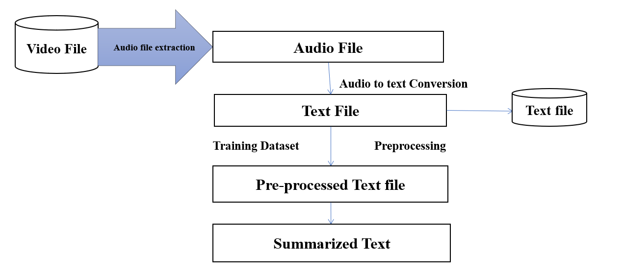
ARCHITECTURE

Slide 9
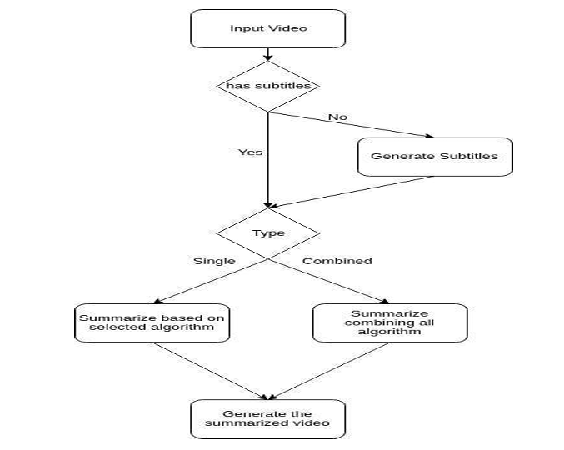
UML DIAGRAMS

Slide 10
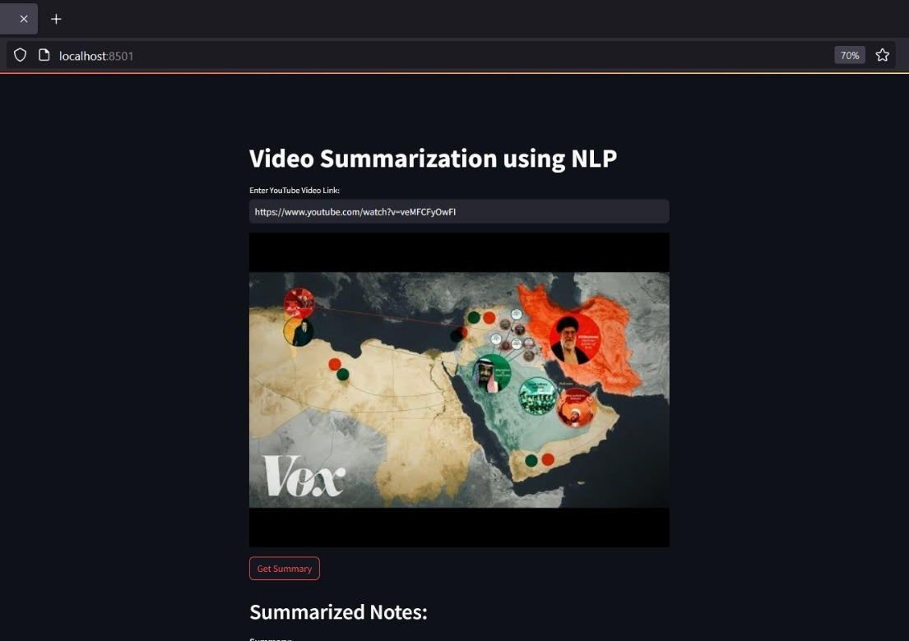
RESULTS AND DISCUSSIONS

Slide 11
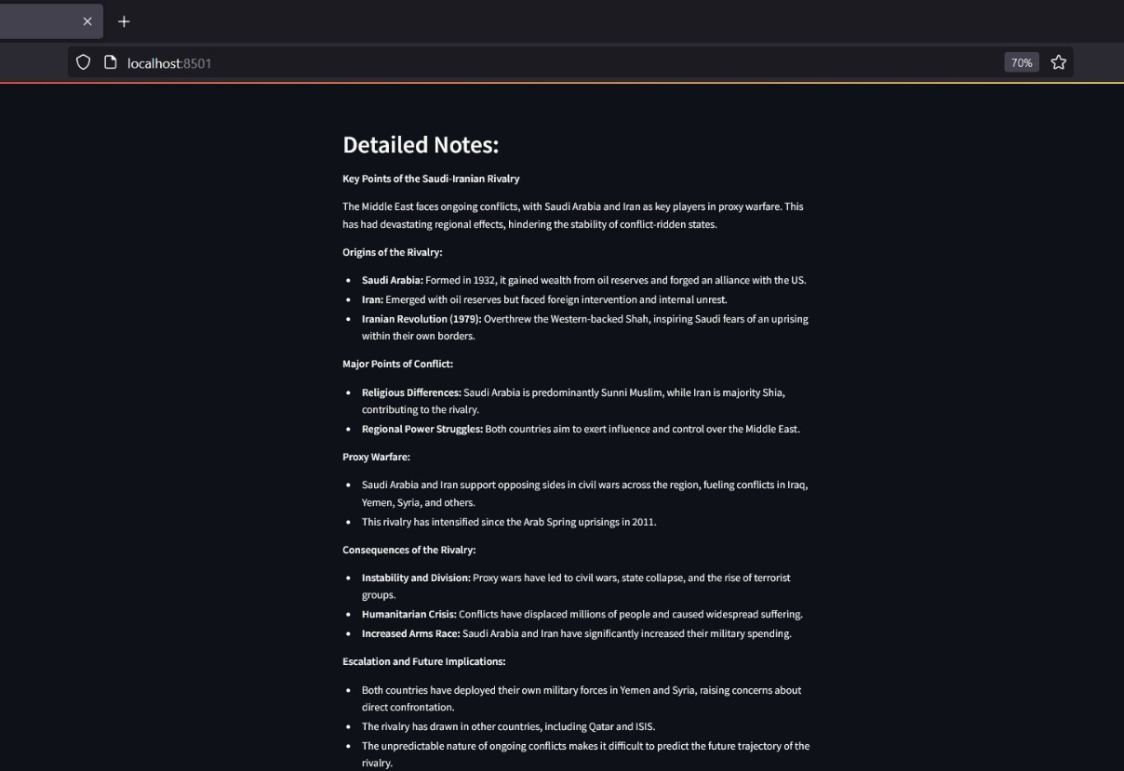
RESULTS AND DISCUSSIONS

Slide 12
CONCLUSION
In conclusion, video summarization using natural language processing (NLP) offers a promising solution to the challenge of efficiently digesting large amounts of video content. By leveraging NLP techniques, such as text extraction, summarization, and semantic analysis, we can extract key insights and generate concise summaries that capture the essence of the video.
This approach not only saves time for users by providing quick access to relevant information but also enhances accessibility for individuals with disabilities who may rely on text-based summaries. Moreover, the integration of NLP with video summarization opens up possibilities for advanced applications in fields such as education, entertainment, surveillance, and more.
As technology continues to evolve, we anticipate further advancements in NLP-powered video summarization, ultimately enhancing our ability to navigate and comprehend the vast landscape of visual information.

Slide 13
THANK YOU

