Slide 1
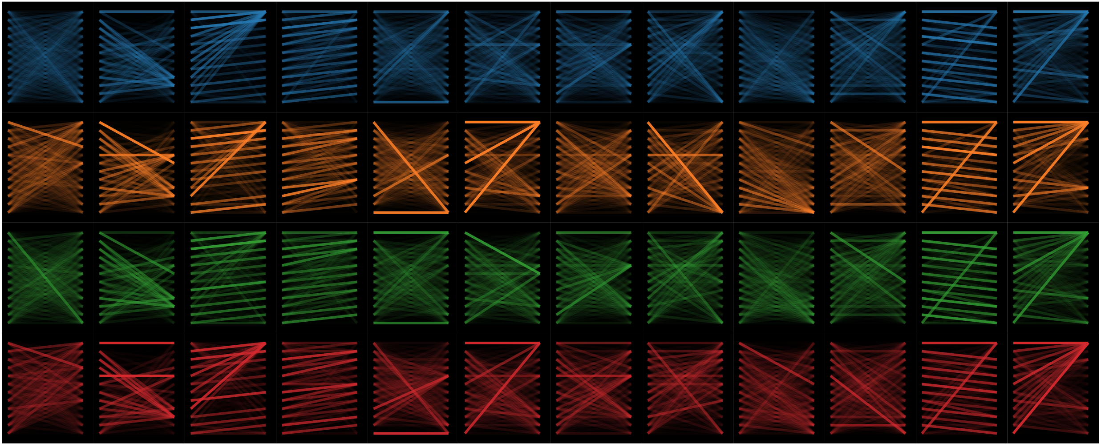
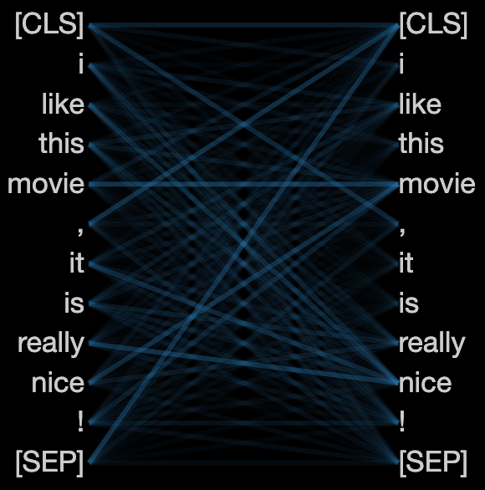
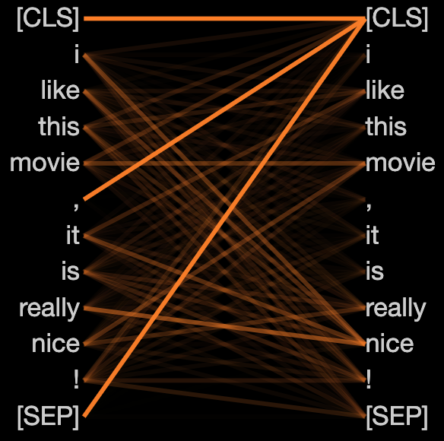
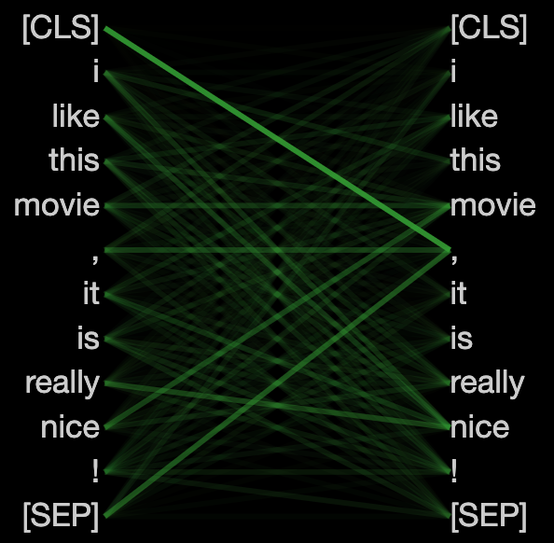
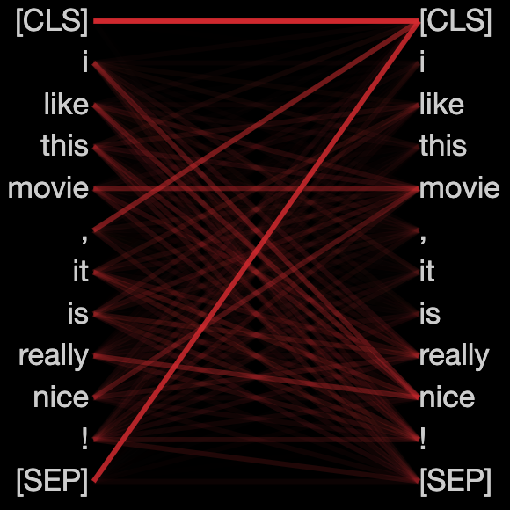








Heads
1
2
3
4
5
6
7
8
9
10
11
12
$$f$$
$$f^{1}$$
Models
$$f^{2}$$
$$f^{3}$$
Model $f$, Head 6
Model $f^{1}$, Head 6
Model${ f}^{2}$, Head 6
Model${ f}^{3}$, Head 6

Slide 2
y
y
x
x
z
z

Slide 3








Scaled Dot-Product Attention
$$H$$
$$V$$
$$K$$
$$Q$$
$$⨁$$
$$⨁$$
Plug-in
Liner
Liner
$$id$$
Liner
Liner
Liner
$$\tilde{h}$$

Slide 4


