Slide 1
Carbon Policy Design for a Wisconsin Biochar Supply Chain
Market Clearing, Endogenous Carbon Prices, and Technology Choice | Progress report, September 2026
72 counties, 13 feedstocks, T1 drying + T2 pyrolysis (300/500°C), 39 technologies
Three policy paradigms: baseline-and-credit | cap-and-trade (endogenous price) | tiered tax + VM0044 eligibility
Data: DOE Billion-Ton 2023 (near-term / mature-market) + USDA NASS + USFS FIA

Slide 2
Research Questions
Q1: How should carbon policy enter a supply chain optimization model so that it genuinely changes locations, technology, and output?
Q2: What is the ENDOGENOUS carbon price of such a system, and how does it compare with RGGI / EU ETS / VM0044 markets?
Q3: Which policy design performs best on cost, removal, and system expansion?

Slide 3
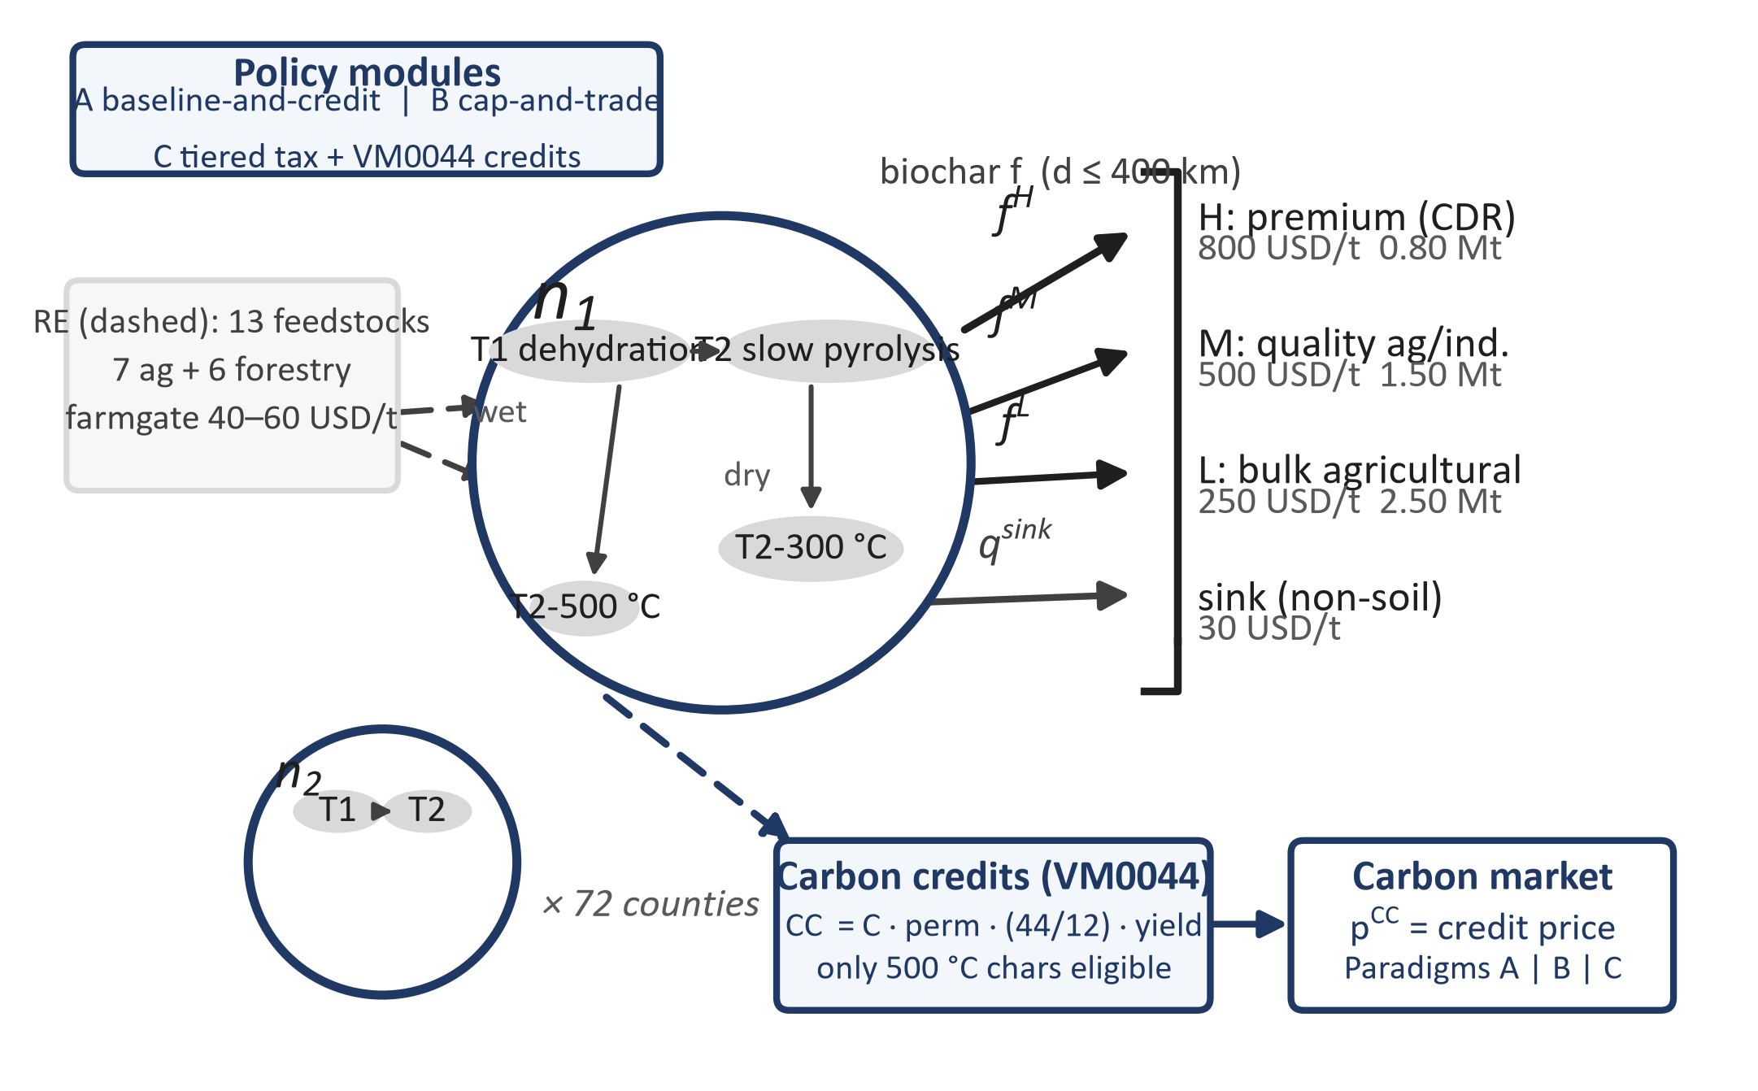
Modeling Framework (Sampat 2019 market clearing)
Duals of mass balances = spatial inherent values (equilibrium prices under coordination)

Slide 4
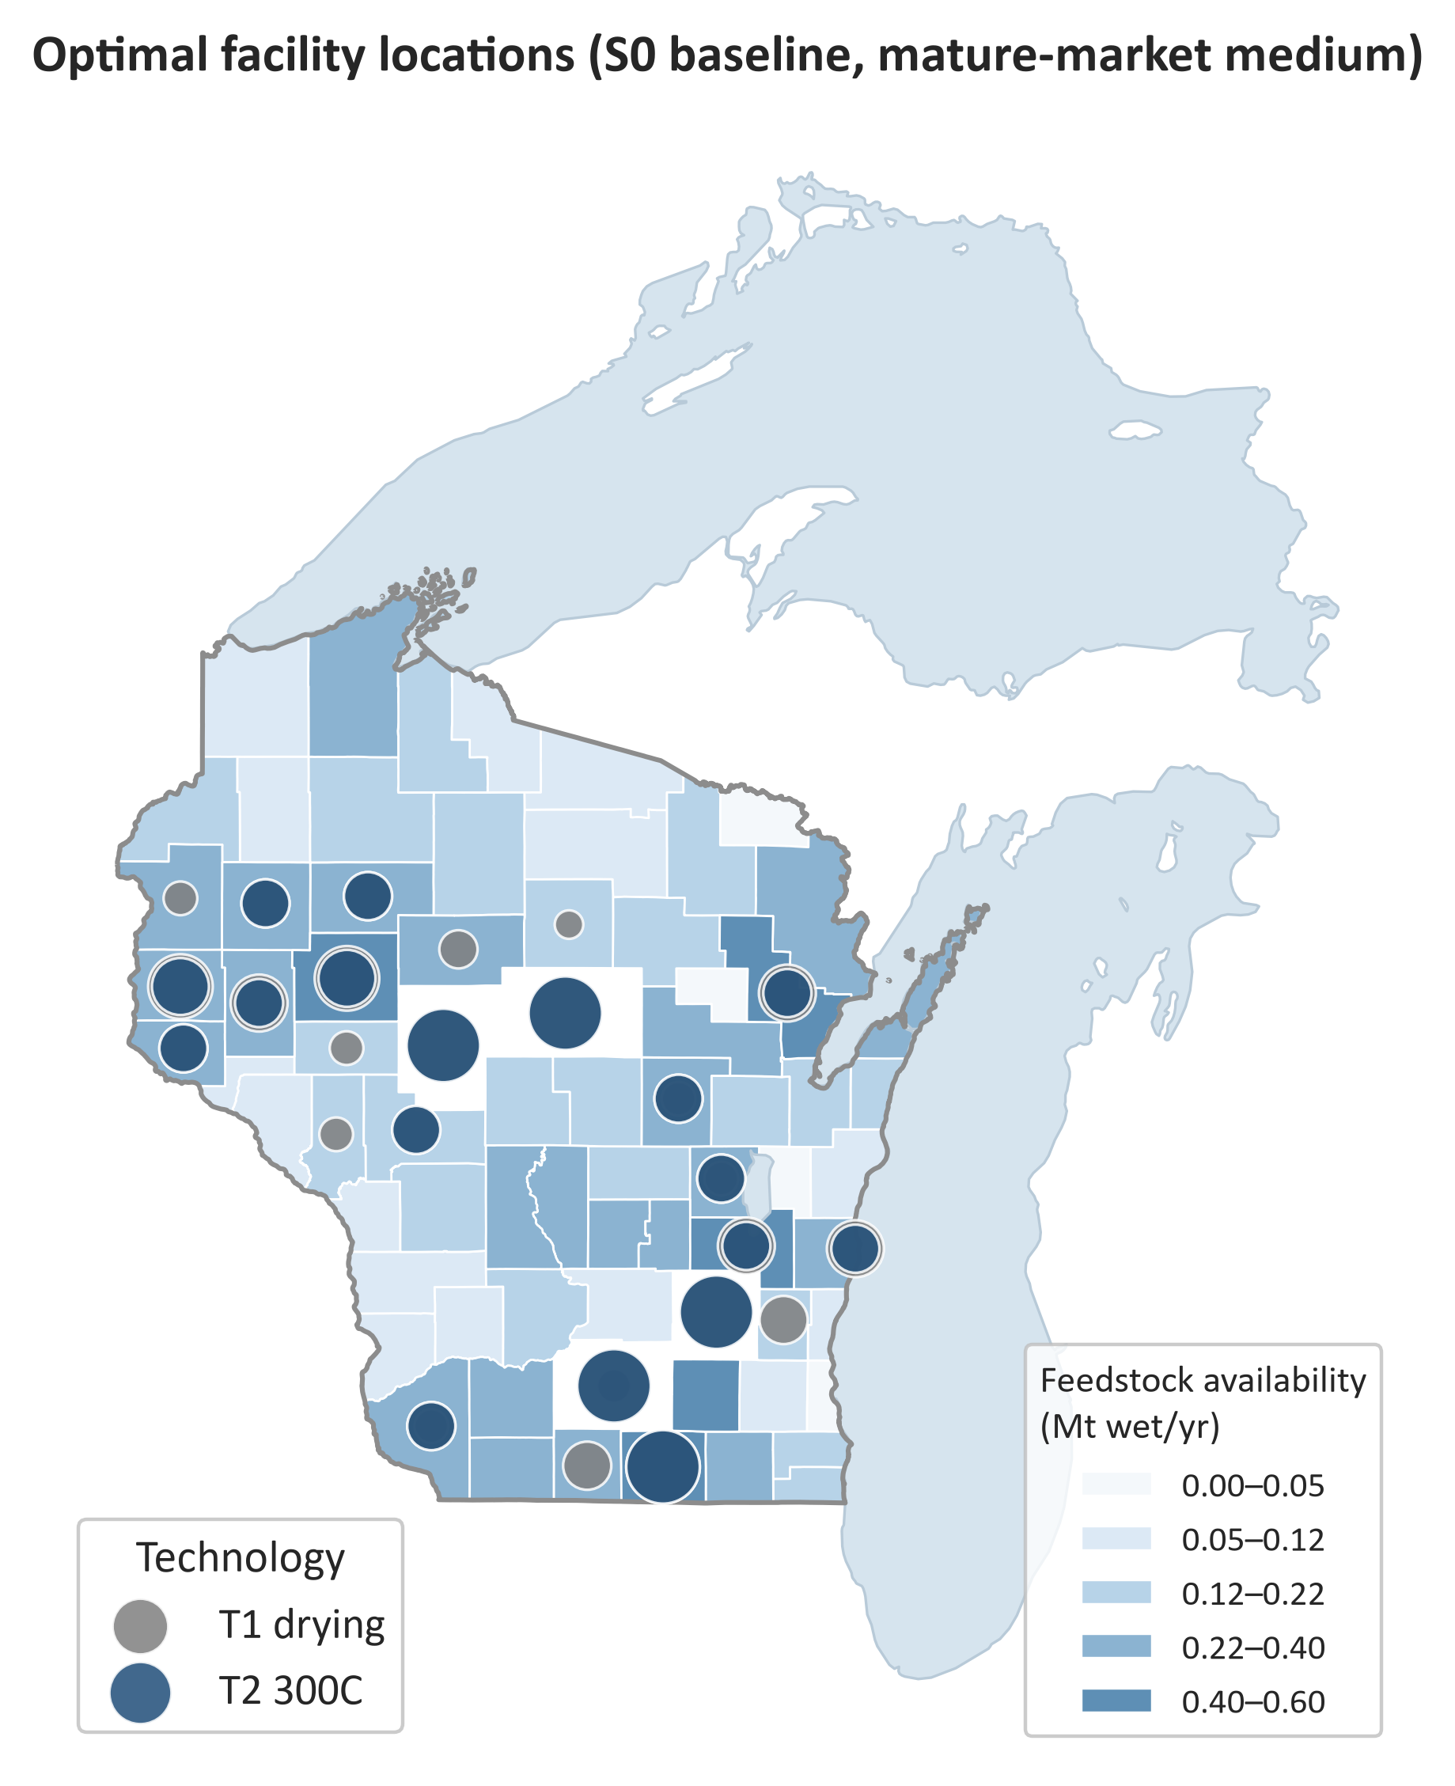
Baseline Market Equilibrium (mature-market medium)
Equilibrium: 2.30 Mt biochar/yr — H ($800) and M ($500) fully served; L ($250) unserved (marginal cost > price)
System surplus $708M/yr (near-term) | $736M/yr (mature-market)
Net removal: -1.60 Mt CO2e/yr (process +979 kt, transport +24 kt, removal -2,598 kt)
Corn stover 5.9 Mt wet fully utilized; facilities T1=78, T2-300=38

Slide 5
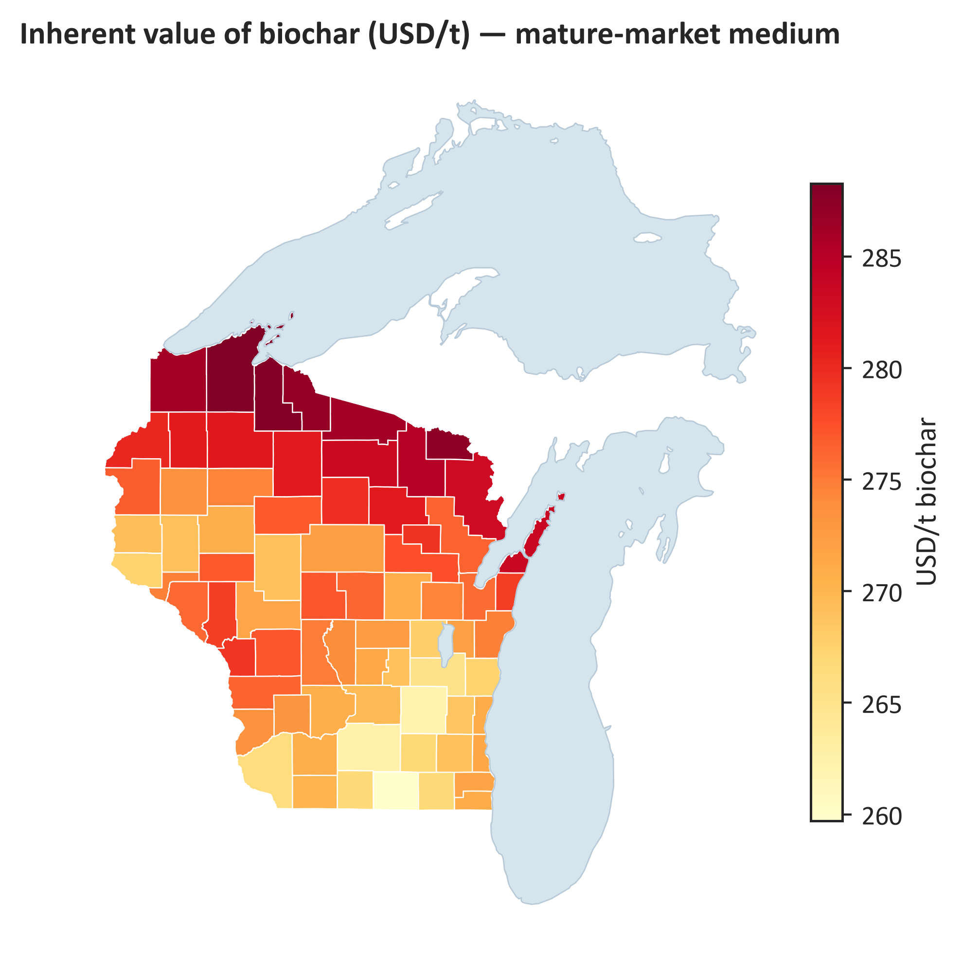
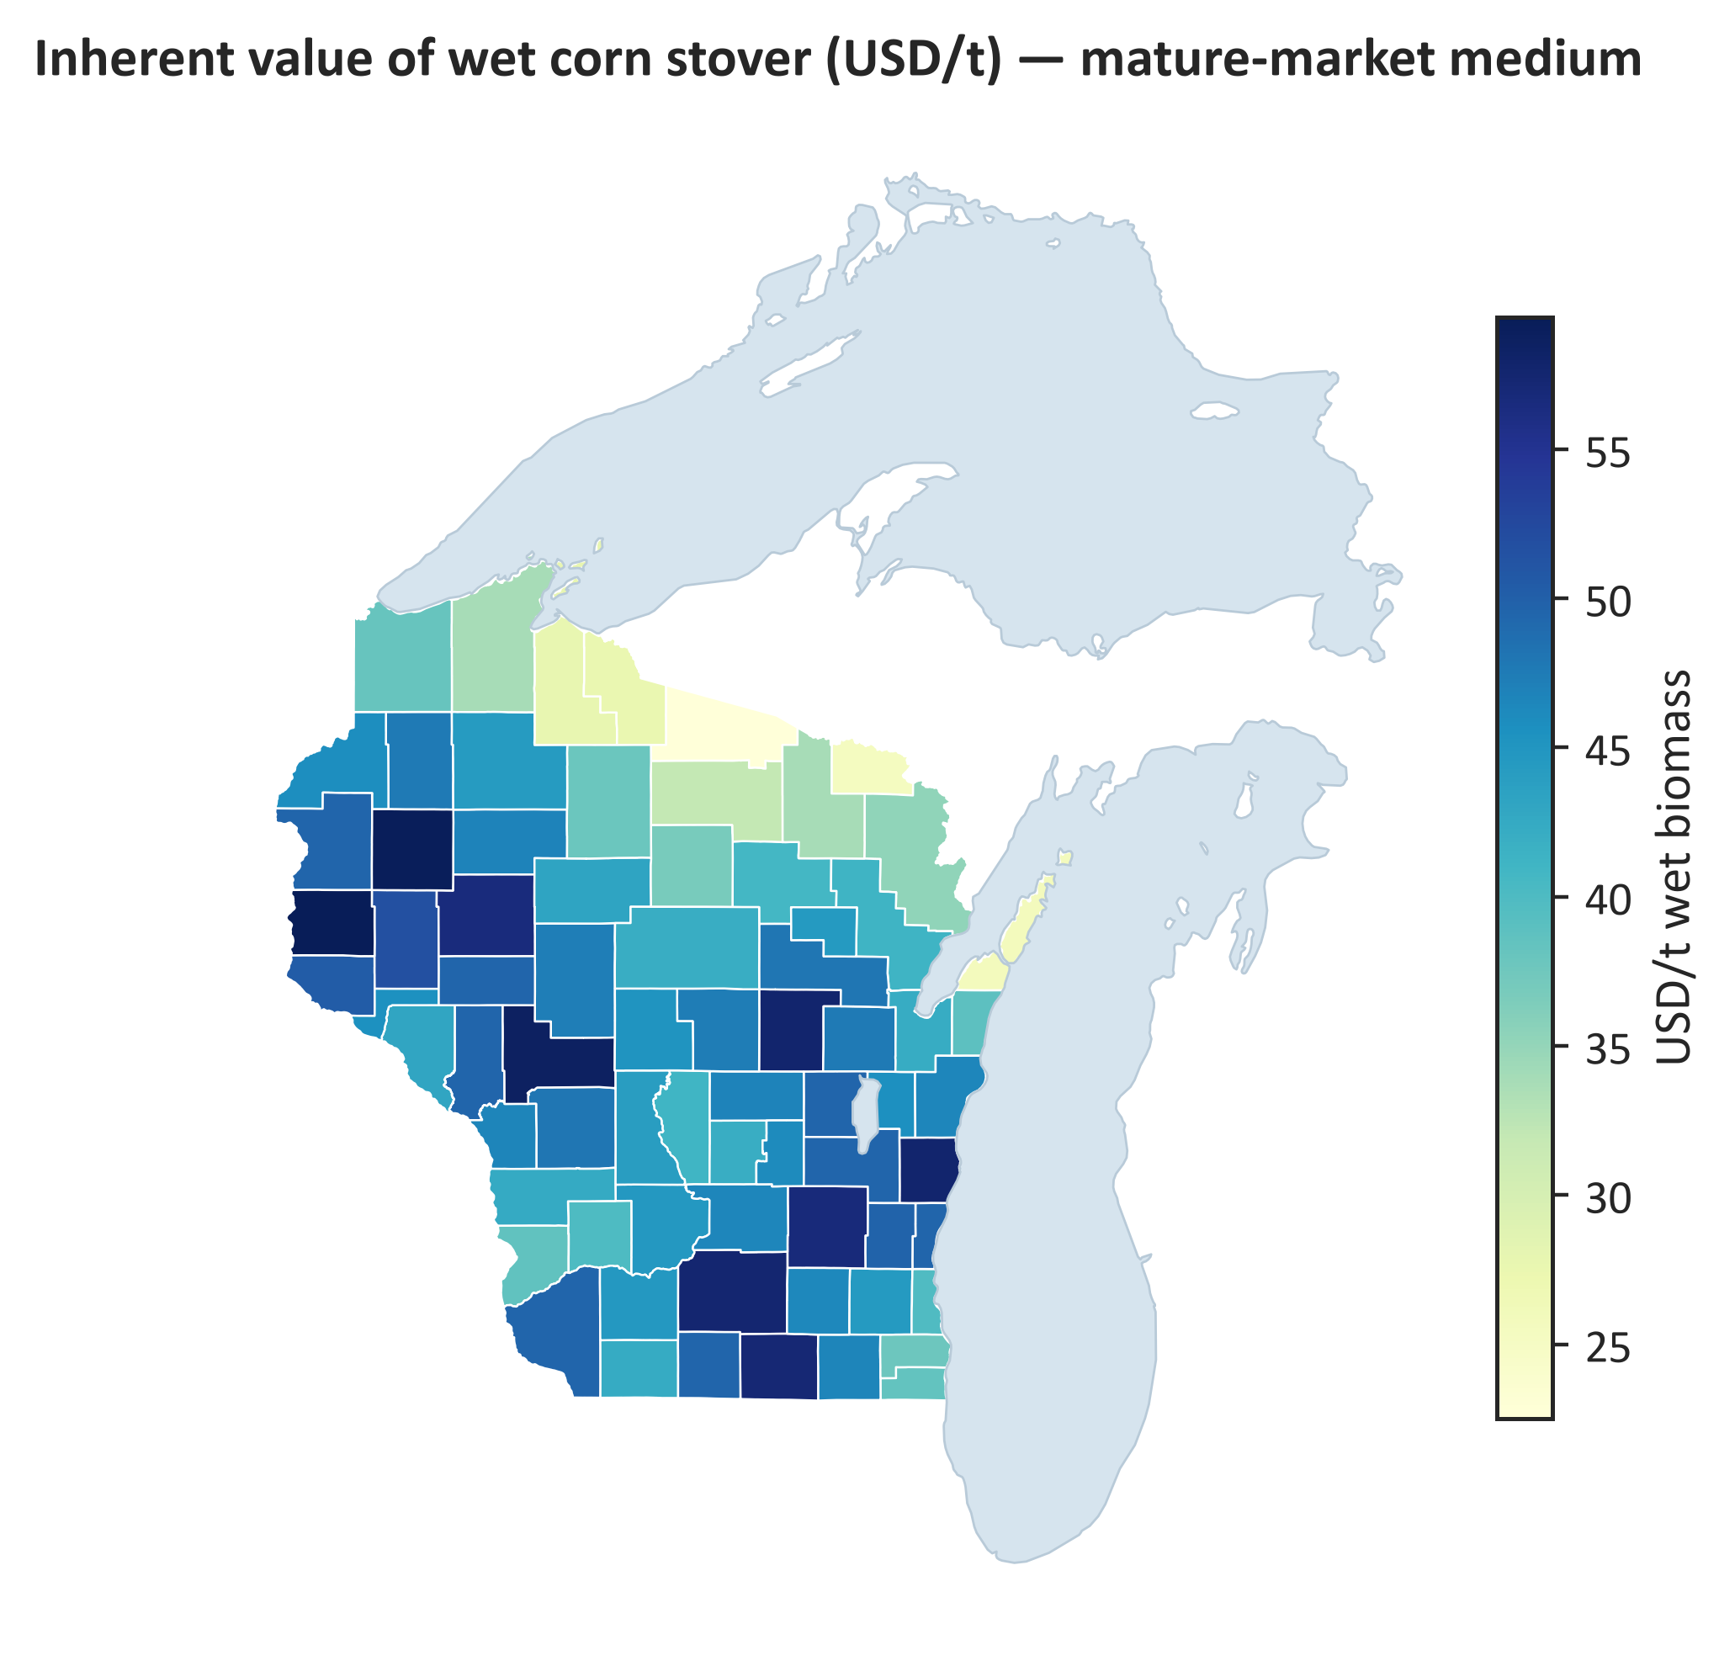
Market Clearing: Inherent Values from LP Duals
Biochar inherent value $305-345/t (near-term) vs $260-288/t (mature): abundant supply flattens location rents
Wet biomass value ($0-77/t) far below farmgate: system is demand-constrained

Slide 6
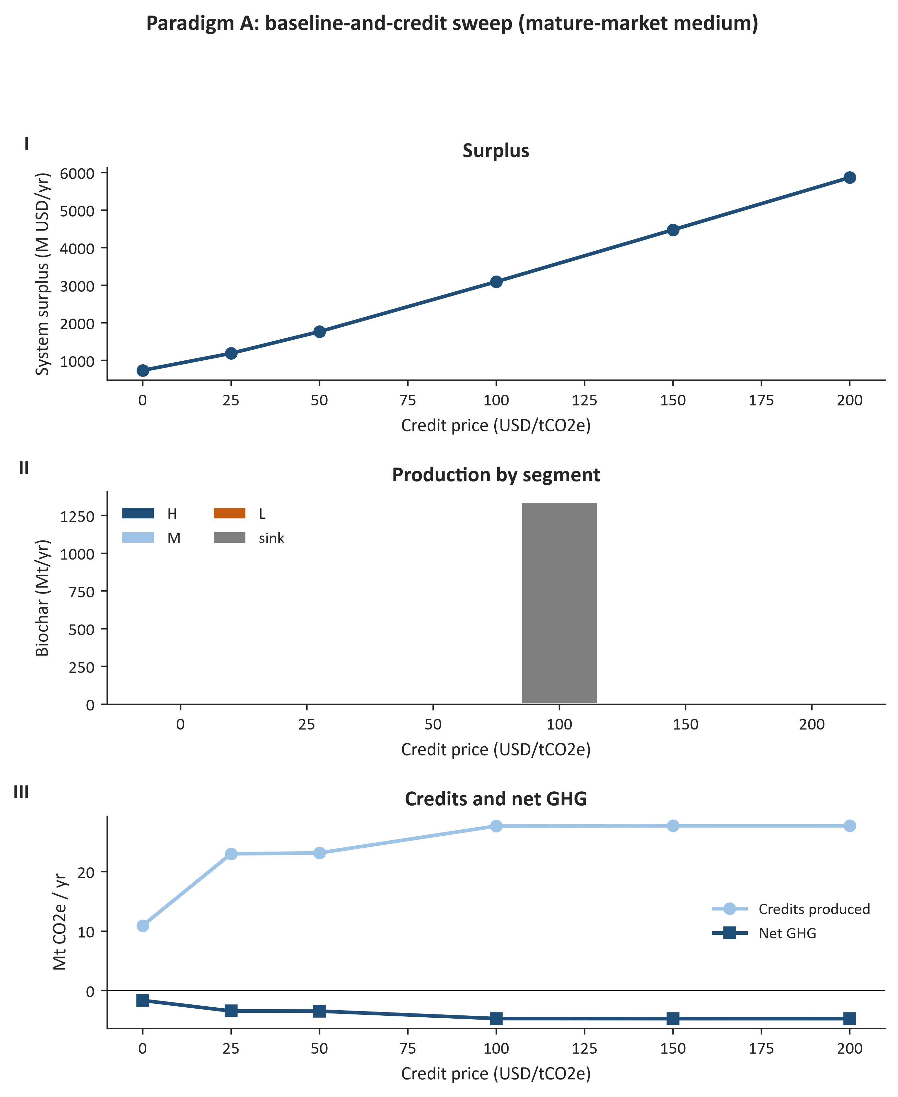
Paradigm A: Baseline-and-Credit
Credits scale with throughput → policy moves the solution
p_c=$25/t activates the bulk segment; $200/t mobilizes ~100% of near-term biomass (surplus $3.36B/yr)

Slide 7
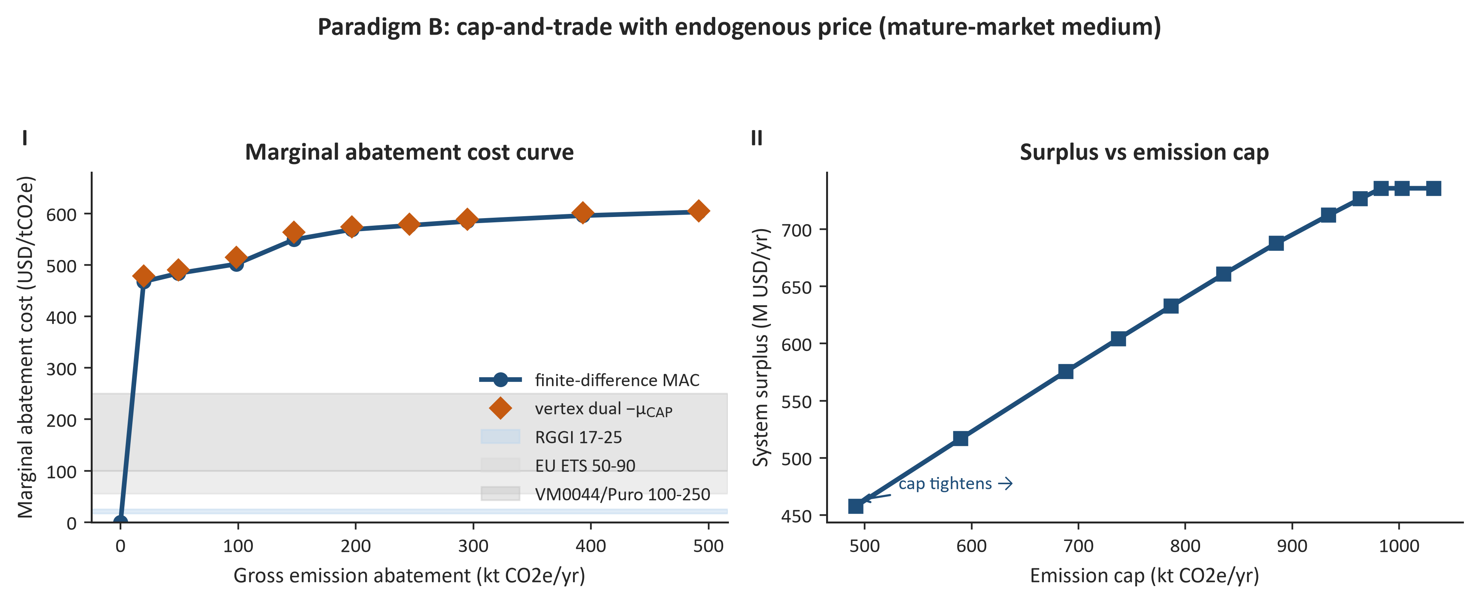
Paradigm B: Cap-and-Trade — Endogenous Carbon Price
Vertex dual of the emission cap = endogenous carbon price; MAC ≈ $351-391/tCO2e first binding intervals, rising to $599 (above EU ETS & voluntary prices)
Net emission caps NEVER bind (π=0): net-negative systems need explicit removal valuation

Slide 8
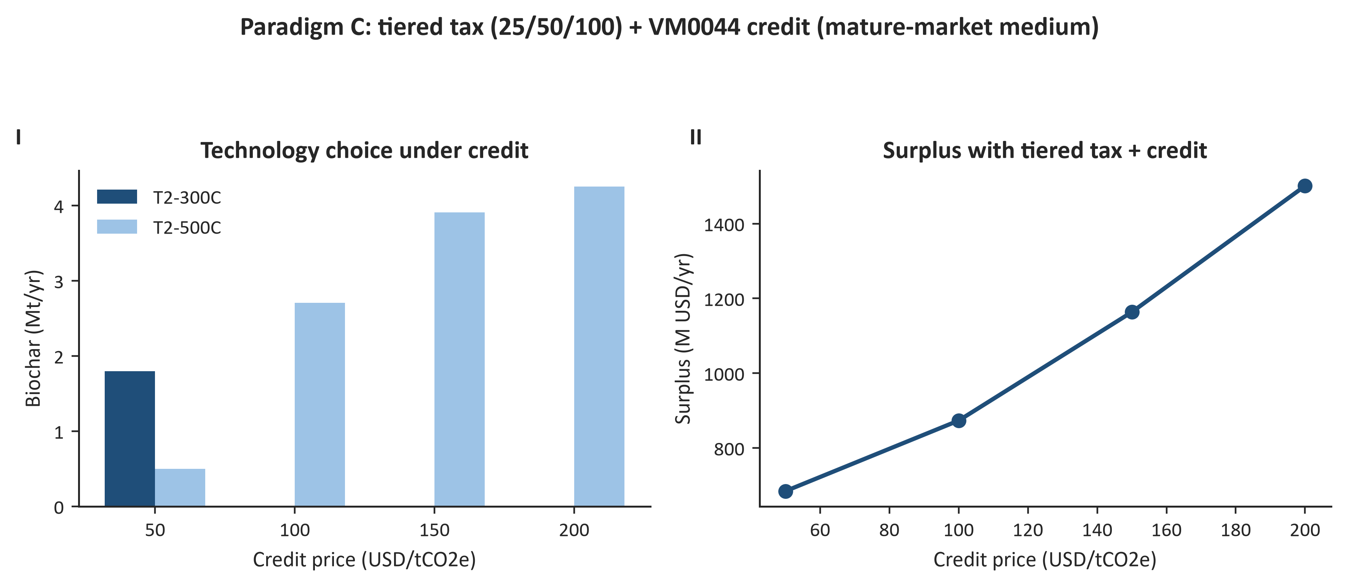
Paradigm C: Tiered Tax + VM0044 Eligibility
H/C ≤ 0.7 gate: ALL 300°C biochar is torrefaction-like (H/C 0.9-1.4) → zero credits; 500°C (H/C 0.40-0.52) always qualifies
Crediting converts the system to 500°C as p_c rises: 2.25 Mt near-term / 4.25 Mt mature at $200/t — credits buy durability, not tonnes
Stress test (500°C H/C +0.25, beyond published range): conversion falls back to 0.31/1.59 Mt — robust within the 0.40-0.55 literature band

Slide 9
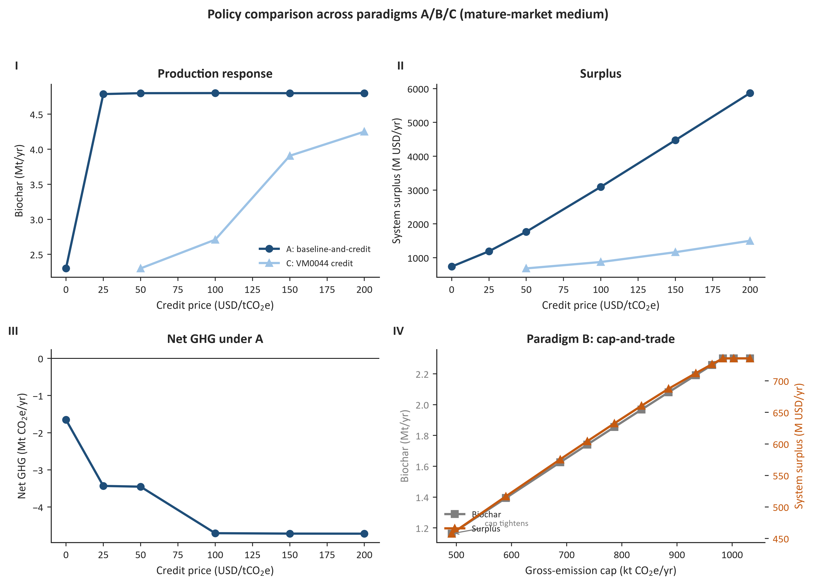
Policy Comparison

Slide 10
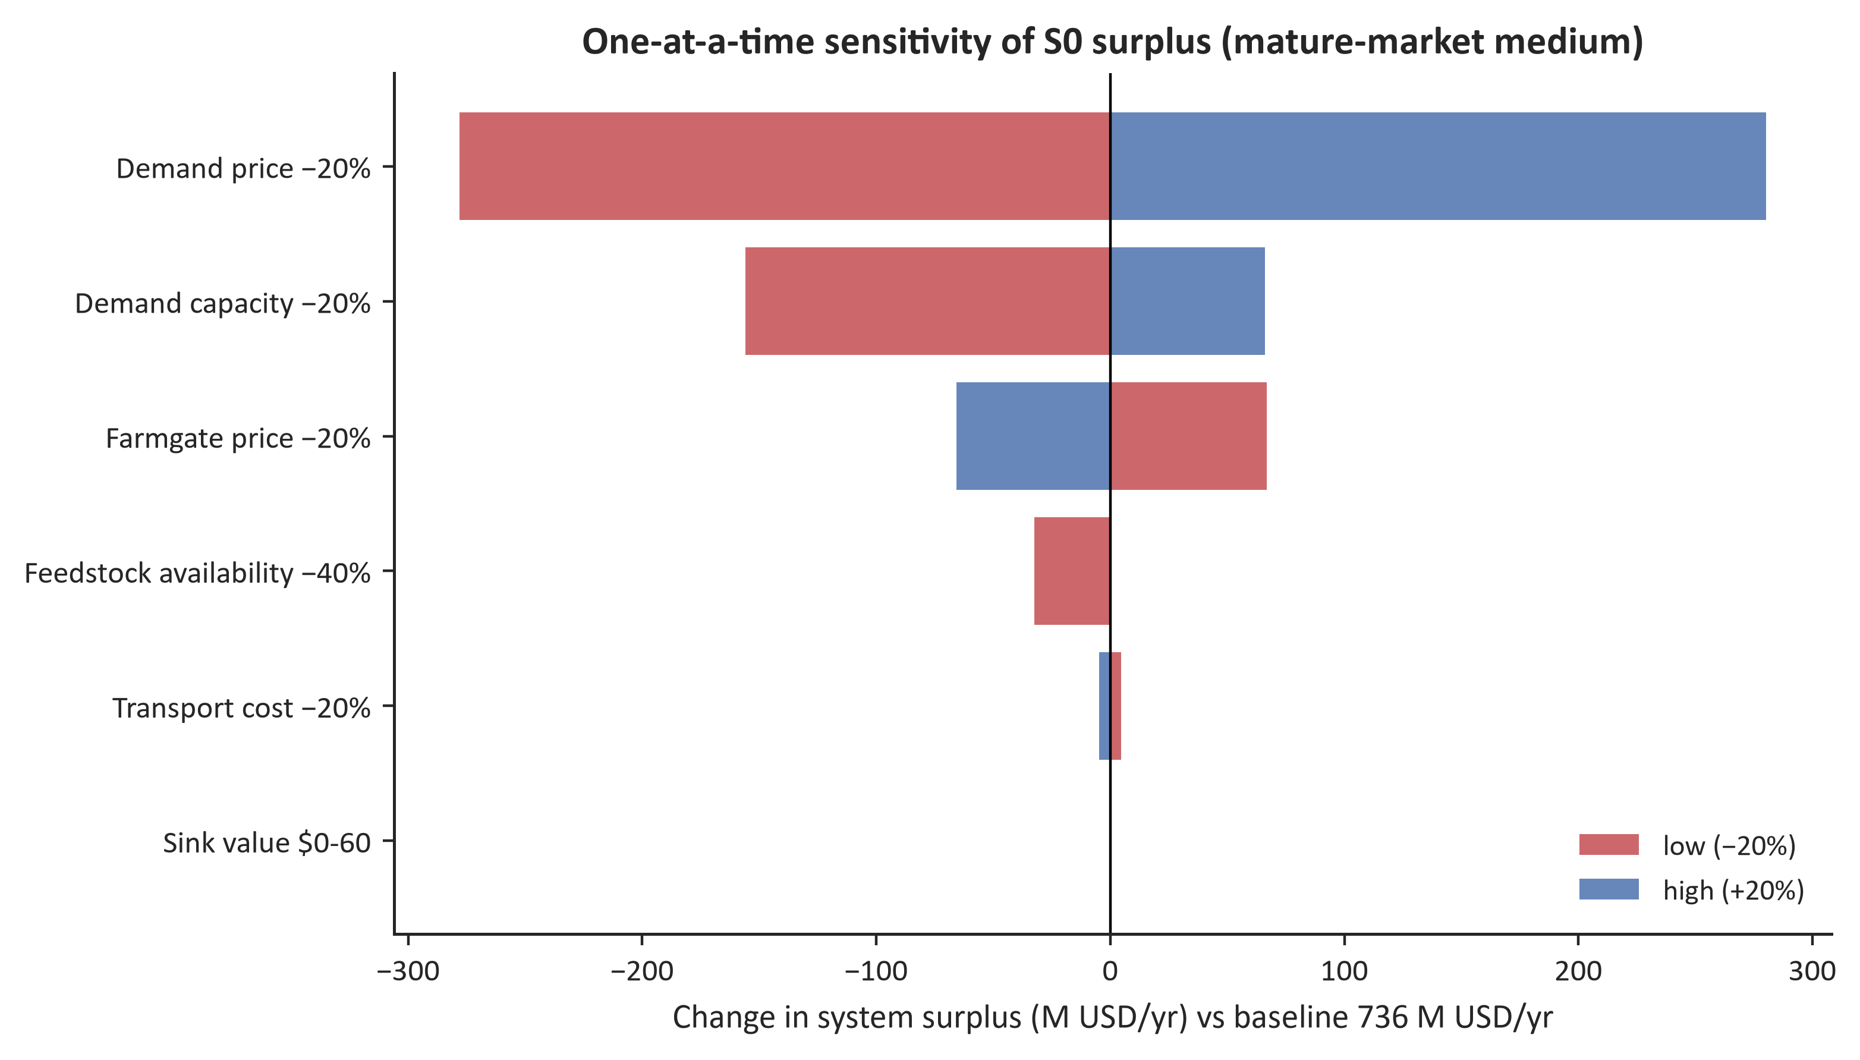
Sensitivity: Demand-side Dominance
Demand price ±20% → surplus ±39% (largest lever)
Demand capacity -20% → quantity -20%
Farmgate ±20% → ±9%; transport ±1% (supply-side minor)

Slide 11
Next Steps
Multi-period / seasonal inventory extension (advisor direction)
BT23 wastes layer characterized (2.27 Mt at <=$70/t, dairy manure 1.13 Mt) for co-location analysis
Tighten MIP gaps on HPC; VM0044 durability factors aligned (0.65/0.80, v1.2 Table 3)
Sensitivity on adoption rate & quality premium calibration

