Slide 1
Demo The End of std::endl
junseOk yang
Notes:
Hello guys. My name is junseok.
Introduce in my demo.
My demo topic is end of end line.

Slide 2
index
1. Description of std::ENDL
2.Compare std::endl to \n
3.show demo
Notes:
This is my ppt index.

Slide 3
1. Description of std::ENDL
#include <iostream>
Int main(void)
{
std::cout << “hello bro” << std::endl;
}
Notes:
This is a std::end line everyone can use.
That is great . Actually that is not really the biggest problem, because ‘cout’ is not.
people can not see ‘end line’ buffered size.
therefore what people normally see is when you write ‘end line’, it is a new line.

Slide 4
2.Compare std::endl to \n
‘\n’
Notes:
What is the Std::end line?
people normally think Std::end line and back slash n are same.
End line is kind of a new line, but it actually happens to be slightly more.

Slide 5
2.Compare std::endl to \n
\n + flush
\n -> \n\r
Notes:
That is basically a new line and flush.
Basically end line and back slash n is similar.
but End line is slow because the output buffer needs to be emptied.
In MS Window, use back flash n as back flash n + back flash r, but this is not important.

Slide 6
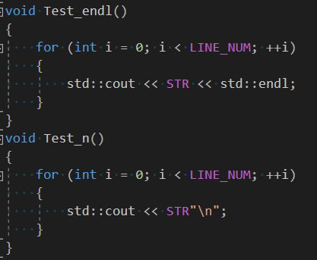

3.show demo
Notes:
This is my simple demo screen shots.
This demo generates 80 characters 10000 new lines.
As a result, the speed difference between end line and base flash n can be seen.
And this is my demo. (demo open)
This function using the end line.
And this function using back slash n.
And this function using ostream operator.
And running program….
This is output. Look at this. Back slash n is faster than end line.

Slide 7
DON NOT USE STD::ENDL
THANK YOU
Notes:
So in summary.
I've told you something that the average programmer was wrong or didn't know.
Do not use end line for your program.
It makes your program slow. Thank you for watching.!!

