Slide 1
APEX
Alpha

Slide 2
Introduction
Wonju Jo
Lead Designer
Haewon Shon
Test Manager
Jookyung Lee
Technical Director
Junseok Yang
Producer

Slide 3
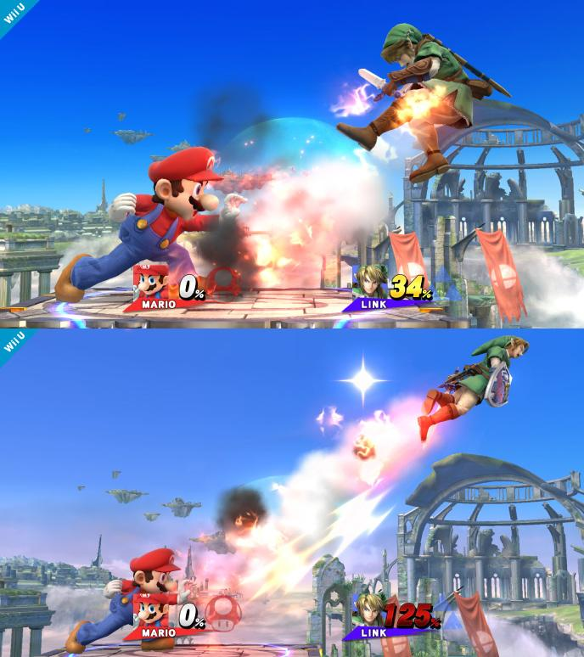
High Concept
APEX is a 2D platformer action game to reach the top of the tower by Knocking-back an opponent player.

Slide 4

Implemented Features
Add main menu & exit
Character Selecting level
Item random drop & item design item ability
Attack action
Making character's graphics and weapon (graphics) & making map
Pause & Restart
Win decision

Slide 5
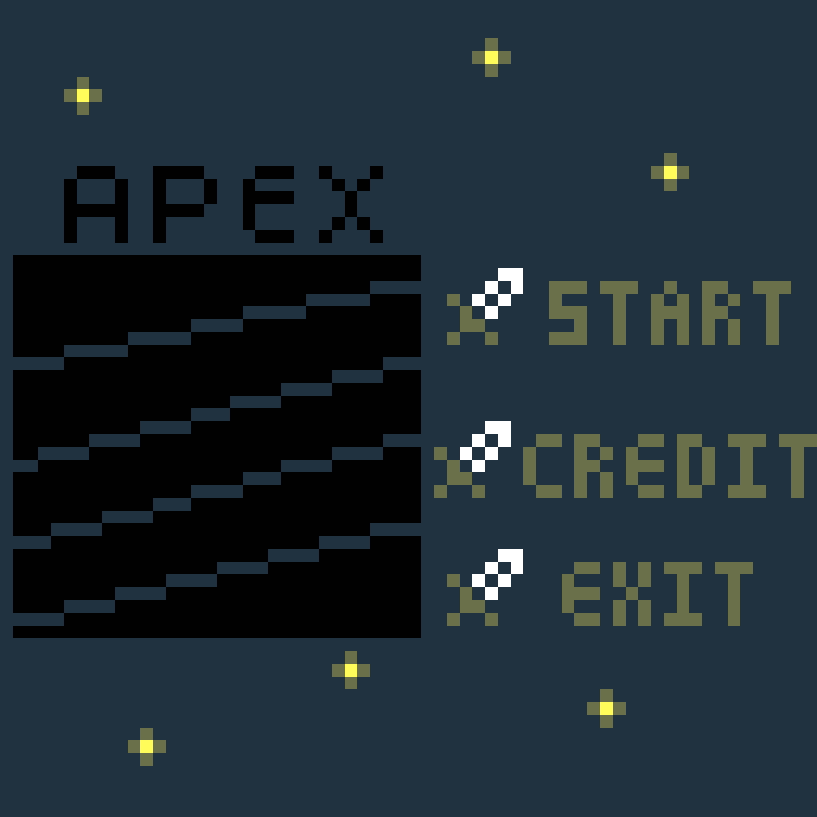
Add main menu & exit
Added main menu with several decisions that make users to easily access game details.

Slide 6
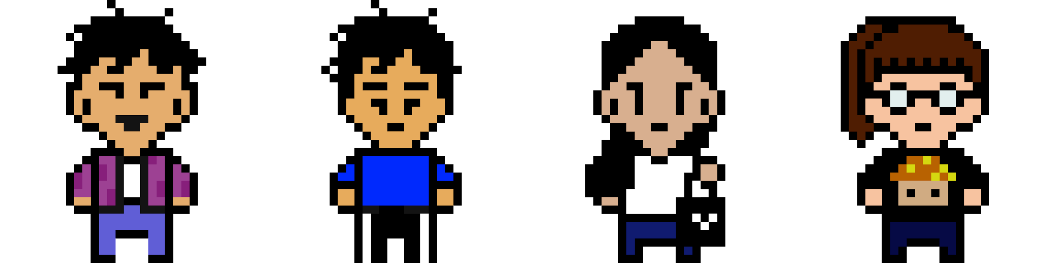



Making character's graphics & weapon & attack action & making map
Give individual graphics to characters that will distinguish each characters.
Express APEX members with their own weapons by graphics.
Making map that will be used in game.
Notes:
발판 생성위치랑 캐릭터들 디자인 부분을 이번 알파에서 구현했다

Slide 7



Item random drop & item design
Add fun factors that makes game more interesting and attractive.
speed up
slow down
spring

Slide 8
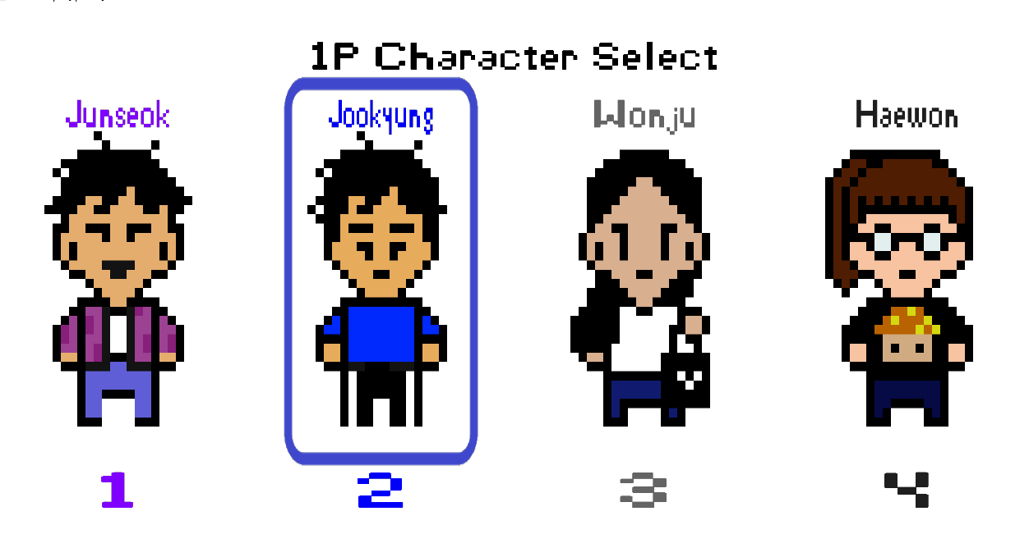
Character Selecting Level
Made a level that let players to select between 4 different characters.

Slide 9
Pause & Restart
Pause game.
Restart game.

Slide 10
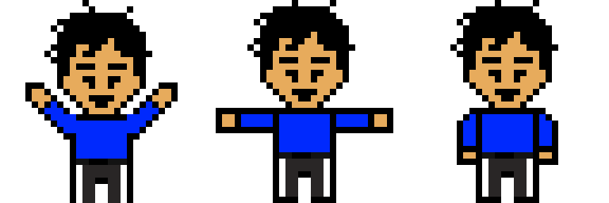
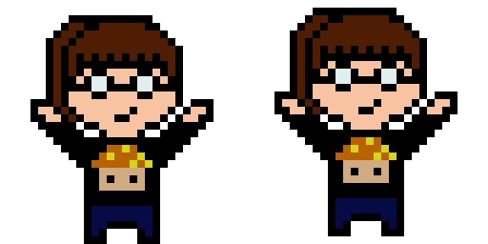


Win decision
Reach the top, player wins.

Slide 11
Future Plan
Apply each character’s stats and balancing
Add ending scene of each character
Add multi-round
Apply sound effects
Add short scene about story before character choice
Additional polish
Notes:
before the prototype presentation, our goals in game is to enable significant movements and let the camera move with time passing.
After prototype presentation, we decided to handle key features in our game such as 2nd player, interacting between players, add items, and fixing bugs.
These features will be done before alpha test according to our scope.
For the last three weeks, we are going to prepare for the open play test and final presentation.
We will get feedbacks from open play test and this will improve our gameplay, and also
we will fix every memory leaks and errors before our final presentation.

