Slide 1
APEX
Final

Slide 2
Introduction
Wonju Jo
Lead Designer
Haewon Shon
Test Manager
Jookyung Lee
Technical Director
Junseok Yang
Producer

Slide 3
High Concept
APEX is a local multiplaying 2D platformer action battle game which contains several rounds with different win conditions.

Slide 4
Contents and Menu
Main Menu
Character Select
Tutorial Round
Dominating Round
Coin Collecting Round
Ending
Game Credit

Slide 5
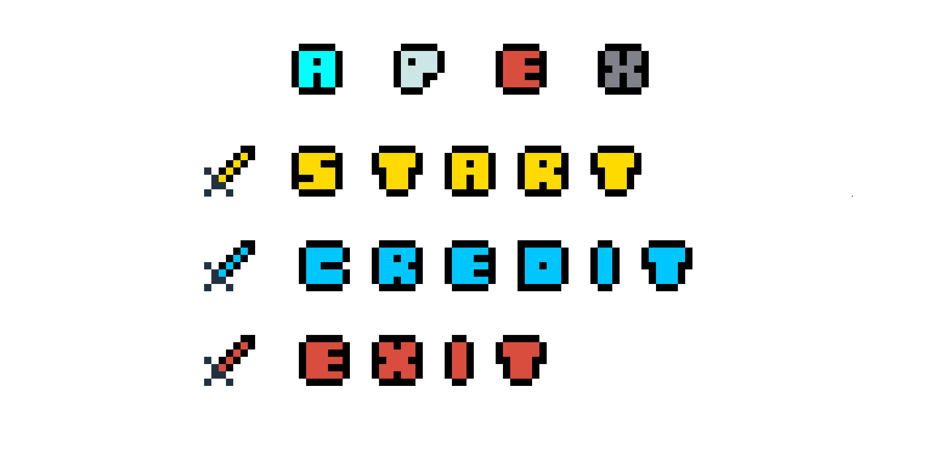
Main
Menu

Slide 6
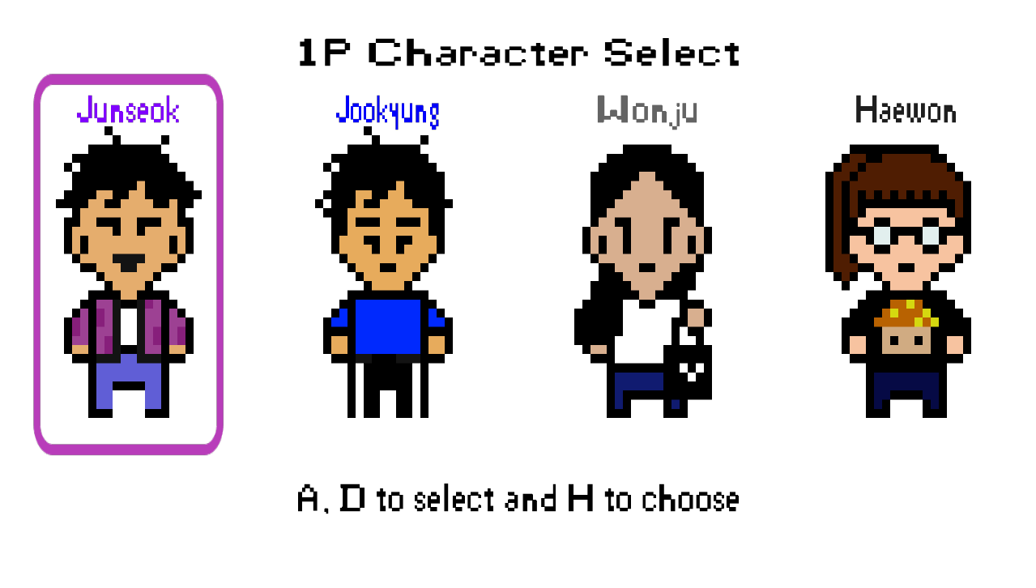
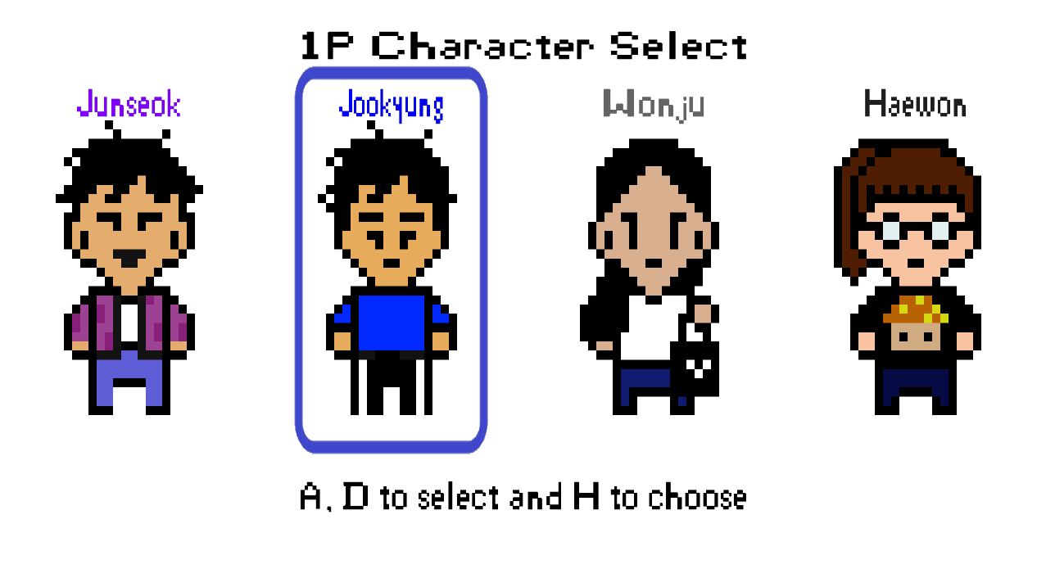
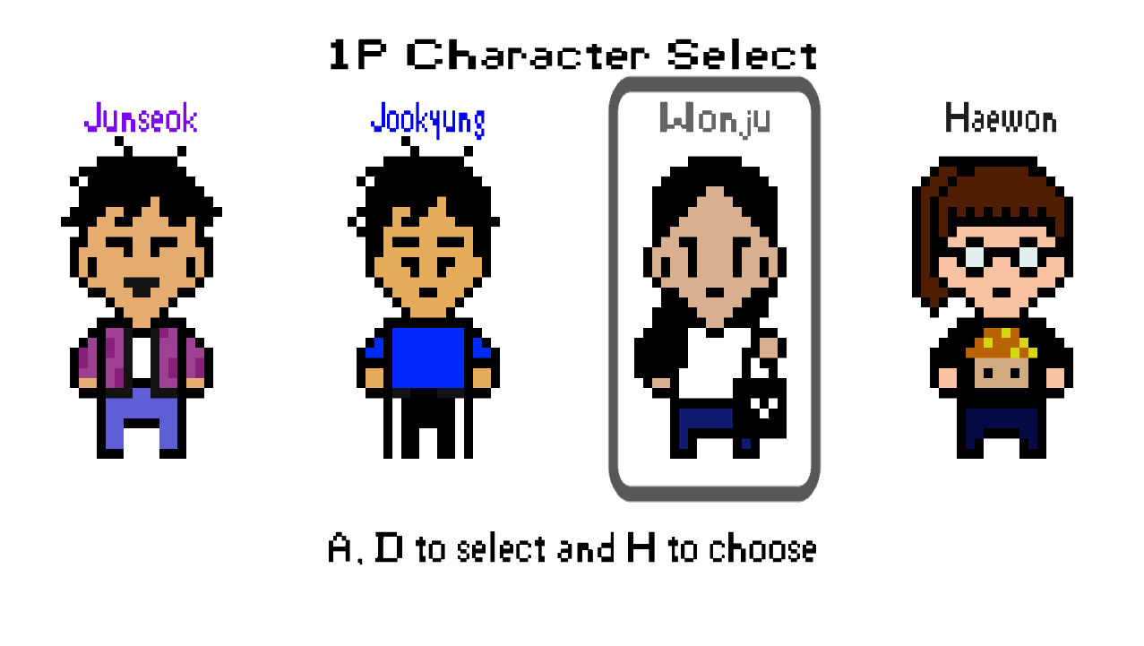
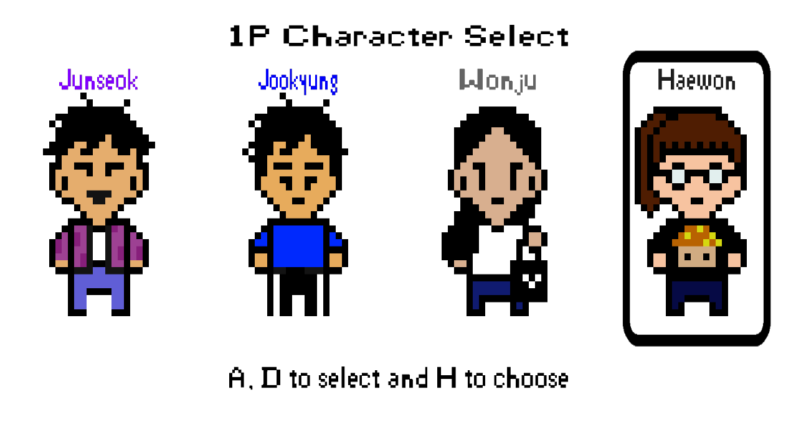
Character Select

Slide 7
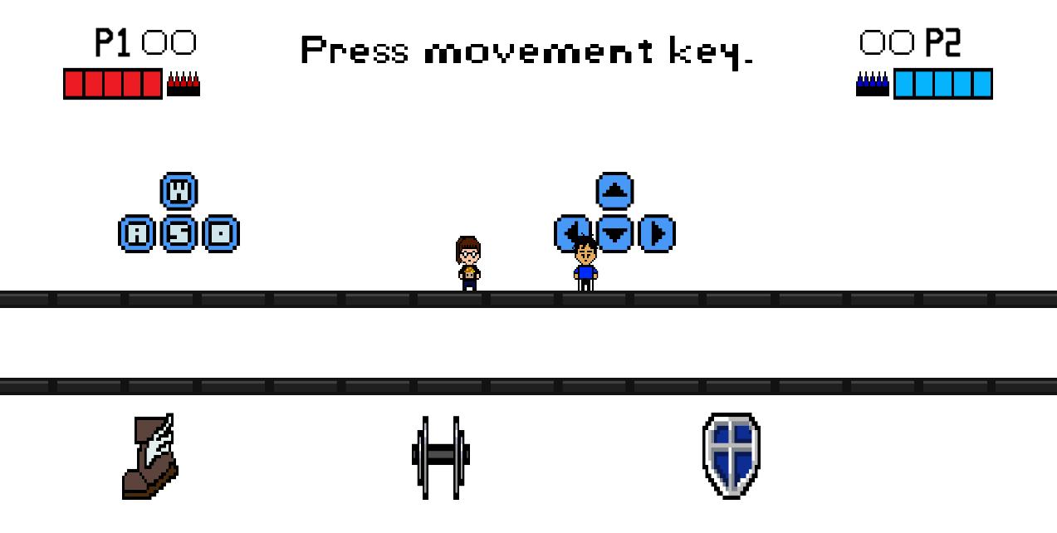
Tutorial Round
Speed Up
Power Up
Stance Up
This round helps players to master basic controls and actions also explaining about items.

Slide 8
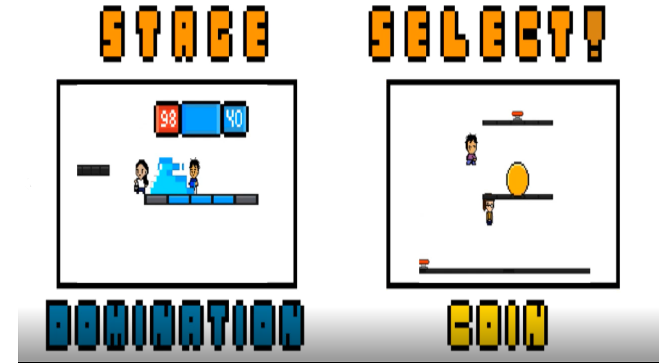
Round Select
This round helps players to selecting wanted round!

Slide 9
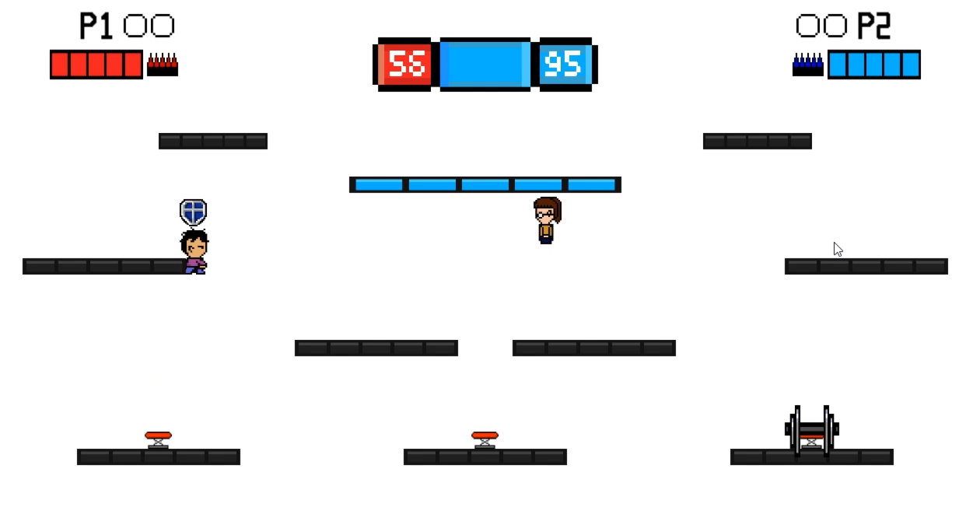
Dominating Round
In APEX, there are dominating rounds which stimulates players to fight and achieve victory.

Slide 10
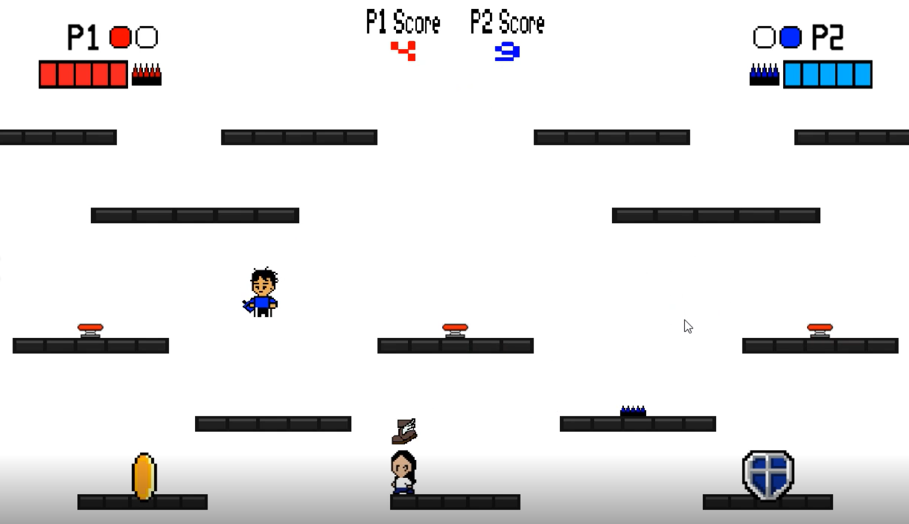
Coin Collecting Round
In this round, players need to obtain randomly generated coins to win.

Slide 11
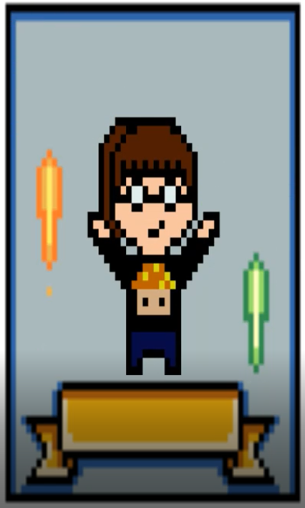
Ending
In this round, show the game ending.

Slide 12
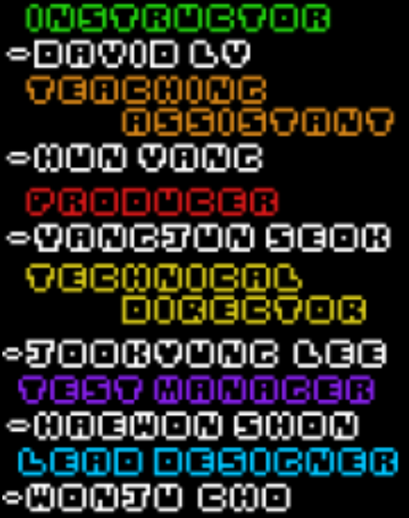
In this round, show the game credit
Game Credit

Slide 13
Risks and Mitigations
Risk:
Changed the main concept of the game.
Mitigation:
Increase the working time and communicated more.

