Slide 1

Lonely Mercenary
by
pinata
GAM 200
Pre-Production Milestone
and Game Submission Presentation
2019.12.13
Custom Engine
Notes:
Pre-Production Milestone and game submission

Slide 2
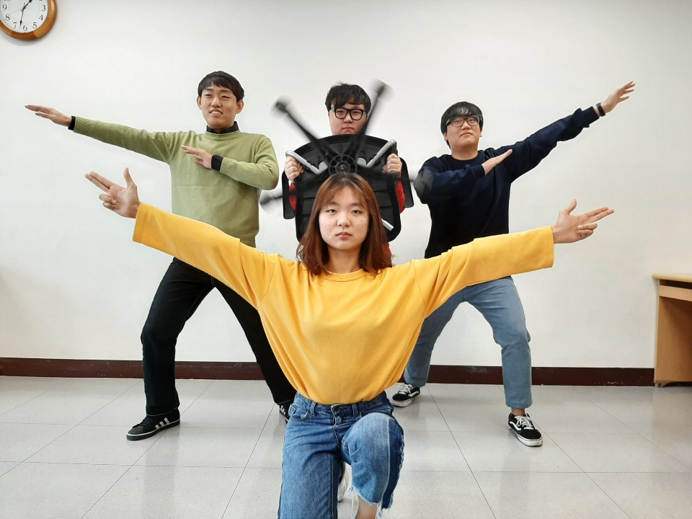
TEAM PHOTO
Wonyong Lee
Minho
Chae
Junseok Yang
Inyeong
Han

Slide 3


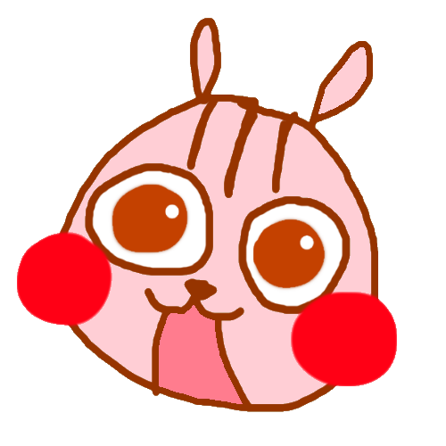

TEAM STRUCTURE
Minho Chae(BSGD)
Producer
Wonyong Lee(RTIS)
Architecture
Inyeong Han(RTIS)
Test Manager
Designer
Junseok Yang(RTIS)
Graphics

Slide 4
GAME ARCHITECTURE
General Approach
OpenGL, SDL2
Completed
State Manager
Object Manager
Math library
Keyboard & Mouse Input
Data-driven
FPS
Main Algorithms
Next
Adding characters(playable characters, enemies), items, and weapons
Notes:
We Using Opengl and SDL2
Also we completed Dividing state with state manager, Template-style math library, keyboard mouse input and FPS for slowing down the project loop speed.
Also we need to optimizing the engine afterall.

Slide 5
GRAPHICS
General Approach
OpenGL, SDL2
Completed
Sprite - Using the DRAW function and the ADDING SCREEN function is much simpler and shorter
Texture - made TEXTURE_ARRAY to store and send textures more easily
Basic Font - made a very basic font based on Sprite
Next
During the vacation, I will do the upgraded animation, font and particle.
Also makes advanced GL based graphics engine.
Notes:
준석

Slide 6
Audio Tech
General Approach
SDL2_mixer
Completed
Play & Stop
Volume control
Next
Sound Effect
Notes:
민호
We used SDL mixer for audio of our engine.
We completed the play & pause and volume control.
Also we need to optimizing the sound function after.

Slide 7
GAME DEMO

Slide 8
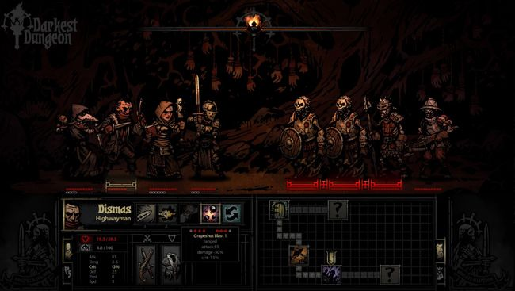
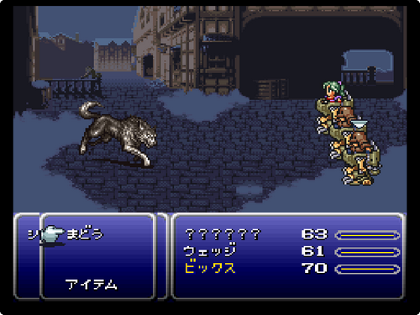
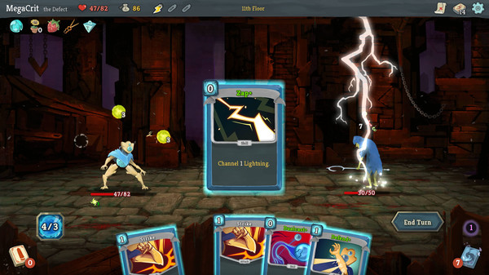
THE GAME CONCEPT - Inspiration
Turn-based
RPG
Roguelike
Notes:
인영
the game concept of our game is a card game, turn_based, RPG, and roguelike.
Player can choose 3 card what they wants to act.
and game is made up of turn-based battle in the same time.
Player can level up as RPG. at last the game genre is rougelike, so when player was dead their status was gone.
The main genre of our game was a Rougelike, and we attach it with card game and turn-based RPG.
The main mechanic of our game, Player can choose 3 cards what they wants to act to fight also enemy can choose 3 act in randomly. At last, as I said the game genre was roguelike, when the player was dead, they lost all progress on that game. however, the unlockable stuff can be saved (i.e, characters, items)

Slide 9
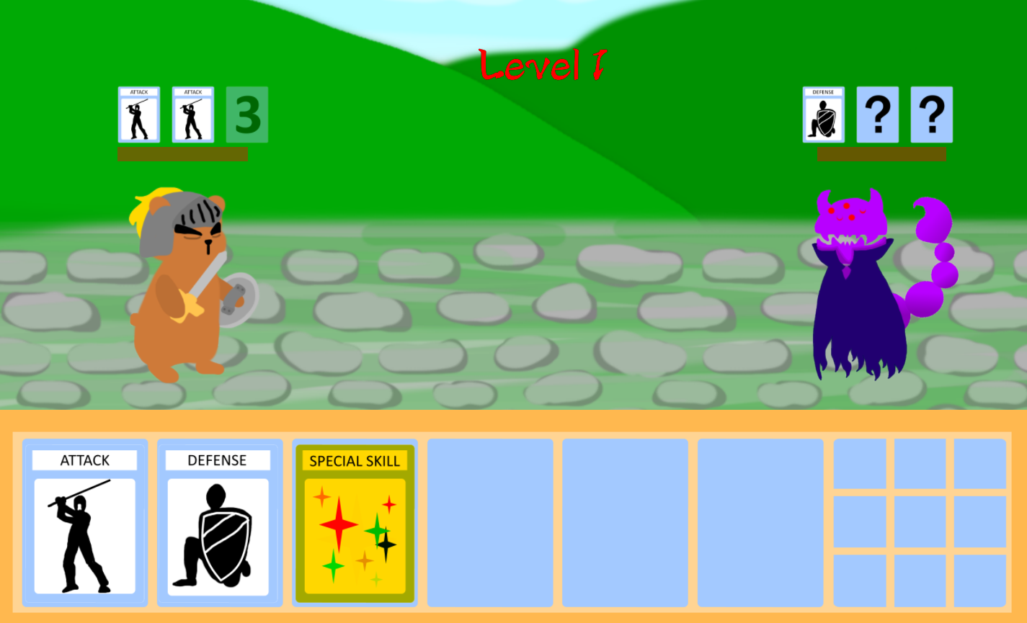
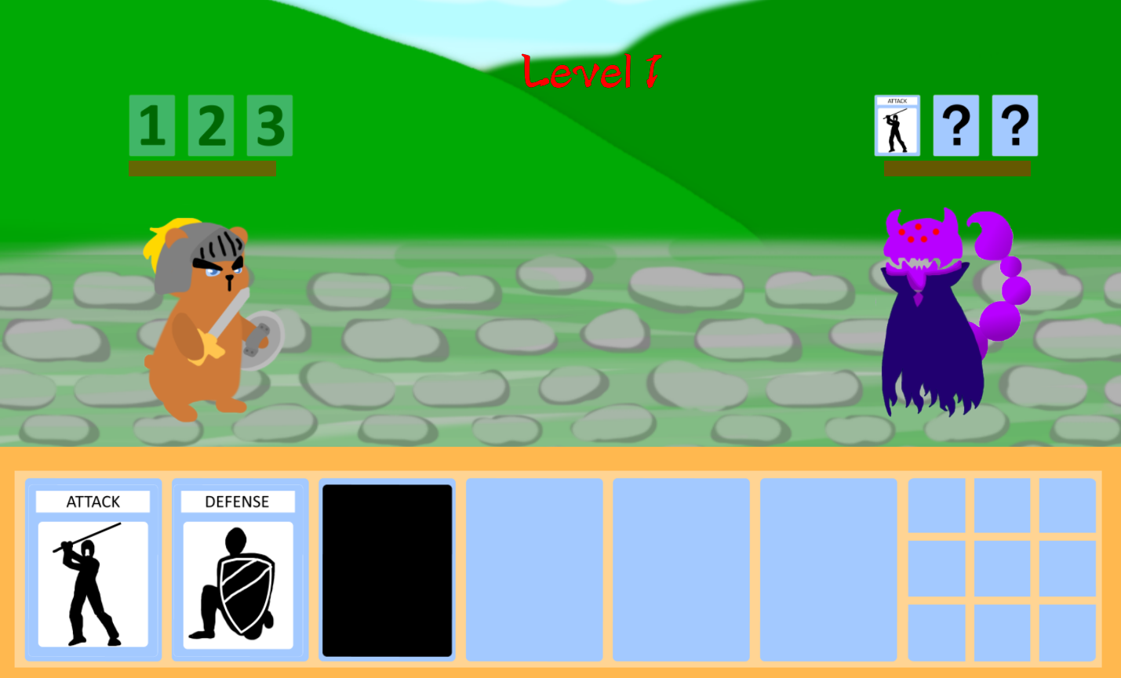
THE GAME CONCEPT - Key Features
Notes:
애니메이션 처리해서 스폐셜 게이지 채우면 쓸수있게된다고 말하면됨

Slide 10


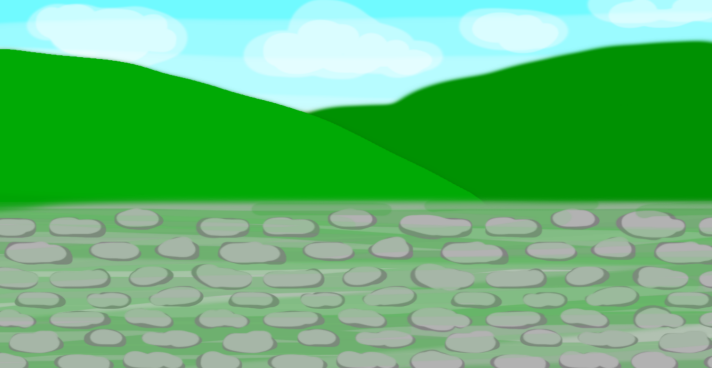

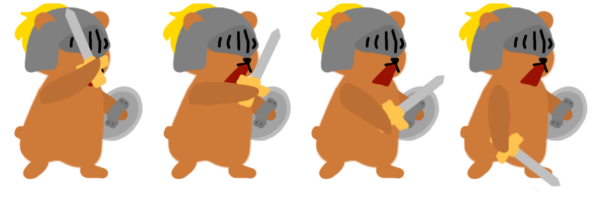
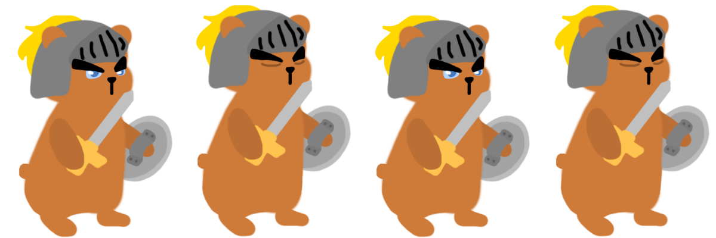
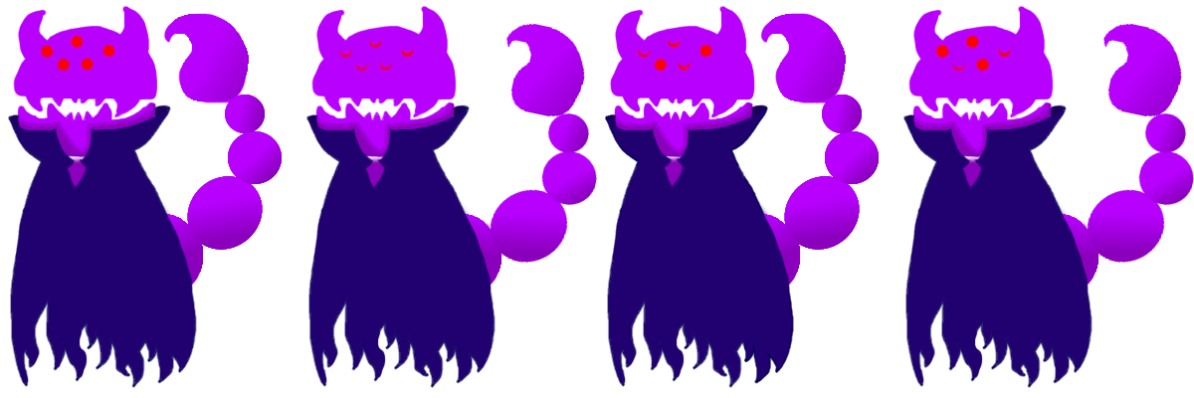





ARTS
Character
Characters
Enemy
NPC
Objects
Act card
Potion
Coin
Background
Various backgrounds
Notes:
인영
we have various characters and enemy.
attack, defence and special skill card. and potion for increasing health.
Needing background and map for reaching boss round.

Slide 11
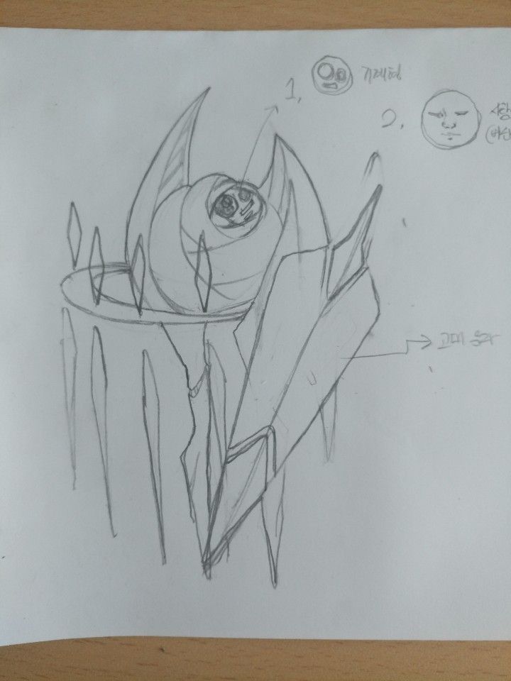
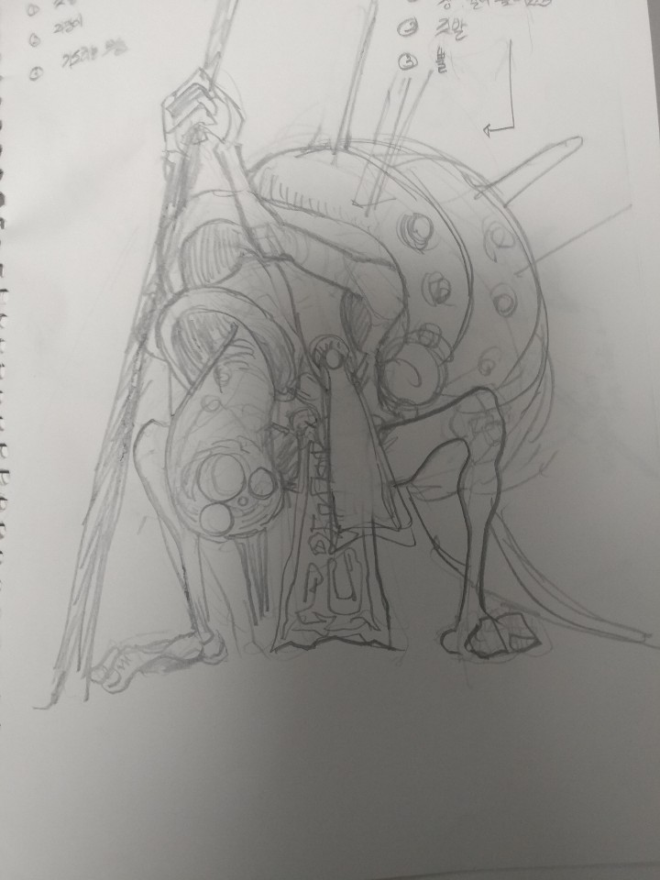
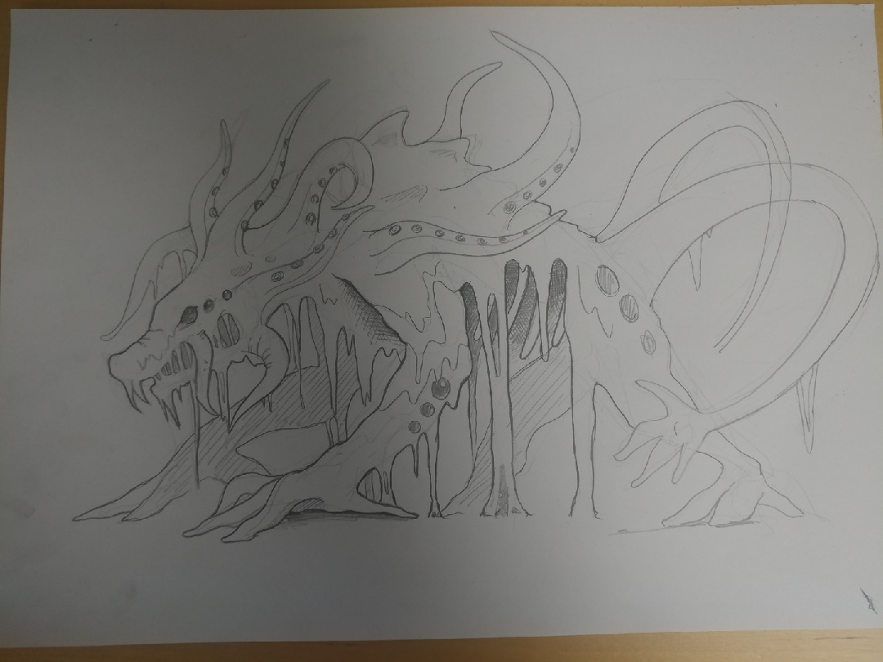
Concept Arts for the future
Special Thanks for Wonyong friend.
Notes:
I don’t know wonyong has friends. I knew him no friends.

Slide 12
RISK 1: Assignments
RISK 1: Spend times to doing class assignments
Many class assignments is hard, so we need to spend times for them.
MITIGATIONS
Mitigation 1:
Start assignments early as much as possible.
Mitigation 2:
Study more for improving programming skills, it can reduces time for spending on assignments.
Notes:
민호
In the Risk, our first risk is time management.
And first mitigations for this is setting a flexible schedule.
Second mitigation is Creating a plan B

Slide 13
RISK 2: Vacation team meeting
RISK 2: Vacation team meeting
Time and place of our team members do not match during the winter vacation.
MITIGATIONS
Mitigation 1:
During the winter vacation, time finds the right time for the team members and makes and makes a team plan in advance.
Mitigation 2:
During the winter vacation, we meet on a discord or online because, there is a long distance between the team members.
Notes:
민호
Our second risk is different coding style.
first mitigation for this is using Clang tool to unify the coding style.
Also, second mitigation is Matching the coding style by discussion.

Slide 14
RUBRIC SELF-ASSESSMENT
DESIGN
Design Guide - YES
Prototypes - YES
Core gameplay - YES
Testing - YES
Plan - YES
Scope - YES
Notes:
준석

Slide 15
RUBRIC SELF-ASSESSMENT
TECH
Technical Guide - YES
Engine Features - YES
Gameplay(in Engine) - YES
Editor Usability - YES
Procedural Content - NO
Art Pipeline - Partial
Audio Pipeline - Partial
Testing Tools - Partial

Slide 16
RUBRIC SELF-ASSESSMENT
ART
Environment/Backgrounds - YES
Characters and Props - YES
Animation - YES
Menus and HUD - YES
AUDIO
Audio Asset List - YES
Prototype Music Implementation - YES
Audio can be heard from engine - YES
Prototype SFX Implementation - YES
Notes:
준석

Slide 17
TEAM SCHEDULE
Members Month | Minho Chae (BSGD) Producer | Wonyong Lee (RTIS) Architecture | Inyeong Han (RTIS) Test Manager | Junseok Yang (RTIS) Graphics
DECEMBER | Modifying the animation method | Optimizing algorithms for reducing lag. Adding Village and shops | Playtest/Adjust battle computation? | Active use of constructor
JANUARY | Adding playable characters | Adding playable characters and enemies, achievements | Adding playable characters, Designing artwork | Advanced Engine Font Practice English
FEBRUARY | Implementing Bosses and the game items (Weapon, Potion, etc...) | Adding stages, apply game items. | Implementing Bosses and the game items (Weapon, Potion, etc...) | Sprite Particle
WHOLE VACATION | Improve game design more actualization | Improve game design more actualization FIXING BUGS!!! | Improve game design more actualization Practice English | Improve game design more actualization Practice English
Notes:
준석

Slide 18

Lonely Mercenary
by pinata
THANK YOU!!!!!
CONTACT: MINHO CHAE
adam912761@gmail.com
Notes:
준석

