Slide 1

Lonely Mercenary
by
pinata
GAM 200
Engine Proof & Concept Presentation
2019.10.18
Custom Engine
Notes:
hi hello we are pinata hohoho
제목 30 고동색
-소제목 25 적갈색
-내용 15 검정색

Slide 2
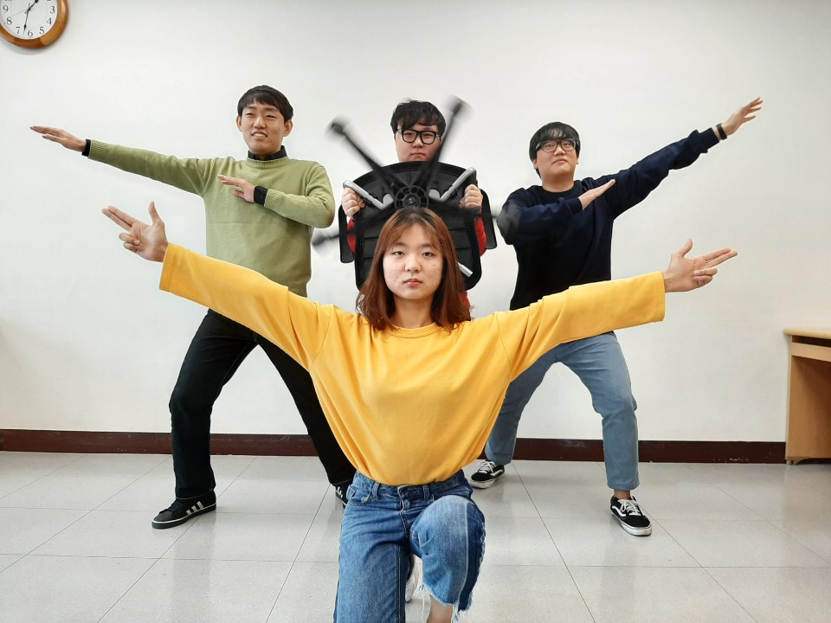
TEAM PHOTO
Wonyong Lee
Minho
Chea
Junseok Yang
Inyeong
Han

Slide 3




TEAM STRUCTURE
Minho Chae(BSGD)
Producer
Wonyong Lee(RTIS)
Architecture
Inyeong Han(RTIS)
Test Manager
Designer
Junseok Yang(RTIS)
Graphics

Slide 4
ENGINE ARCHITECTURE
General Approach
OpenGL, SDL2
Completed
State Manager
Template-style Math library
Keyboard & Mouse Input
FPS
Data-driven
Next
Data Driven
Notes:
We Using Opengl and SDL2
Also we completed Dividing state with state manager, Template-style math library, keyboard mouse input and FPS for slowing down the project loop speed.
Also we need to optimizing the engine afterall.

Slide 5
GRAPHICS
General Approach
OpenGL, SDL2 and GLEW
Completed
Window
Shader
Mesh
Sprite
Sprite animation
Camera
Next
Optimizing Graphic
Notes:
준석

Slide 6
PHYSICS
General Approach
Simple Physics(Collision)
Completed
Object Move
Mouse Collision
Mouse Check
Next
Additional : Gravity, Speed, Object Collision
Notes:
인영
Our engine using really really simple physics.
We need choose and move card in game. So we check collision between object and mouse and moving object using mouse.
in the future, we will add gravity, speed and collision between objects in case we are going to use it.

Slide 7
Audio Tech
General Approach
SDL2_mixer
Completed
Play & Pause
Volume control
Next
Optimizing Sound function
Notes:
민호
We used SDL mixer for audio of our engine.
We completed the play & pause and volume control.
Also we need to optimizing the sound function after.

Slide 8
ENGINE DEMO

Slide 9
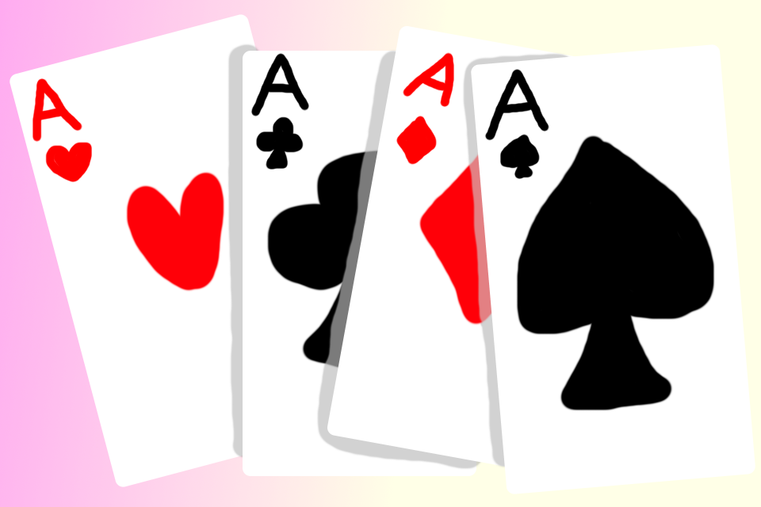
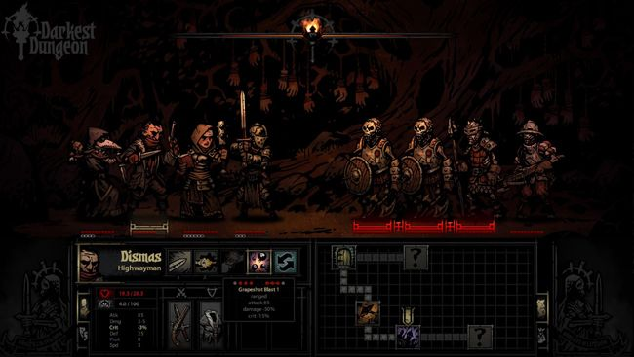
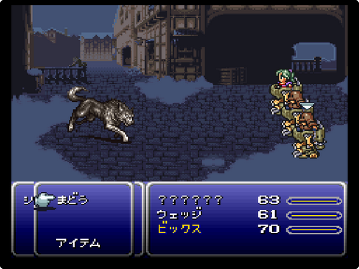
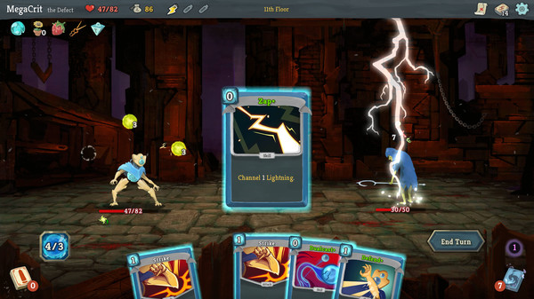
THE GAME CONCEPT - Inspiration
Card
game
Turn-based
RPG
Roguelike
Notes:
인영
the game concept of our game is a card game, turn_based, RPG, and roguelike.
Player can choose 3 card what they wants to act.
and game is made up of turn-based battle in the same time.
Player can level up as RPG. at last the game genre is rougelike, so when player was dead their status was gone.
The main genre of our game was a Rougelike, and we attach it with card game and turn-based RPG.
The main mechanic of our game, Player can choose 3 cards what they wants to act to fight also enemy can choose 3 act in randomly. At last, as I said the game genre was roguelike, when the player was dead, they lost all progress on that game. however, the unlockable stuff can be saved (i.e, characters, items)

Slide 10
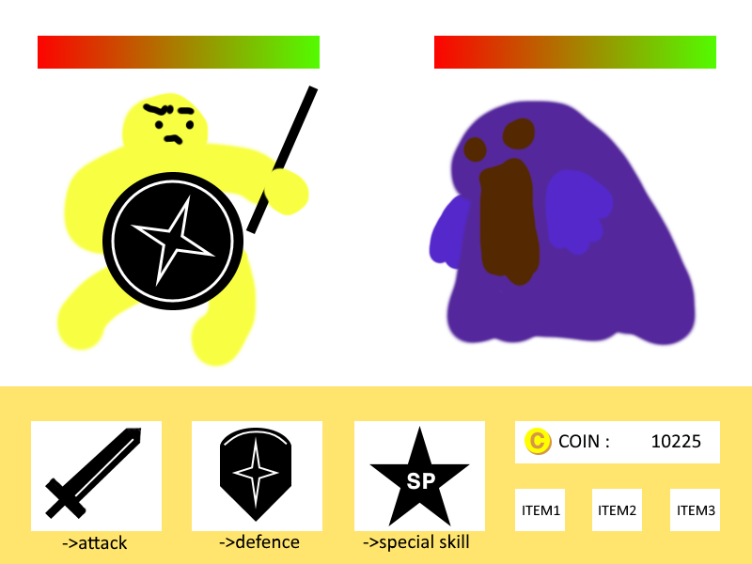
THE GAME CONCEPT - Key Features
HEALTH
PLAYER
Many type of characters
ENEMY
COIN
CARD
Attack, Defence,
and special skill
ITEM
Potion, etc.
Notes:
인영
this is simple our game’s key feature.
player control only using mouse.
each round choosing three acts for battle.
playing until health reaches zero.
end of battle, we can gain coin and buy item from store.

Slide 11
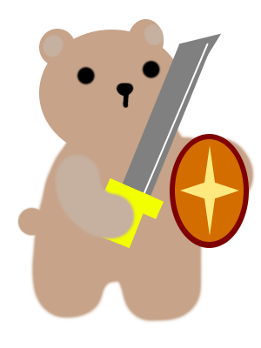

ART
Character
Various characters
Enemy
NPC
Objects
Act card
Potion
Coin
Background
Map
Notes:
인영
we have various characters and enemy.
attack, defence and special skill card. and potion for increasing health.
Needing background and map for reaching boss round.

Slide 12
RISK 1: Time Management
RISK 1: Time Management
When team schedule which set previously is not followed due to each member's tasks and personal circumstances.
MITIGATIONS
Mitigation 1:
Set a flexible schedule that can be modified quickly.
Mitigation 2:
Create a plan B that can be followed without embarrassment.
Notes:
민호
In the Risk, our first risk is time management.
And first mitigations for this is setting a flexible schedule.
Second mitigation is Creating a plan B

Slide 13
RISK 2: Different Coding Style
RISK 2: Different Coding Style
Because of the different coding style of each person, it takes times to understand the other person’s code.
MITIGATIONS
Mitigation 1:
Use Clang tool to unify the coding style.
Mitigation 2:
Match the coding style by discussion with team members
Notes:
민호
Our second risk is different coding style.
first mitigation for this is using Clang tool to unify the coding style.
Also, second mitigation is Matching the coding style by discussion.

Slide 14
RUBRIC SELF-ASSESSMENT
ARCHITECTURE
Configuration and tweaking data is data-driven - no
Game objects are data-driven - no
Preliminary deserialization of some game data - no
GRAPHICS and AUDIO
Graphical content can be displayed - yes
Basic sprites/models displayed - yes
Basic animations displayed - yes
Audio can be heard from engine (FMOD API) - yes
Notes:
준석

Slide 15
RUBRIC SELF-ASSESSMENT
PHYSICS
Object movement - yes
Collision detection - yes
DEBUGGING TOOLS
Basic sprites/models displayed - yes
Basic animations displayed - yes
Audio can be heard from engine - yes
Notes:
준석

Slide 16
TEAM SCHEDULE
WEEK | Minho Chae (BSGD) | Wonyong Lee (RTIS) | Inyeong Han (RTIS) | Junseok Yang (RTIS)
 | Producer | Architecture | Test Manager | Graphics
Week 8 | MIDTERM | MIDTERM | MIDTERM | MIDTERM
Week 9 | Sprite & Sound Optimizing | Basic Game Mechanic | UI Design, Imgui | Engine Optimizing
Week 10 | Animation Optimizing | Basic Game Mechanic | Artwork for prototype | Engine Optimizing
Week 11 | PRESENTATION | PRESENTATION | PRESENTATION | PRESENTATION
Notes:
준석

Slide 17

Lonely Mercenary
by pinata
THANK YOU!!!!!
CONTACT: MINHO CHAE
adam912761@gmail.com
Notes:
준석

