Slide 1
背景噪声互相关和提取频散曲线并行程序讲解
范兴利
2020年10月12日

Slide 2
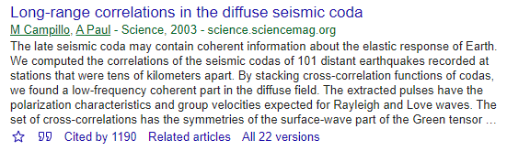
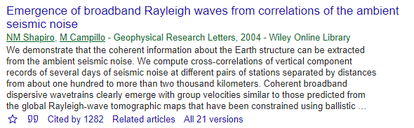
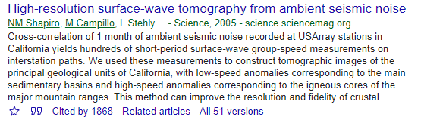
发展简史
Cross-correlation of coda waves
Cross-correlation of ground noise

Slide 3
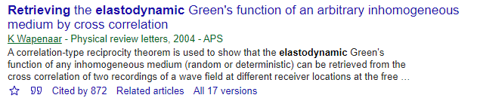
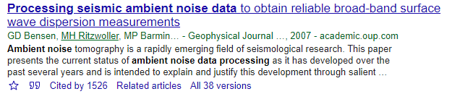
发展简史
Theoretical basis
Data processing procedures

Slide 4
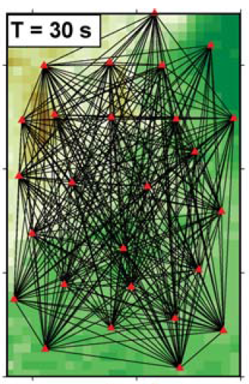
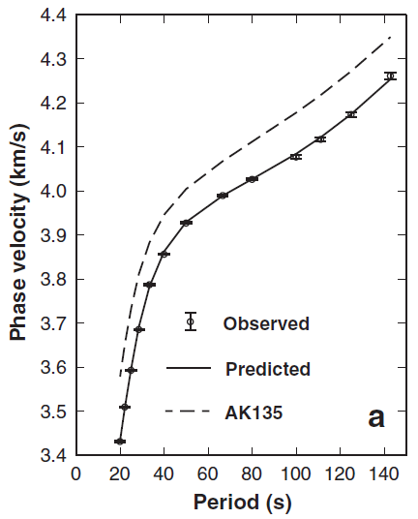
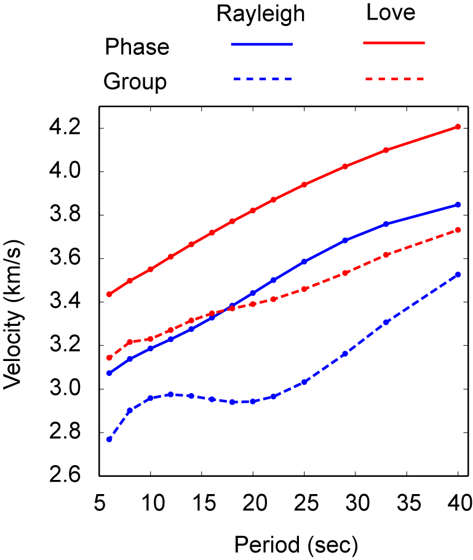
背景噪声成像方法优势
不受地震分布影响
获得短周期面波信号
远震数据
噪声数据

Slide 5
背景噪声成像方法的关键三步
波形互相关
提取群速度/相速度频散曲线
二维群速度/相速度反演

Slide 6
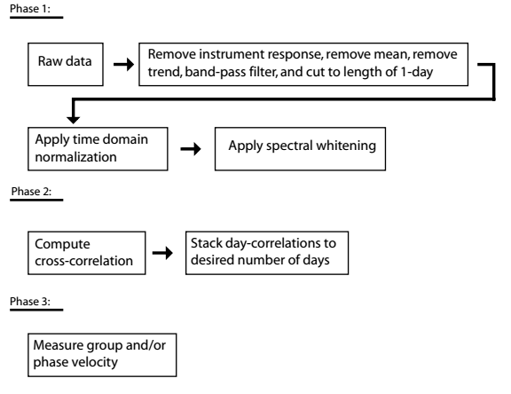
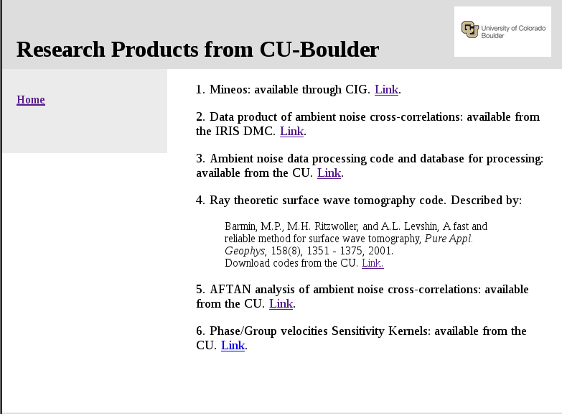
Code availability
波形互相关
提取频散曲线
二维群速度/相速度反演
(Bensen et al., GJI 2007)
http://ciei.colorado.edu/Products/

Slide 7
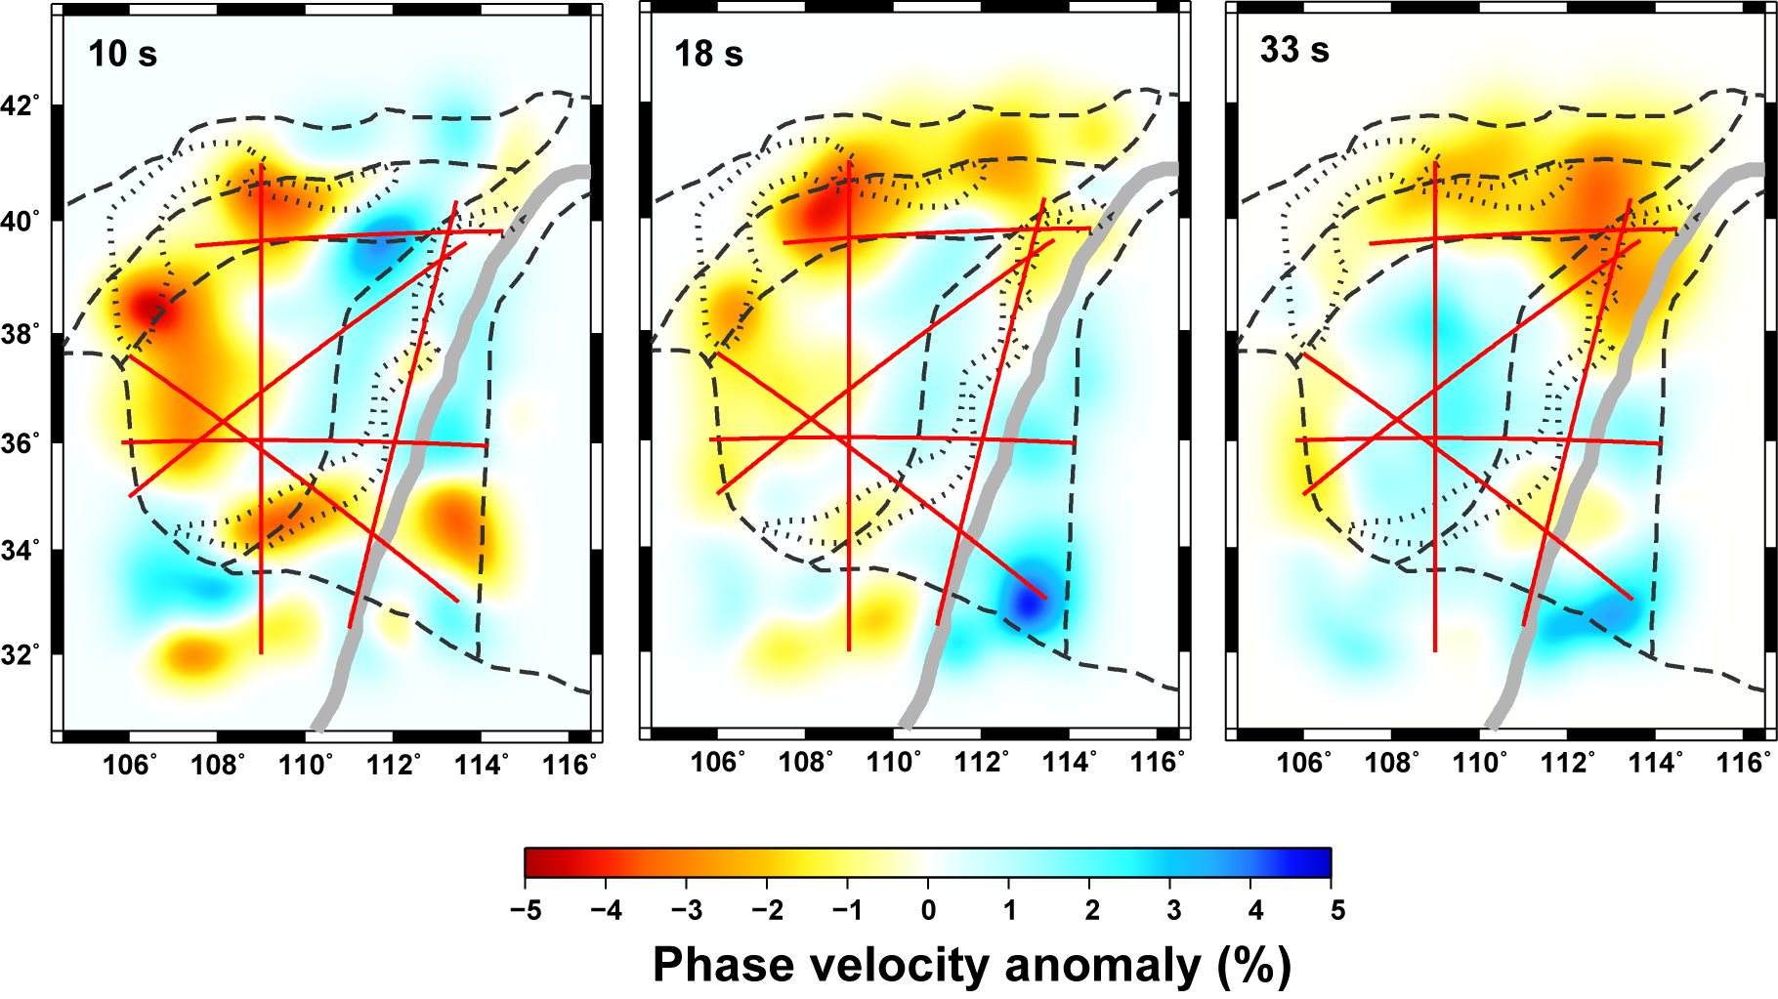
相速度图

Slide 8
系统和软件配置要求
which gfortran
/usr/bin/gfortran
which sac
usr/local/sac/bin/sac
which python3
usr/local/bin/python3
which mpifort
usr/local/bin/mpifort
which mpirun
usr/local/bin/mpirun
a. Linux操作系统
b. gfortran编译器
c. sac
d. python3
e. OpenMPI
grep ‘physical id’ /proc/cpuinfo | sort –u | wc –l 查看物理cpu个数
1
grep ‘core id’ /proc/cpuinfo | sort –u | wc –l 查看cpu核心的个数
4
grep ‘processor’ /proc/cpuinfo | sort –u | wc –l 查看cpu线程的个数
8

Slide 9
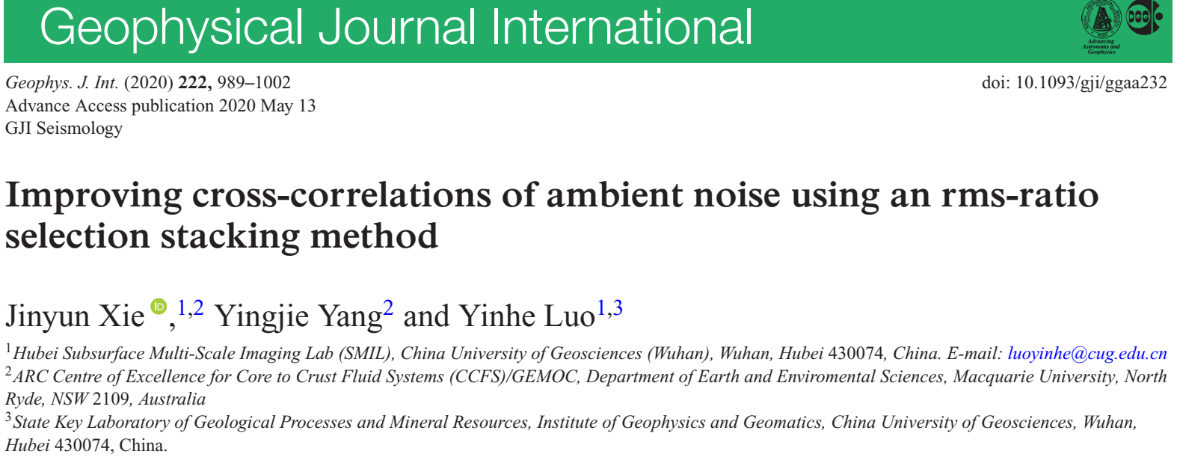
Compile.sh
编译并安装SRC/AFTAN下的AFTAN_PROG
编译并安装SRC/AND_Driver下的AND_Driver
编译并安装SRC/TF_PWS下的TF_PWS
安装路径默认为/usr/local/bin，非root用户会提示你输入sudo密码。可以在Compile.sh和相应的Makefile文件中修改INST_DIR变量来设置不同的安装路径
which AFTAN_PROG
usr/local/bin/AFTAN_PROG 安装成功
which AND_Driver
usr/local/bin/AND_Driver 安装成功
which TF_PWS
usr/local/bin/TF_PWS 安装成功
cd /TEST-Your
input.dat 输入参数配置文件
myTools.py 自定义的Python函数库
ref1Dmod.dat 一维相速度参考模型
passbands.dat rmsr_ss叠加方法所用频带参数
Run.py 执行脚本
plot.sh 绘制频散曲线脚本

Slide 10
Publicly available code for ambient noise data processing, including but not limited to
Fortran code by Barmin et al., 2001
http://ciei.colorado.edu/Products/
Fortran code by Rawlinson and Sambridge (2003)
http://rses.anu.edu.au/~nick/surftomo.html
Python code by Goutorbe et al. (2015)
https://github.com/bgoutorbe/seismic-noise-tomography
Matlab code by Yao Huajian (require personal contact)
http://yaolab.ustc.edu.cn/resources.php?i=28
Fortran code by Hongjian Fan et al. 2015 (Inversion for 3-D S-wave velocity structure)
https://github.com/HongjianFang/DSurfTomo

