Slide 1
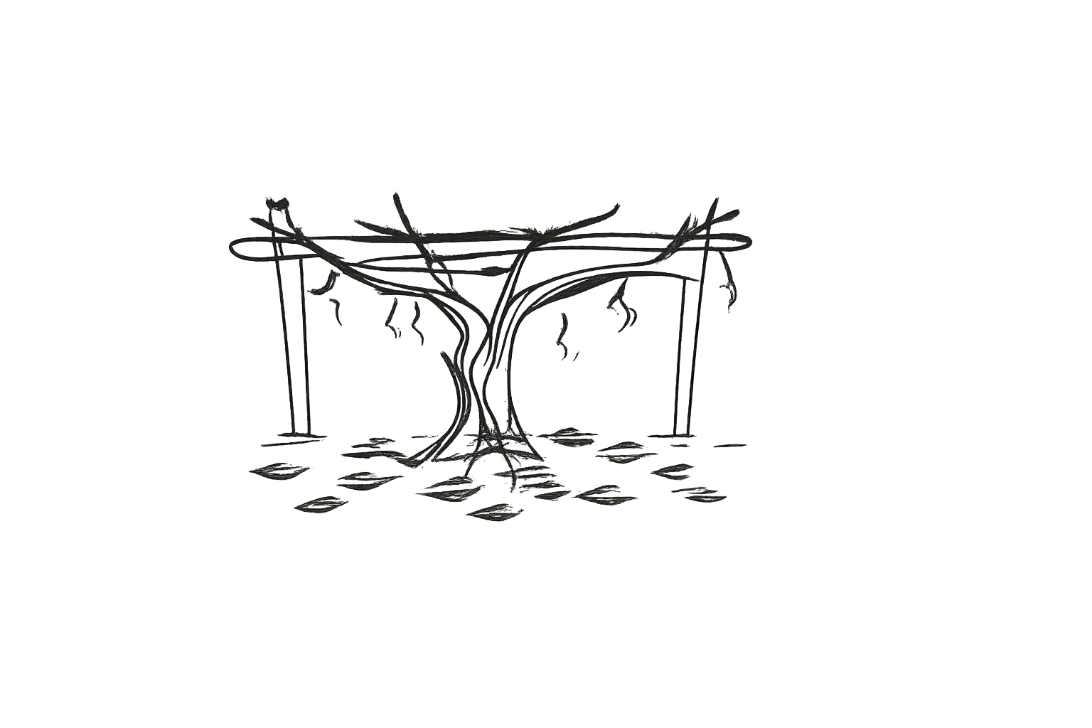
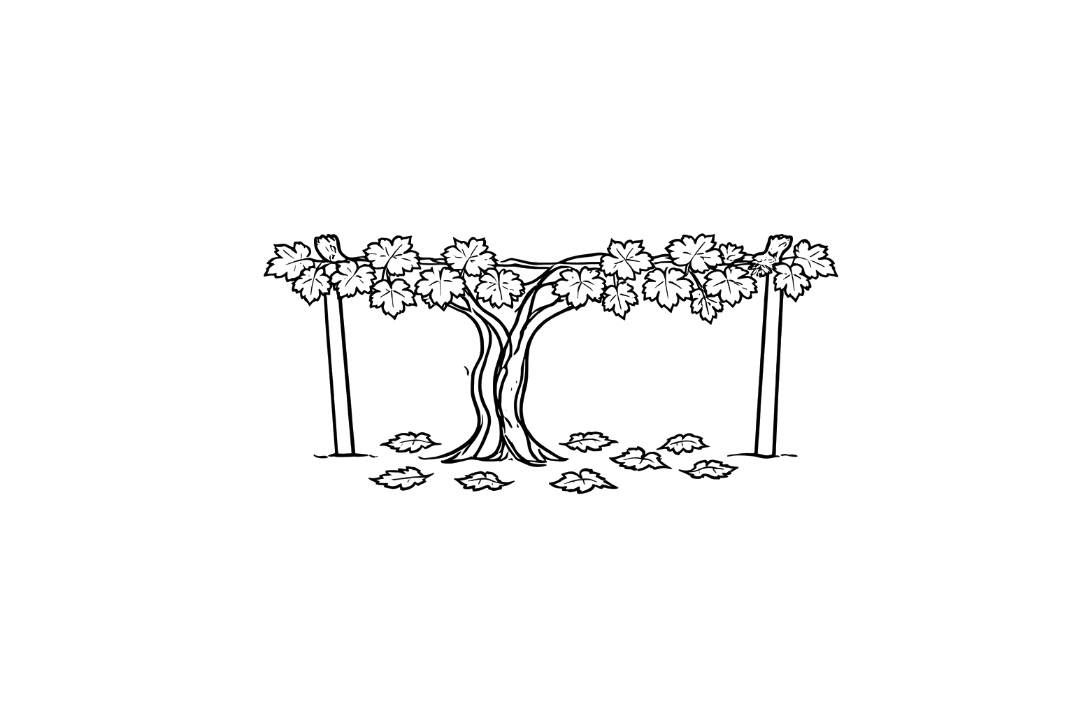
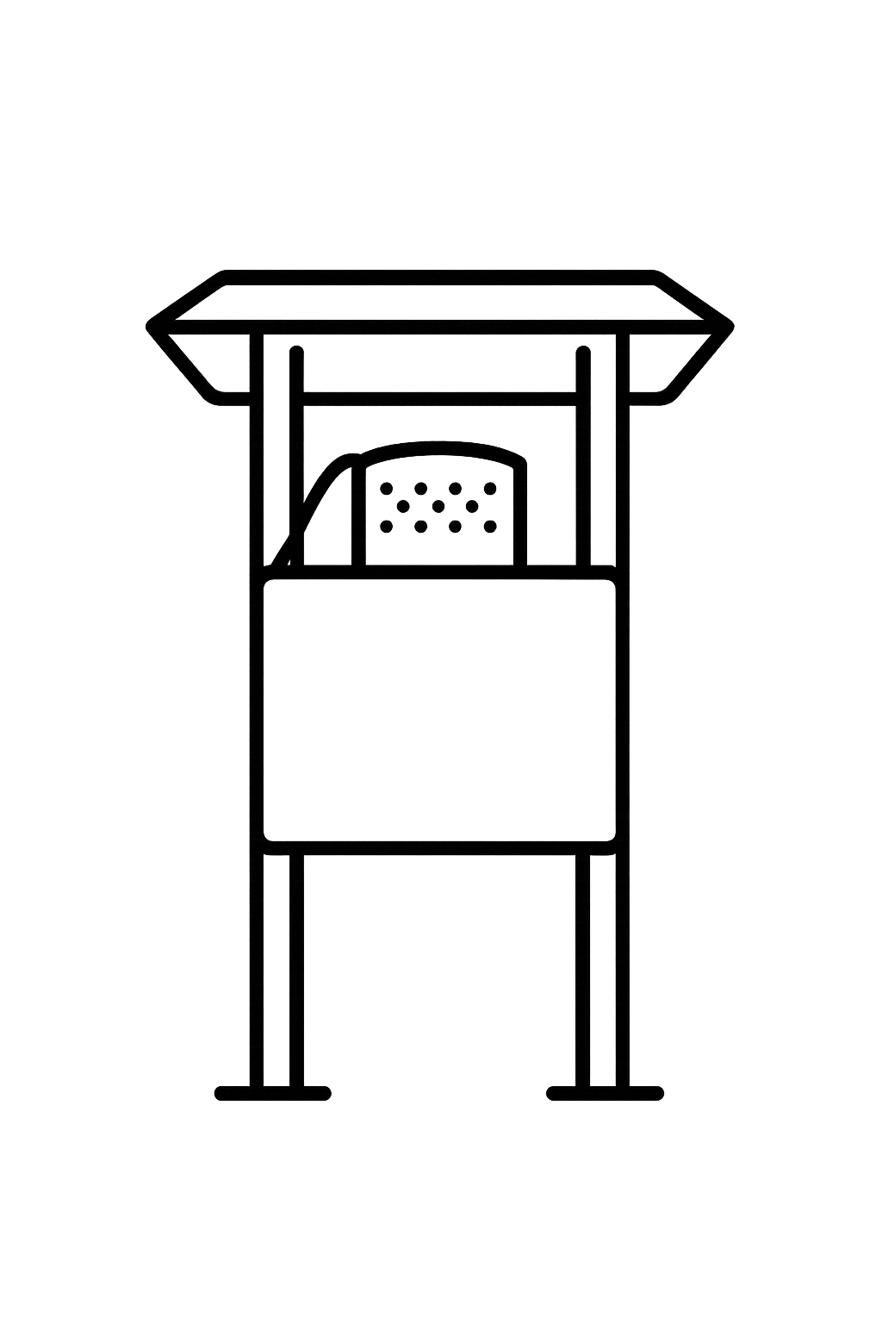
Invalid dispersal
Valid dispersal
First infection
Spore
Trap
Infected leaf litter
Infected leaf litter
Feb
Mar
Apr
May
Jun

