Slide 1
Sentiment Analysis Presentation
By
Yawe Arthur Shalom

Slide 2
Background
In recent years, the rise of social media platforms such as Twitter, Facebook, and Instagram has transformed the way people express their emotions, opinions, and experiences. Every second, millions of users share posts that reflect their thoughts, moods, and attitudes toward personal and social issues. This wealth of unstructured textual data presents an opportunity to extract meaningful insights about public emotions, behavioral patterns, and even mental health conditions.
Sentiment analysis, also known as opinion mining, is a branch of Natural Language Processing (NLP) that aims to automatically identify and categorize opinions or emotions expressed in text as positive, negative, or neutral. By applying machine learning and text analysis techniques, sentiment analysis helps detect the underlying emotional tone within written communication.
This project focuses on analyzing social media posts (tweets) to determine whether the expressed sentiment is depressive (negative) or non-depressive (positive). The study is motivated by the growing global concern over mental health and the potential for early detection of depressive behavior through online expression. By classifying sentiments accurately, such models can contribute to tools for mental health monitoring, awareness, and support systems.
Using Natural Language Processing (NLP) and machine learning techniques particularly TF-IDF vectorization and Logistic Regression classification the project demonstrates how artificial intelligence can extract emotional meaning from text data and identify patterns related to mental well-being.

Slide 3
Data Sourcing
The dataset was got from Opendatabay. This dataset comprises depressive and non-depressive tweets collected between December 2019 and December 2020. Its primary purpose is to provide a valuable resource for sentiment analysis and text classification, particularly in the domain of mental health and wellness. the text data was obtained from social media posts (tweets), focusing on the mental health domain specifically distinguishing between depressive and non-depressive language.
The dataset comprises of 3 columns, these are the ID, the text(the tweet), and the sentiment score(1 or 0).
Where the 1 = non-depressive and 0 = depressive
Metadata Included:
- Tweet text content
- Sentiment or classification label (Depressive / Non-Depressive)
- Keywords and hashtags relevant to mental health (e.g., “depression”, “sad”, “lonely”, “happy”)
Purpose of the Data:
To analyze sentiment patterns in tweets related to mental health, which can support understanding emotional trends, early detection of depressive tendencies, and improving mental health interventions.

Slide 4
Formulating the guiding research questions and objectives
Research Questions
What are the most common keywords and linguistic patterns in depressive vs. non-depressive tweets?
What is the distribution of depressive and non-depressive posts in the dataset?
How accurately can an automated sentiment analysis model classify depressive tweets?
Can machine learning or NLP techniques help in identifying early signals of depressive language in social media posts?
Objectives
To preprocess and clean raw social media text data.
To explore patterns, keywords, and frequency of depressive vs. non-depressive language.
To apply sentiment analysis or text classification techniques to categorize tweets.
To evaluate model performance using metrics like accuracy, precision, and recall.
To provide insights that can support mental health awareness and intervention strategies.

Slide 5
Performed Data Checks
In order to understand my dataset better I performed some checks on it.
Used the .shape() to identity the number of rows and columns – it had 134347 rows and 3 columns.
Used the .isnull() to check for any missing vales – it had 18 in the text column
Used the .duplicate() to check for duplicates – it had no duplicates.
Dropped the missing rows to have consistent data

Slide 6
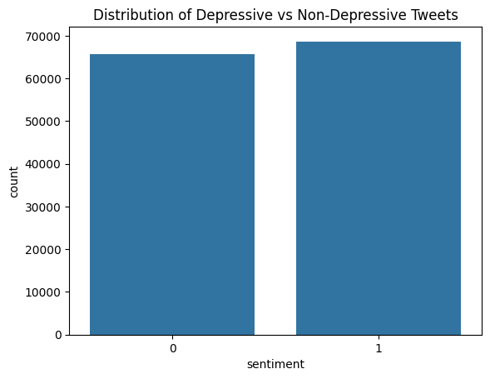
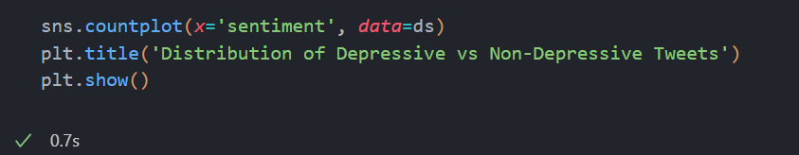
Exploratory Data Analysis
This is the graph that should the distribution of Depressive tweets vs Non-Depresssive tweets within the data

Slide 7
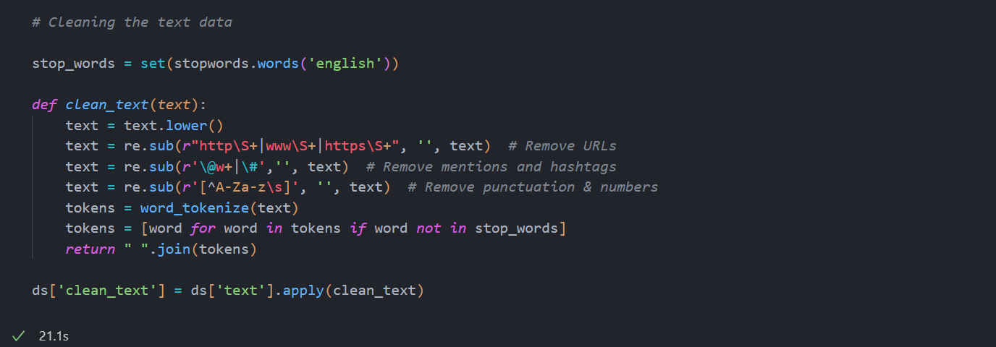
Performed text cleaning on the text data
The text cleaning involved
- Lowercasing text
- Removing URLs, punctuation, mentions (@), hashtags, and special characters
- Removing stopwords
- Tokenizing words

Slide 8
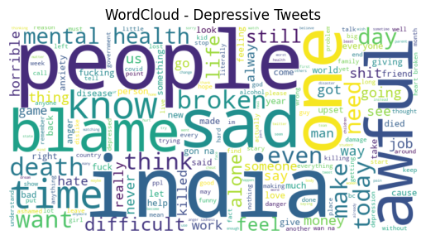
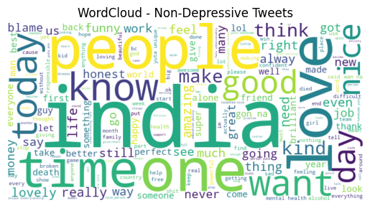
WordCloud – This showed the most used words in the depressive and non-depressive tweets

Slide 9
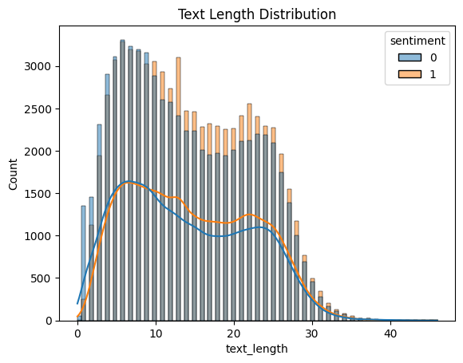
This was an analysis of the text length.
From the visualization we can observe that tweets that are depressive have a higher word count and text length.

Slide 10
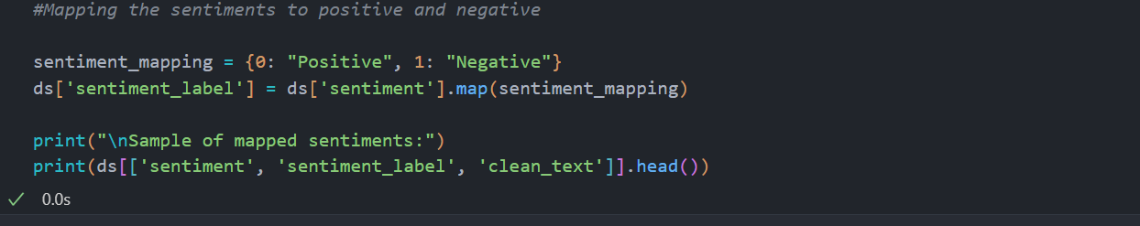
The mapping
This phase involved mapping the dataset sentiment indicators to words like positive or negative for sentiment lablelling to simplify the classification.

Slide 11
Sentiment Classification
This step involved using a classification algorithm to create a model for prediction.
Steps:
Splitting the dataset in to the sentiment label and the text
Splitting in to the train data and text data
Performed vectorization using Tfidvectorizer, this converts words into numeric vectors
Trained the LogisticRegression using the train data.
I used the LogisticRegression because it is interpretable and effective for text classification.

Slide 12
Model evaluation
This phase involved testing to see how the model performs on the test data.
First feed the test data into the model and the out was stored in y_pred as an array.
Then used I compared the model prediction with the actual labels to evaluate the performance;
===== Logistic Regression Evaluation =====
Accuracy: 0.9064 -> Out of all tweets tested, ~91% were correctly classified as Positive or Negative.
Precision: 0.8833 -> When the model predicted Positive, it was correct 88% of the time.
Recall: 0.9314 -> Out of all the actual Positive tweets, the model successfully identified 93%.
F1 Score: 0.9067 ->The harmonic mean of Precision and Recall — indicates strong overall balance between identifying and predicting correctly.

Slide 13
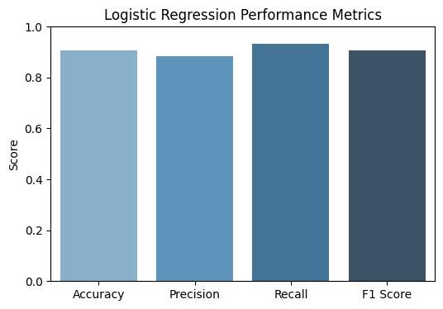
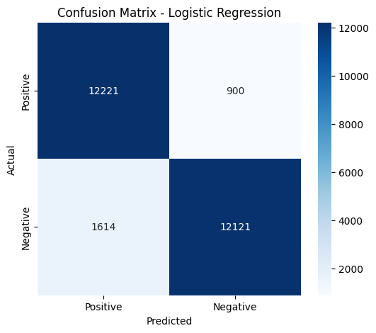
Evaluation metrics visualizations

