Slide 1
SmartPtr-C 2.0
C memory. Finally safe.
Final Review · Project 12 · Team Error-404
Saketh N · S Mithil Reddy · Sai Yasaswi
Notes:
Open with energy: every C programmer has crashed on memory bugs. We built a library that catches them all, with one include.

Slide 2
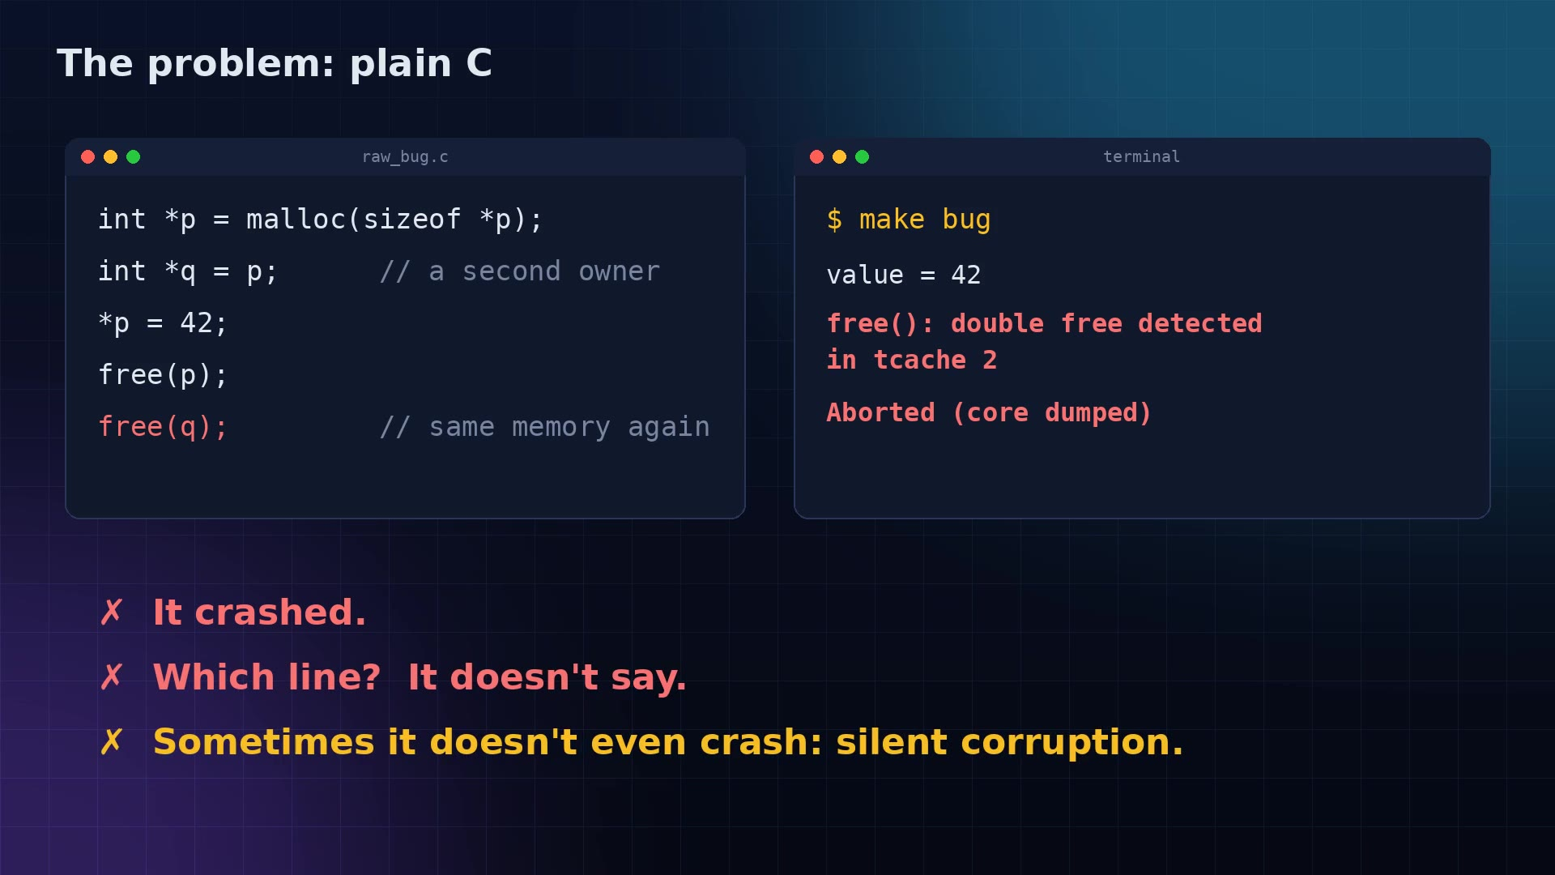
Plain C: crash, no line, no reason
A pointer is only an address: it forgets who owns the memory
Double free, overflow, use-after-free, leaks
The crash message never says which line
Notes:
Play the clip: the same memory freed twice. glibc aborts, and the message doesn't tell you where.

Slide 3
One line changes everything
#include "smartptr.h"
No new functions. Keep writing malloc and free.

Slide 4
Two layers, one library
LAYER 1
LAYER 2
Sentinel
Ownership
Zero API
Smart pointers
Every malloc / free watched
Bugs blocked or explained
Leaks reclaimed at exit
Works on ANY existing C
unique · shared · weak
Every conversion
sp_auto scope cleanup
Borrowing, deferred destroy

Slide 5
How Sentinel watches memory
01
02
03
A record for every block
Sentinel bytes
Quarantine
A hash table keyed by address: kind, owners, where it was created, and its last 12 events
16 known bytes after every block. If they change, something wrote past the end
Freed memory is poisoned with 0xDD and held back. A second free or a late write is caught
Notes:
At exit, Sentinel also scans leaked blocks for pointers to each other and runs Tarjan's algorithm to find reference cycles.

Slide 6
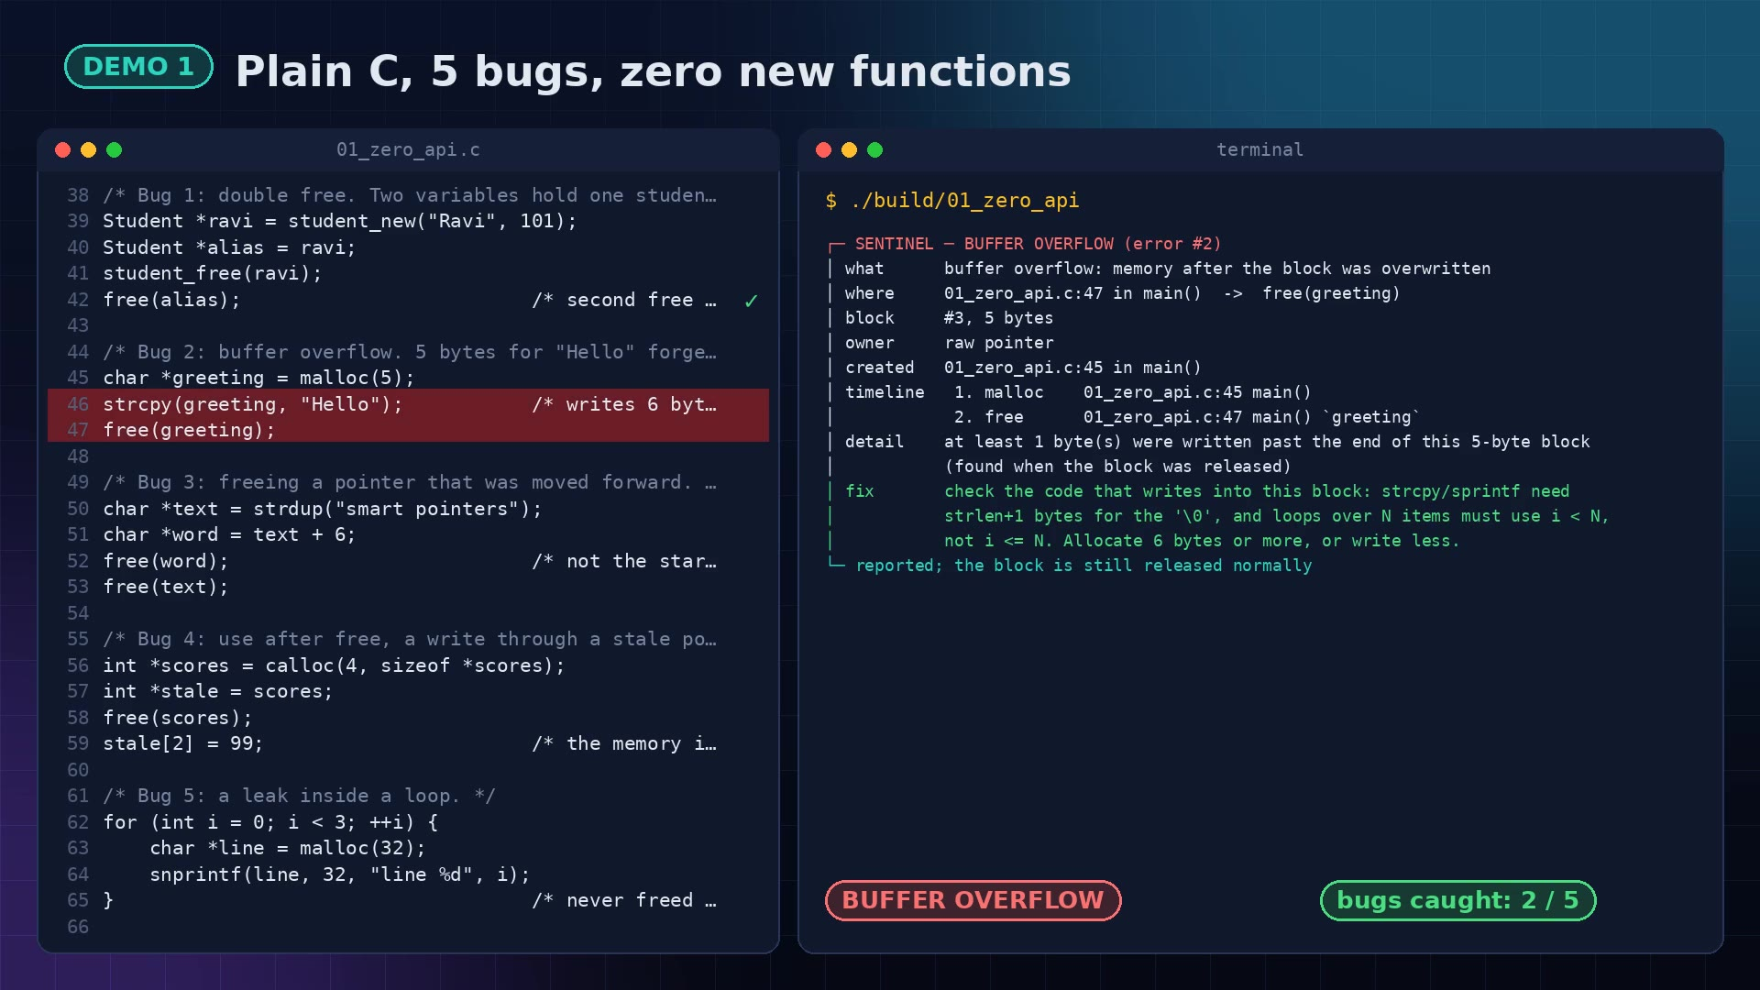
Plain C, 5 bugs, 0 crashes
DEMO 1
Double free: blocked
Overflow: 1 byte past the end
Interior free: blocked
Use after free: byte 8 changed
Leak in a loop: 3 blocks, reclaimed
$ make demo
Notes:
Live command: ./build/01_zero_api. Point out each box: where, block, owner, timeline, fix. The program reaches the end.

Slide 7
Errors become explanations
┌─ SENTINEL ─ DOUBLE FREE (error #1)
│ where 01_zero_api.c:42 -> free(alias)
│ block #1, 16 bytes
│ owner raw pointer
│ created 01_zero_api.c:22 in student_new()
│ timeline 1. malloc :22 student_new()
│ 2. free :31 student_free() `s`
│ 3. BLOCKED :42 main() `alias`
│ fix set the pointer to NULL after free()
└─ second release blocked; program continues
where file, line, function and the exact call
block id, size, type
owner raw, unique, shared (+ count)
timeline the block's life story
fix chosen from what was observed

Slide 8
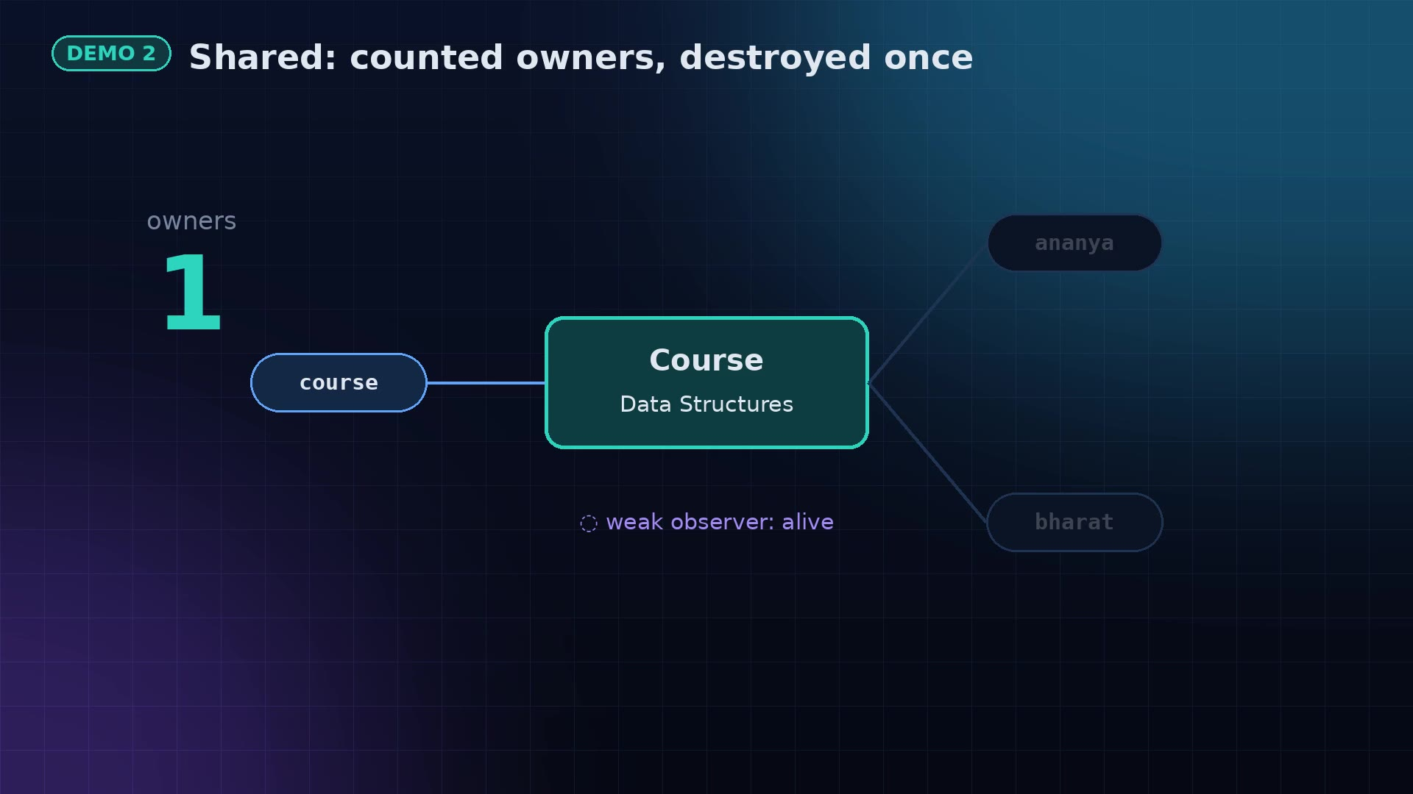
Ownership: unique and shared
DEMO 2
sp_move: the old owner becomes NULL
Sharing a unique object: refused, explained
Shared count 1 → 3 → 0
Destructor runs exactly once
Notes:
Live commands: ./build/02_unique and ./build/03_shared_weak.

Slide 9
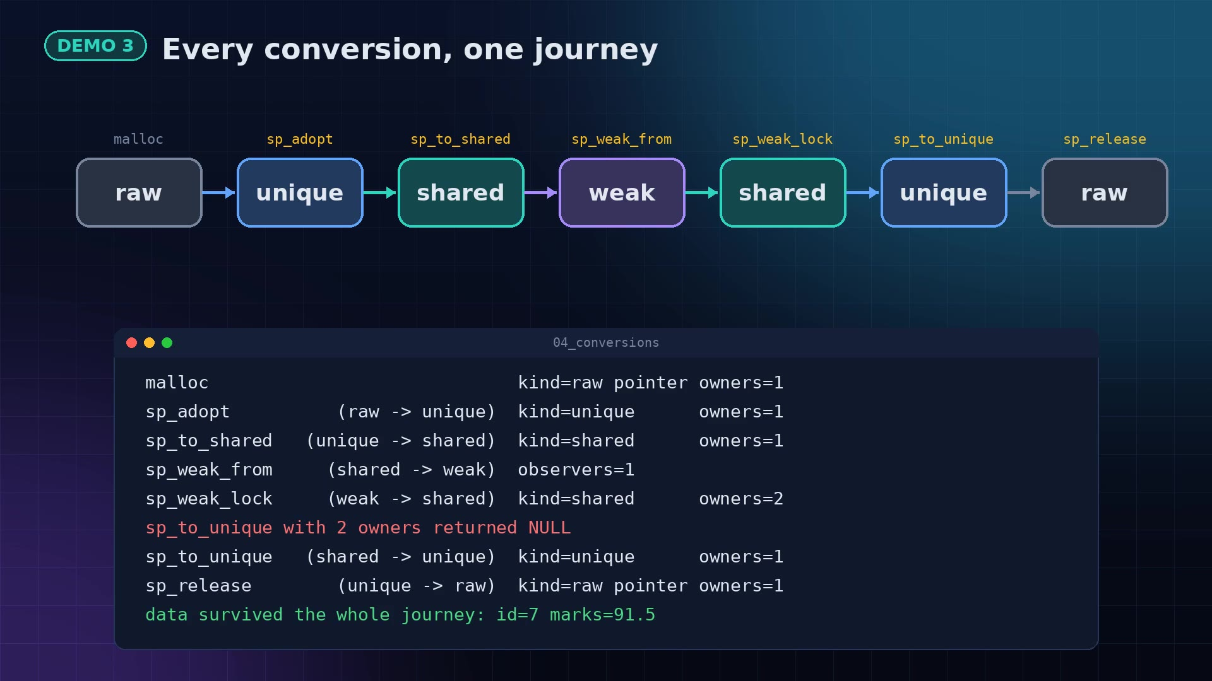
Every conversion, both ways
DEMO 3
raw ⇄ unique ⇄ shared ⇄ weak
shared → unique with 1 owner (C++ can't)
Refused with 2 owners, explained
Data survives the whole journey

Slide 10
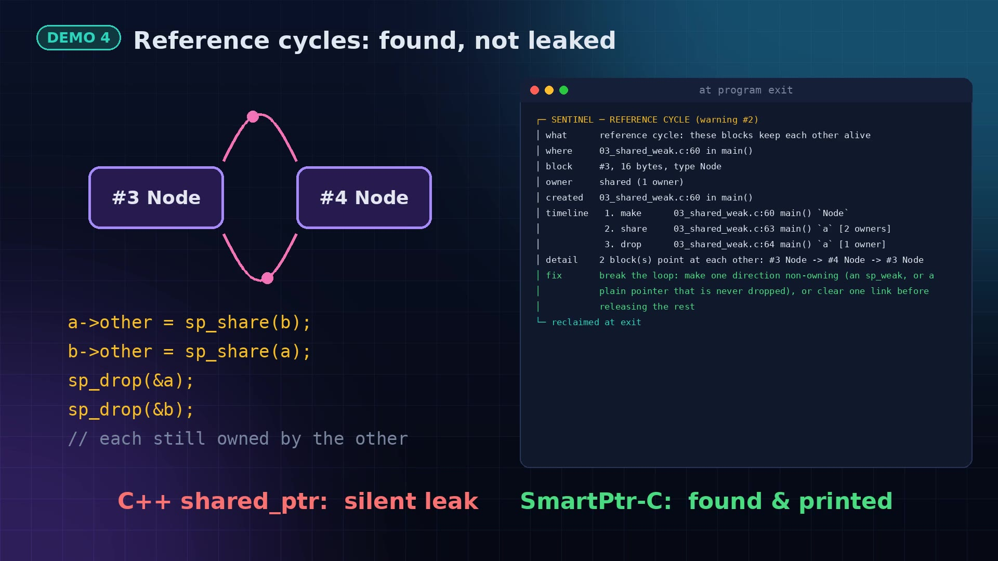
Cycles: found, not leaked
DEMO 4
Two nodes own each other
C++ shared_ptr: silent leak
Sentinel scans leaked memory, runs Tarjan's algorithm
Prints the loop: #3 → #4 → #3

Slide 11
Beyond C++ smart pointers
Situation | C++ std | SmartPtr-C 2.0
Works on existing malloc/free code | no | yes
Double free / use after move | undefined behaviour | blocked + explained
Overflow, use-after-free writes | not detected | detected
Reference cycles | silent leak | found + printed
shared → unique | impossible | with 1 owner
Release while in use | dangling pointer | destruction deferred
Out-of-memory testing, JSON log | no | built in
Honest trade-off: C++ is free and compiler-checked; we check at run time (~30× slower malloc), built for development and testing.

Slide 12
Proof, not promises
58/58
0
0
0
tests pass
Valgrind errors / leaks
ASan + UBSan findings
TSan data races
$ make test
ALL TEST SUITES PASSED
$ make valgrind
VALGRIND: 0 errors, 0 leaks in every test and example
Notes:
Live: make test, then make valgrind. Mention -Wall -Wextra -Wpedantic -Werror: zero warnings.

Slide 13
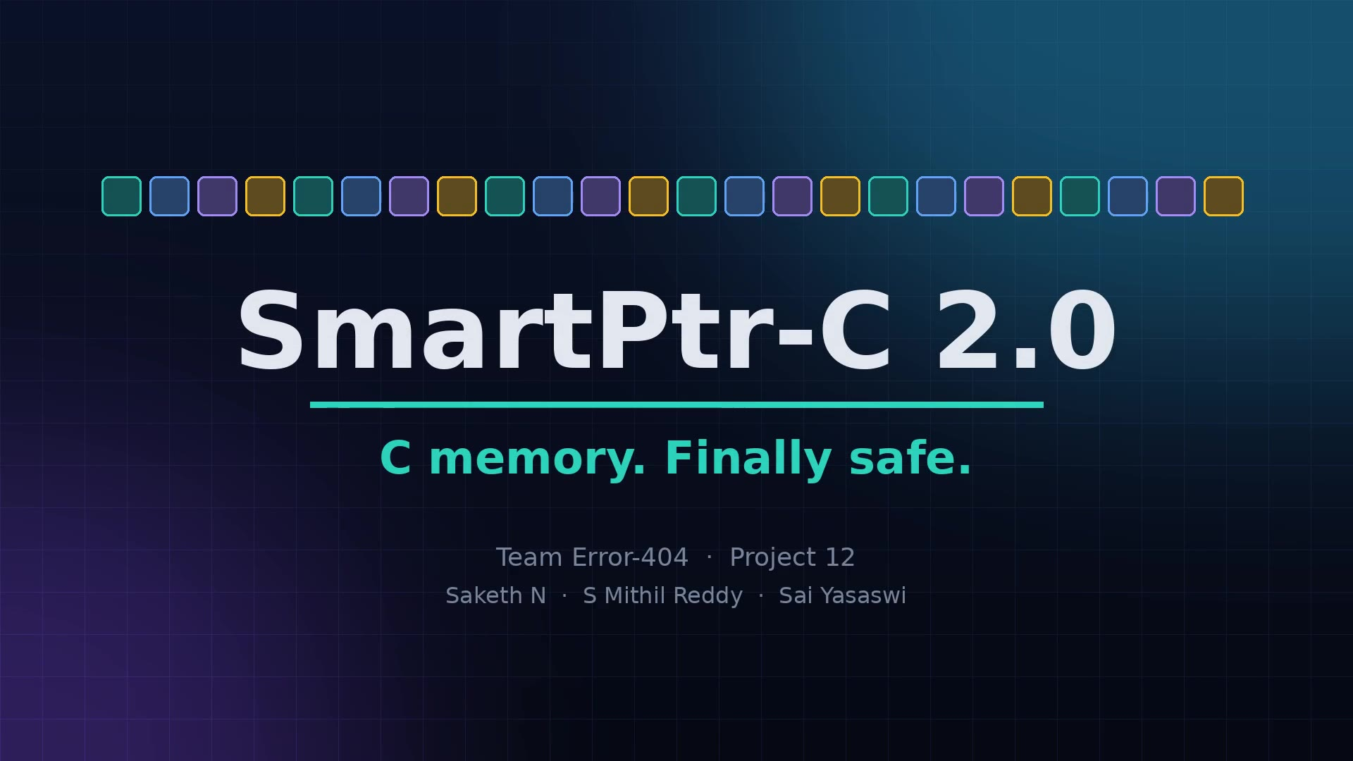
The whole story in 2 minutes
Notes:
Backup: if the live demo fails, play this video. It shows every demo with real output.

Slide 14
Honest limits and what's next
LIMITS
NEXT
Only files that include smartptr.h are watched
C still needs one marker to free: free, sp_drop or sp_auto
Reads after free are not detected
Run-time cost: a development tool
LD_PRELOAD mode: protect code without recompiling
Guard pages to catch reads after free
Per-bucket locks + atomics for speed
Ownership graph export for visual debugging

Slide 15
Questions?
SmartPtr-C 2.0 · one #include, every bug explained
Team Error-404 · Saketh N · S Mithil Reddy · Sai Yasaswi

