Slide 1
Federated learning for cybersecurity
Guided By: Prof. Dilip Kumar S

Slide 2
research SUMMARY
Federated Learning (FL) is a distributed paradigm that enables many clients to train a shared model without sharing their raw data. The central server aggregates the updates locally computed.
Challenge Faced
• Security and Privacy Challenges: The fundamental premise of Federated Learning is to provide privacy to the local datasets. A secure aggregation algorithm is proposed that can aggregate encrypted local models without decrypting the data in the aggregator
Necessary privacy is provided at the local learner level instead of providing protection to a single data sample.

Slide 3
Literature review
Federated Learning (FL) Framework
FedAvg Algorithm
Introduced by Google (McMahan et al., 017), Federated Learning enables decentralized model training on edge devices without transferring raw data to a central server. It addresses privacy concerns in data-sensitive applications like healthcare and finance.
The Federated Averaging (FedAvg) algorithm aggregates model updates from multiple clients, combining local stochastic gradient descent with weighted averaging. It significantly reduces communication overhead while achieving high accuracy across non-IID data distributions.

Slide 4
Literature review
Differential Privacy in FL
Challenges in Federated Learning
Dwork et al. (2006) introduced Differential Privacy as a formal privacy-preserving technique. In the FL context, it involves adding calibrated noise to model updates, ensuring individual data points cannot be inferred from shared gradients.
Issues like data heterogeneity, communication bottlenecks, and security threats (e.g., model poisoning). Solutions such as adaptive learning rates, secure aggregation, and personalization have been proposed.

Slide 5
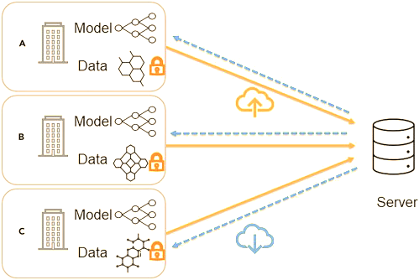
PROGRESS Implementation
Schedule Implications
Complete Implementation: All local client models have successfully completed training. Aggregated global model has been finalized and validated.
Federated Learning Pipeline Fully Functional: The entire framework—including local training, secure update transmission, central aggregation using FedAvg, and privacy-preserving mechanisms—is fully implemented and tested.

Slide 6
ATTENTION AREAS
Terms to Understand
Client (Participant): This refers to any individual device or organization that holds private data and trains a local model. Each client contributes by learning from its own data.
Central Server: The central coordinating entity that collects model updates from the clients. It aggregates these updates to build a shared, global model.
Local Model: The model that each client trains on its private dataset. It encapsulates the learning derived solely from the client's data.
Global Model: The aggregated model that results from combining the insights (model updates) provided by all clients. This model benefits from the collective knowledge of all participants.
Model Aggregation: The process by which the central server merges the local models from each client to update and improve the global model. (FedAvg)

Slide 7
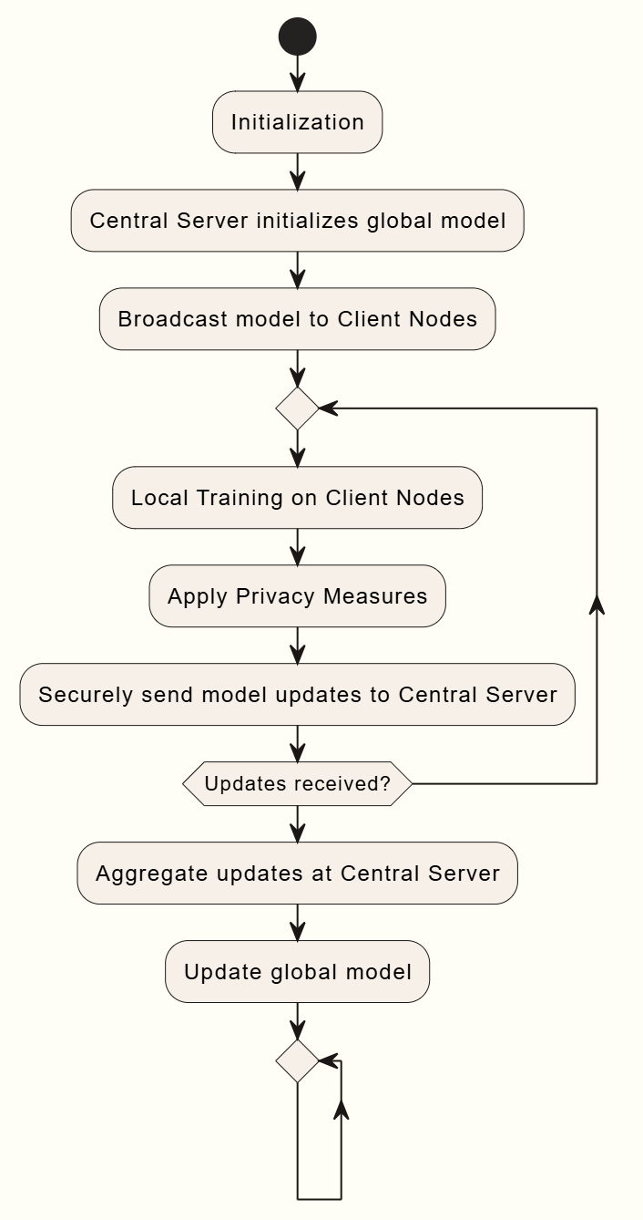
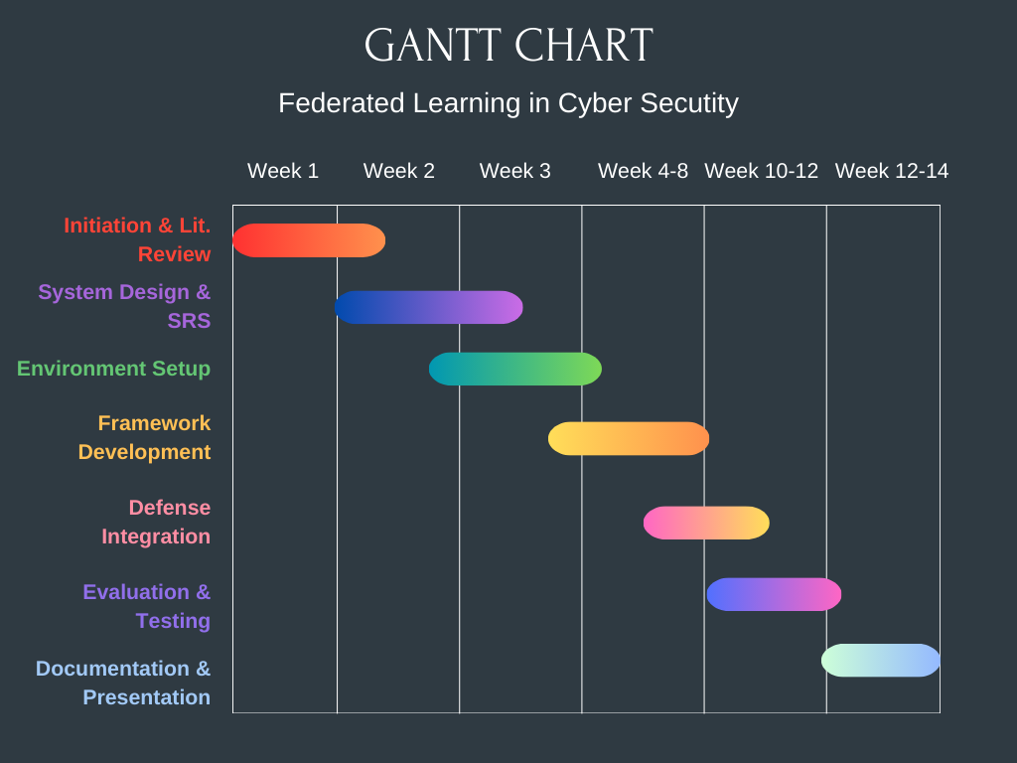
SCHEDULE and flow diagram

Slide 8
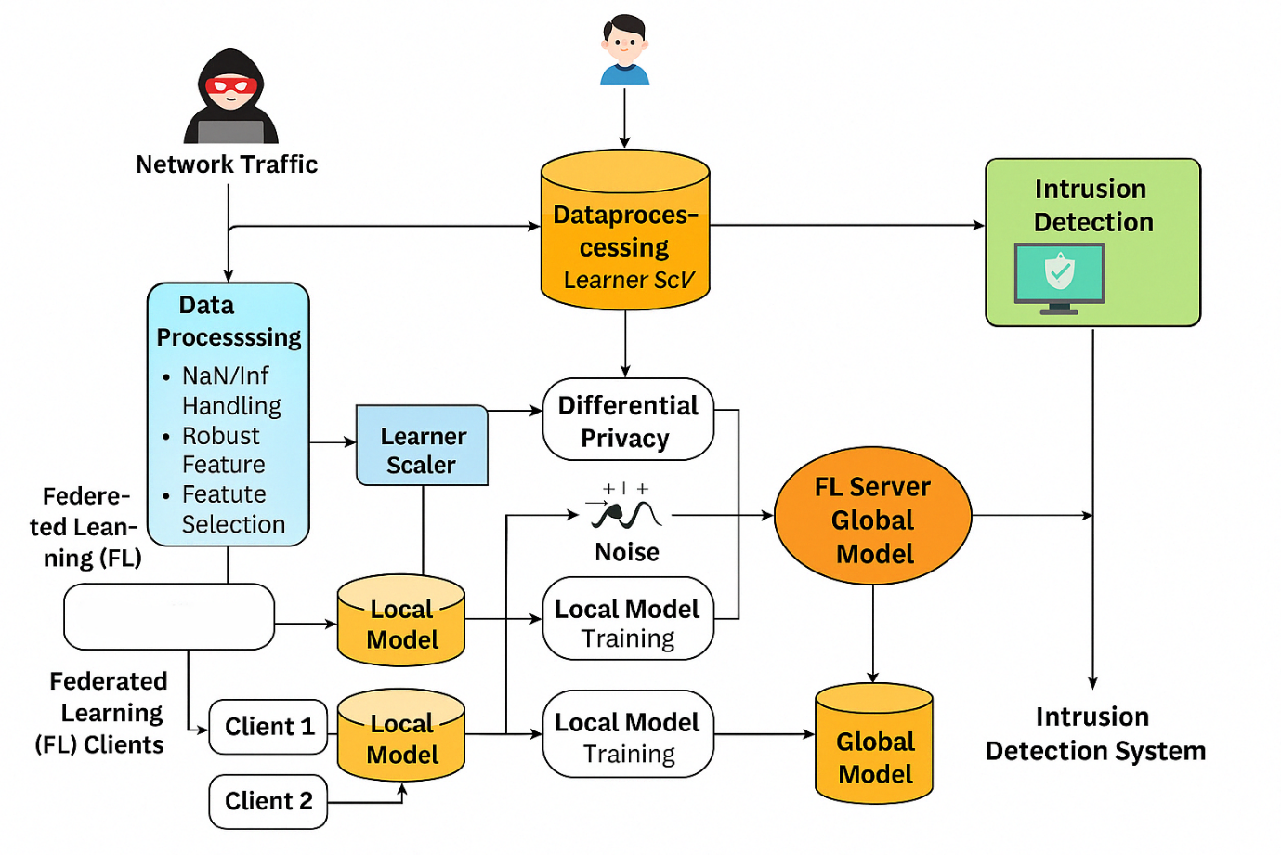
Architecture
FedAvg Algo

Slide 9
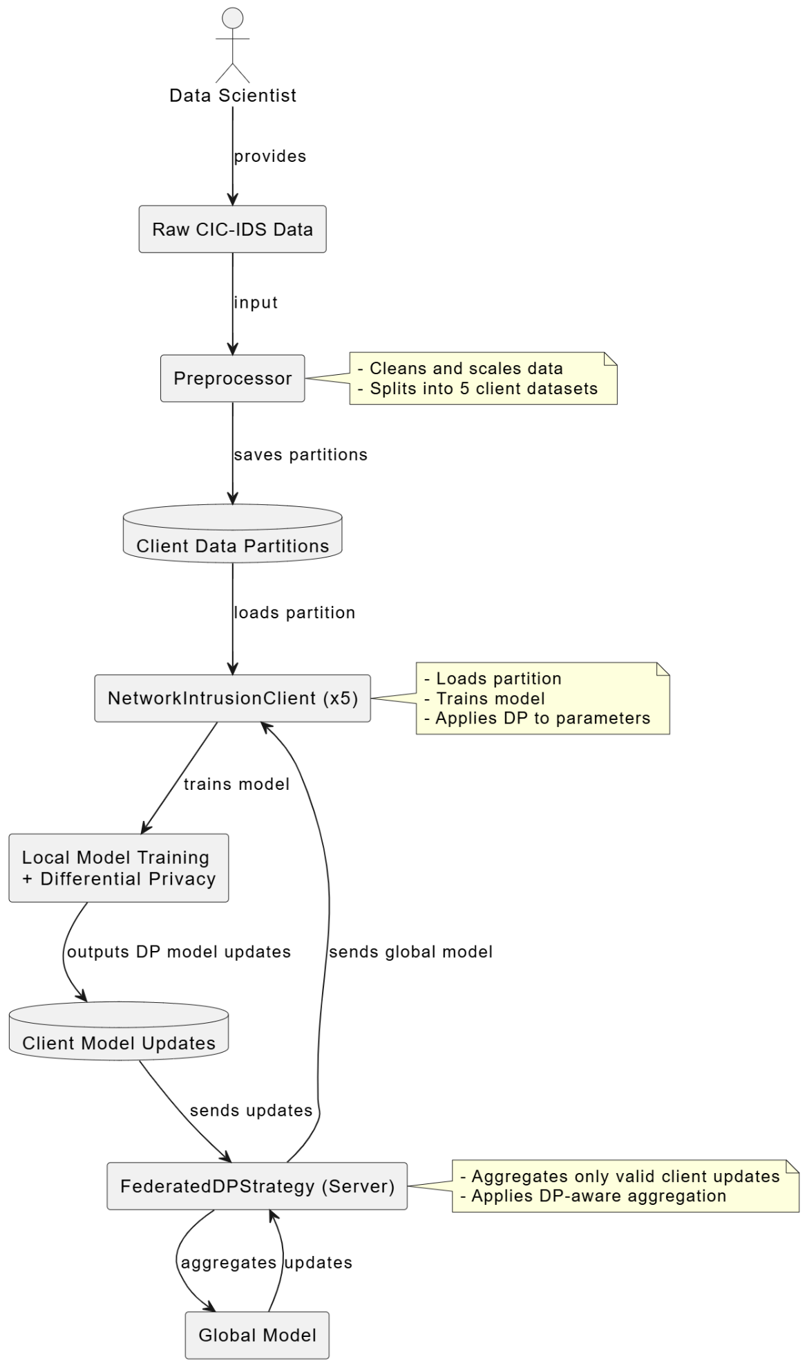
Dataflow diagram

Slide 10
Procedure
1. Dataset Preparation & Distribution Realistic or synthetic datasets were prepared and distributed across multiple simulated clients to represent data heterogeneity and privacy constraints. 2. Client-Side Local Training Each client device trained a local machine learning model using only its own data with differential privacy added, preserving data privacy and ensuring decentralized learning. 3. Model Update Sharing Instead of raw data, trained model parameters (weights/gradients) were securely transmitted to a central aggregator to avoid privacy leakage. 4. Global Aggregation via FedAvg The central server employed the Federated Averaging (FedAvg) algorithm to merge client updates into a unified global model iteratively. 5. Performance Evaluation & Optimization The aggregated model was tested on validation datasets to assess accuracy and convergence. Final tuning and optimization were done before project completion.

Slide 11
Result
Metric Pair | Trade-off | Explanation
Privacy (ε) vs Accuracy | Inverse | Stronger privacy (lower ε) introduces more noise → reduced accuracy.
Accuracy vs Recall | Balanced | Too high a threshold increases precision but decreases recall.
Latency vs Throughput | Not measured but relevant | Local model training increases latency, but allows parallelism across clients.
Feature Dimensionality vs Performance | Decreases | Fewer features improve training speed but may reduce model expressiveness.
Data Imbalance vs Precision | Not measured but relevant | Minority class (attacks) underrepresented → may hurt precision.
11
Global Model (Post Aggregation):
Accuracy: 0.916
F1-Score: 0.90
Recall: 0.886

Slide 12
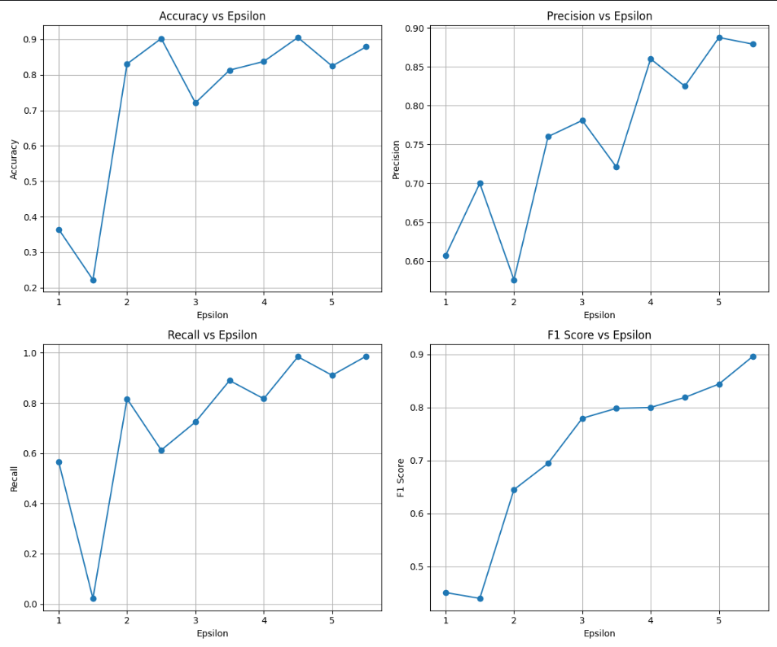
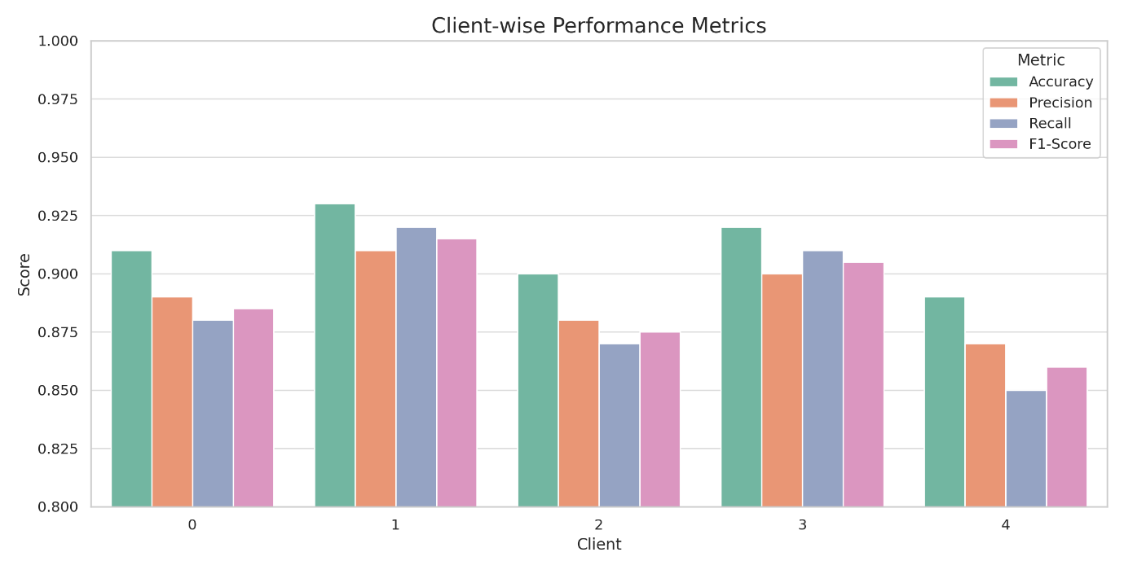
OUTPUT

Slide 13
COSTS
Projection Of Costs
Computational Resources
Preprocessing: ~0.56 GB RAM needed per 1 million rows — feasible on standard laptops.
Client Training: ~2.5 seconds per round on CPU — efficient and scalable for low-end machines.
Server Aggregation: Negligible (<1 second per round) — minimal compute overhead.
Optimization Highlights:
Used float32 for memory-efficient operations.
Leveraged .parquet files to skip redundant preprocessing.
Component | Approx. Size
Full Dataset (preprocessed) | ~120 MB
Client Datasets (x5) | ~24 MB each (~120 MB)
Scaler Object | ~300 KB
Model Checkpoints | Negligible

Slide 14
TECHNOLOGY
Technical Problems That Have Been Solved
Technologies Used
For Project
Data preprocessing
Federated Learning client and server communication
Model definition with a simple logistic regression, decision-making process is more transparent than black-box neural networks
Python 3.8+
PyTorch (for local dataset training)
Flower (flwr) (for Local Federated learning coordination)
Pandas & scikit-learn (for data processing and preprocessing)
PyCharm Community Edition / VS code (as the IDE)

Slide 15
RESOURCES
Kannan, Y. (2024). Federated Learning in Cybersecurity: Applications, Challenges, and Future Directions. International Journal of Science and Research. Available at: https://www.ijsr.net/archive/v13i7/MR24706174710.pdf
Sen, J. (2024). Privacy in Federated Learning. arXiv. Available at: https://arxiv.org/abs/2408.08904
Hasan, J. (2023). Security and Privacy Issues of Federated Learning. arXiv. Available at: https://arxiv.org/abs/2307.12181
Zhang, Y., & Wang, X. (2025). Enhancing AI Cyber Security with Privacy-Preserving Federated Learning. SSRN. Available at: https://papers.ssrn.com/sol3/papers.cfm?abstract_id=5091427
Zhang, L., et al. (2021). Trustworthy Federated Learning: Privacy, Security, and Beyond. arXiv. Available at: https://arxiv.org/abs/2107.03006
Harder, T., & Lutz, C. (2021). Privacy-first health research with federated learning. Nature Digital Medicine, 4(1), 1-10. Available at: https://www.nature.com/articles/s41746-021-00489-2
Liu, Y., & Chen, H. (2023). Federated Learning for Cybersecurity: A Survey. IEEE Transactions on Information Forensics and Security.
Wang, S., et al. (2024). Federated Learning for Secure Data Sharing in Healthcare Systems. Journal of Biomedical Informatics.
Li, T., et al. (2023). Federated Learning for Privacy-Preserving Machine Learning: A Review. ACM Computing Surveys.
Yurdem, B., Kuzlu, M., Gullu, M.K., Catak, F.O. and Tabassum, M. (2024) 'Federated learning: Overview, strategies, applications, tools and future directions', Heliyon, 10(19), e38137. https://www.sciencedirect.com/science/article/pii/S2405844024141680

Slide 16
Thank You
21BCE0303 Velidindi Kaarthika Dhruv
21BCE2099 Mehul Mathur
21BCI0137 Yash Shrivastava

