Slide 1
REAL-TIME
Sign Language
Recognition System
Bridging the communication gap through
AI-powered gesture understanding
Yash Pratap Singh
Session 2025–26 · GenAI

Slide 2
THE CHALLENGE
Problem Statement
Communication Barrier
Pixel-Heavy Models
Communicating with sign language users is difficult without specialized training.
Existing apps rely on raw image pixels — slow to process and fail under poor lighting.
Environment Sensitivity
Our Goal
Dim rooms, busy wallpapers, or changing backgrounds break conventional vision models.
A lightweight, real-time system using webcam geometry — not pixels — that works in everyday conditions.

Slide 3
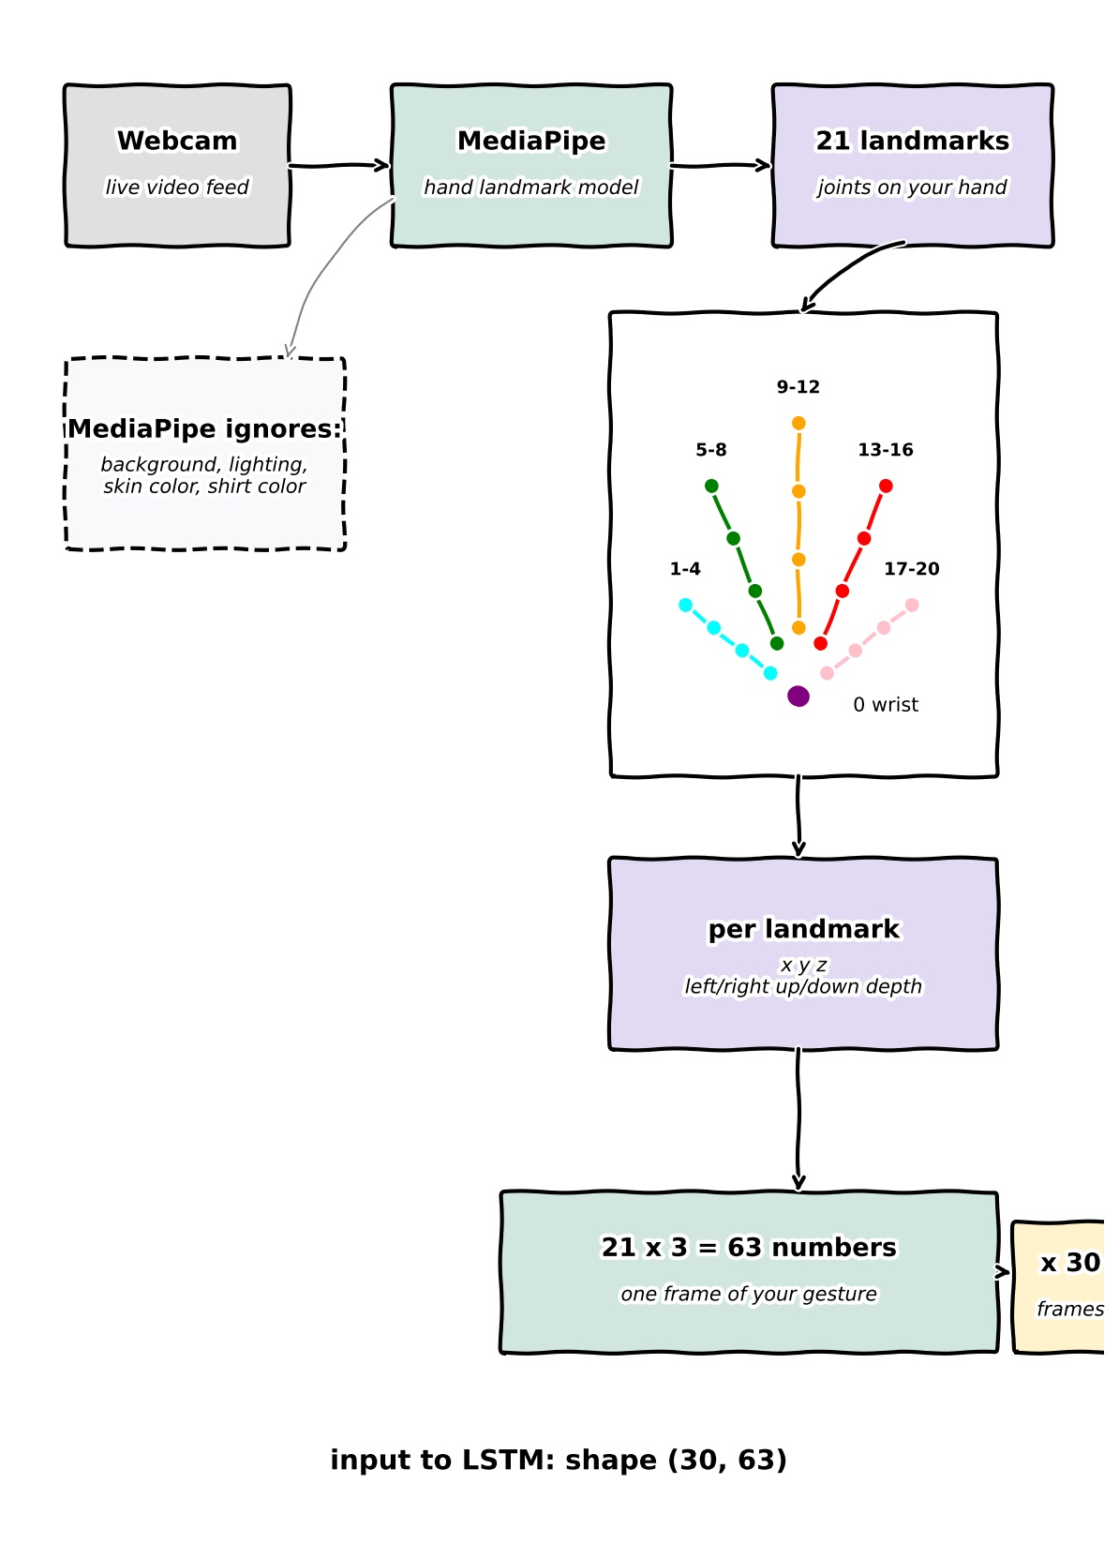
DESIGN & ARCHITECTURE
Data Pipeline — From Webcam to LSTM
01
MediaPipe Tracking
Captures 21 hand landmarks per frame — ignores background, lighting & skin color.
02
3D Coordinates
Each landmark provides x, y, z values → 21 × 3 = 63 numbers per frame.
03
30-Frame Buffer
63 numbers × 30 frames = shape (30, 63) fed into the LSTM network.
Model Size: 5 MB · vs 50–200 MB (conventional image models)

Slide 4
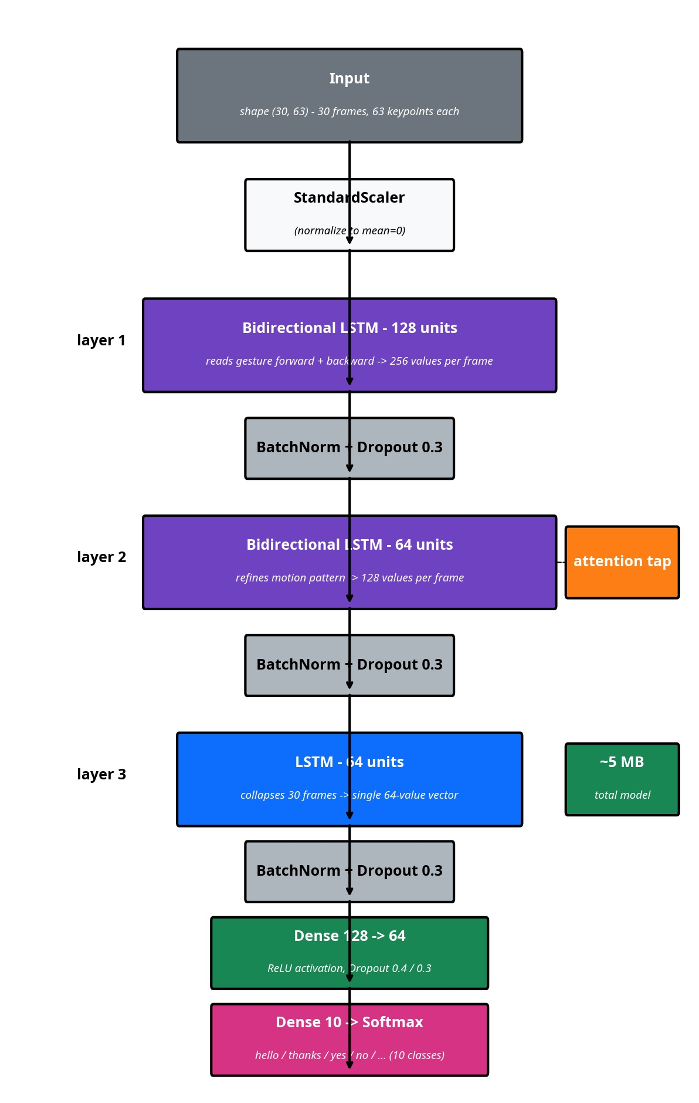
MODEL ARCHITECTURE
Bidirectional LSTM Neural Network
Layer 1
BiLSTM — 128 units
Reads gesture forward + backward → 256 values per frame
Layer 2
BiLSTM — 64 units + Attention
Refines motion patterns → 128 values per frame
Layer 3
LSTM — 64 units
Collapses 30 frames → single 64-value vector
Dense
128 → 64 → Softmax (10)
ReLU activation + final classification across 10 ASL signs
BatchNorm + Dropout (0.3) applied between all layers for regularization

Slide 5
DATASET & PREPROCESSING
Custom Dataset — Built from Scratch
10
30
~1s
80/20
ASL Signs
Sequences Each
Per Clip
Train/Test Split
Signs Trained: hello · thanks · yes · no · stop · peace · ok · fist · call · point
⚖️ StandardScaler Normalization
🔀 Data Augmentation
💾 Saved Scaler File
Coordinates adjusted to zero mean and unit variance. Position-invariant — works whether close or far from the lens.
Random noise injected into training sequences to prevent memorization and improve real-world generalization.
Scaler persisted to disk ensuring live webcam data is transformed identically to training data at inference time.

Slide 6
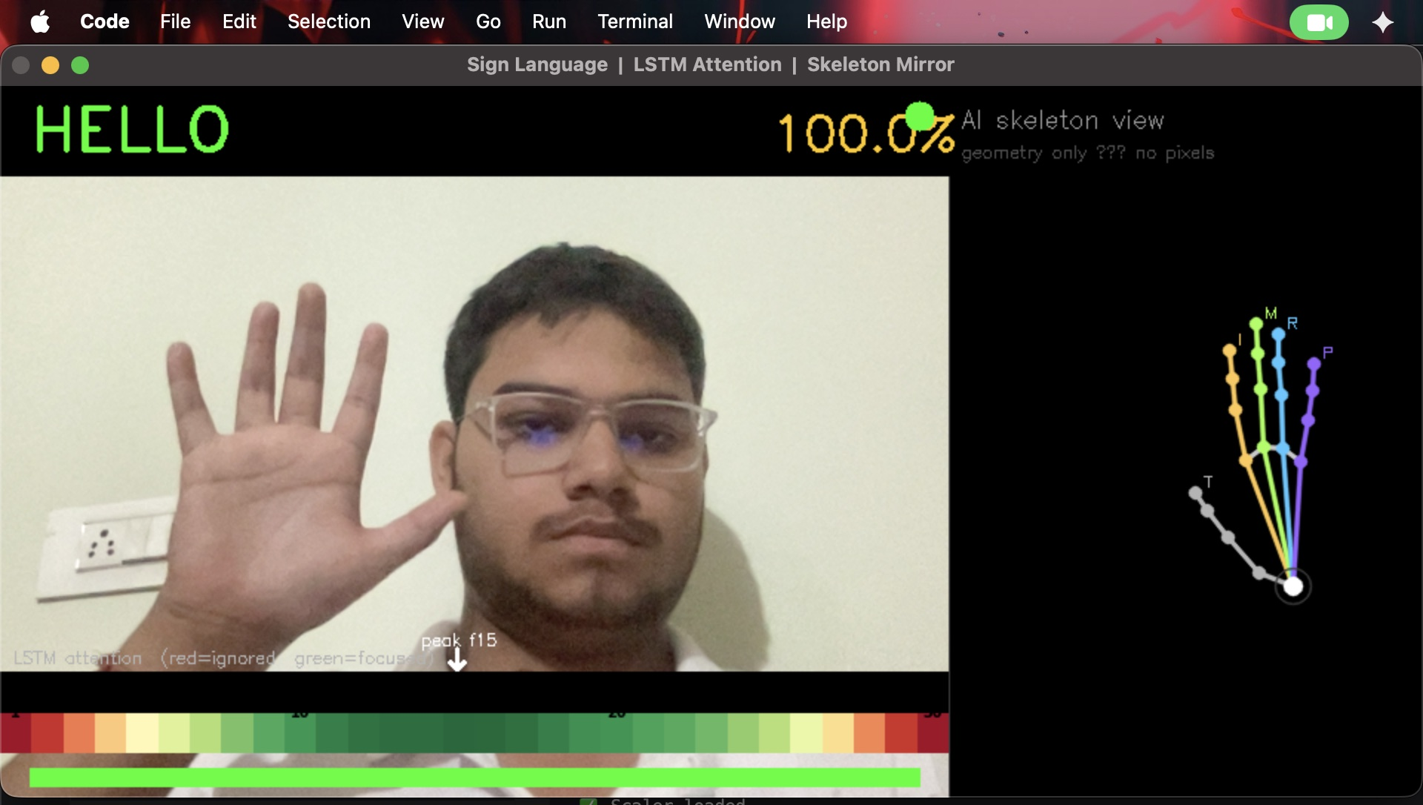
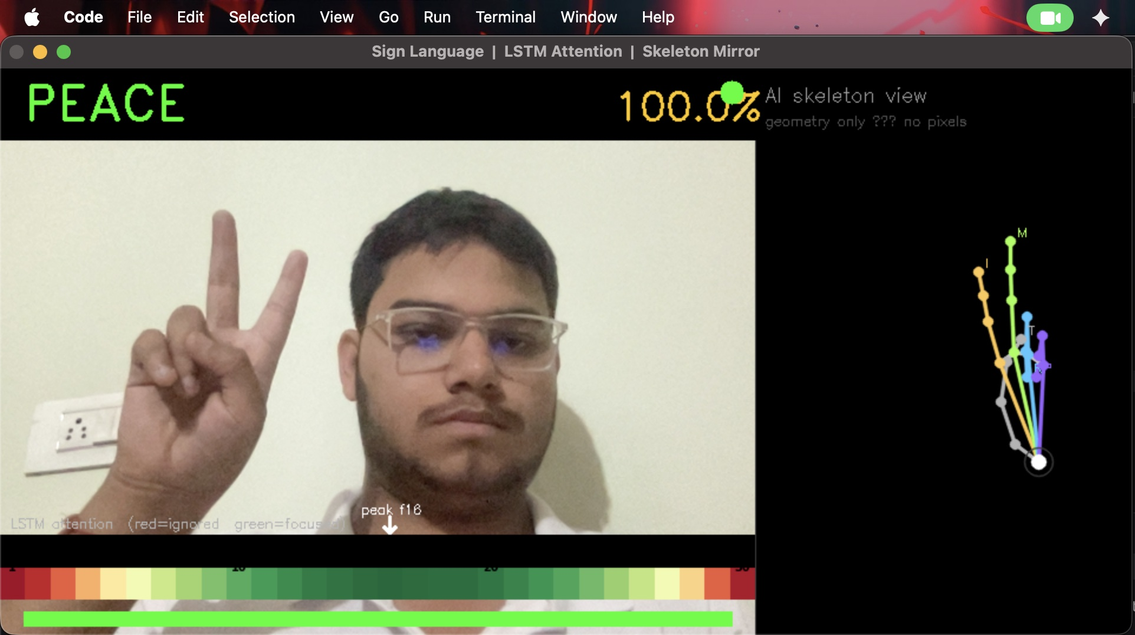
LIVE APPLICATION
Real-Time Demo Interface
DEMO — "HELLO" at 100%
DEMO — "PEACE" at 100%
Attention Heatmap
Skeleton Mirror
Confidence Meter
Color bar highlighting which frames the model weighted most
Live hand landmarks rendered as dots + lines (geometry-only view)
Orange → green bar giving instant signer feedback

Slide 7
RESULTS & ENGINEERING
Accuracy, Challenges & Solutions
95%
Problem: Video Freeze on Speech
Fix: Moved text-to-speech to a separate background thread — video loop now runs uninterrupted.
Test Accuracy
on held-out data
Problem: Wrong Coordinate Scale
Fix: Forgot to apply scaler to live input. Loading saved scaler from training phase fixed inference.
⚠ Known Confusion
"hello" vs "thanks" — both use an open palm near the face, making them visually similar for the model.
Confidence threshold set at 75% — prediction only displayed when model is sufficiently certain.

Slide 8
WHAT'S NEXT
Roadmap & Future Development
Two-Hand Tracking
v2.0
Mobile Offline App
v2.1
Track both hands simultaneously to recognize complex signs like 'family' or 'work'.
At only 5 MB the model is lightweight enough to run fully offline on Android/iOS.
Expanded Vocabulary
v3.0
Accessibility Collaboration
v3.1
Add more common phrases and everyday vocabulary beyond the current 10 ASL signs.
Partner with accessibility developers to learn best practices for two-hand sign recognition.

Slide 9
KEY TAKEAWAYS
A Fast, Fair &
Lightweight System
Yash Pratap Singh
Session 2025–26
GenAI
→ Geometry over pixels — works across skin tones, lighting & backgrounds → 5 MB model runs real-time on consumer hardware — no GPU needed → 95% accuracy on 10 ASL signs with LSTM attention mechanism → Transparent interface — attention heatmap + skeleton mirror

