Slide 1

PAYROLL MANAGEMENT SYSTEM
Developed by- yasH bisht
B.Tech (cse),section g,iii semester
University roll no.- 2018872

Slide 2
INTRODUCTION
This project deals with the salary providing department of an organization.
A payroll management system is a model that calculates the salary of employee on the basis of their job grade, working hours and prior experience.
It deals with the problems of delayed payment of salary, easier and faster computation because of the simple model.
Each employee can have a payslip displaying about their salary deductions, appreciations, taxes & allowances.

Slide 3
OBJECTIVE
The system focuses on a model that can provide ease of automation in salary providing department.
To have data stored in a document for future referencing, about employee salary details.
To maintain a record of employee job grades, department & loans.

Slide 4
PROJECT DESCRIPTION
The first window shows the preface of the code.
-
Thereafter, it allows the admin to enter the details of employee, working in the company.
The details get saved in txt file.
Modification and deletion of the records can be done easily without sabotaging the other entries of file.
The program offers a list displaying all the employees with their details.
-
It shows the name of the project and developer.
After 5 sec, it redirects user to the login window.
Payslips of employees can easily be generated.
-
-

Slide 5
TECHNOLOGY USED
Programming language used: C++
Platform Used: VS Code
OS: Windows 10

Slide 6
FEATURES OF C++ USED
OOPS Concepts
Encapsulation
Abstraction
Class
Objects
File Handling Operations
Reading from file
Writing in a file
Header files
<conio.h>
<ctype.h>
<windows.h>
<stdlib.h>
<iostream>

Slide 7
FUNCTIONS
void preface();
void access();
void main_menu();
void modify_remarks(int);
void Enter();
void modify_r();
void editmenu();
void display_name();
void modify_F_Name(int);
void modify_L_Name(int);
void modifyCode(int);
void modifyDes(int);
void modifyExperience(int);
void modifyAge(int);
void modifySalary(int);
void modifyJobGrade(int);
void Records();
void delete_r();
void search_r();
void save_r();
void get_r();
void display_e_Payslip();

Slide 8
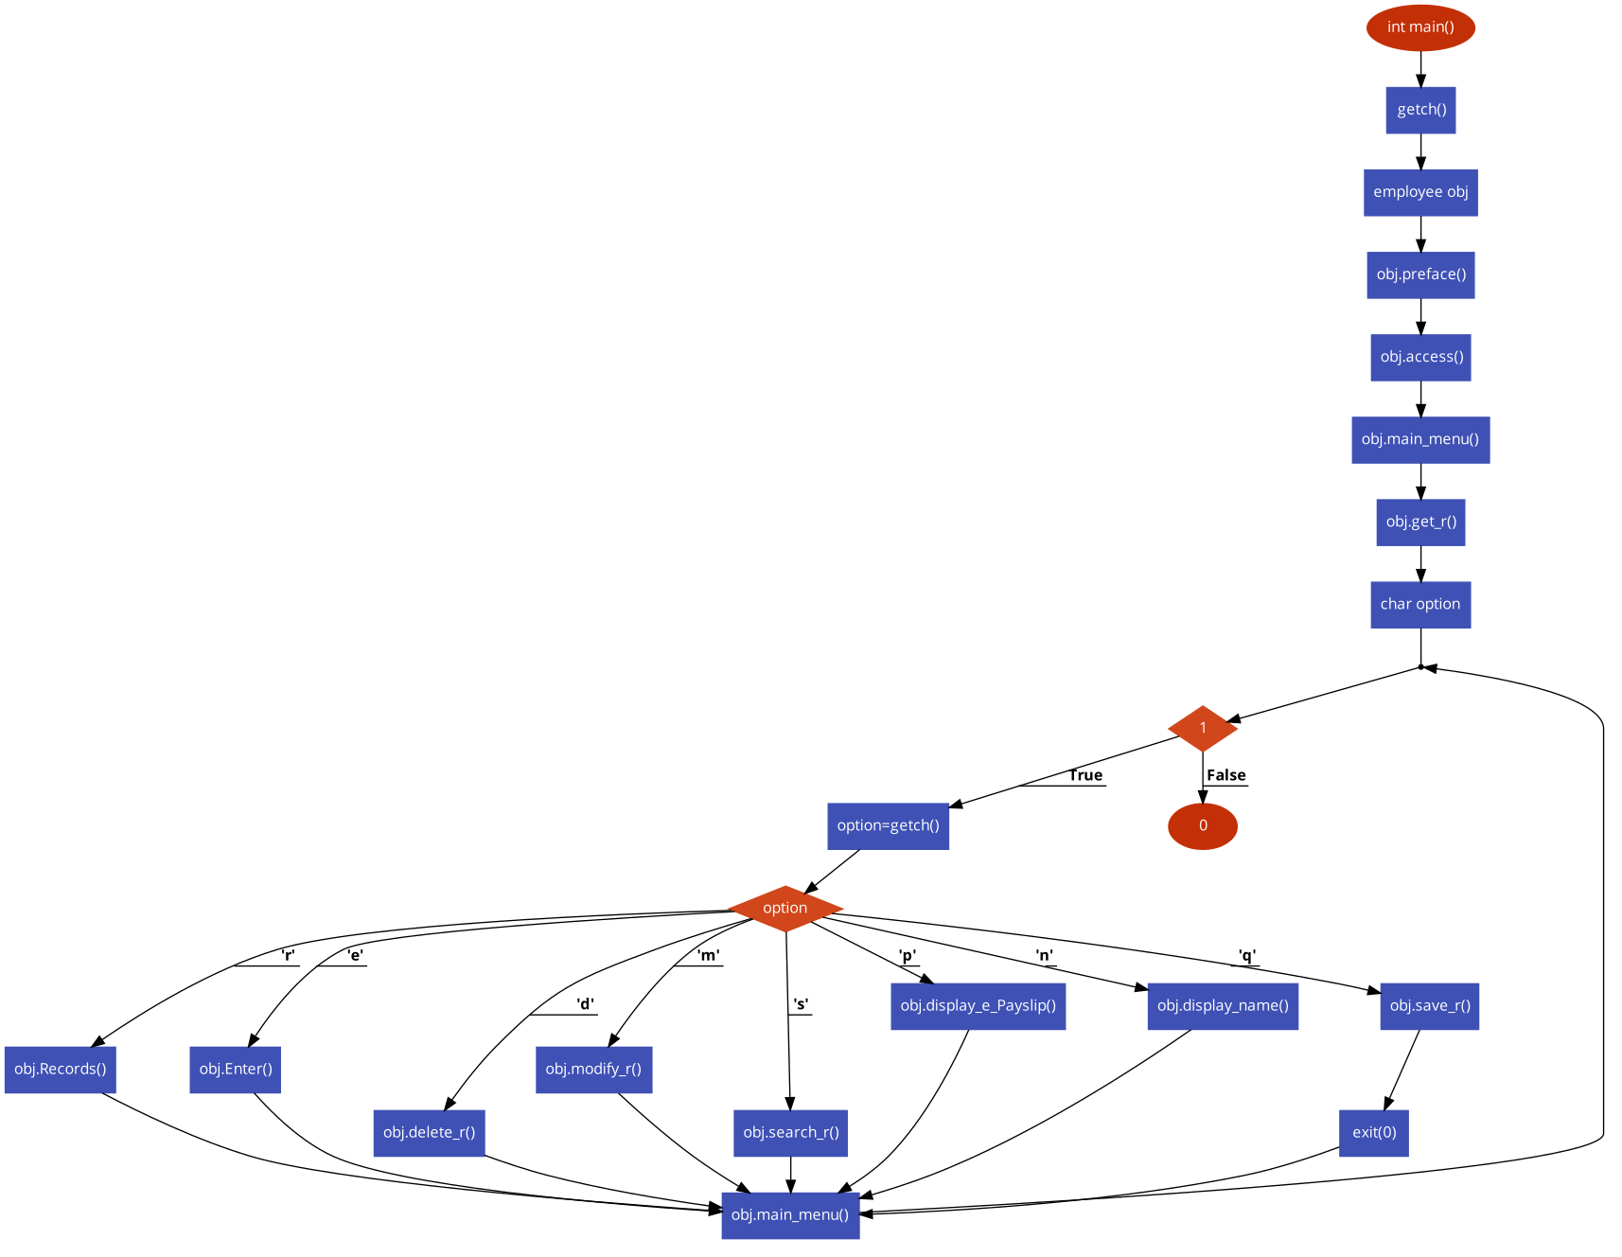
FLOWCHART

Slide 9
CONCLUSION
This mini project is my effort to make an interactive C++ program which is appealing to the user.
The system has been developed with OOPS concepts.
The system is strong to handle daily operations.
The system helps to maintain a reliable database.
It can be further improved.

Slide 10



THANK YOU!!

