Slide 1

CONTENT BASED MOVIE RECOMMENDATION SYSTEM
YASHWANTH ATLURI
UU38697
Prepared for: UMBC
Data Science Master Degree Capstone by Dr. Chaojie (Jay) Wang

Slide 2

INTRODUCTION
The abundance of available content poses a challenge for viewers in finding movies aligned with their tastes. Content-based recommendation systems offer a solution by analyzing the inherent characteristics of movies to deliver personalized suggestions. Join us as we explore the inner workings, benefits, and challenges of these systems, and discover how they are reshaping the way audiences discover and enjoy films.

Slide 3
Research Questions:
How can movie features be optimally combined for effective content-based recommendations?
How can user profiles dynamically evolve for improved accuracy in content-based movie suggestions?
Which metrics best evaluate the performance of content-based movie recommendation systems?

Slide 4
DATA
- Movies.csv: Contains metadata for 10,329 movies, including unique identifiers, titles, genres, and release years.
- Rating.csv: Records 105,339 user-movie interactions, detailing user IDs, movie IDs, ratings, and timestamps.
- Each row in Movies.csv represents a distinct movie with its unique identifiers, title, genres, and release year.
- Each entry in Rating.csv signifies a user's rating for a specific movie, along with the corresponding user and movie IDs, rating value, and timestamp.
- The "Movies Dataset" facilitates movie identification and genre classification, aiding in personalized recommendations.
- The "Ratings Dataset" captures user preferences through ratings, crucial for generating personalized movie suggestions.
- Together, these datasets form the foundation for building a content-based movie recommendation system, leveraging movie metadata and user preferences

Slide 5
Features/Predictors
Features in Movies.csv:
movieId: Unique identifier for each movie.
title: Title of the movie.
genres: Genres associated with the movie.
releaseYear: Year the movie was released.
Predictors in Rating.csv:
userId: Unique identifier for each user.
movieId: Unique identifier for each movie.
rating: User's rating for the movie, typically on a scale from 1 to 5.
timestamp: Timestamp indicating when the rating was given

Slide 6
Machine learning
Feature Engineering: Transforming raw data into a format suitable for machine learning algorithms, such as converting categorical data into numerical representations and creating new features based on existing ones.
TF-IDF (Term Frequency-Inverse Document Frequency): A numerical statistic used to quantify the importance of words in a document relative to a corpus, helpful for representing movie titles or genres as numerical vectors in recommendation systems.
Cosine Similarity: A metric measuring the similarity between two vectors in a multidimensional space by calculating the cosine of the angle between them, commonly used in recommendation systems to find similar items based on their feature representations.

Slide 7
TOOLS
PYTHON
GOOGLE COLAB
STREAMLIT

Slide 8
Model deployment
- Serialize Model: Convert the trained recommendation model into a deployable format.
- Integration: Seamlessly integrate the model into the production application or system.
- Scalability and Performance: Optimize system architecture to handle user requests efficiently in real-time.
- Monitoring and Maintenance: Implement monitoring tools to track system performance and schedule regular maintenance for updates

Slide 9
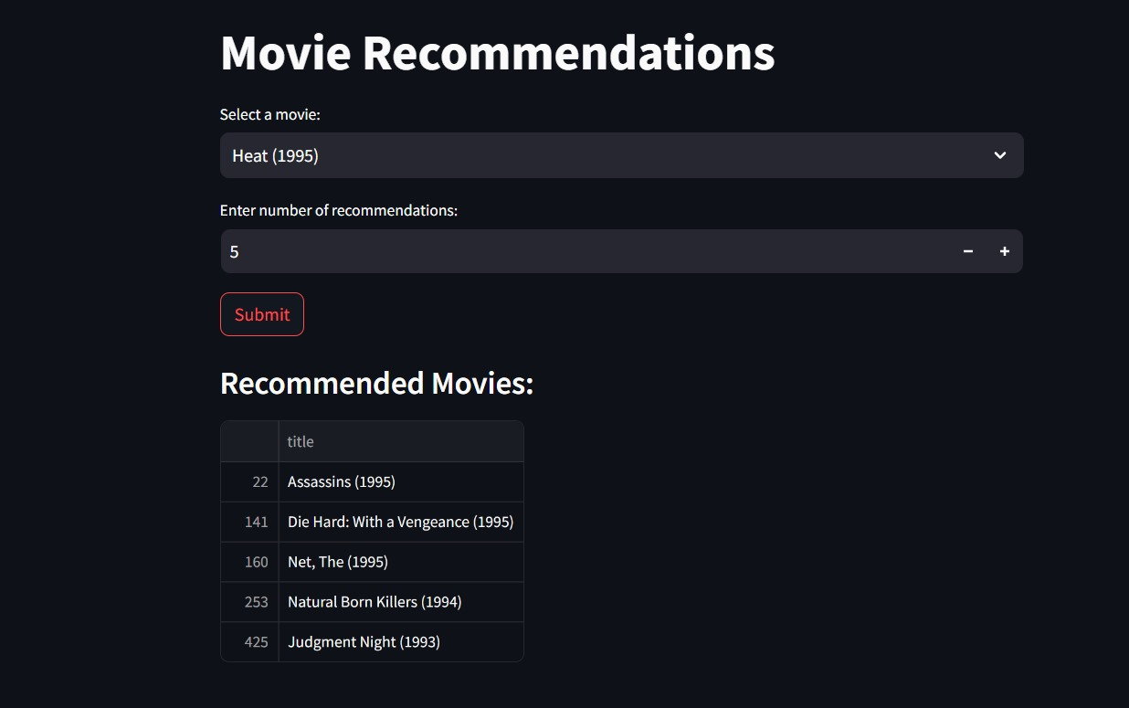
Screenshot of deployment

Slide 10

THANK YOU

