Slide 1
Neural Discrete Representation Learning (VQ-VAE)
van den Oord, Vinyals, Kavukcuoglu | NeurIPS 2017
G. Sri Yasaswitha
Roll No. 24CS2015 (IDD) | Deep Learning 2026 | Paper DL-081
Every image is stored as a grid of code indices like this
Notes:
Introduce yourself and the paper. VQ-VAE replaces the continuous latent of a VAE with a discrete codebook. The coloured grid on the right is a picture of what the model stores: every image becomes a grid of integer code indices.

Slide 2
Why discrete latents?
1
2
3
The problem
The idea
The payoff
Standard VAEs use continuous latents and often suffer posterior collapse: a strong decoder learns to ignore the latent code.
Snap every encoder output to its nearest vector in a learned codebook. The latent is now a grid of integers.
Compact, discrete codes can be modelled by a powerful autoregressive prior, which turns the autoencoder into a generator.
Notes:
Motivation. Posterior collapse is the VAE failure mode this paper sidesteps. The discrete bottleneck also matches how images, speech and language are naturally structured, and lets us reuse autoregressive models for generation.

Slide 3
The vector quantiser
Image
32x32x3
Encoder
2 strided convs + ResBlocks
Quantiser
nearest codeword
Decoder
ResBlocks + 2 deconvs
Output
reconstruction
Codebook e1 ... e512 (K = 512 vectors, D = 64)
64 integers
is all we store per image (8x8 grid of indices)
Straight-through estimator
argmin has no gradient, so zq = z + (e - z).detach(). The forward pass uses e; the backward pass copies the gradient to z.
dist = |z|^2 - 2 z.e + |e|^2, computed for all K codes at once
Notes:
Walk left to right. Encoder produces an 8x8 grid of 64-d vectors. For each vector we find the closest of 512 codebook vectors using the expanded squared distance. The straight-through trick is the key line of the VectorQuantizer class: zq = z + (zq - z).detach().

Slide 4
Training objective
L = || x - x^ ||^2 + || sg[z] - e ||^2 + beta || z - sg[e] ||^2
Reconstruction
Decoder and encoder learn to rebuild the image.
Codebook
Moves each chosen codeword toward the encoder output.
Commitment
beta = 0.25 stops the encoder drifting away from the codebook.
EMA variant (used for the main model)
Drop the codebook term. Update each codeword as a moving average of the encoder vectors assigned to it, with decay 0.99.
Perplexity = exp(entropy of code usage): near K means all codes used, near 1 means collapse.
Notes:
Be ready to derive this on the board. sg is stop-gradient. Term 2 only updates the codebook, term 3 only updates the encoder. With EMA the codebook is updated by running counts and running sums instead of by gradient, which is more stable.

Slide 5
My implementation
CIFAR-10
dataset
K=512, D=64
codebook
8x8
latent grid
Written from scratch in PyTorch
VectorQuantizer: nearest-code search, straight-through, commitment and codebook losses, EMA updates
Encoder, decoder with residual blocks
PixelCNN prior with masked convolutions (types A and B)
Scaled down from the paper
Small network, 10 epochs, one seed, CIFAR-10 only
10 epochs
Adam, lr 2e-4
128
batch size
seed 0
reproducible
Notes:
Standard building blocks (Conv2d, Adam, torchvision) are used; the VQ layer and the PixelCNN prior are my own code. State clearly that the scale is reduced, as the guidelines ask.

Slide 6
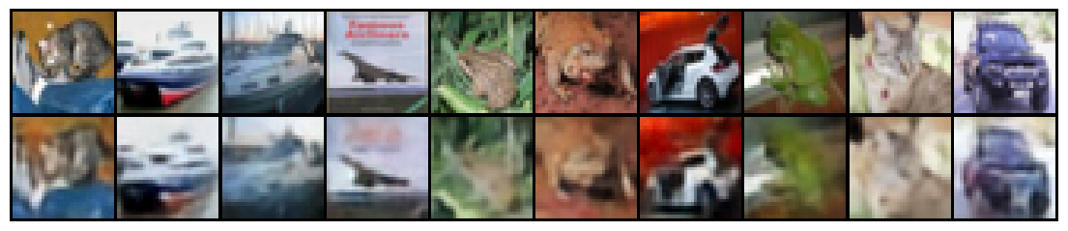
Reproduction: reconstructions
Top: original | Bottom: reconstruction from 64 integers
0.01535
test MSE
407
test perplexity
512 / 512
codes used
Notes:
Main model: K=512 with EMA. Colours and layout are preserved; fine texture is blurred because the 8x8 grid is a 16x spatial compression and the model is small and short-trained. Compare qualitatively with the paper (Sec. 4) and say clearly that this is a reduced-scale reproduction.

Slide 7
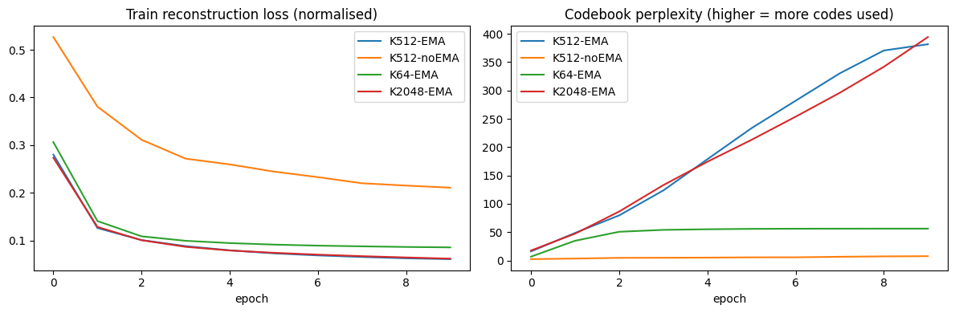
Ablation 1: EMA vs gradient codebook
EMA codebook
MSE 0.01535, perplexity 407, 512/512 codes
Gradient codebook: collapse
MSE 0.0516 (3.4x worse), perplexity 8.4, 18/512 codes
Notes:
Same K, same seed, only the codebook update differs. Without EMA only 18 of 512 codes are ever used: codebook collapse. EMA keeps every code alive and gives 3.4x lower test MSE. Likely reason: unused codewords get no gradient and are never pulled toward the data, while EMA updates are normalised per code.

Slide 8
Ablation 2: codebook size K
K | Perplexity | Codes used
64 | 57.0 | 64 / 64
512 | 407.0 | 512 / 512
2048 | 449.8 | 602 / 2048
Takeaways
Too small (K=64): limited capacity, 40% higher MSE than K=512
K=2048 gains only 0.9% in MSE but 70% of codes stay unused
Notes:
All runs use EMA, 10 epochs. K=512 is the sweet spot at this scale. Going to 2048 does not help because the small model and short training cannot make use of the extra codes: only 602 are ever selected. 0.02143 / 0.01535 = 1.40.

Slide 9
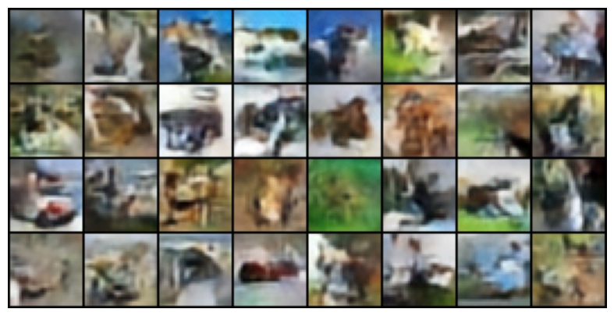
Generating images with a PixelCNN prior
Autoregressive model over the 8x8 code grid in raster order (masked convolutions)
Best test NLL: 4.63 nats per code at epoch 8, versus 6.24 for a uniform guess (ln 512)
Test NLL then creeps up to 4.67 while train NLL keeps falling: overfitting
Samples have plausible colours and layout, but no clear objects
32 samples: sample code grid, then decode
The VQ-VAE alone only compresses. The prior makes it generative.
Notes:
Masked convolution A hides the current position, B allows it, so each code only sees codes before it. Sampling is sequential: 64 forward passes. The overfitting after epoch 8 suggests early stopping or dropout; I did not tune this.

Slide 10
Failure cases and what did not work
Codebook collapse
Dead codes at large K
Gradient-only codebook used 18 of 512 codes and gave 3.4x worse MSE.
K=2048 used only 602 codes, so the extra capacity was wasted.
Blurry outputs
Prior overfits
Reconstructions lose fine texture. Samples show colour and layout but no sharp objects.
Test NLL rose after epoch 8. No early stopping or regularisation was added.
Limits: 10 epochs, single seed, small network, CIFAR-10 only.
Notes:
Be honest here; the guidelines reward it. Possible fixes: codebook reset for dead codes, longer training, larger encoder, hierarchical VQ-VAE-2, more seeds.

Slide 11
Takeaways
1
EMA is essential
Same architecture: 512/512 codes with EMA, 18/512 without.
2
K=512 is enough here
K=2048 lowered MSE by only 0.9% and left most codes idle.
3
Prior makes it generative
PixelCNN over 64 codes beats a uniform guess (4.63 vs 6.24 nats).
References
A. van den Oord, O. Vinyals, K. Kavukcuoglu. Neural Discrete Representation Learning. NeurIPS 2017. arXiv:1711.00937
Implementation: own PyTorch code (Colab notebook), CIFAR-10 via torchvision
Notes:
Close with the three takeaways, then invite questions. Be ready to explain every line of VectorQuantizer and derive the loss.

