Slide 1

K.S.INSTITUTE OF TECHNOLOGY
#14, Raghuvanahalli, Kanakapura Main Road, Bengaluru-560109
2021-2022
DEPARTMENT OF COMPUTER SCIENCE & ENGINEERING
GLASS CLASSIFICATION
UNDER THE GUIDANCE OF :
MRS. FARHEEN FARHATH
PRESENTED BY :
YASHWANTH K
1KS18CS121

Slide 2
CONTENTS
Introduction
Company Profile
Problem Statement
Flow Chart
Scope
objective
Dataset Used
Libraries Used
Implementation
Outcome of the Project
Conclusion

Slide 3
INTRODUCTION
Glass Classification : Identify type of glass by materials used in the glass.
This may help in crime case, glass left in the crime spot can be used as evidence if model is correctly identified!

Slide 4
COMPANY PROFILE
Corporate Name: PRINSTON SMART ENGINEERS
Main Office: Vishnuvardhan Statue Rd, Vishwa Priya Nagar, Begur, Bengaluru, Karnataka. Pincode- 560068
Phone: +91 9810188747
Contact Person: Mrs. Fraheen Farhath (Managing Director)
Email Address: Prinston.Smart@gmail.com
Year Stand Up: 2004
Company Category: IT Software/Embedded

Slide 5
PROBLEM STATEMENT
Research and obtain a valid Dataset, analyse the Dataset, modify it according to the requirements and finally train the model using all Algorithms and choose appropriate Algorithm in order to output the type of Glass based on user’s input.

Slide 6
FLOW CHART
DATASET
DATA PREPROCESSING
TRAINING DATASET
TESTING DATASET
ML MODEL
PREDICTING

Slide 7
SCOPE
To get best and approximate results, used Random Forest Algorithm.
And Libraries
After training the model. It predict the type of glass depends on user’s input (Input is based on the material used in glass).

Slide 8
OBJECTIVES
Features & Modification of Dataset
Data Preprocessing
Implementation of Classification Algorithms
Professionally establish

Slide 9
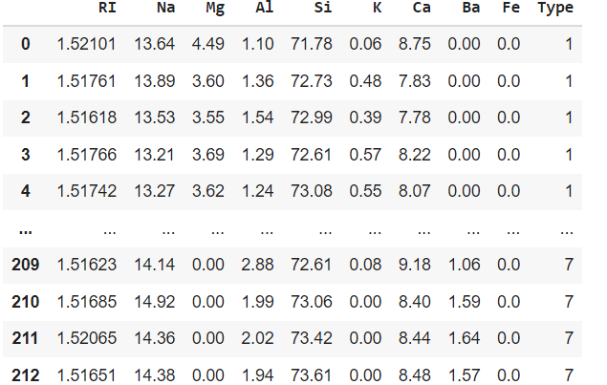
DATASET USED

Slide 10
LIBRARIES USED
Pandas
- Used to Data Analysis.
Numpy
- Used to Numerical Analysis.
SciKitLearn
- Used to preprocess and model building.

Slide 11
IMPLEMENTATION
I have implemented all classification algorithms but chosen Random forest algorithm based on the accuracy.
Random Forest Algorithm is a popular learning algorithm belongs to Supervised learning technique.
It is based on the concept of ensemble learning.
It contains the number of decision trees on various subsets of the dataset and takes the average to improve the predictive accuracy of the dataset.
Greater number of trees leads to higher accuracy.

Slide 12
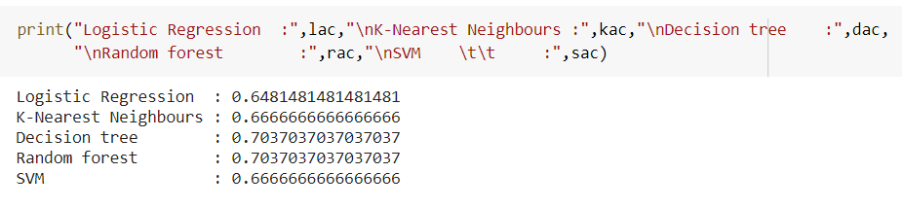
OUTCOME OF PROJECT

Slide 13
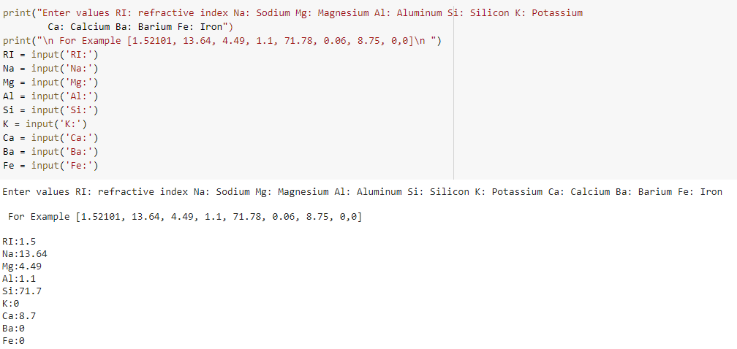

Slide 14
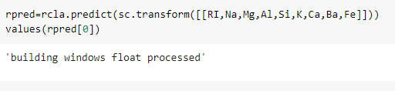

Slide 15
CONCLUSION
The Glass classification is done from scratch , it is quite challenging.
this project will help to predict which type of glass.
It gave me good experience and to improve skills in the Machine Learning algorithms.

Slide 16
THANK YOU

