Slide 1
Static Structural Analysis Of MLD Blade
FEA REPORT
Report No.: MWI/FEA/ACK-6203/01
Date: 1st Oct 2026
Client:

Slide 2
1. Material Properties
Material | Item | Young's Modulus (MPa) | Poisson's Ratio | Density (t/mm³) | Yield Stress (MPa) | Allowable Von-Mises Stress (MPa)
BHN 400 | Blade | 170000 | 0.3 | 7.8E-9 | 380 | 292
Units: Length = mm, Mass = tonnes, Time = second, Force = Newton
Allowable Von-Mises Stress:
σall = Syt / FOS
FOS = 1.3

Slide 3
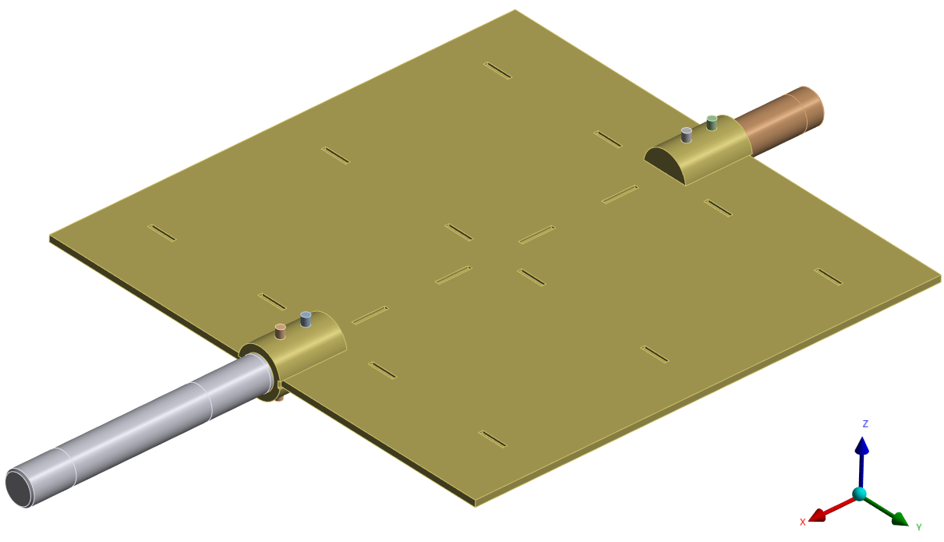
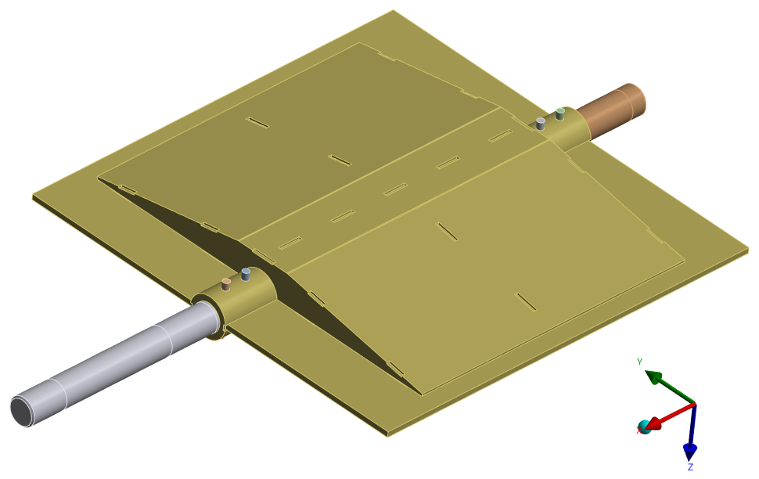
2. Blade Geometry
Top view
Bottom view

Slide 4
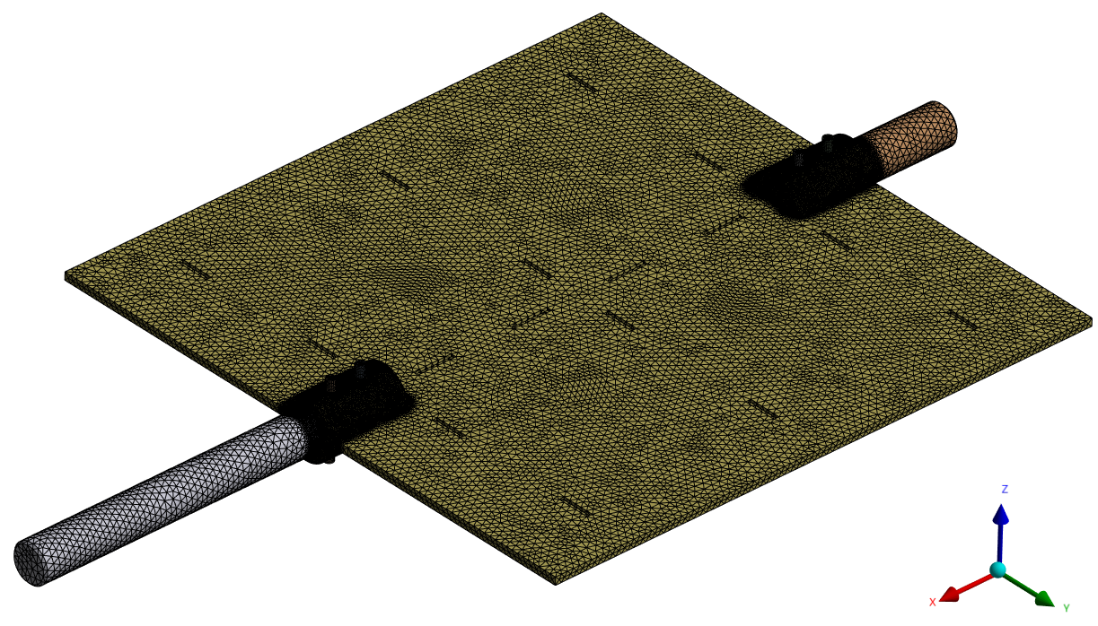
3. Blade Mesh

Slide 5
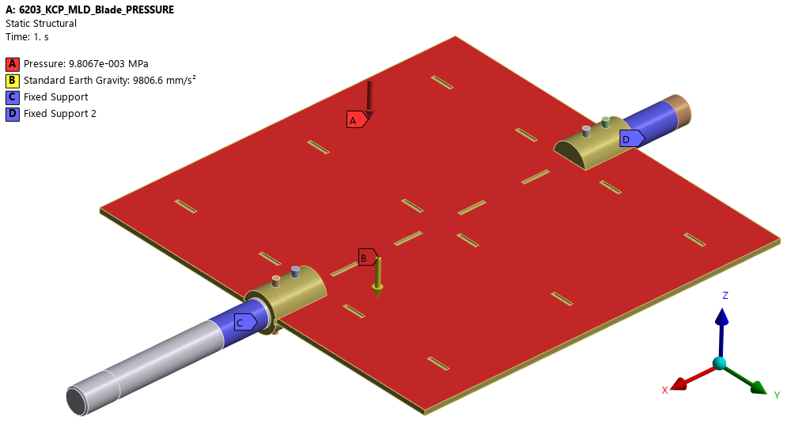
Case 1: Pressure Only (Self Weight + Pressure)
Boundary Conditions
Design pressure 1000 mmWC applied which is 0.00981 MPa.
Self weight considered.
Fixed support applied on the left shaft.
Fixed support applied on the right shaft.

Slide 6
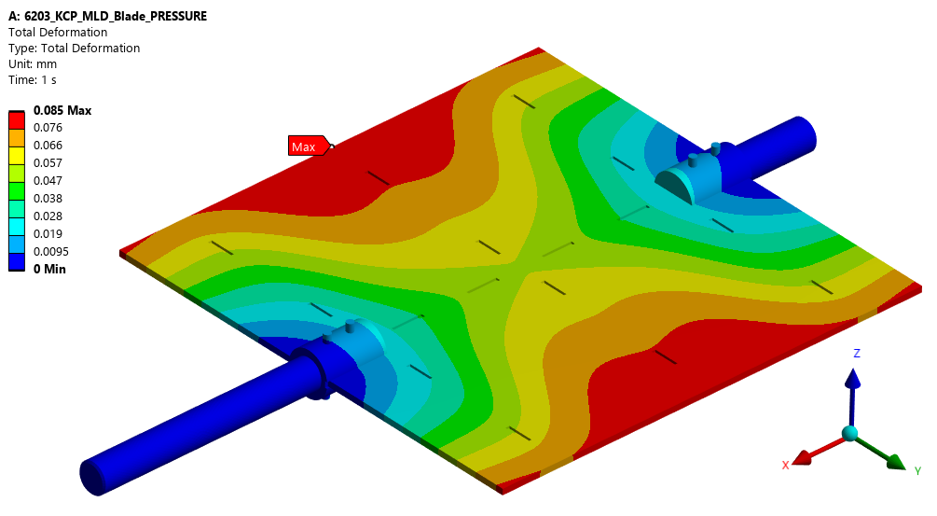
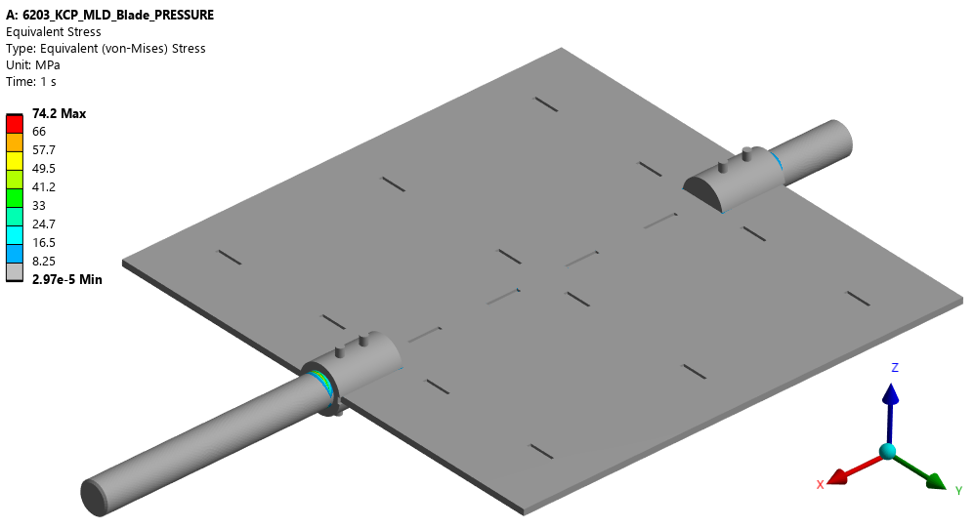
Case 1: Results
Total deformation
Von-mises stress
Maximum Total Deformation – 0.085 mm
The stress is within the materials
allowable limit of 292 MPa.

Slide 7
Case 1: Observation & Summary
Total deformation in the Blade is 0.085 mm.
Von-Mises stress in the Blade (74.2 MPa) is within the materials allowable stress limit of 292 MPa.
Therefore, the Blade is structurally adequate to withstand the applied load under this load case.

Slide 8

Case 2: Pressure + Moment (Self Weight + Pressure + Moment)
Boundary Conditions
Cylindrical support applied on the left shaft.
Design pressure 1000 mmWC applied which is 0.00981 MPa.
Self weight considered.
Moment of 1,000,000 N·mm (1000 N·m) applied at the left shaft end.
Cylindrical support applied on the right shaft.
Fixed support applied at the right shaft end.

Slide 9
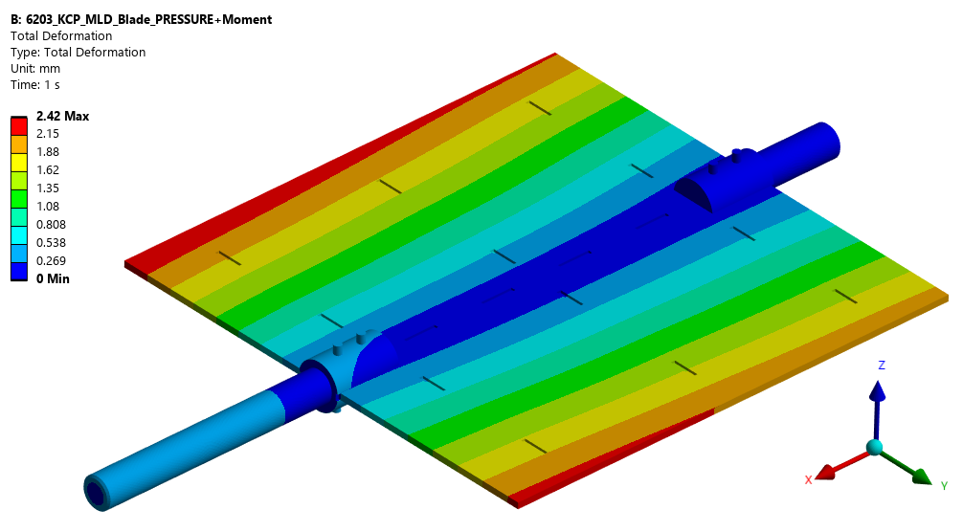
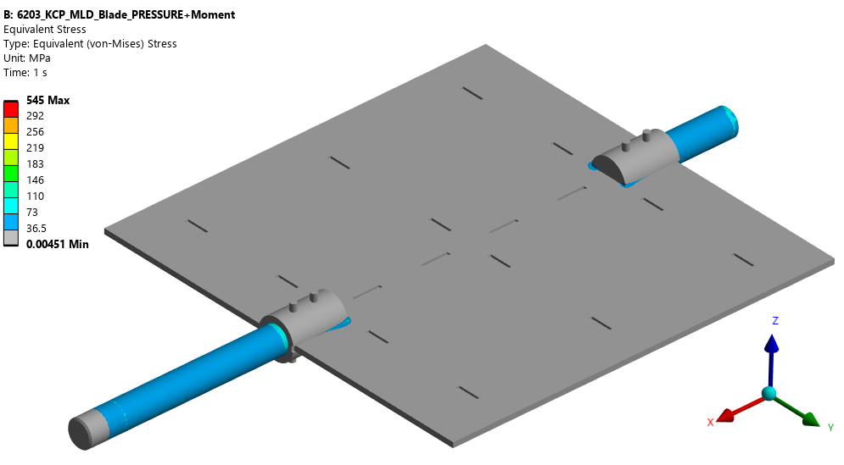
Case 2: Results
Total deformation
Von-mises stress
Maximum Total Deformation – 2.42 mm
The stress exceeds the materials
allowable limit of 292 MPa.

Slide 10
Case 2: Observation & Summary
Total deformation in the Blade is 2.42 mm.
Von-Mises stress in the Blade exceeds the materials allowable stress limit of 292 MPa.
Therefore, the Blade is structurally inadequate to withstand the applied load under this load case.
Need to take corrective actions.

Slide 11
Final Summary
Load Case | Max. Deformation | Max. Von-Mises Stress | Allowable Stress
Case – Pressure Only | 0.085 mm | 74.2 MPa | 292 MPa
Case – Pressure + Moment | 2.42 mm | Exceeding Limit | 292 MPa

